Slide 1
Dr Sam Beasley Hampshire & IOW Educational Psychology

Slide 2
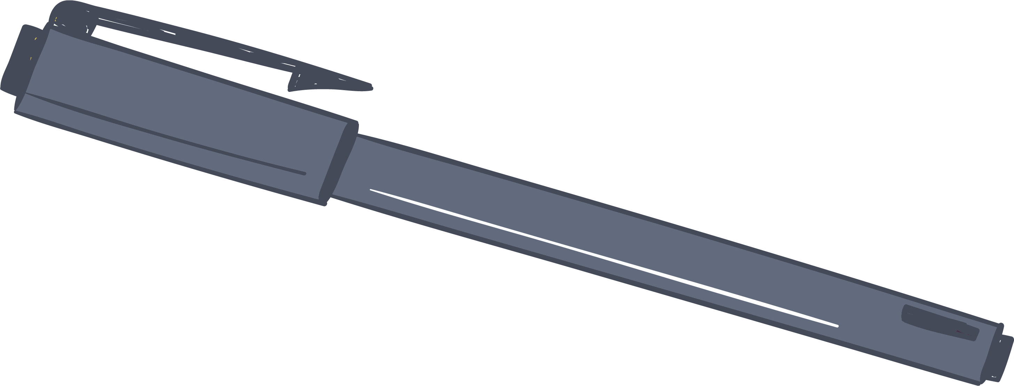
Aims
Share what psychological research says works for wellbeing
Suggest how this can be implemented for you and also for your team
Practice some wellbeing activities
Share resources and tools to use for improving wellbeing

Slide 3
HEAD

Slide 4
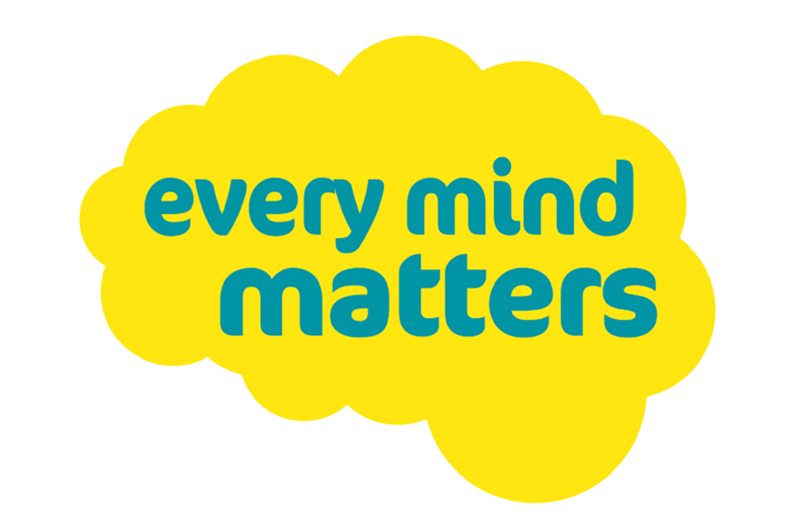
Notes:
I’m making an assumption that I don’t need to tell you why wellbeing is important for you right now, you know:
High workload – pressure
Change to workload
Change to working environment
Frustration
Concerns about the future - unpredictability
Like me, you step into people lives when people are at their most emotionally heightened – that’s tough, especially when you’re doing that all day, back to back. You’re working in a high stress environment around people who could be facing burnout – teachers and other staff. Perhaps someone in your group of friends or family is going through a hard time.
You’ll be totally aware of the mental health crisis facing young people, in fact you all work with children with social and emotional difficulties and are at the coal face here, often the front line of support.
This is the logo for the government’s mental health partner – a helpful online platform (link at the end). But the point here is crucial – Your Mind Matters.
There are so many things we can do to make a positive change, not just to look after ourselves but also those around us. Today I will be sharing a number of mood boosting ideas and activities that can turn things around. Like the Every Mind Matters campaign says - You’re not alone, we’re in this together and for the next 2 hours we can work together to share all our best tips and support each other. You’re in the right place here today.
You are important and you can totally do this.

Slide 5
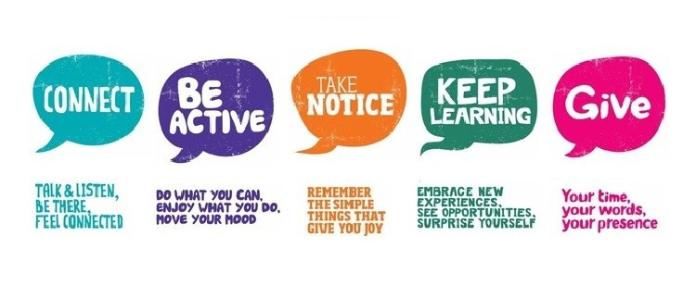
Courtesy The Mental Health Foundation of New Zealand, www.mentalhealth.org.nz
Notes:
This presentation is based on a project by the New Economic Foundation in 2011 which gathered all the scientific evidence on what supports wellbeing: 5 steps to wellbeing is used by many organisations including NHS, Mind, Social Care, Local Authorities. Action for Happiness charity are excellent and have 10 keys to wellbeing, these 5 broken down. The advice is more or less the same everywhere because it’s evidence based.
They are so flexible - lots of good examples around – I will share some but invite you to think of some ideas of your own and make your own plan – one idea for each ‘way’.
The websites at the end give loads of ideas which can be shared I am sharing just a few today due to time.
Resilience is like weighing scales – need to address the balance by focusing on some of these five areas we will cover today.

Slide 6
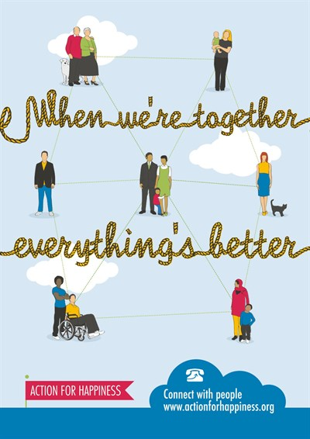
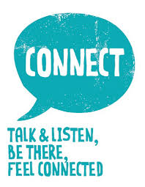
1. Connect with people
Notes:
Many studies have shown that both the quality and quantity of social connections have an impact on our physical and mental health. Having a network of social connections or high levels of social support appears to increase our immunity to infection, lower our risk of heart disease and reduce mental decline as we get older. Not having close personal ties poses the same level of health risk as smoking or obesity.
Social media helps with connection sometimes, but don’t rely on it. Jury is out on whether video calls or phone calls are better – some research suggesting video enhances connection, but others calling it exhausting and prompting social anxiety.
For you: Shared experience, shared space to enjoy the ‘down time’ as well as the work time. Share humour – I know my friends and family love it when I send them videos of cats doing funny things – maybe not your thing!

Slide 7
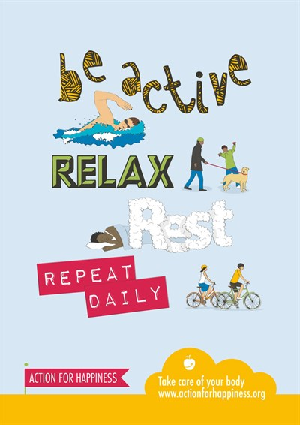
2. Take care of your body
Notes:
As you know, your body and our mind are connected. Being active makes us happier (chemicals in the brain) as well as being good for our physical health. It encourages your brain to release serotonin, which can improve your mood and can even lift us out of a depression (nice guidelines) and relieve anxiety (NHS recommendation). Involved in goal setting, which improves sense of achievement and self-esteem.
It is about getting active but it’s also about looking after your body in general with simple acts like:
unplugging from technology taking breaks if you’re someone who uses their ipad or phone a lot
Drinking enough water
Nutrition – taking breaks to eat, having breakfast
making sure we get enough sleep! Turning off screens an hour before bed, trying not to have screens where you sleep.
Getting time outside around midday, for natural light
For the children: PE lessons and the golden mile etc.
You all know that it helps to get children moving as you’re talking. Some of my ELSAs have said they won’t go back from working outside during lockdown as the children enjoy it so much more out there. Go for a walk as you talk. Throw the ball back and forth as you’re shouting out feelings words, triggers for feelings, qualities of a good friend, whatever! Or kicking the ball into a goal/or throwing into a net.

Slide 8
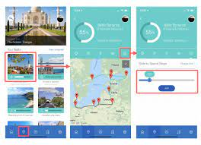
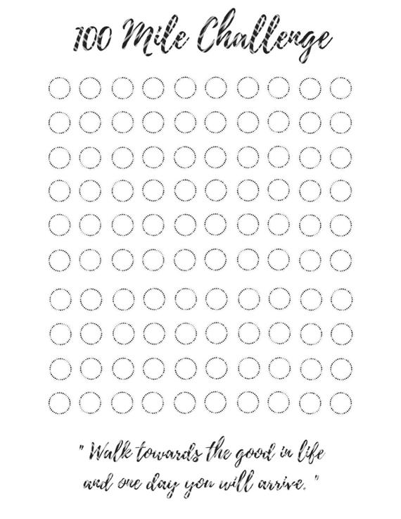
World Walking app
Notes:
Group exercise could encourage students (and staff) to exercise out of school e.g. Move for Mind 30 day challenge as a team any way you like – cycle, walk, jog “with” (virtually) for the students, staff team, family or friends.
Our team enjoyed using the app World walking – we all contribute our steps to a Lands End to John O’Groats walk and great wall of China.
Another school has a group of staff who each ‘walk a mile’ regularly – then see how far can we walk as a group (e.g. to Bournemouth, Lands End etc)
How can you encourage the kids to get to school without using the car?

Slide 9
3. Live life mindfully
Notes:
Mindfulness is essentially expanding our awareness to our bodies and feelings without judgement, good or bad of what you find or trying to change what you notice- trying to get rid of thoughts of feelings the more they buzz around!. Mindfulness practice sessions are often called meditations, but you don’t need to be a Buddhist or religious to take part.
Some of us here might feel overwhelmed by our thoughts, feelings and inner judgements at times. Others might not consider themselves to have many inner thoughts or feelings at all…neither is great! If you’re in the first camp, we tend to focus on our thoughts and content of our minds to the exclusion of everything else – sounds, sights, smells around us.
If you’re in the second group you might be running on auto-pilot in particular routines and patterns of behaviour rather than making informed decisions on what is right for you and those around you in the moment. Either way, we can get the sense of feeling a bit trapped. Maybe you’re okay in one area of your life but not in another like work, home, resting for sleep.
Hard to feel like we have time for it, but research suggests that mindfulness actually helps us feel like we have more time as it helps our perception of time feel more under control. Being in the present moment makes us feel happier than thinking about the past/future. Also Mindfulness meditation promotes creative thinking. Mindfulness-based stress reduction can be an effective treatment for poor sleep, even for those with serious medical conditions like chronic pain, research suggests. Just by deliberately noticing and being aware of your heart rate can help you to reduce it, just the noticing can bring the heart rate down.
8 week mindfulness meditation class can lead to structural brain changes including increased grey-matter density in the hippocampus, known to be important for learning and memory, and in structures associated with self-awareness, compassion and introspection. 12.5 minutes a day of meditation for 8 weeks increased Marines' resistance to stress – reduced stress perception in high-stress pre-deployment condition – and these are guys who outwardly appear hard as nails.

Slide 10
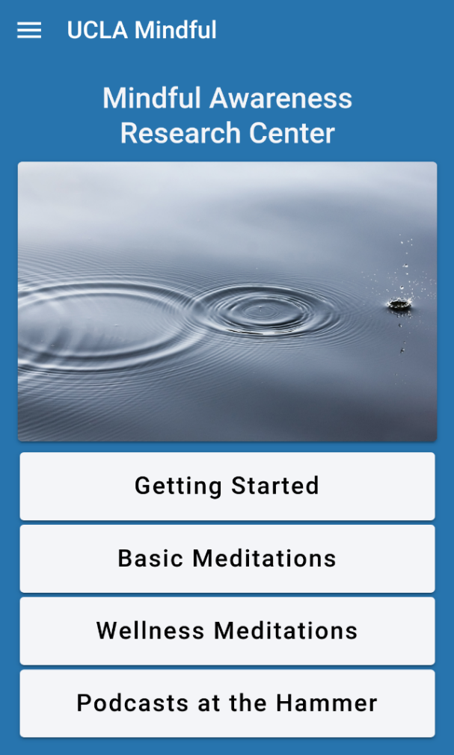
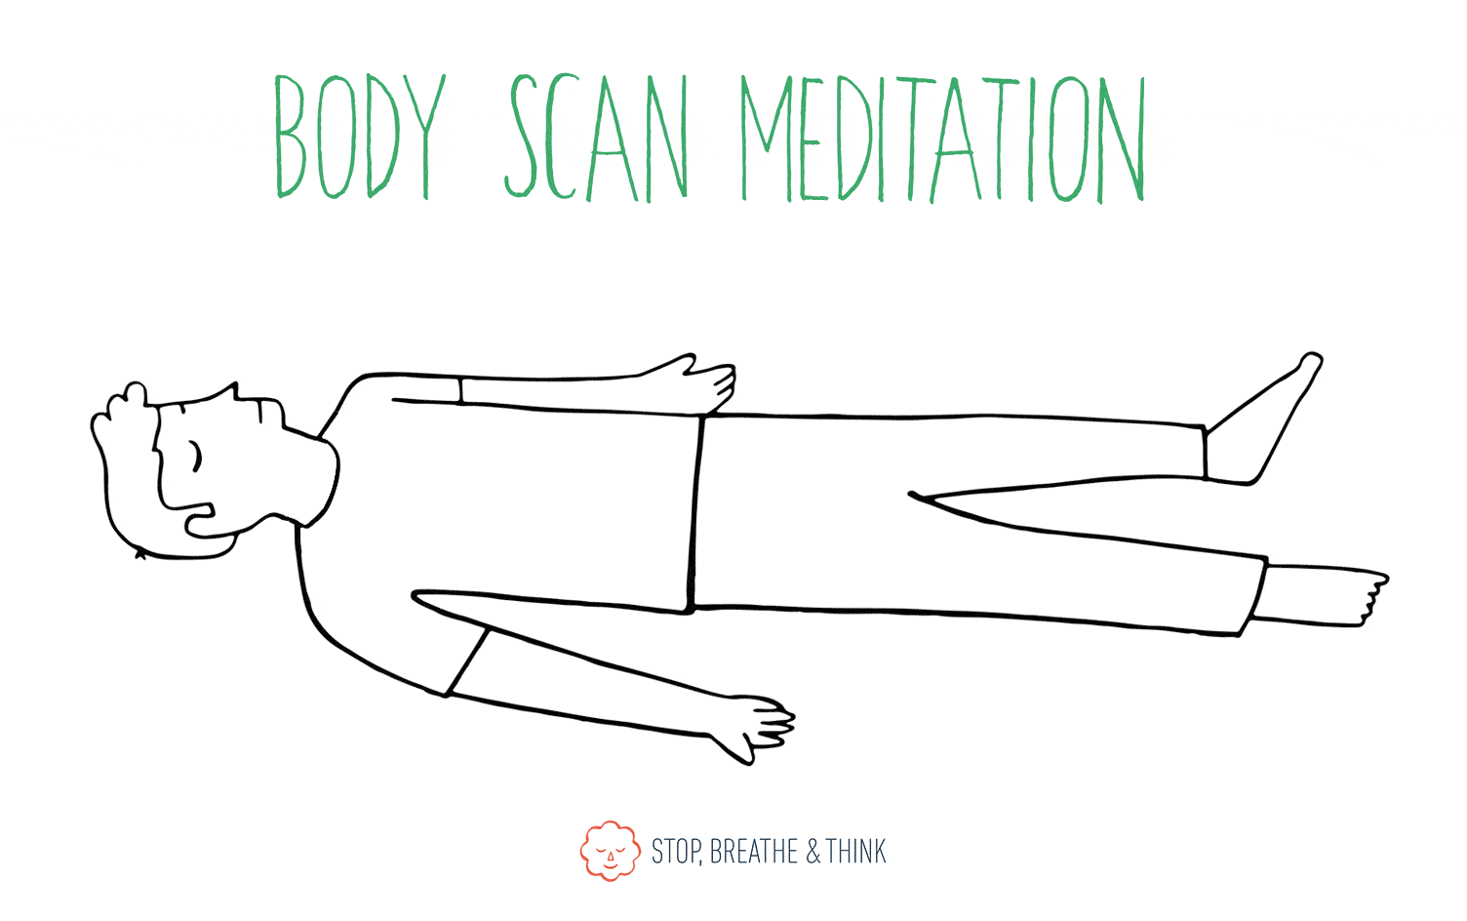
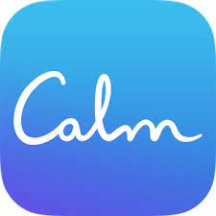
Notes:
There are lots of apps for this – Developed by the Mindful Awareness Research Center at the University of California, Los Angeles (UCLA), 10 per cent happier (my mum likes this one – not condescending), Calm (subscription), headspace which is free for most education staff. May need to explore these to find one with the personalities that suit you.
Headspace | Mini Meditation | Let Go of Stress (youtube.com)

Slide 11
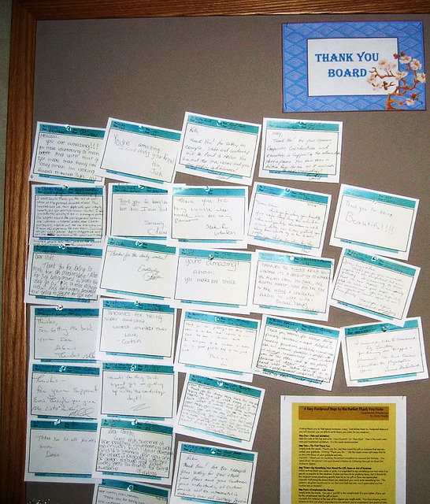
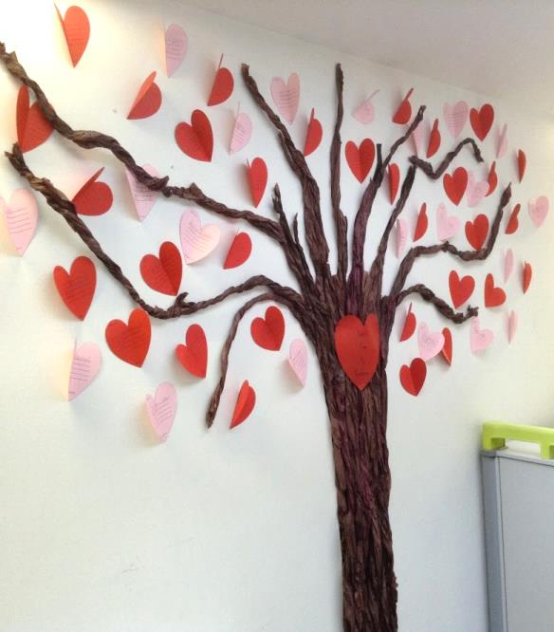
Notes:
Take notice also links to Gratitude eg. Write/share 3 good things. The more we record good things, the more we notice them as we happen, the more we remember them. Done just 2 mins a day for 21 days the brain scans for positive, not negative. Gratitude garden app or diary. Solid research base.
Photos – thank you board in one school and a kindness tree in another school. Could be an email.
Shawn Achor psychologist at Harvard (link to his video at the end)- When we notice the positive we feel more positive. Dopamine turns on all the learning centres in the brain.

Slide 12
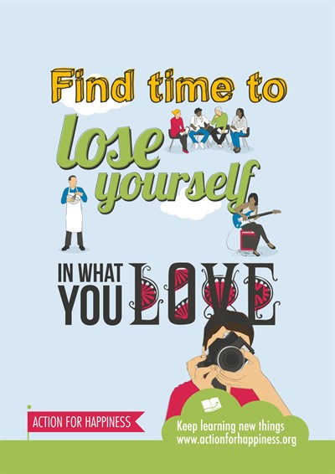
4. Keep learning new things
Notes:
Learning affects our well-being in lots of positive ways. It exposes us to new ideas and helps us stay curious and engaged. It also gives us a sense of accomplishment and helps boost our self-confidence and resilience.
When we are focused on something, we are being mindful, and that often happens when we are learning something new. Challenge yourself to master something.
Sing, try a sport, learn a skill, draw. You might have a party trick already, if not YouTube can teach you anything!(almost) We will all learn something new together when I show a video soon.

Slide 13
Character strengths
https://www.viacharacter.org/
Notes:
Learning helps us use our strengths. ‘Flow’ (losing yourself) comes from working with your strengths.
Two of the founders of Positive Psychology (Seligman & Perterson) developed a classification of human strengths, that consistently emerge across history, culture, gender, SES. 24 character strengths, 6 broad categories.
This is now a well evidenced intervention. When skilfully applied, character strengths can have a significant positive impact on your life. Research shows that using character strengths can help:
Buffer against, manage and overcome problems i.e. build our resilience
Improve relationships
Enhance heath and overall well-being – increase life satisfaction
Character strengths questionnaire - I would really recommend that you try this activity yourself, as it’s a really nice exercise. For the children – there is a young person’s version ages 10-17
Think of something you don’t like to do at work- or something you need to do at least once a week. Take your top five strengths and aim to do that task using at least one of those personal strengths
Share your strengths with another person and /or consider together examples of how you each already use strengths at work and home and how it links to your hobbies and interests.

Slide 14
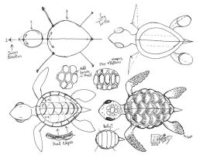
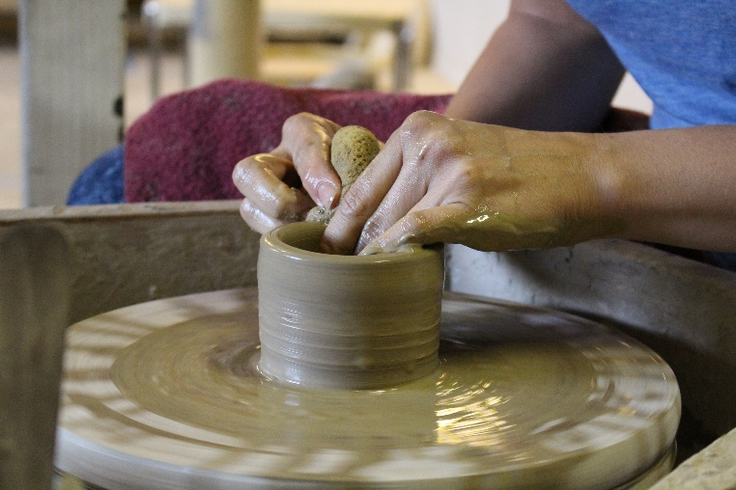
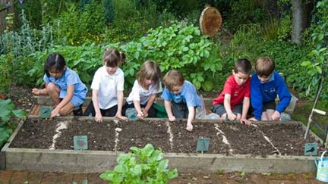
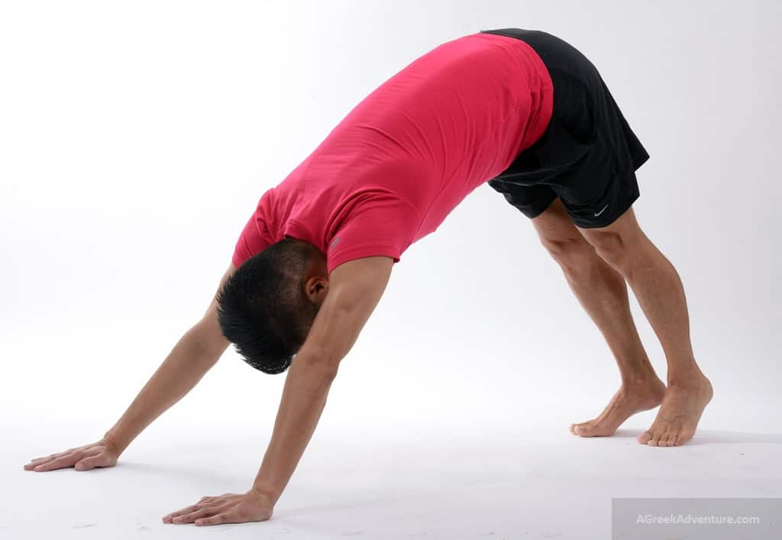
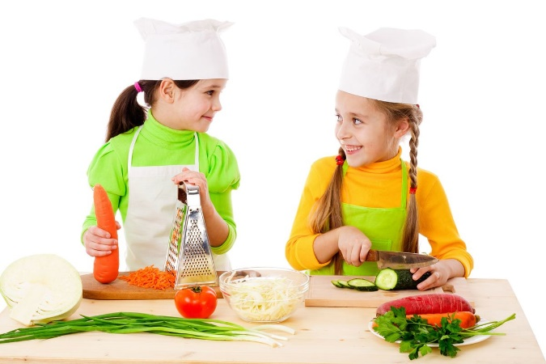
Notes:
Think about what you like to do in your spare time – Are you a good cook? A gardener?
What did you used to love doing when you were young? At primary school / Secondary school?
“Talent bank” – any member of the team able to teach art, pottery etc? Volunteering short evening sessions for staff? Not necessarily to teach, but gather a group of interested people to have a go?
From Kings Copse - We did a couple of pottery painting evenings. Art teacher did a class for staff
For the children: Obviously it’s all about learning at school, but could they run clubs for each other? Make a video teaching others about their interest – make them feel like an expert. Kids love learning party tricks– a breakdancing move, trick shot of some sort, pen spin or coin spin through fingers, something that looks cool!
Video - Learn to draw (e.g. an elephant) in 60 sec. How to Draw an Elephant for Kids Easy in 60 seconds – YouTube https://www.youtube.com/watch?v=5RVZofPEIdk

Slide 15
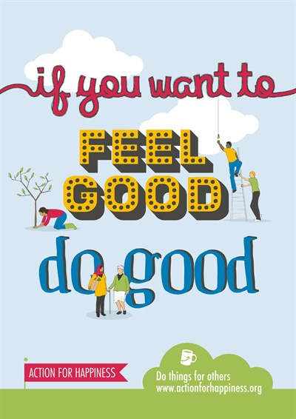
5. Do things for others
Notes:
Sometimes we feel like all we do is give give give. I’m sure many of you are helping others at the moment – some lovely kindness support going on at the moment helping the children, neighbours, friends or family members who have been more vulnerable lately. Doing things for others releases endorphins in the brain and boosts happiness for us as well as the people we help. Spending money on others has more positive effects on our mental health than spending it on ourselves (although if you’re a parent you might want to keep that piece of information to yourself or your kids will never let you forget it).
When we give to others it activates the areas of the brain associated with pleasure, social connection and trust.
Happiness is contagious! Research shows that the happiness of a close contact increases the chance of being happy by 15%. So if you’re happy, they’re more likely to be happy too.
For the children: Stories to develop kindness and empathy – Empathy Lab. Arrange events for charity that means something to them– an issue that has affected your school or your students? It’s a great way to develop empathy. One school has a Kind Kids Club – they have to do 10 acts of kindness to become a member – hold a door open etc, Litter picks, elderly penpals, donating hair, Lyla has donated her hair several times asking for water aid donations instead of birthday presents (raised nearly £5000 and won a JustGiving award)

Slide 16
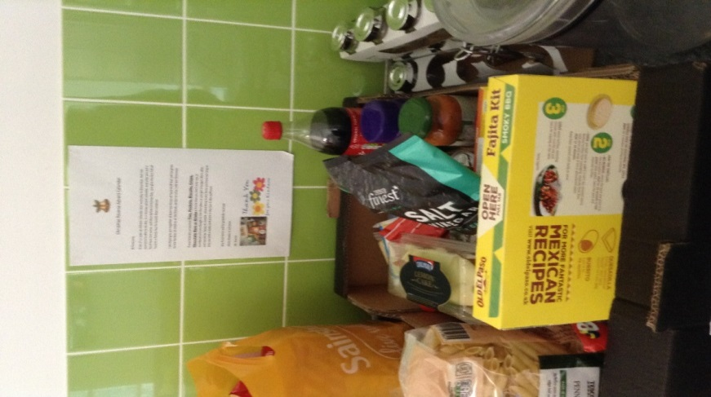
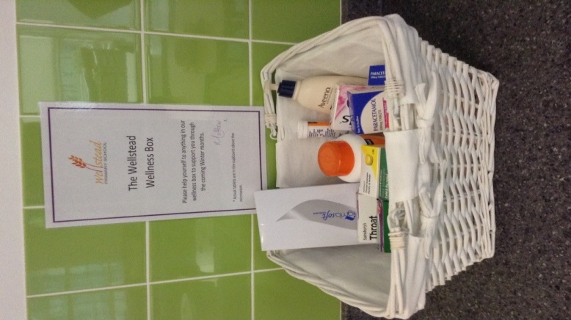
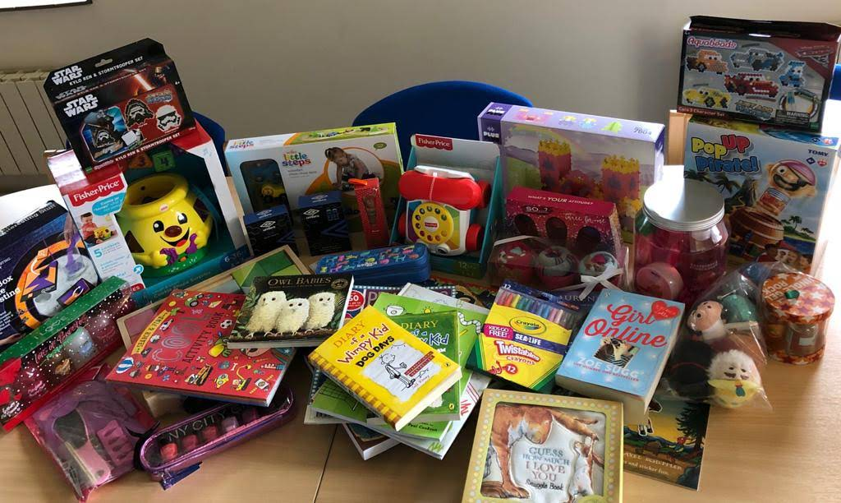
Some examples
Notes:
Wellness box, food bank (from a school staff room) and a toy collection for Wave 105 xmas presents radio appeal
- several schools do collections like this
Sharing compliments, thank yous and random acts of kindness –The knock-on effect of this is striking. Cover a duty, make someone a cuppa, share planning.
We do office angel, where we’ve picked a name out of the hat and try to drop something nice in their pigeon hole or on their desk for them, not expensive, can set a budget. A postcard, a little treat, a flower.

Slide 17
‘Happiness is not something ready made. It comes from your actions’ Dalai Lama
‘I don’t have to chase extraordinary moments to find happiness – it’s right in front of me if I’m paying attention and practising gratitude’
Brene Brown
‘Happiness is a thing to be practiced, like the violin’ John Lubbock
Notes:
Thoughts about happiness
Return to principle Happiness is contagious –so happiness is good for you – and your happiness is also good for your friends, family, colleagues, and the children / families you support.
Positive psychology shows us that wellbeing and flourishing can be promoted through activities. Can’t do it just by ‘making an effort’ to be happy

Slide 18
Web resources
www.actionforhappiness.org
https://actionforhappiness.org/take-action
https://www.annafreud.org/
www.nhs.uk/conditions/stress-anxiety-depression/improve-mental-wellbeing
www.mentalhealthatwork.org.uk
https://www.nhs.uk/oneyou/every-mind-matters/
https://www.mind.org.uk/get-involved/donate-or-fundraise/take-on-an-active-challenge/move-for-mind-resources/
https://www.educationsupport.org.uk/
Notes:
Education Support, supporting teachers and education staff has a free helpline for anyone working in the education sector

Slide 19
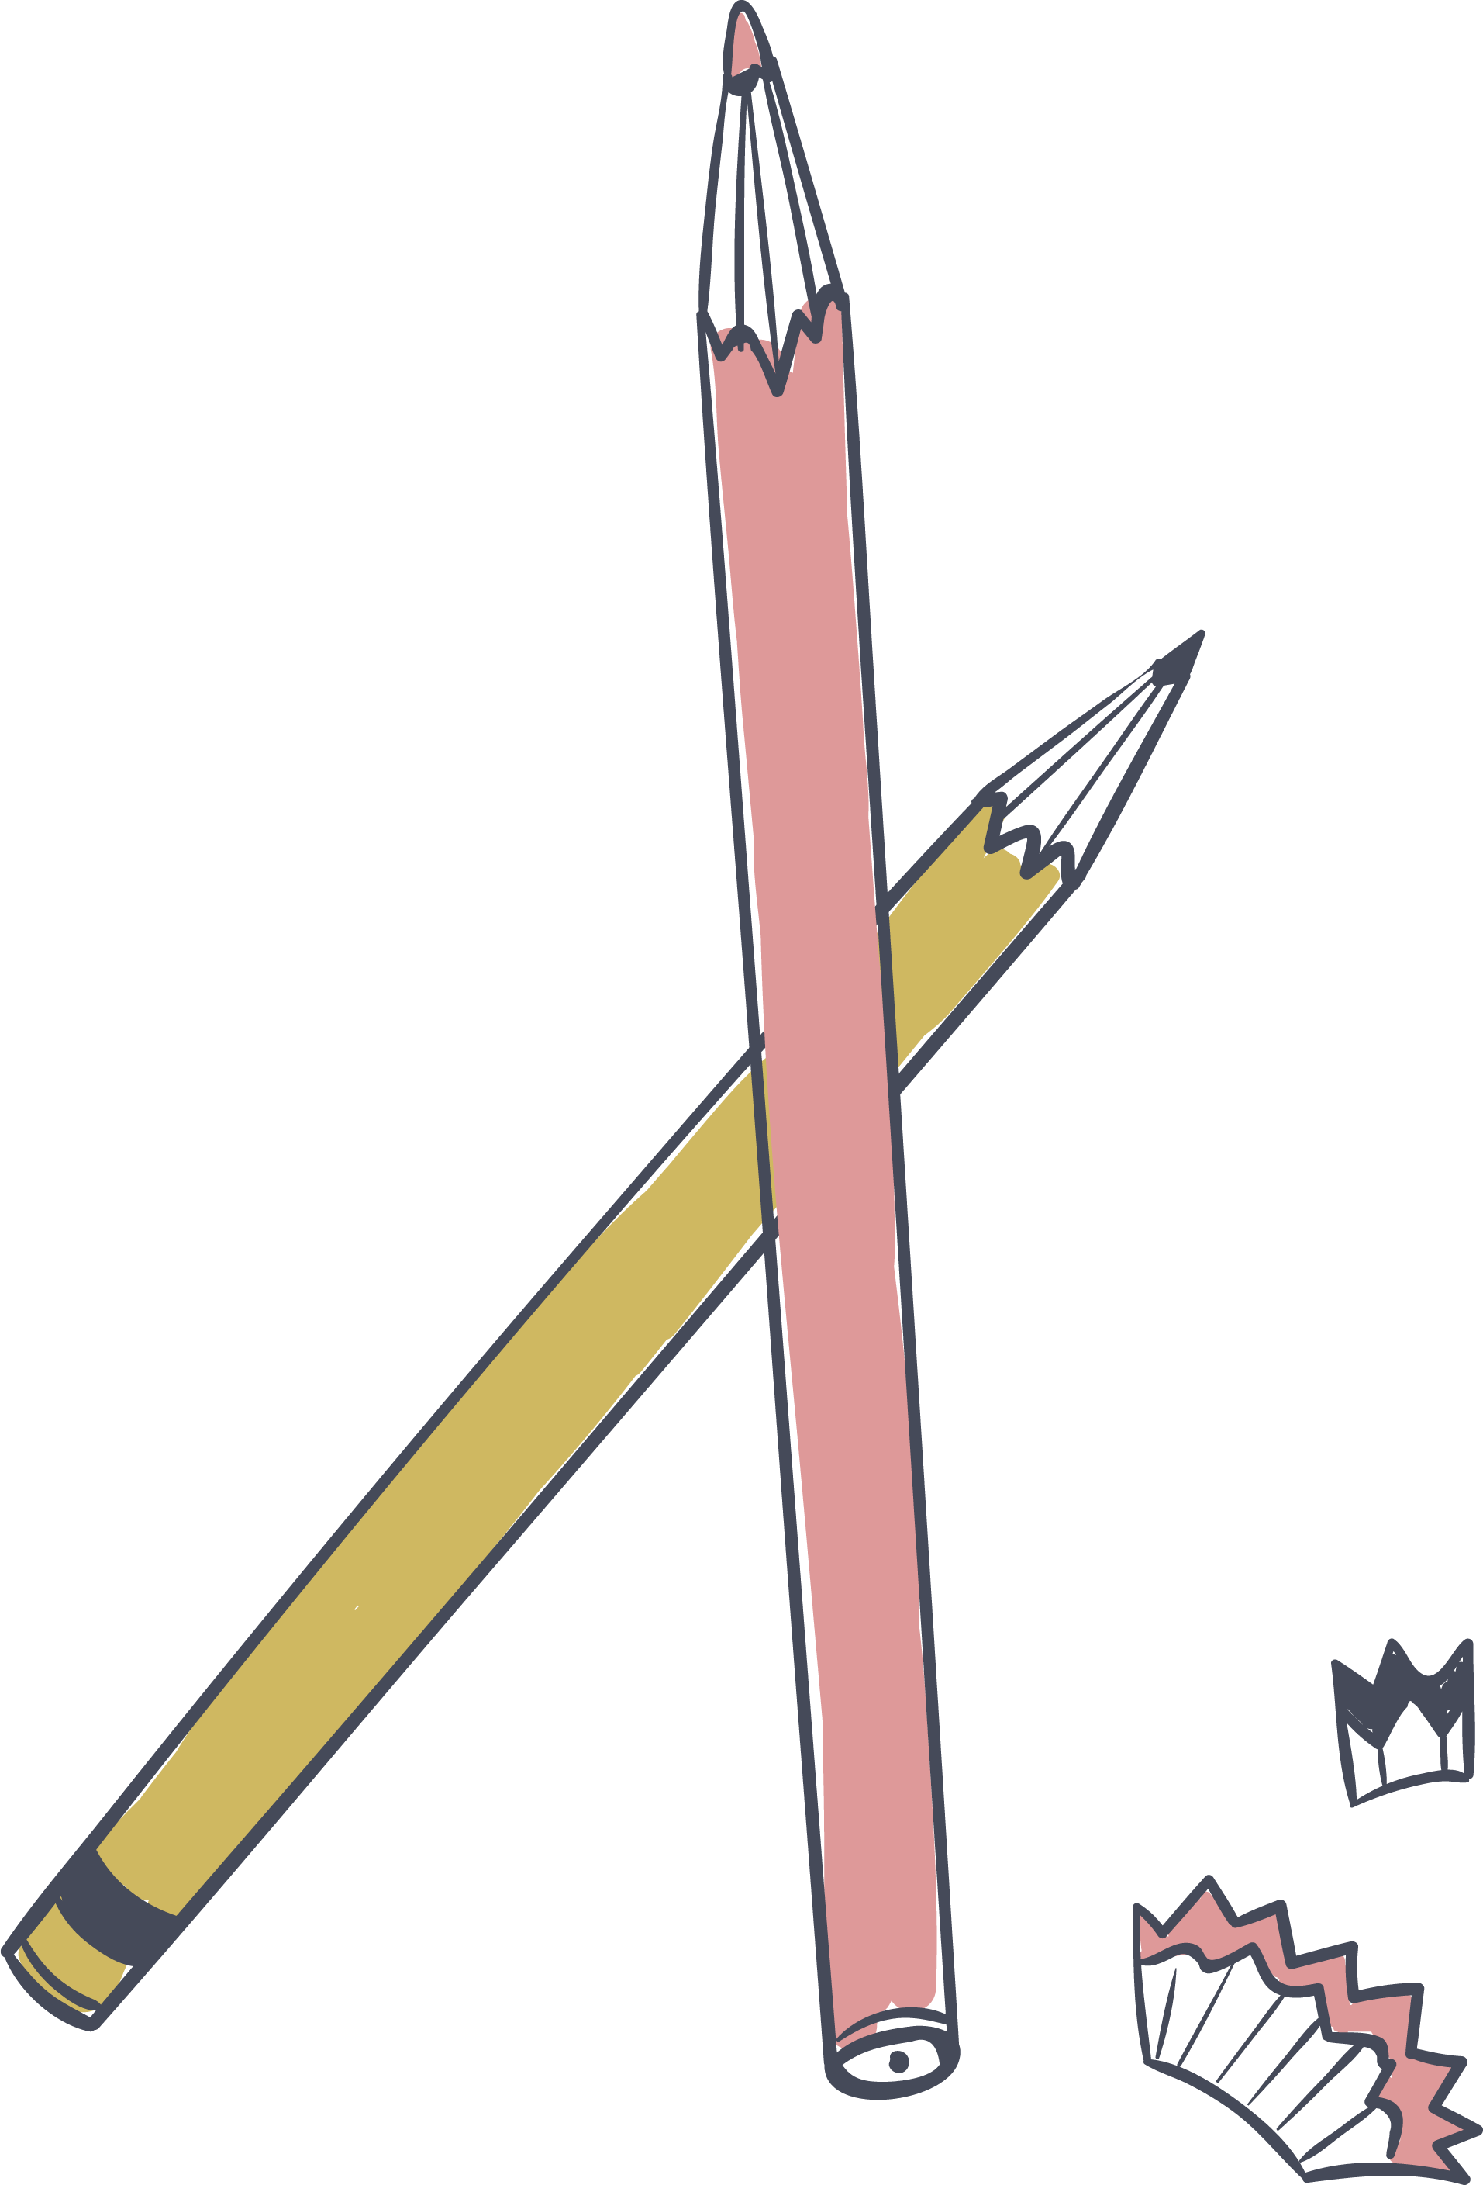
Video resources
https://actionforhappiness.org/talks-library
www.youtube.com/watch?v=fLJsdqxnZb0 : The happy secret to better work | Shawn Achor
https://www.youtube.com/@headspace: Headspace YouTube channel
https://www.youtube.com/watch?v=5RVZofPEIdk – How to draw an elephant in 60 seconds

Slide 20
HIEP support
Through SLA we are able to offer:
Individual or group supervision.
Supporting the school leadership team / mental health lead to identify areas for development and make systemic changes, drawing on our knowledge of organisational psychology and mental wellbeing.
Staff training using the evidence based Five Ways to Wellbeing for individual and whole school wellbeing planning.

Slide 21
Thank you!

