Slide 1
Oracy
The implementation and impact at St Mary’s Catholic Primary School

Slide 2
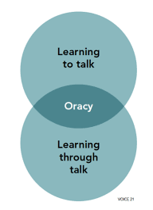
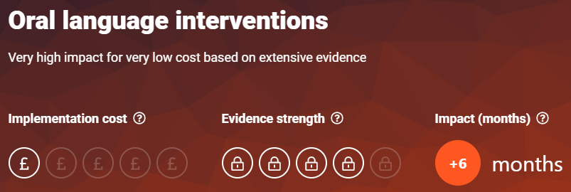
Why Oracy?
Improving life chances
Voice 21 describe oracy as ‘the ability to articulate ideas, develop understanding and engage with others through spoken language.’
Education Endowment Foundation (EEF)
Source: Talking about a Generation, The Communication Trust
Source: Educating for the Modern World, CBI/Pearson 2018

Slide 3
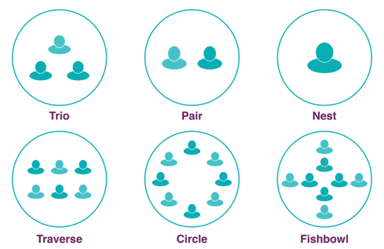
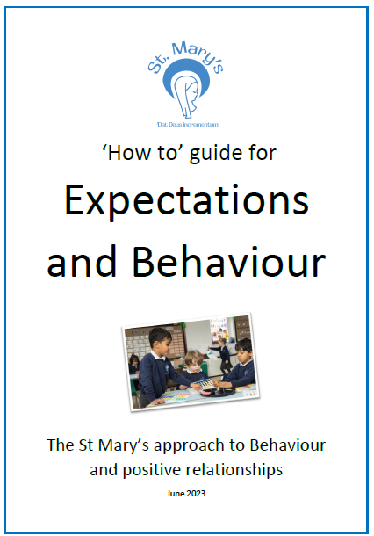
Why then?
Autumn 2019
Quadruple Requires Improvement
High suspensions
Passive learners and disengaged
Poor attitude to learning
Strategies implemented
Routines and expectations
Practise
Opportunities for quality talk
Sentence stems
Pupil voice across the school
Leadership groups
Learning behaviours
Standing to speak
Tracking the speaker

Slide 4
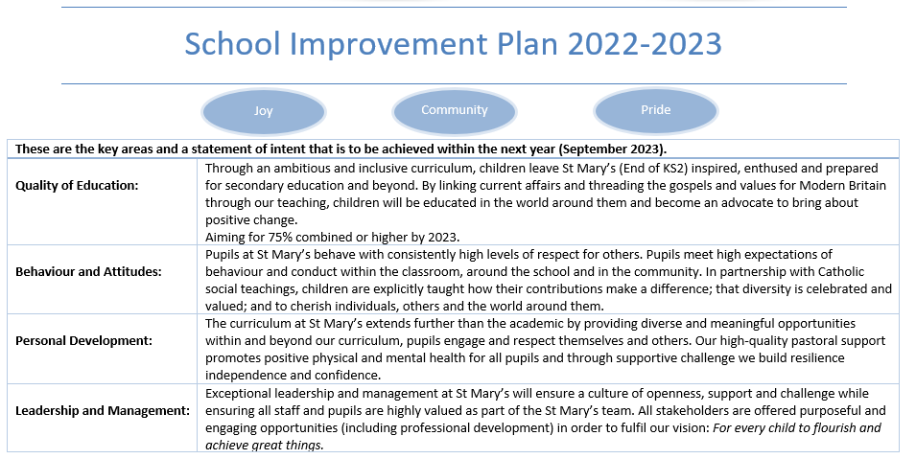
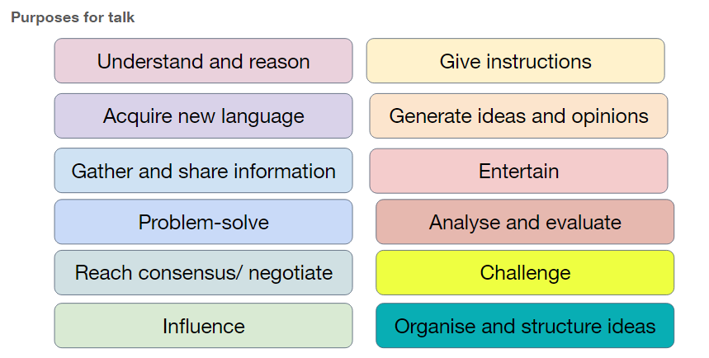
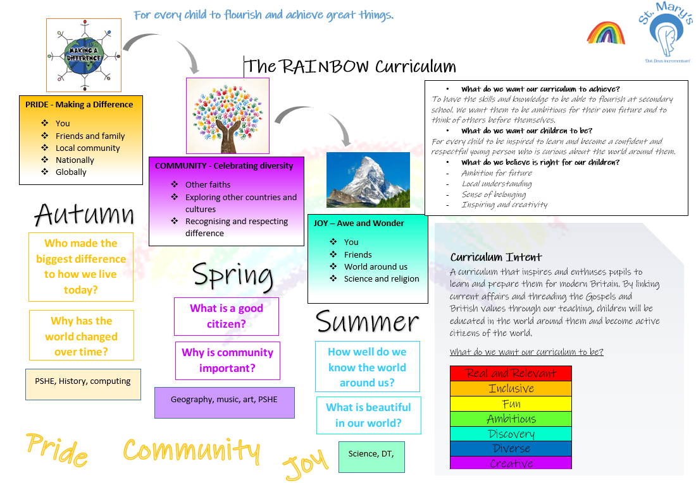
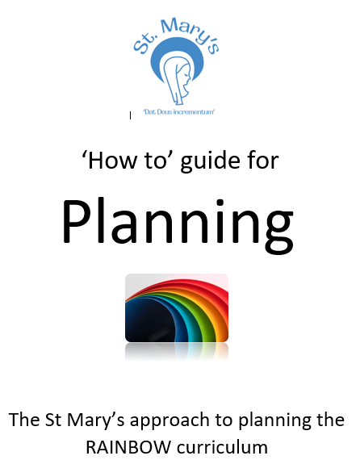
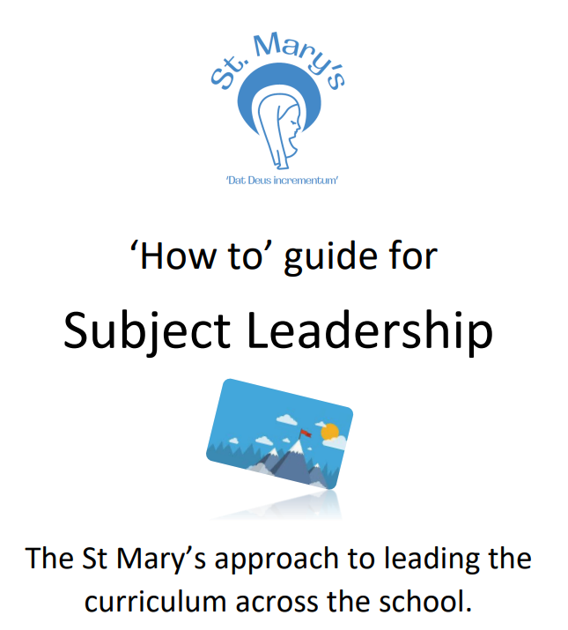
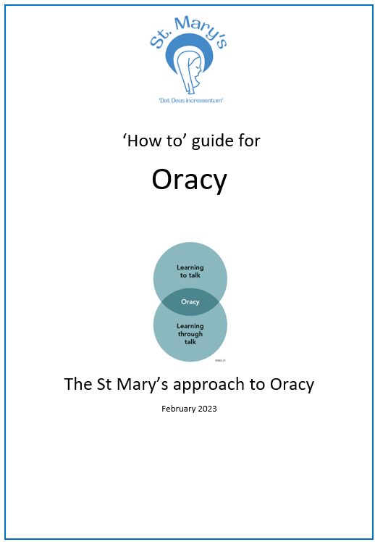
Development of Oracy
Establishing Oracy as a subject
Part of whole school strategy
Progression of skills
Long term, mid-term planning
Talk rules in class
Strategies in other policies

Slide 5
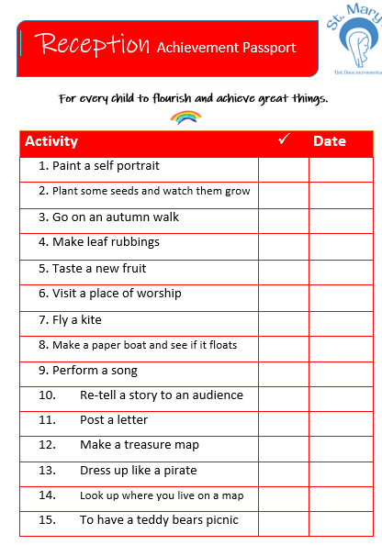
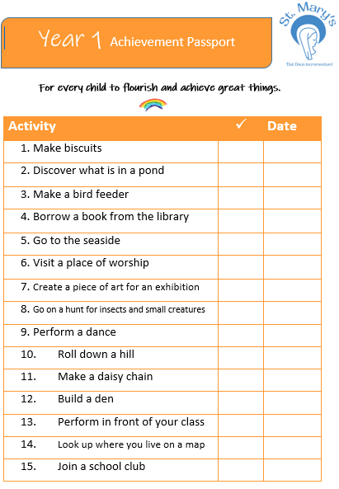
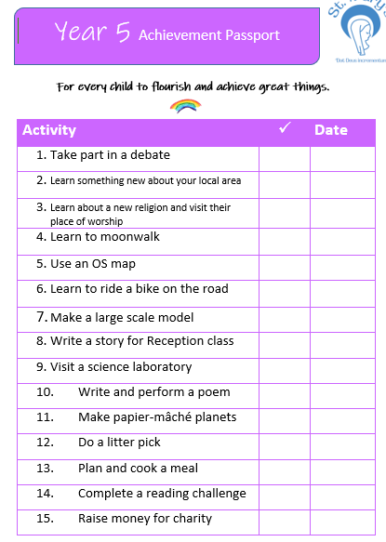
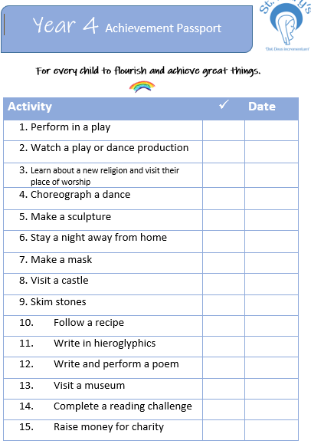
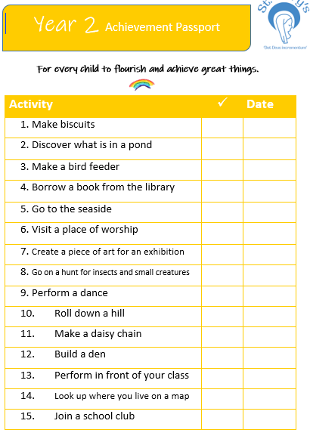
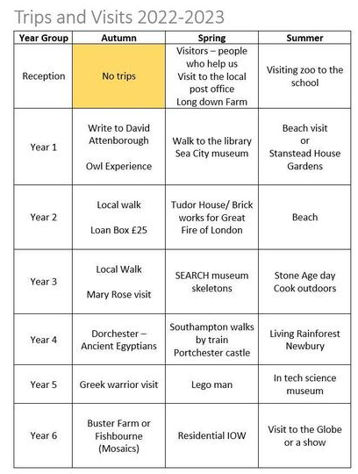
Focus on Personal Development and Oracy
Achievement passports
Building cultural capital and utilising this in Oracy
Using wider audiences
Aspirations – what is my sentence?
https://www.dixonsba.com/why/my-sentence

Slide 6
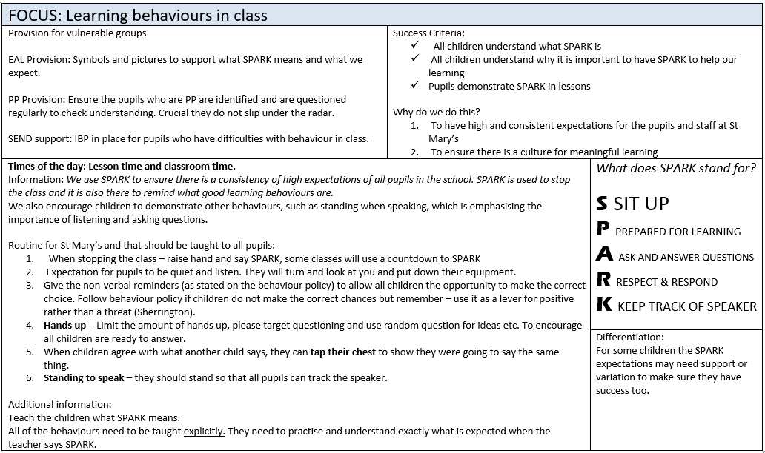
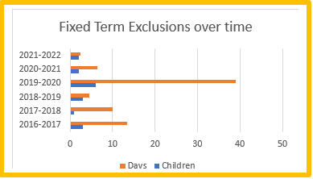
Focus on Behaviour and Oracy
High expectations
I care too much to lower my expectations of you

Slide 7
Reflections
Oracy is not a scheme
Quality Oracy builds positive relationships
Time to talk and express
Oracy is implemented differently everywhere
How would it support the needs of your school?
How to support parents with developing Oracy at home.

