Slide 1
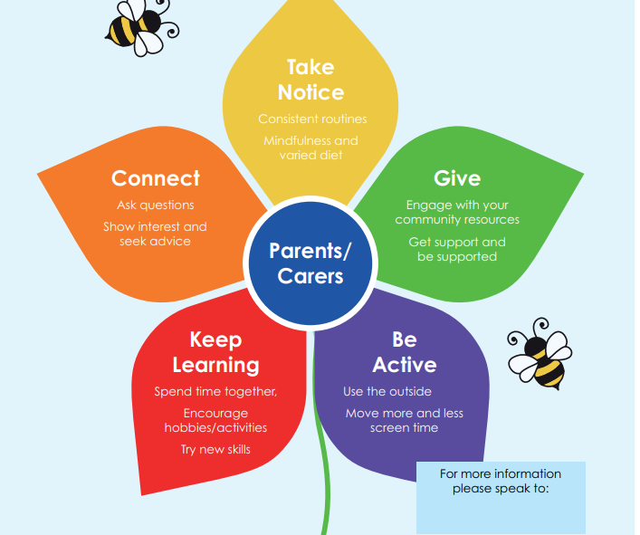
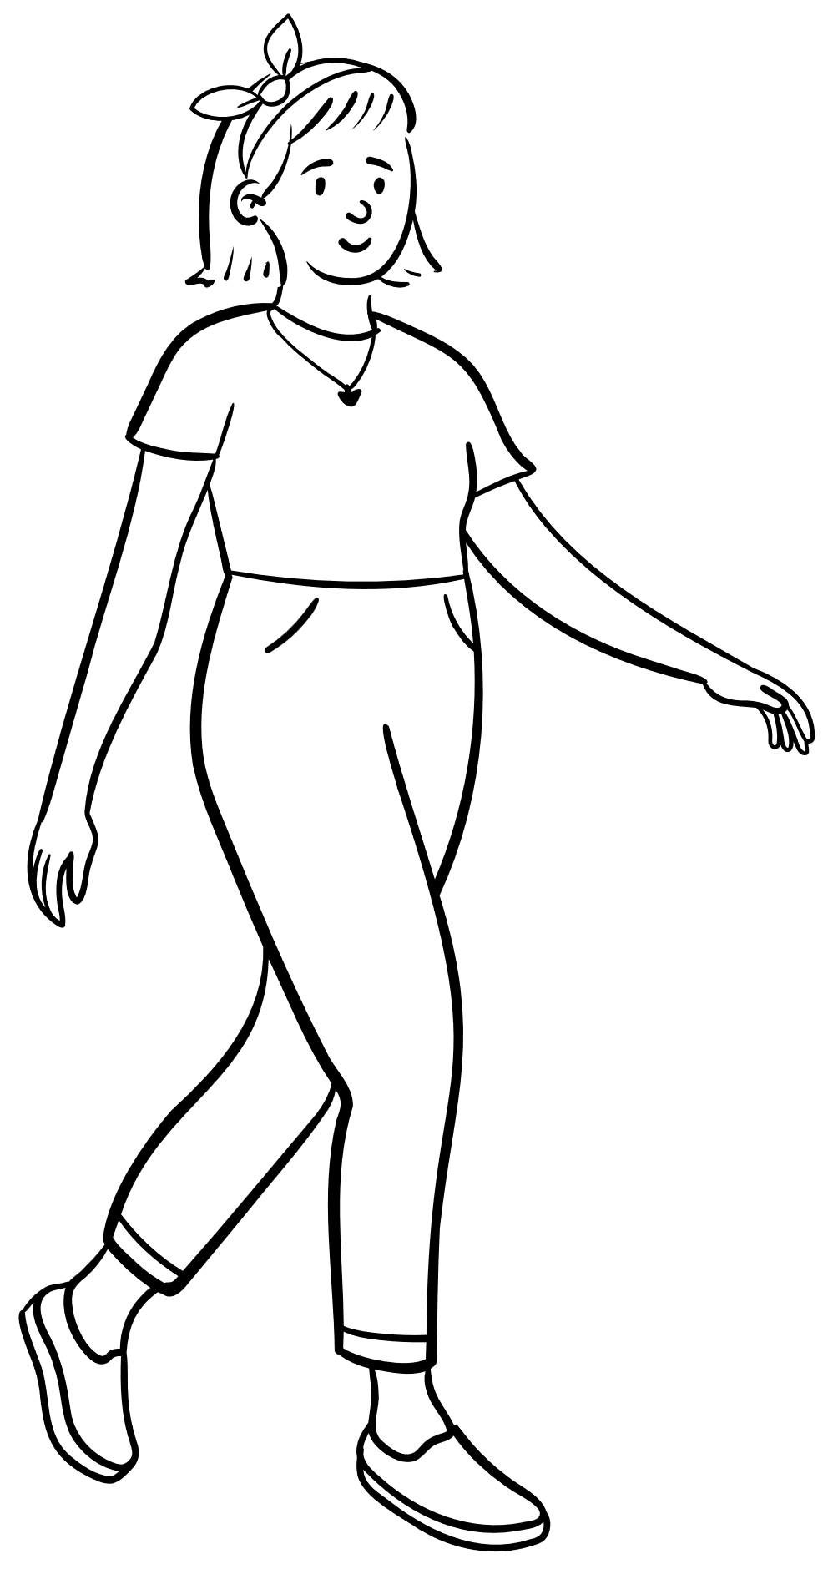
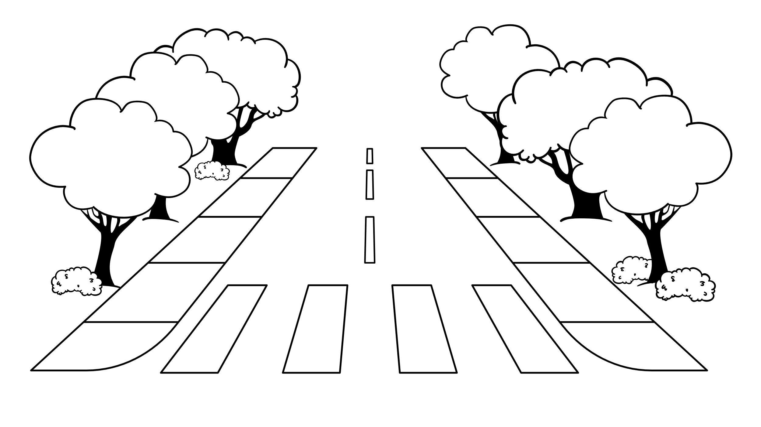
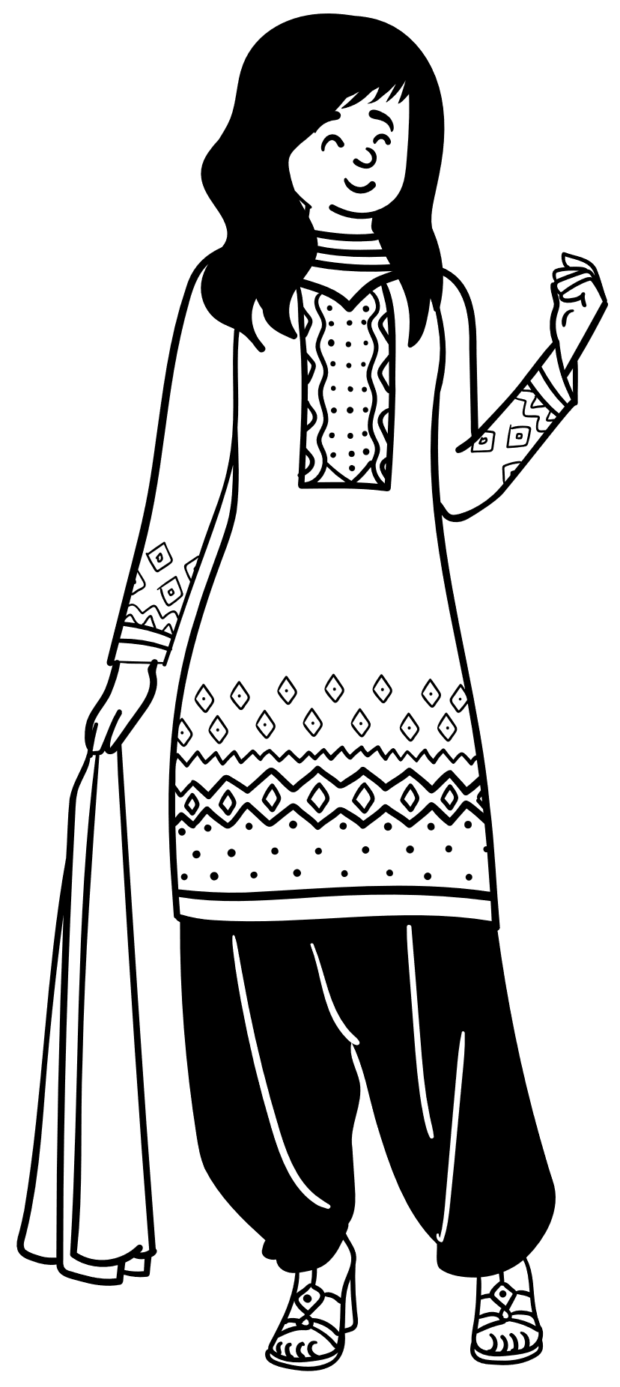
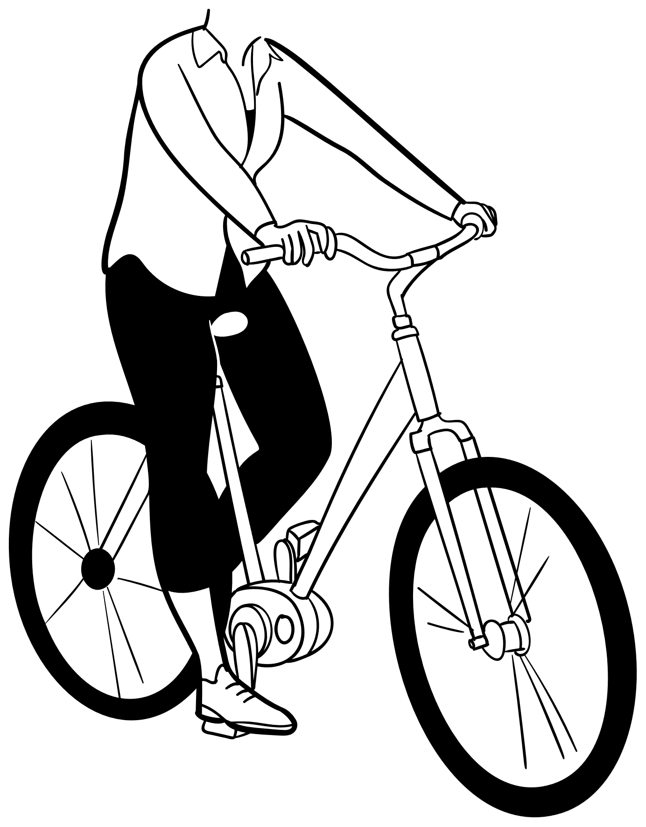
Back to Basics
Managing wellbeing at home
When was the last time you took notice and showed an interest?
https://www.hants.gov.uk/socialcareandhealth/childrenandfamilies/back-to-basics
Volunteer Project
Have you thought about giving your time to others or the community?
When was the last time you talked and connected with someone?
When did you last spend time together and learn new things?
How often do you get out and enjoy the outdoors?
For extra support with any barriers, please speak to a professional.

