Slide 1
Learning Zone
Guidance and tips for delegates

Slide 2
Getting the best out of the learning zone
so
This Photo by Unknown Author is licensed under CC BY-NC
This Photo by Unknown Author is licensed under CC BY

Slide 3
A quick overview
Logging in to the Learning Zone- Hampshire Maintained Schools Accessing from outside school?
In School or on a managed laptop?
Academies and other schools
Check/update your correspondence email address
Searching for a course and much more
Browsing by topic
Where to find our help guides
Sign up to Moodle Site News
Contact information – for help

Slide 4
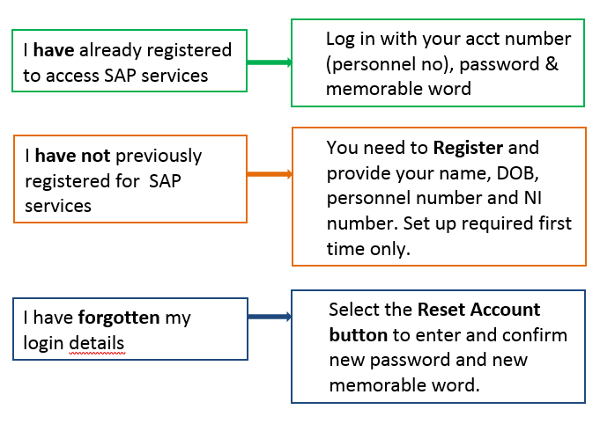
Logging in to the Learning Zone Hampshire Maintained Schools
Log in with your personnel number, password and memorable word

Slide 5
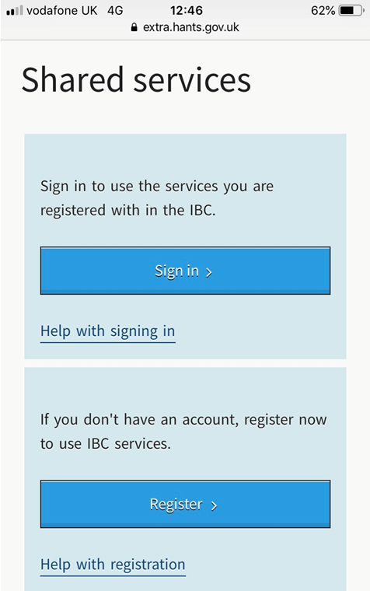
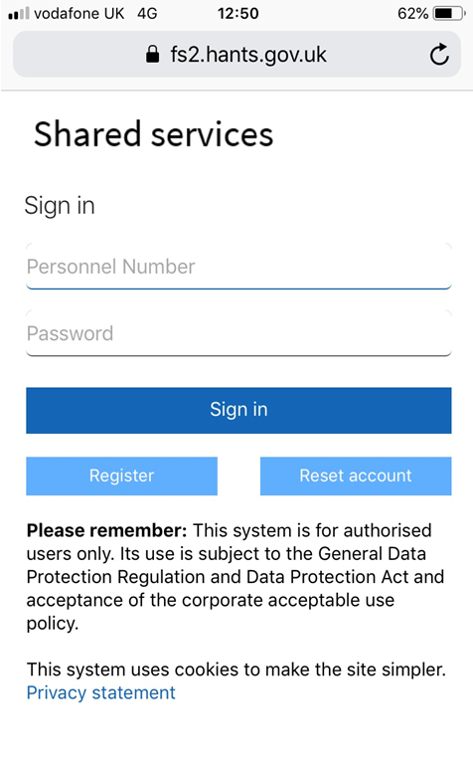
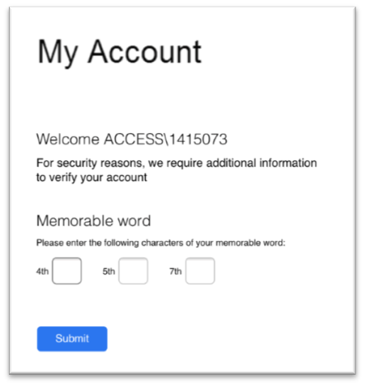
1. Accessing the Learning Zone Hampshire Maintained Schools
Accessing from outside school? - access via the Hampshire County Council shared services page https://extra.hants.gov.uk/sharedservices.

Slide 6
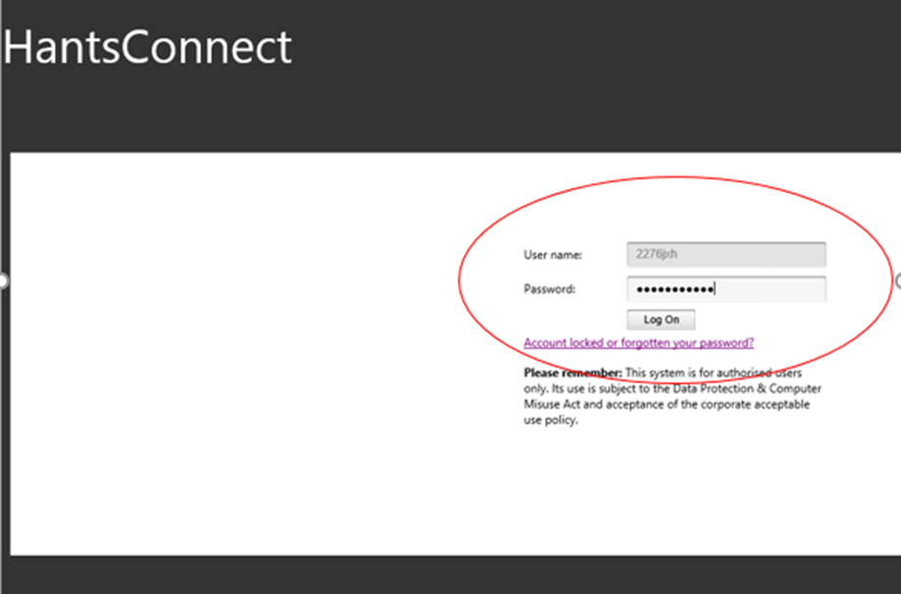
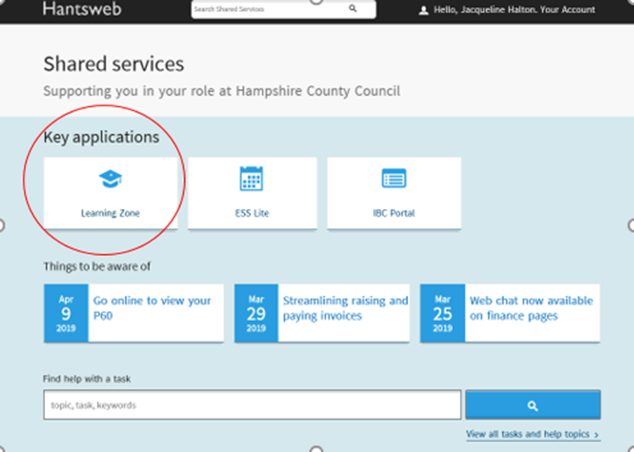
2. In School or on a managed laptop?
Access the IBC portal via your HantsConnect page, then click on the Learning Zone tile

Slide 7
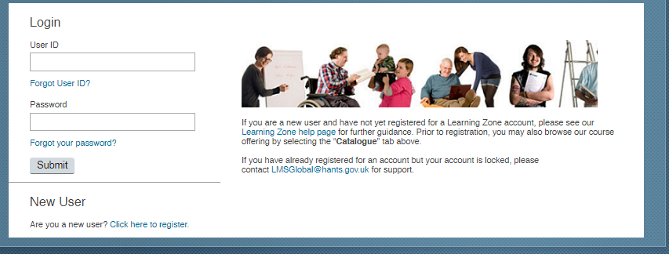
3. How to access the Learning Zone – Academies and other schools
Sign in to the login page using your User ID (EXT****) and password
If you are not yet registered to use the Learning Zone please contact your school business manager for access codes
If you cannot yet access the Learning Zone you can still browse our catalogue of training offers via the same page.

Slide 8
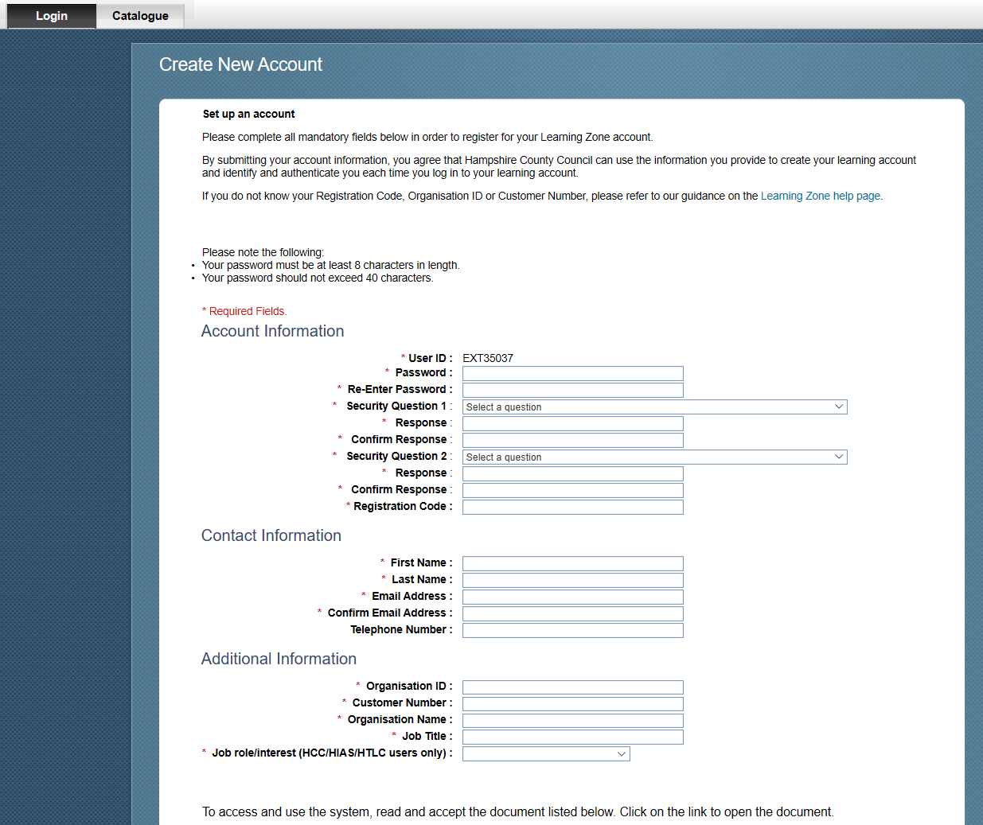
Academies and other external schools- Not yet accessing?
If you don’t have a User ID ask your school business manager for your Org ID, Customer number and registration code. You need this to set up your own access to the Learning Zone

Slide 9
4. Check/update your correspondence email address
Go to the staff shared services page - https://extra.hants.gov.uk/employee/
Click the ESS Lite tile & select “My Information”
Ensure that both the Personal Email and Correspondence Email boxes are completed
No email address in the Correspondence Email = no booking confirmations, joining information or course notifications
Non Hampshire maintained/external schools – email address is requested during the sign up to register for the Learning Zone

Slide 10
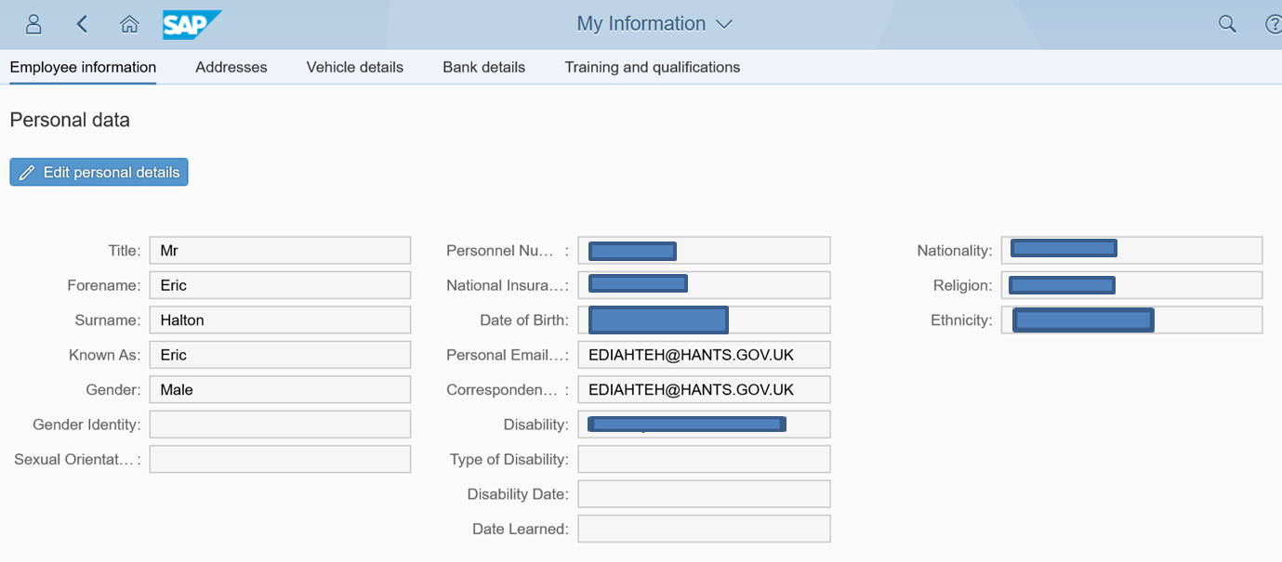
Important communications from Learning Zone
THIS IS THE ONE THAT MATTERS TO THE LMS

Slide 11
5. Searching for a course and much more
Find Learning
Use this to search for a course – using course title or keyword/s from the title
Browse all courses
Use this to browse and explore a wider range of professional learning in areas of interest.
Featured
Upcoming learning items that have been flagged by HTLC. Featured courses will be highlighted on School Communications.
Recommendations
Learning Items can be recommended to you via a colleague.

Slide 12
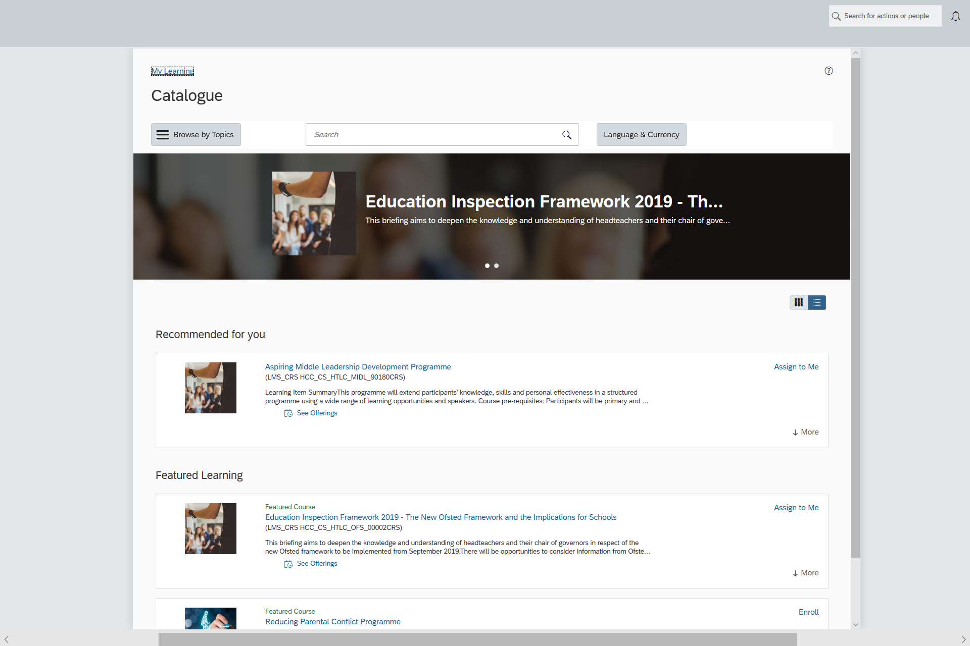
6. Browsing by topic
To search the whole catalogue in areas of interest click “Browse by topic”
All HTLC courses are listed
in “Professional Skills” area
Use the arrows to narrow down the selection from here, eg Teaching and Learning, School Curriculum, School Leadership, Assessment etc, then further again by subject or theme, eg English, History, Schools Middle Leadership

Slide 13
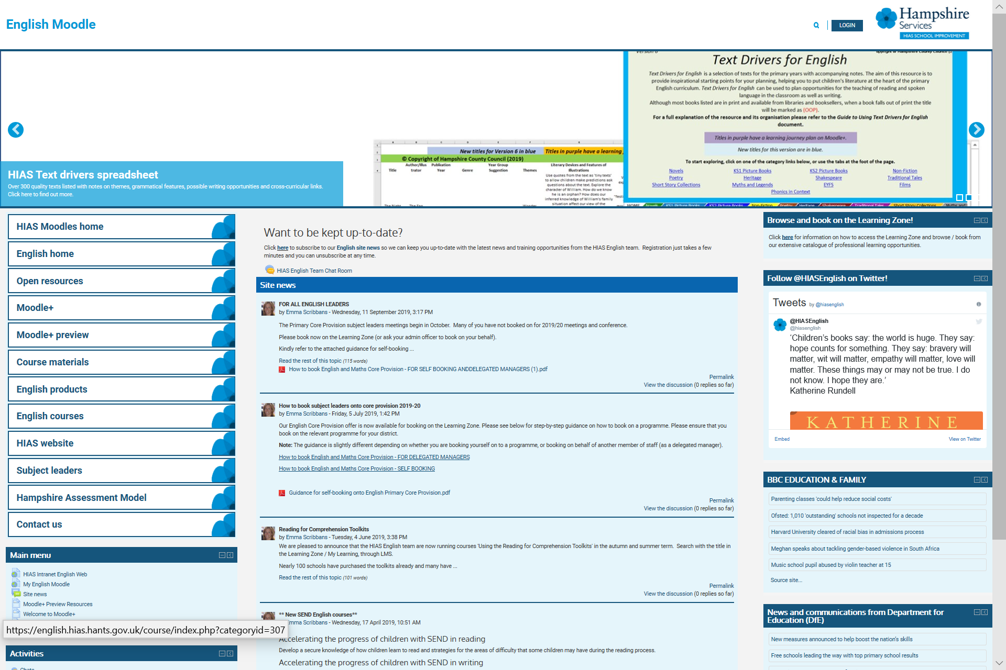
7. Where to find our help guides
https://hias-moodle.mylearningapp.com/
To reach our HIAS Moodle Home page
Learning Zone information and guides are accessed from this link
Choose any subject
home page e.g. English

Slide 14
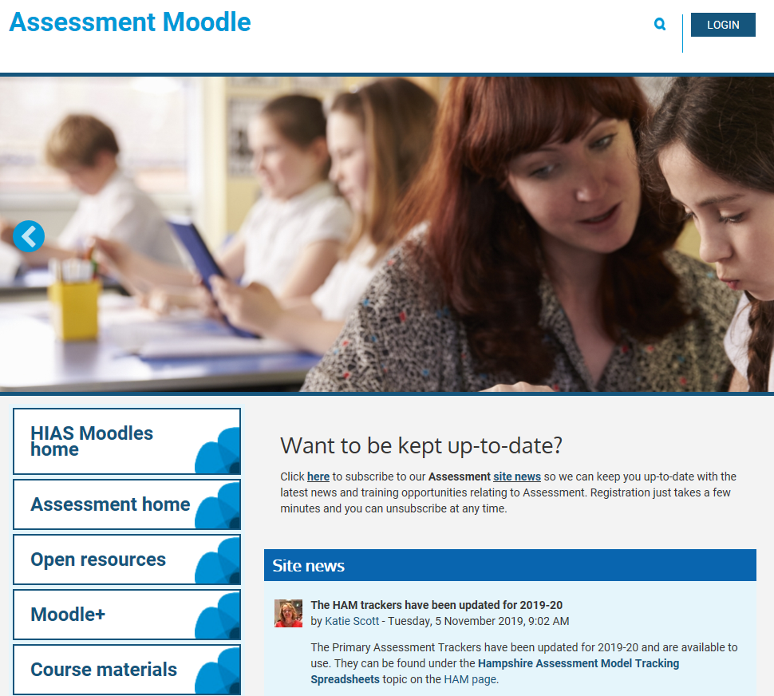
8. Sign up to Moodle Site News
Keep up-to-date with the latest news and training opportunities in your subject area
You receive email notifications every time news or messages are posted
Register via a link on the home page of all our Moodle sites

Slide 15
9. Contact information – for help
For help with bookings and course queries Contact the HTLC Learning Support Team htlc.courses@hants.gov.uk. Tel: 01962 718600
For help with accessing the Learning Zone & licences Contact the HCC IT Help Desk: Tel: 01962 84700
For help with HIAS Moodles Contact htlcdev@hants.gov.uk

