Slide 1
AI In Secondary Education
A School’s Teaching and Learning Experience
Dr Phil Sleat
Assistant Headteacher
Exams and Assessment

Slide 2
Introduction
Background to our use of AI
How we train staff
Six uses of AI at Swanmore
Our staff experience
Our AI Acceptable Use Policy
Our pupil experience
Some top tips

Slide 3
Background
Swanmore College has been working with AI tools since September 2023.
Our use has been largely opportunistic and exploratory rather than planned in detail.
We have however now trained most of our teaching staff and some support staff in the use of Large Language Models and Generative AI.
We have explored a number of application areas (use cases!) and are beginning to see benefits and impact from the technology.
We have largely settled on using the free versions of ChatGPT and (to a lessor extent) Google NotebookLM

Slide 4
Training approach
Swanmore runs a series of research based training courses for teachers. These take place in the one hour, directed time, CPD session each week.
Our current courses include
Challenging our more able
Responsive teaching – AfL
Building resilience in our learners
AI – Using Technology to Improve Teaching and Learning
Notes:
Teachers choose two courses per year to attend. The purpose of each session is to teach our teachers and allow them to experiment prior to the next session.
We have now trained approximately 90 teachers in using AI to support their teaching.

Slide 5
Training approach – AI Objectives
Objective 1 : Introduction to ChatGPT and large language models
Objective 2 : Ethics of AI
Objective 3 : Creating resources in ChatGPT
Objective 4 : Using ChatGPT to support marking and assessment
Each session allows the staff to learn some new techniques, to play with the technology in the context of their own subject and to (most importantly) share best practice.

Slide 6
Training approach – Some questions for you?
Who in your school is making use of AI currently?
Who are your AI champions?
What are they currently using AI for?
How might you share best practice across a wider audience in your school?
Over to you

Slide 7
Teaching and Learning
Assessment
How is Swanmore using AI?
Quality Assurance
Support
Use Case 3
Resource Creation
Use Case 1
Inclusion Room
Use Case 2
Curriculum and Planning
Use Case 4
Marking and moderation
Use Case 5
Lesson Observations
Use Case 6
Library Management

Slide 8
Use Case 1 : Inclusion Room
We have an internal ‘inclusion’ room where pupils can go if they are struggling to remain in lessons.
The mix of pupils arriving in the inclusion room differs each day. Keeping these pupils on track with their subject curricula has been difficult.
ChatGPT has been used to create resources ‘on the fly’ tailored to the needs of the specific pupils and their abilities during any school period.
Notes:
“In R&R, we have been using AI (predominantly ChatGPT) to help support students and generate useful resources. We have been using AI to plan interventions, creating exactly what students need help with in a matter of minutes. We have also been using AI to make worksheets for students, ensuring work is always at the right level.
AI has also been useful when students arrive without warning and need something to do; we are able to quickly create relevant work on the spot. For Year 11 pupils specifically, AI has been incredibly useful for revision purposes, such as finding important quotes or quick summaries to help them prepare for exams.”

Slide 9
Use Case 2: Curriculum and Planning
Prompt
Response

Slide 10
Use Case 3: Resource Creation
Prompt
Response
Prompt
Response

Slide 11
Use Case 4: Using ChatGPT to support marking and assessment
Prompt
Response
Prompt
Prompt

Slide 12
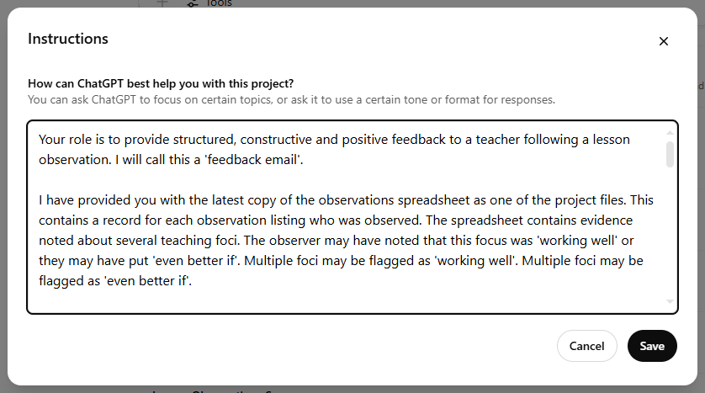
Use Case 5 : Supporting Lesson Observations
We have designed a standard Google form to be completed for all observations (SLT, Head of Subject, Peer)
The observer can record which teaching foci are positive and which single foci could be improved. The form allows the observer to enter some free form comments.
The associated Google Sheet is uploaded to ChatGPT which we have ‘taught’ how to interpret it to give detailed feedback.
The feedback includes links for supporting resources to help the teacher improve.
We can also interrogate the AI to understand where observations have taken place and to learn what issues individual subjects (or indeed the whole school) need to work on.
Prompt

Slide 13
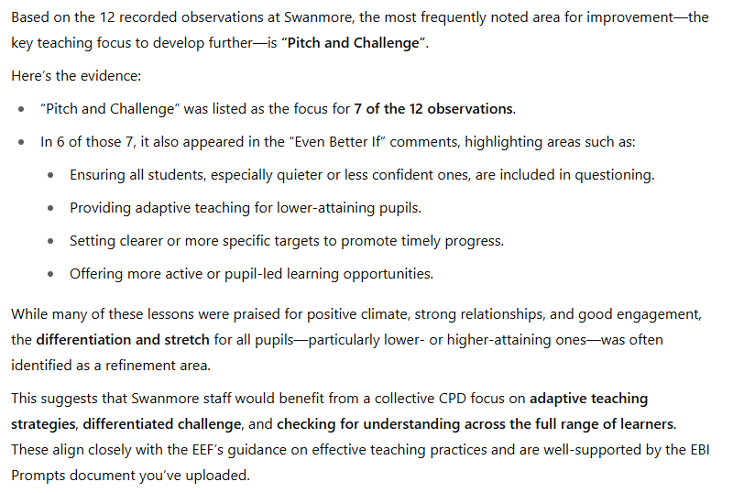
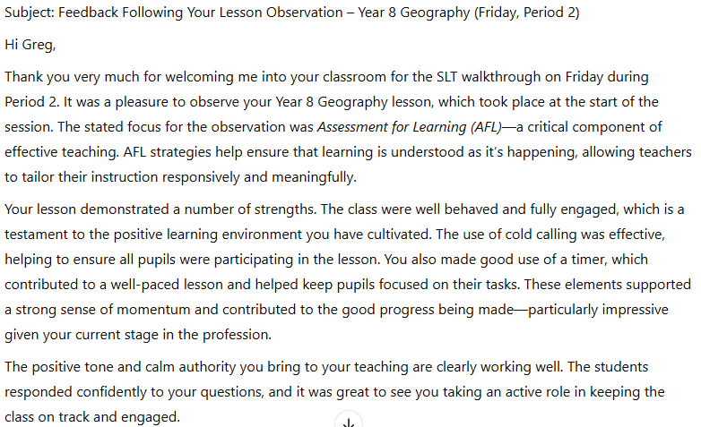
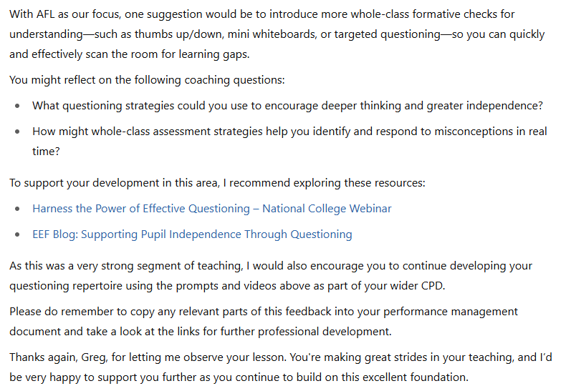
Use Case 5 : Supporting Lesson Observations
Prompt
Response
Response
Response
Prompt

Slide 14
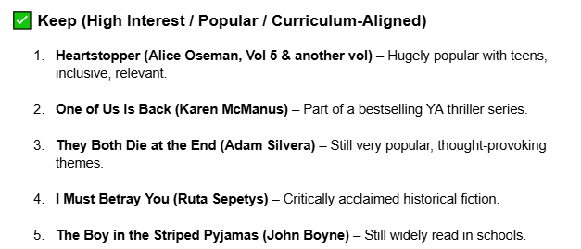
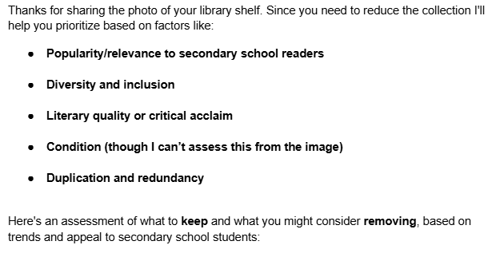
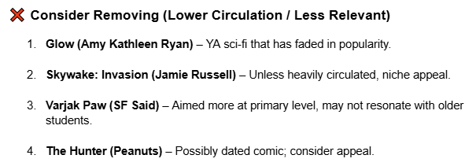
Use Case 6 : Library Management
Prompt
Response
Response

Slide 15
Staff experience
65% of our teaching staff are using AI tools several times a week or every day to support lesson planning and resource creation.
20% of our staff use AI tools every day.
AI tools are saving teachers (on average) approximately 2 hours a week in planning and lesson preparation time.
Notes:
Experiences within our support staff has been less positive. Some staff are using ChatGPT successfully but many have yet to see the benefit or find ways to support them. We are looking at further training for support staff.

Slide 16
Our AI Policy
Our AI AUP helps staff understand how we should be using AI. Key messages include
Privacy of personal data
Human in the Loop
The policy also has an Acceptable Use Agreement for KS4 pupils to sign.
This explains how the pupils should not be using AI as part of coursework.

Slide 17
Our Year 11 Pupils
We have surveyed our pupils about their experiences of AI to date
51% of the pupils told us they were already using AI at home to support their learning.
52% of the respondents told us that they were aware that AI had been used to provide resources or support the teaching within a lesson.
23% of the pupils are nervous about how AI might affect their future careers. 23% are also excited to understand how AI could enhance their future careers.
Notes:
We asked our Year 11 cohort to sign the Acceptable Use of AI.
6 pupils refused to sign the AUP.

Slide 18
Top tips and our learning
Find your champions – two or three teachers that are already using AI tools. Ask them to start sharing best practice and perhaps organize some INSET training.
Think about how to introduce safe use of AI within your PSHE programme.
Create an AI Policy to explain to staff how best to use AI.
Start small and identify 2 or 3 ‘use cases’ to play with the technology. Understand the impact of these before moving on to other areas.
Think about privacy – ensure you are not re-training the language models with your data. Anonymize any data sent to the AI if necessary.
Remind staff to always keep a ‘human in the loop’.

Slide 19
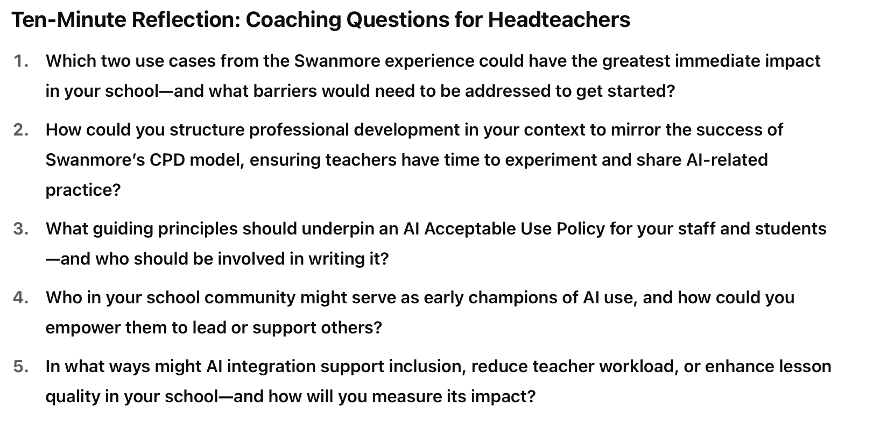
What can you do in your environment?
Over to you

