Slide 1
Using Regulation support plans to improve inclusive teaching

Slide 2
Behaviours that challenge shows that a student needs support in order to regulate something. This could be their primary need, emotions, sensory needs or executive functioning skills. This has led us to creating Regulation Support Plans alongside PPPs to help staff support pupils.
ANY student who is showing signs of having difficulties in regulating can have a Regulation Support Plan - not just those with an EHCP.

Slide 3
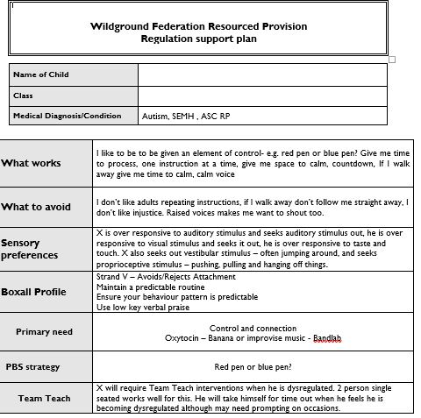

Slide 4
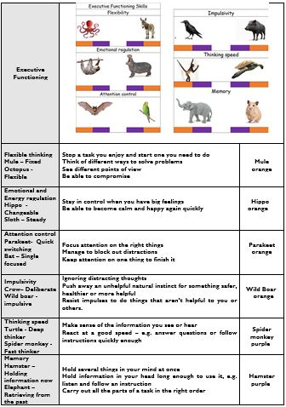

Slide 5
Using the Boxall Profile
The Boxall profile is a tool to assesses the social and emotional development of pupils aged 4-18.
The profile is split into 2 sections.

Slide 6
Section 1 Developmental strands covers organisation of experience and internalisation of controls. The scores in green indicate the average scores of a competently functioning child.
Section 2 Diagnostic profile covers self-limiting features undeveloped behaviour and unsupported development. The scores in green indicate the range of average scores of a competently functioning child.
Beyond the Boxall will help with setting targets and how to adapt and scaffold for the child. These are replicated in the SEMH section of our PPPs.

Slide 17
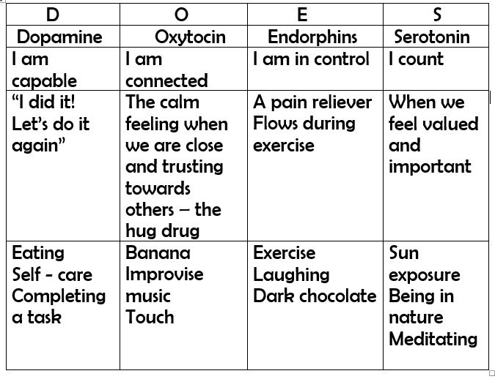

Slide 24
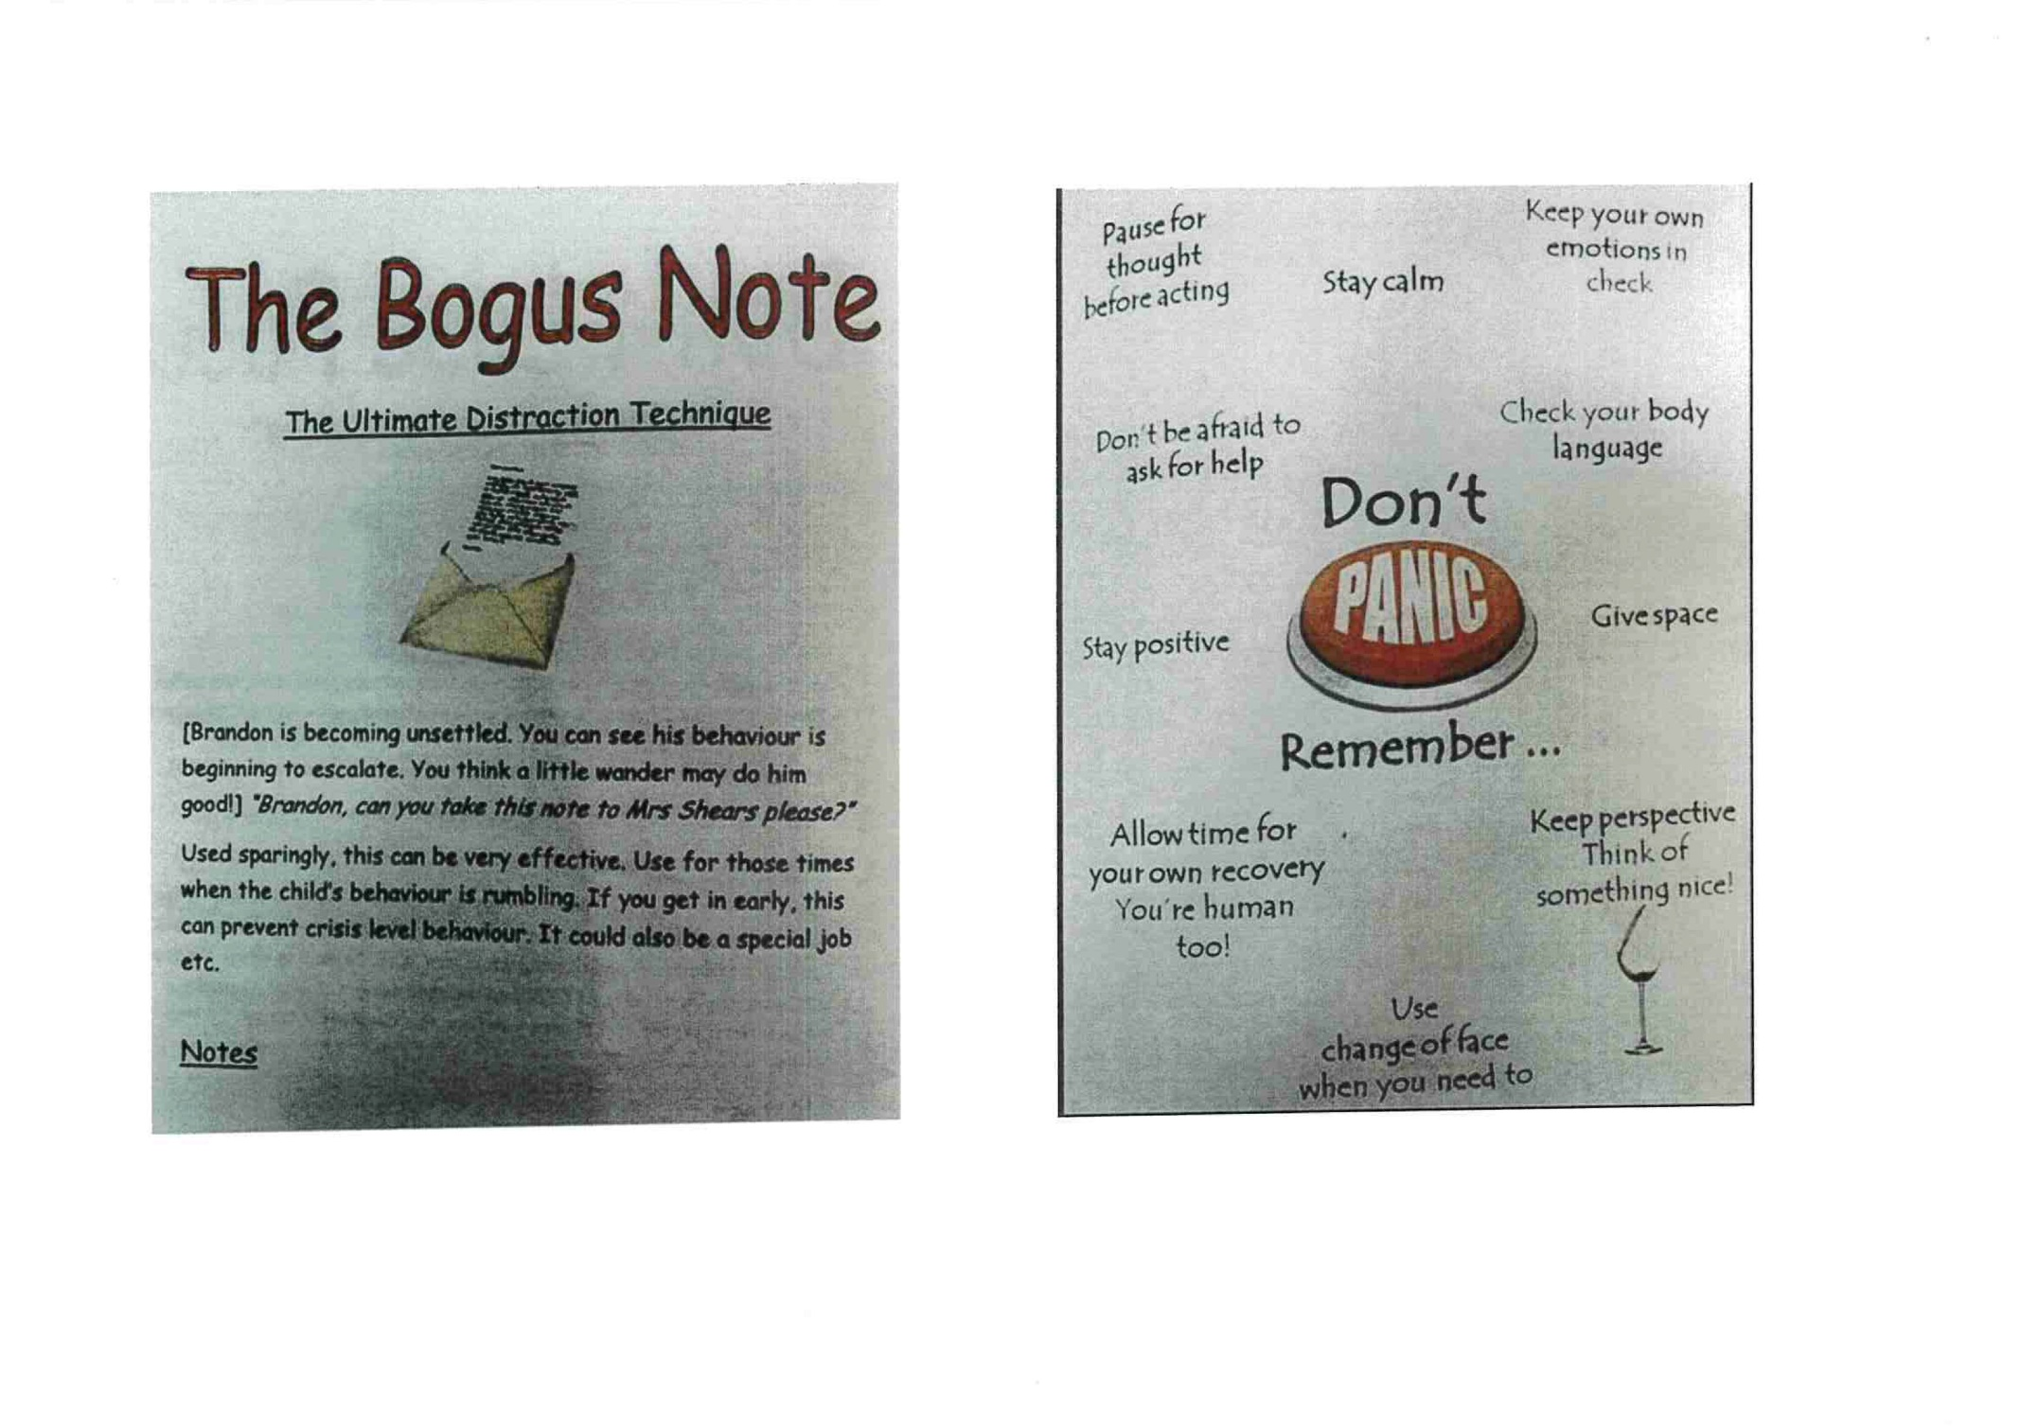

Slide 25
EXECUTIVE FUNCTIONING SKILLS
Barkley defines executive functioning as a self directed action intended to change subsequent behaviour… to achieve a more positive consequence.
Wildground believe these are developed in the same way as Vygotsky’s speech to thought; out loud, to themselves, private thought.
The development of executive functioning skills enable us to do what we think.

Slide 26
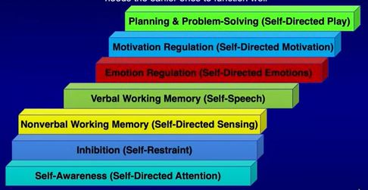

Slide 27
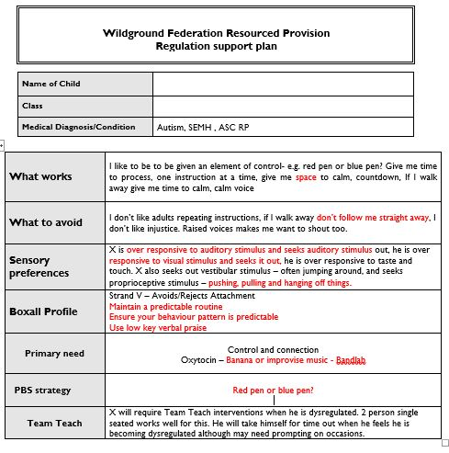

Slide 28
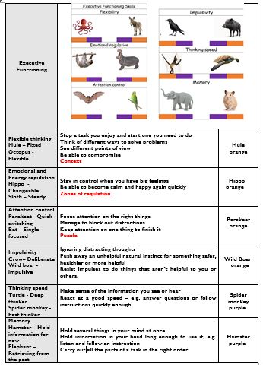

Slide 29
These strategies have been developed to suit our school from the works of:
Russell Barkley
Majorie Boxall
Lev Vygotsky
Primary Behaviour Service
Hampshire County Council
Kit Messenger
Leah Kuypers
Dr Dan Hughes
Lindsey Biel and Nancy Peske

