Slide 1
Good afternoon & welcome Secondary Curriculum Leadership Conference
& Best Practice Event

Slide 2
Schedule:
1:00pm | Introducing the Hampshire curriculum model
1:20pm: Keynote 1 | Helping children with SEND to become resilient and independent learners Testbourne Community School
2:10pm: Breakout sessions | Addressing the impact of lost learning through the curriculum – The Burgate School Quality assurance of the curriculum - Amery Hill School The teaching and learning project - Bishop Challoner School
2:50pm | Refreshments
3:00pm: Keynote 2 | No silver bullets Amery Hill School
4:00pm | Conference close
Notes:
Next slide is breakouts

Slide 3
Housekeeping
Notes:
Fire – tennis courts
Toilets – staff ones and accessible ones
Breakout rooms - all on the first floor
Conference finishes at 4pm
SLIDES - These slides are available on the Leadership Moodle

Slide 4
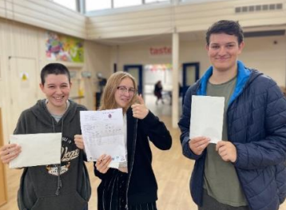
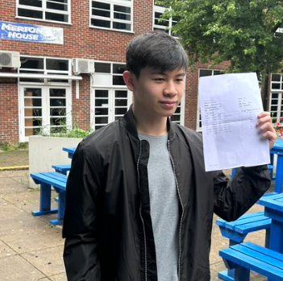
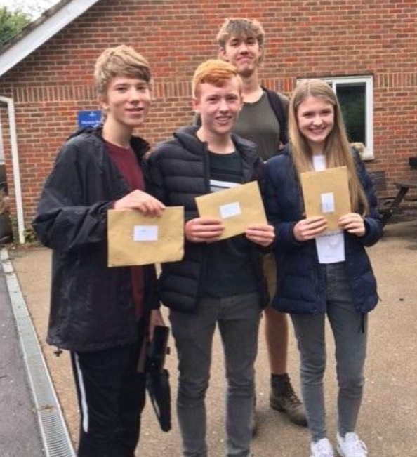
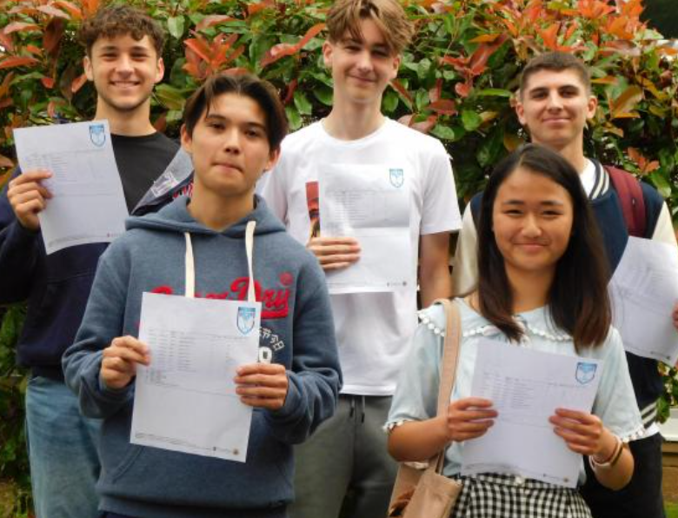
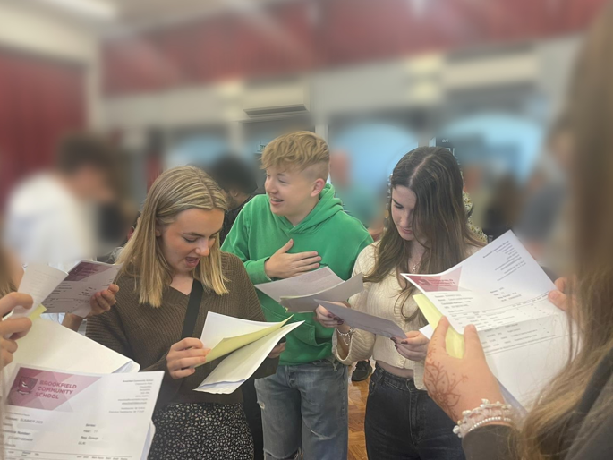
Notes:
Reflect and celebrate success of Hampshire students – individual stories and triumphs as students move to post-16 and post-18 education, work and experiences

Slide 5
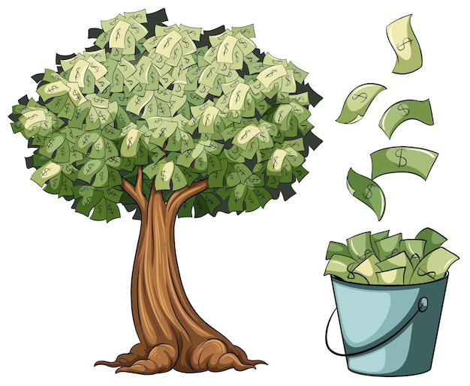
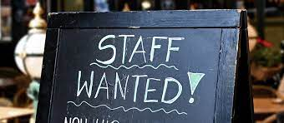
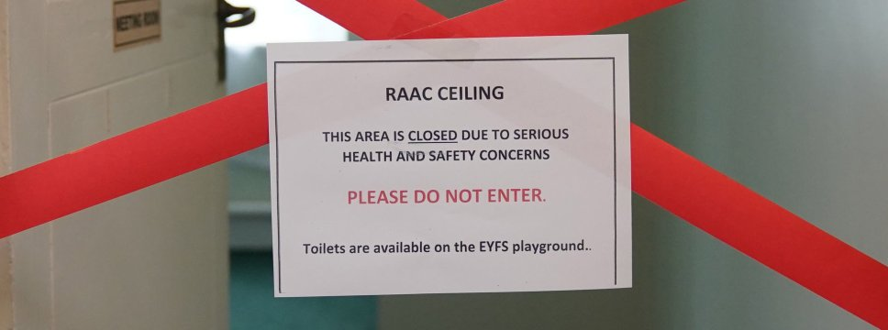
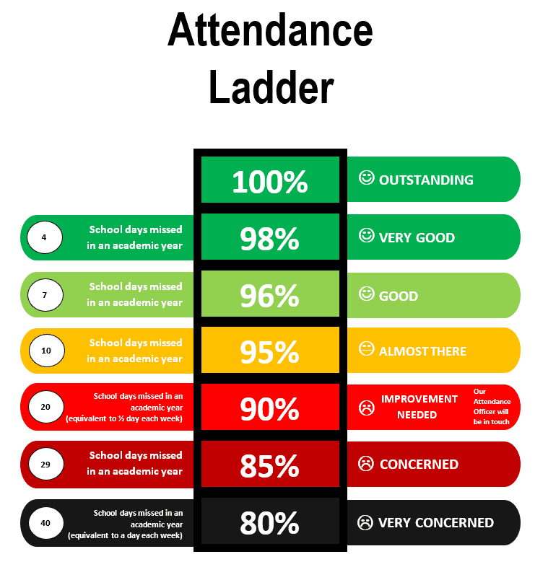
Notes:
Thank you – for all you do in a variety of challenging and relentless circumstances to support our students

Slide 6
Hampshire Aspiration A8 50
Collaboration
Listening & responding to common needs e.g KS3 assessment or the SENK research projects
Bespoke support
Networking – subjects, TED, attendance
Notes:
Tania

Slide 7
‘Every teacher, regardless of their role needs to be invested in conversations and thinking about the curriculum’
Emma Turner 2022

Slide 8
Discussion points:
What language is used in your school to talk about the curriculum?
To what extent is there a shared understanding of this language?

Slide 9
The Hampshire Curriculum
Layer five
Achievement: attainment and progress
Standards- nationally defined
Layer four
The learning environment
Timetable
Blocking and interleaving
Personalisation
of learning to reflect
additional needs
Learning in action – the experience of learning
Layer three
Consideration of Year 7-
induction planning
Balance of learning and practice
Curriculum map for learning stages and
subjects
Thematic links and cross curricular
planning
Schemata
Design of the planned curriculum
Impact Implementation Intent
Layer two
Pedagogy
Cognition and learning
Epistemology
The knowledge base of ‘subjects’ - how knowledge is acquired and the developmental order of acquisition
The relationships of subjects- their organisation
Concrete and abstract
Clarity about skills and knowledge
Development of a school- based narrative to shape and improve teaching and learning
Clarity of subject and overarching pedagogy
Understanding of metacognition
Retrieval and recall
Maturation and cognitive needs
Layer one
Key drivers
School’s health- Ofsted outcome
Socio-economic profile
Performance data in the context of expectations
Prior attainment
Experience of pupils- cultural profile
Pupil mobility
Context
Core beliefs
Values of the school
community
Aims
Hampshire aims linked to the school’s overarching vision
Support for British values
Notes:
This is the level of thinking we do when working with schools and considering the curriculum.
Good leaders will make this workable for a school so that whilst all of these levels of thinking may be in place, we make that manageable for teachers

Slide 10
Unpicking Layers 3&4

Slide 11
Layer 3
How clear are the links of curriculum mapping and associated schemes to the understood context, and clarity about all aspects of learning?
How well understood is this by all leaders?
Is the learning construct the same for all year groups, pupil groups, developmental groups?
How are new students supported in their introduction to new subject areas?
Notes:
Where achievement is not strong as desired the school should review the curriculum (Layer 3) that is planned, make adjustments and review the learning experience (Layer 4).

Slide 12
Layer 4
What is the rationale behind the curriculum organisation and its timetabling- balance of time, placement of units and themes, and subject proximity?
How does the learning environment support the school’s stated vision, expectations and the curriculum?
Is the learning experience equally effective for all groups of pupils?

Slide 13
Schedule:
1:00pm | Introducing the Hampshire curriculum model
1:20pm: Keynote 1 | Helping children with SEND to become resilient and independent learners Testbourne Community School
2:10pm: Breakout sessions | Addressing the impact of lost learning through the curriculum – The Burgate School Quality assurance of the curriculum - Amery Hill School The teaching and learning project - Bishop Challoner School
2:50pm | Refreshments
3:00pm: Keynote 2 | No silver bullets Amery Hill School
4:00pm | Conference close
Notes:
Next slide is breakouts

Slide 14
Helping children with SEND to become resilient and independent learners
Jon Beck and Gerry Gray
A whole school improvement journey
Notes:
Jon

Slide 15
Who are we and why are we here?
Jon Beck - HT
Gerry Gray - SENDCo

Slide 16
The challenges
Inadequate funding
Inadequate special provision
Inadequate resourcing
Inadequate access to expertise
Rapidly increasing numbers of children with EHCPs
Increasing complexity of need
Increasingly unreasonable and demanding parents
Schools and LA are all wrestling with these challenges.

Slide 17
Developing a vision (despite the challenges)
Simple vision:
SEND children are successful in school and become resilient and independent learners so that their life chances are enhanced.

Slide 18
Assess, Plan, Do, Review The beginning
Lacking inclusivity – e.g., location of SEND team.
Not focused on learning
Too focused on “hugs, cups of tea and biscuits” pastoral support
Too little accountability for teaching staff and Teaching Assistants
Lack of leadership
Poor organisation and record keeping
Numerous complaints
Staff access to information was convoluted.

Slide 19
Assess, Plan, Do, Review The beginning
Limited access to strategies and support
Limited understanding of the main conditions
Lack of connect between behavioural, pastoral and SEND needs
Lack of co-operation between SEND staff and Pastoral staff
Ineffective support given in the form of “Velcro Veras”
Teaching staff believing SEND was someone else’s job
Poor communication with parents
Poor attention to statutory process

Slide 20
Assess, Plan, Do, Review The beginning
CPD and training did not have focus on SEND
Training on T and L missed the “Golden Thread” opportunity
Expertise missing in key areas
Silo mentality of learning support staff

Slide 21
Assess, Plan, Do, Review The detailed vision and plan
Shaped by personal experience
Supporting not pandering
Avoiding secondary gain
Teaching and learning focus
Inclusivity
High academic expectations (no limitations on options etc)
No missing learning for other interventions
No “Velcro Vera” dependencies
Overt linking of pastoral and SEND

Slide 22
Assess, Plan, Do, Review The detailed vision and plan
Reasonable adjustments must be reasonable!
No excuses for poor behaviour (sometimes reasons)
High caliber learning support staff
High caliber SENDCo
Succession planning
Dialogue with experts and research
High quality communication and customer service
Children achieving poorly and coping poorly
Parents are clear about how and why we do things from the outset
Teaching staff to understand behaviour is communication

Slide 23
Assess, Plan, Do, Review The detailed vision and plan
Professional challenge and dialogue
Seek feedback and act upon it

Slide 24
Assess, Plan, Do, Review Getting stuff done - research
Visits to Court Moor and others to look at models
Discussions with Sarah Kiel, HIAS and booking of visits
Reading including EEF, Chartered College, Hampshire’s SEN document – SEN Support Toolkit: Strategic Knowledge Base (hants.gov.uk)
Analysis of feedback from parents
Observations of students and TAs
Talking to the pastoral team and teachers about their struggles with children

Slide 25
Assess, Plan, Do, Review Getting stuff done - realisations
TA professional expectations
TA professional autonomy
Recruitment of suitably skilled SENDCo impossible
Internal SENDCo would be needed
Quality Assistant SENDCo would be needed
Better accommodation needed
The organisation and communication of information did not work
Better training needed

Slide 26
Assess, Plan, Do, Review Getting stuff done – Learning coaches
Rebranded TAs to Grade C, Learning Coaches with professional expectations
Virtual Tutor Group
Autonomous in delivering support as needed
Responsible for two or three EHCPs each
Responsible for profiles for children
Largely self-directed
Developed and promoted where showing promise (e.g. ELSAs at Grade D)
Embracing turnover to get quality staff
Ensuring invites to INSET day

Slide 27
Assess, Plan, Do, Review Getting stuff done – Learning coaches
Advantages for recruitment and retention
Acceptance of transience – e.g. those interested in teaching as a career
Spent time finding the right seat on the bus for some
High caliber over-qualified team
Dedicated and highly professional
Highly skilled with particular specialisms
Training with ASENDCo to give whole school understanding
Better understanding of whole school principles and operations

Slide 28
Assess, Plan, Do, Review Getting stuff done – SENDCo
Appointed lead teacher to train but did not work out
2 internal staff completed the training but did not wish to be SENDCo long term (provided capacity)
Appointed AHT T and L as SENDCo and redistributed other responsibilities

Slide 29
Assess, Plan, Do, Review Getting stuff done – SENDCo AHT
Teaching and learning focused
Rapid change, rapid improvements
Senior leader weight
Ensuring that SLT and Middle Leaders also focused on SEND
Decision-making powers

Slide 30
Assess, Plan, Do, Review Getting stuff done – Accommodations
Moved to main building
Created new larger space and ASENDCo/SENDCo office
Decorated and furnished

Slide 31
Assess, Plan, Do, Review Getting stuff done – Accommodations
Brighter more welcoming workspace for all
More versatility
More inclusivity
More usability

Slide 32
Assess, Plan, Do, Review Getting stuff done – Information
Created a One-Note Profile for each child that was shared with all staff
Evolved to a SharePoint folder linked to Linked Documents in SIMS
Revised record keeping systems, set up APDR calendar and EHCP review calendar
Created guides for parents and invited parents into school individually and en masse.
Focused on philosophy, rationale and communication of strategy

Slide 33
Assess, Plan, Do, Review Getting stuff done – Information
Staff feedback – OneNote not working for them
Change to SharePoint
Lots of information sharing with parents meant more confidence and fewer complaints
Proactive use of our information
Easy to access advice and guidance
Better engagement of staff and parents

Slide 34
Assess, Plan, Do, Review Getting stuff done – CPD
Case Conferences
SEND children presenting to staff
Strategies training
Specific training on ASC, ADHD etc
Guest speakers
Pragmatism
Drip feed of messages
Training and development of learning coaches
SEND Golden Thread in all CPD and discussion

Slide 35
Assess, Plan, Do, Review Getting stuff done – CPD
Requests for specific training now coming
Open dialogue of challenge between LCs and Teachers
Better understanding of needs
More understanding that adjustments to curriculum or pedagogy don’t have to be onerous or complicated
More empathy
More confidence

Slide 36
What do children say about their provision?
“The best thing about TCS is the teachers are really caring. If you are sad, they ask you what’s wrong and they really notice you.”
Reading intervention and reading with a teacher has helped me improve. I really enjoy reading club.
I really enjoy reading and have help with writing and reading and sometimes I have a scribe and the teacher helps me and will read the text aloud.
I have a laptop all day making it easier than normal writing. Teachers check in lessons what is on my screen.
I get lots of tutoring. Tuesday and Wednesday is reading, and it is building up my confidence to read aloud as I could not do it in September.
I have ELSA and really enjoy it.

Slide 37
What do children say about their provision?
My English teacher helps me get ideas down like bullet pointing first and giving me extra time for planning.
I get PowerPoint slides in advance which helps and teachers are proactive in asking if I need help.
My tutor emails me the spellings each week so I can practice before tests.
My exit card allows me to go to the up or stand outside. I have a TA who helps me refocus and get back to some work as I find it hard to sit and concentrate. A teacher helps motivate me and my lesson resilience tally helps.
My teachers chunk information down so I can understand it better.
I record my writing by dictating.
Teachers know me, read my profile and know my needs.

Slide 38
What does it all look like in action?
The learning Hub
The personnel in the Hub and beyond
The learning coach model
The CPD
The classroom
The support when it goes wrong
The expectations
The importance of the SEND agenda
More proactive and positive parent comments

Slide 39
Other things we’ve learnt along the way
Don’t be too accommodating – e.g. coloured paper, exam access arrangements
Make parents work for some adjustments to filter out those that are not genuine requests
Communication is vital – think customer service (parents, children and teaching staff are customers).
Work on relationships with the SEND case workers (we have a 30 min fortnightly check-in with ours)
Honesty and transparency with parents – what’s possible, what’s not.
Put the child first – not always aligned with parents’ wishes.

Slide 40
Next steps
Further student input to staff training
Increasing informal opportunities for parental engagement – e.g. SENDCo presence at all parents’ evenings.
Streamlining the EHCP Annual Review process so workload is distributed (See Greendale School)
Giving SEND students more ownership of their plans and documents.

Slide 41
Questions, visits etc
j.beck@testbourne.school
g.gray@testbourne.school

Slide 42
Reflection on Jekyll and Hyde the novel as a whole
Put these chapters in order:
The Last Night
Dr Jekyll was Quite at Ease
Search for Mr Hyde
Incident of the Letter
Henry Jekyll's Full Statement of the Case
Dr Lanyon's Narrative
Story of the Door
The Carew Murder Case
Remarkable Incident of Dr Lanyon
Incident at the Window

Slide 43
No Silver Bullets
Investigating self-efficacy and self-regulation in our schools

Slide 44
Intent
Consider the educational zeitgeist - how it does not aid self-efficacy
Reaffirm definitions and create shared language
Principles and practice
Forum: principles
Effective practices to promote high self-efficacy

Slide 45
Caveat
I’m going to divide the room
Empirical evidence and action research – I am not an academic
Facilitator NPQLT – dipping into lots of different classrooms

Slide 46
Zeitgeist 1 – Corporate Identity
School is increasingly influenced by business principles as schools become more corporate.
Every lesson must have…
Classroom environment has a similarity of preparation, expectation and outcome… teachers’ self- efficacy is marginalized.
The result of desperation in response to teacher shortages?
Security or boredom: education for what type of life?

Slide 47
Zeitgeist 2 – Retrieval Practice
Ebbinghaus’s Forgetting Curve.
Misinterpretation of Ebbinghaus: Not completed in a classroom; the artefacts to remember were sequences of syllables deliberately chosen for their lack of connection and linguistic association, read in monotone to a metronome: the principle of forgetting is sound but what is being forgotten has no relevance in our classrooms.
Retrieval practice for its own sake adds to cognitive load.
Retrieval practice linked with connections to current learning / metacognition is powerful.

Slide 48
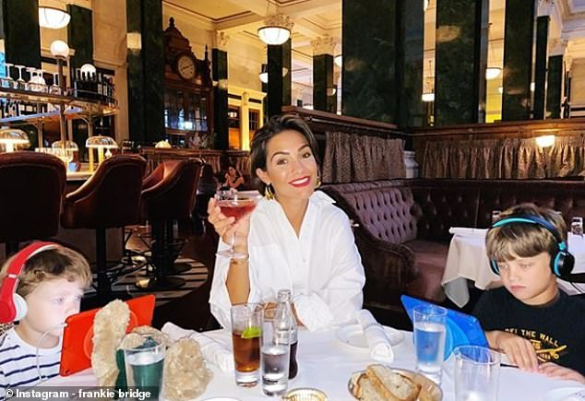
Zeitgeist 3 - Edufun
Learning is hard. Are we over-compensating?
Behaviour isn’t a good. Are we over-compensating?
Scenario: 6 quizzes in 6 different lessons throughout the day. 1 student wins each time, probably the same student. The rest have had an entire day reaffirming that they are a loser. . . Especially the student who comes last, chances are they come last every time.
Do students remember the knowledge / learning or do they remember the quiz?
Are we teachers or are we Justin?

Slide 49
Zeitgeist 4 - Results
Who owns the results?
Who cares the most?
Education for life?

Slide 50
Zeitgeist 5 - Desperation
We do not have enough teachers. Adverts are not responded to. Schools are being ransomed by teaching agencies.
Post –Covid recovery: We didn’t realise how much we were the finger in the dam.
Snake-oil sellers: the expensive quick-fix failures.

Slide 51
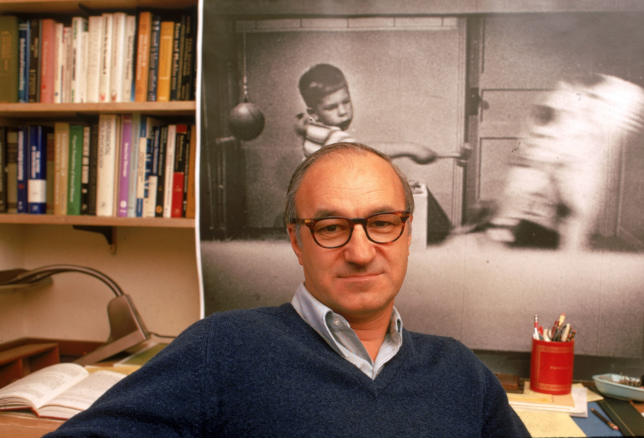
Definitions
Bandura, A. (1977) Toward a unifying theory of behavioural change.

Slide 52
Definition – Self-efficacy
Self–efficacy: originally proposed by psychologist Albert Bandura; in school it focuses on a student recognising that by following certain learned behaviours and schema, a person can face specific challenges competently.
Difficulties and blocks become issues to be mastered rather than a threat.
Students become more self-reliant in the face of these specific challenges as they have developed to confidence to self-solve rather than wait for rescue.

Slide 53
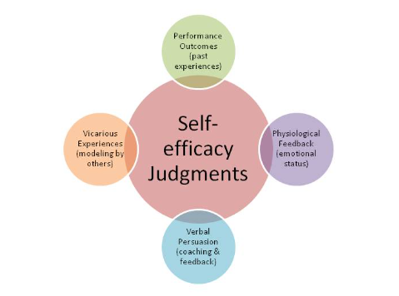
4 Aspects to good self-efficacy:
Performance Outcomes: Your past experiences
Physiological Feedback: Your emotional status
Verbal Persuasion: Coaching and feedback
Vicarious Experience: Demonstrating how to…

Slide 54
Definition – Self-regulation
Self-regulation: originally proposed by Albert Bandura - a graduated approach to the idea of self- directed learning.
It doesn’t allow for the autonomy of choice of WHAT is learned – these parametres are still set by the teacher or the exam boards. The self-regulation focuses on: monitoring, finding and utilising of resources; using a schema to progress to goals; the ownership of the metacognitive processes designed to help improve results.

Slide 55
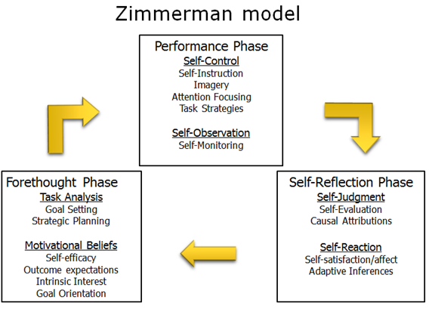
The major self-regulative mechanism operates through 3 principal subfunctions:
Self-monitoring of one's behaviour, its determinants, and its effects.
Judgment of one's behaviour in relation to personal standards and environmental circumstances.
Affective self-reaction.
Self-regulation: 3 processes / phases
Zimmerman, B. J. (2000). Attaining self-regulation: A social cognitive perspective. In M. Boekaerts, P. R., Pintrich, & M. Zeidner (Eds.), Handbook of self-regulation (pp. 13-39). San Diego, CA: Academic Press.

Slide 56
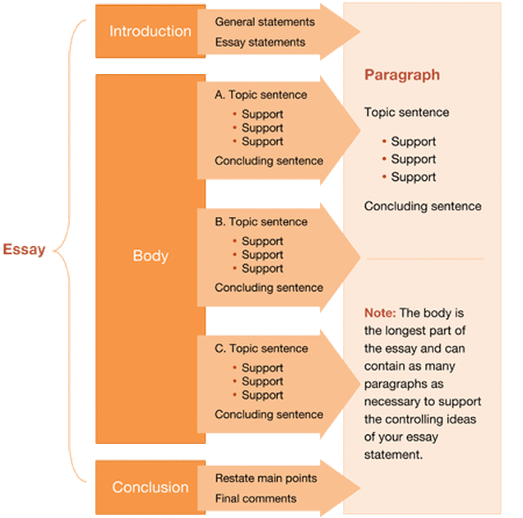
Definition - Schema
A schema (pl: schemata or schemas) describes a pattern of thought or behaviour that organises categories of information and the relationships among them. It is a mental structure / model.
In schools, we help our students create concrete models to document / deal with conceptual / abstract knowledge. It is a thought process made concrete.
The most powerful schemata are those which the students create or adapt for themselves.

Slide 57
Schemata help simplify the world / immediate environment.
Schemata also impact how quickly people think and learn.
Schemata can also change how we interpret incoming information, we can put it into context and then make meaning
Schemata can also be remarkably difficult to change.

Slide 58
Pit Stop
Consideration of what doesn’t help.
Focus on what does help students develop high self efficacy.
Let’s start with first principles

Slide 59
Shared Principles not Shared Practice
Knowledge: Secure subject knowledge. Secure pedagogy. Creation of schema for teaching and for learning. | Emotionally safe classrooms: A place where students are supported to try. Effective scaffolds. A culture of high expectations, trust and self-efficacy.
Optimising learning time: Positive climate and minimises disruption. Tackles education’s long Covid: gaps in knowledge and skills, and redresses the balance between teaching and LEARNING. | Activating learning through hard thinking: Pillars: structure, explanation, questioning and assessment, interaction, embedding knowledge and skills. Activate learning through the creation of schema, self-regulation, metacognition.

Slide 60
Example: English lesson
Principle: secure subject knowledge
Lesson 1 of Macbeth revision, retrieving information and knowledge taught 7 months ago.
English Classroom 1: Students recall the plot of Macbeth by each student representing a key moment of the play and forming a line in the correct order of action. Socially constructing to make meaning.
English Classroom 2: Students recall the plot of Macbeth by rearranging the plotline into the most to the least important scenes and justifying their choice. Refining and ordering to make meaning.

Slide 61
Forum
Knowledge | Accelerating Learning
Duty of Care | Education for life

Slide 62
Forum

Slide 63
Further thinking
Compliance vs Ownership?
Task, Performance, Learning?
Moving students from novice to mastery – how do you do that?
How do you measure your impact / efficacy? ( See Jon Eacott’s Break-out seminar on the Quality of Education Reviews )
Have you forgotten KS3?

Slide 64
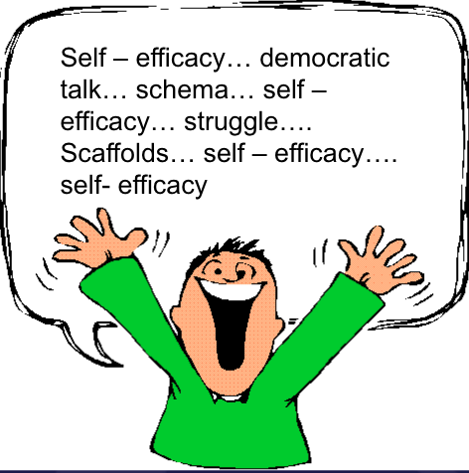
Productive Strategies / Schemata
Vertical Slice for implementation ( Rethinking Education podcast - Dr James Mannion )
Creating ripples and allies – you won’t be able to do this by yourself, you’ll sound like a lunatic!
Student Voice.
Differentiation and disappearing scaffolds.
Refreshing it constantly – realise it is never finished.
Make use of cognitive science: dual coding, interleaving, spaced learning, retrieval practice, modelling, question strands, mix it up, keep it fresh

Slide 65
Retrieve for purpose.
Coach not critic - getting the students to exercise self-talk that is encouraging and supportive rather than negative and defeatist.
Mine self-belief: catch the student doing something well, publicly praise, get them to see where they are efficacious.
Use and talk about SCHEMA. Make this part of your school shared language. Get the students to realise when they are subjected to it and how THEY can adapt and create.
Move from “today’s learning objective is…” to a student creating their own goal within that objective. For some, it will be to get through the lesson – they will – they’ve hit their goal! Develop.

Slide 66
Yeah… but…
I don’t have any teachers in …How can I possible achieve this.
Challenging
You have subject leaders – trust them to lead. Even if they decide to go “corporate” THEY have made that decision. You have given them to chance to engage self-efficacy for their departments. They now have the agency of choice… the ripples will spread.

Slide 67
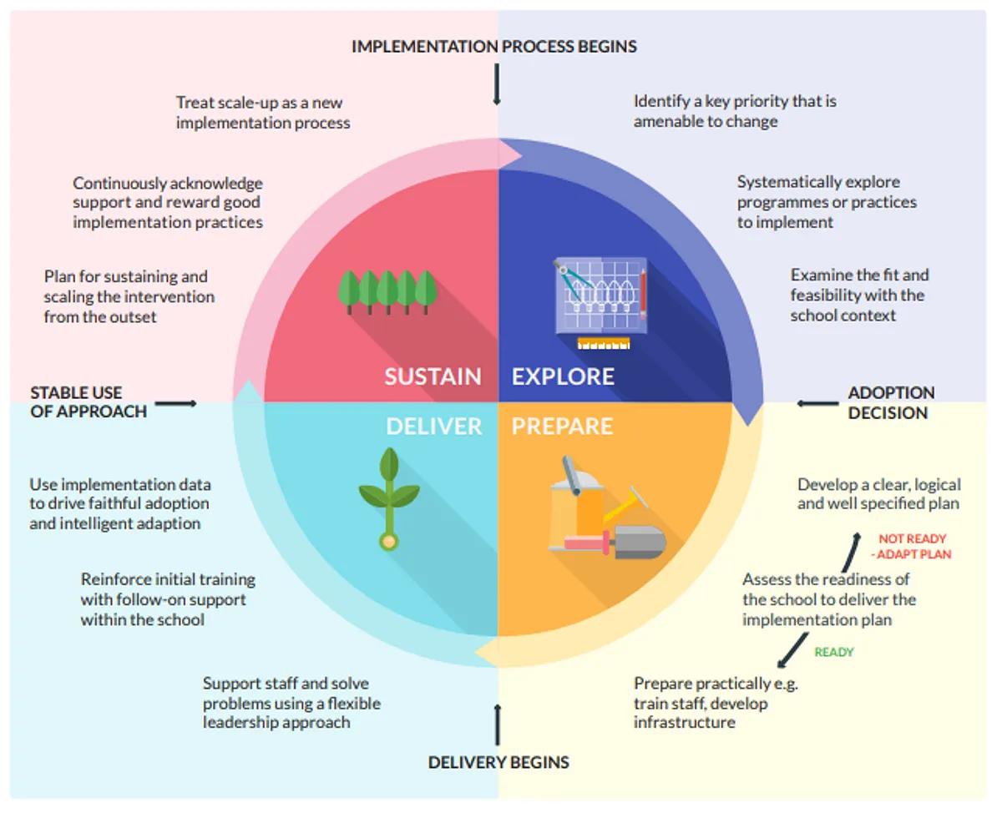
Final thoughts
Source EEF
Time to implement. This is not an overnight fix.
No goody bag or free pens.
A divided room.
Time to think and then stratagise and then lead.

Slide 68
Extra Material - Not for Conference but for Moodle
Cognitive Science techniques done poorly and well
The follow slides reference lessons I ran as a training exercise at Amery Hill.
This ran during February Inset and we debated the lessons and a video of me teaching both lessons ( exerts only ) and students then discussing how they felt they learned in each of these lessons.

Slide 69
A Non-model: How does this lesson prevent self-efficacy, self-regulation and just learning in general?
The following slides are of a lesson about Jekyll and Hyde into which I have inserted Macbeth retrieval practice.
I have made use of cognitive science in my slides. I’ve done this purposefully poorly.
The retrieval elements occur in slides 3 – 8.
As soon as the students filled in the gaps in slide 8, that was the end of the retrieval work on Macbeth and I returned to Jekyll and Hyde.
Slides 9 – 13 also attempt to make use of cognitive science but again these are non-models.

Slide 70
Jekyll and Hyde
Thinking about the whole text

Slide 71
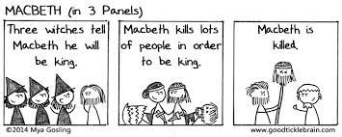
Macbeth fun quiz

Slide 72
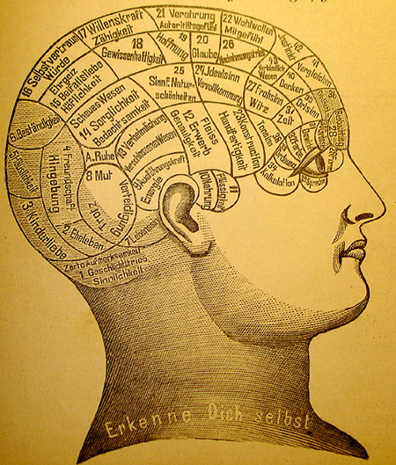
Fun Quiz: Let’s see who gets the most points !
Fill in the missing word:
Full of _______________ is my mind

Slide 73
Who said “Will these hands ne’er be clean?”

Slide 74
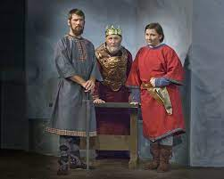
Name one of Duncan’s sons.

Slide 75
How many witches are there?

Slide 76
Macbeth has three titles in this play he is Thane of____________, Thane of __________ and ___________

Slide 77
Reflection on Jekyll and Hyde the novel as a whole
Put these chapters in order:
The Last Night
Dr Jekyll was Quite at Ease
Search for Mr Hyde
Incident of the Letter
Henry Jekyll's Full Statement of the Case
Dr Lanyon's Narrative
Story of the Door
The Carew Murder Case
Remarkable Incident of Dr Lanyon
Incident at the Window

Slide 78
Work in pairs to tell me the most important aspect of three key chapters
Model answer for chapter 1:
The most important part of chapter 1 is that Hyde is introduced and shown to be a violent and unsympathetic. The reader begins by knowing this and recognises that Hyde is violent and unsympathetic.

Slide 79
Feedback to the class – What is the most important aspect of the key chapters
Cold calling:
Polly
Eliot
Maisie HW
Picking these students in this order ensured that the first two students provided good, clear and well developed answers and the final student, who had a much lower PA profile felt dreadful. This student just answer “ I don’t know.” and shut down

Slide 80
List the themes in the novel
A massive prize for the student who does this first

Slide 81
Question and Answer Session: How do these themes develop?
Model: Duality
Chp 9 The truth is revealed and Jekyll is revealed to have been Hyde – the Horror of this discovery would have astounded the reader and caused huge tension.
Chp 10 the dual life of Jekyll is explained and the reader makes links. However the rather melodramatic and self- pitying tone rather vexes the reader and the tension drops and we head towards resolution
Chp 7 Jekyll is no longer in control of when he becomes Hyde – the dual nature is all in the control of Hyde. Jekyll is doomed
Chp 5 the letter links the handwriting and provides another link between Jekyll and Hyde
Chp 4 Minor character of Hyde’s landlady – having an evil face but excellent manners
Chp 6 Jekyll declares himself to be the chief sinner and chief sufferer – he subtly makes the link that the power is now with Hyde
Chp 1 Subtle introduction of the theme in through the idea of the door
Line of normality in terms of tension
This was a good use of visuals to help students plot tension. It was a
detailed and clear model… However, the students had only mins left
of the lesson to complete a similar graph for the 6 other named themes!

Slide 82
A model of efficacious retrieval: Does this lesson aid memory and the students’ mental models?
This model of retrieval practice would not occur every lesson. It takes too long – this part took 25 mins – at least half the lesson.
I would do something like this once a fortnight at most.
Consider the cognitive science approaches used.
How is challenge utilised and scaffolded to sustain interest ?
Consider how this extended starter uses schema, social construction and metacognition to aid self- efficacy.

Slide 83
Awaking Thinking Pause Jekyll to remember Macbeth

Slide 84
Using AOs to respond
In a moment you are going to see a picture. I want you to use your AO skills to respond.
Yes, I know there isn’t language but treat the picture as language and read the image.
AO1, AO2, AO3 Context, AO4?
AO1 Comprehend the image, work out WHAT it is about.
AO2 What visual techniques and cues has the photographer used to create meaning?
AO3 What cultural connotations might this image have?
AO4 How effective is the image? What is missing that will give us more information / greater insights?

Slide 85
Thinking Schema
Level 1
Level 2
A basic response, providing an answer to WHAT.
Level 3
Developed ideas, thinking about HOW, WHY, WHEN, and INFERENCES and CONNOTATIONS.
DETACHED CRITICAL OVERVIEW – Essential for Grade 9 answers: How effective, could it be better, could there be alternatives?

Slide 87
Level 3
DETACHED CRITICAL OVERVIEW – Essential for Grade 9 answers: How effective, could it be better, could there be alternatives?
I inserted this slide here to challenge the students and activate harder thinking.

Slide 88
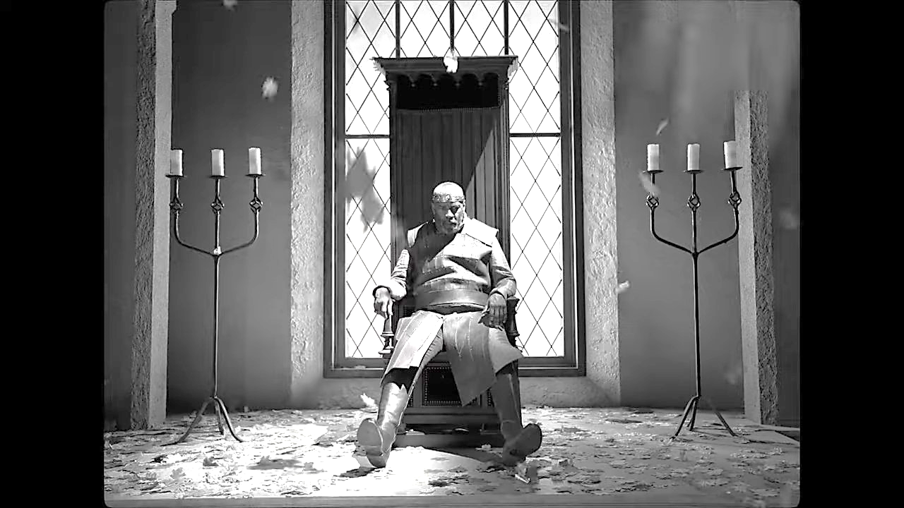

Slide 89
Why is this image better?
Level 1
Level 2
A basic response, providing an answer to WHAT
Level 3
Developed ideas, thinking about HOW, WHY, WHEN, and INFERENCES and CONNOTATIONS
DETACHED CRITICAL OVERVIEW – Essential for Grade 9 answers: How effective, could it be better, could there be alternatives?

Slide 90
Match: image, quotations and tone
O full of scorpions is my mind
 | …Out, out brief candle, Life’s but a walking shadow, a poor player That struts and frets his hour upon the stage And then is heard no more. It is a tale Told by an idiot, fully of sound and fury Signifying nothing
I am in blood Stepp’d in so far that should I wade no more, Returning were as tedious as to go o’er. | Still it cried, “Sleep no more” to all the house; “Glamis hath murdered sleep.” and therefore Cawdor Shall sleep no more: Macbeth shall sleep no more
This was a handout on the desk – proximity to the text and images really aided discussion

Slide 91
Thinking Awoken
On the record card write 3 aspects of his character that you have remembered / recalled from our lesson.
Challenge yourself to good self-regulation and make these beyond level 1 recall. Use your thinking schema to deepen your knowledge.

Slide 92
Key Language – AO2
Contrast
Chiaroscuro – ( the play of black and white )
Melancholy
Stare suggests…
Middle-aged
Troubled / frown suggests…
Moody
Shadows suggest…
Who could this be?
Why might they feel this way?
Key terms just displayed on the board, not announced as the students who needed extra help looked up from their record cards. Those who needed it, naturally looked up and saw the scaffold there.
Notes:
Diff – key language to scaffold thinking

Slide 93
3 Things Recalled About Macbeth
The pictures serve to remind me that Macbeth is…
The four quotations serve to remind me that Macbeth is…
The crucial thing to understand about Macbeth by the end of the play is…

Slide 94
Return and Link to Jekyll and Hyde
In this extended starter we have awoken our thinking about Macbeth.
How can we use this retrieved knowledge to understand a little more about Jekyll?
Hints below if we need them
Tragic Hero?
Hamartia?
Reader sympathy?
Which character is better crafted and why?

Slide 95
References
Self regulation: https://www.frontiersin.org/articles/10.3389/fpsyg.2022.861493/full
https://files.eric.ed.gov/fulltext/ED518491.pdf
https://drive.google.com/drive/folders/1nmfU4RVHrVMfd8j4WWuAWRiM2YWtpp09
Cognitive Science
https://drive.google.com/drive/search?q=schema
https://educationendowmentfoundation.org.uk/support-for-schools/implementation
How to learn? From mistakes (Diana Laufenberg | TEDxMidAtlantic) https://www.ted.com/talks/diana_laufenberg_how_to_learn_from_mistakes?utm_source=tedcomshare&utm_medium=email&utm_campaign=tedspread- How schools can nurture every student's genius (Trish Millines Dziko | TEDxSeattle) https://www.ted.com/talks/trish_millines_dziko_how_schools_can_nurture_every_student_s_genius?utm_source=tedcomshare&utm_medium=email&utm_campaign=tedspread

Slide 96
How to escape education's death valley (Sir Ken Robinson | TED Talks Education) https://www.ted.com/talks/sir_ken_robinson_how_to_escape_education_s_death_valley?utm_source=tedcomshare&utm_medium=email&utm_campaign=tedspread
Accountable Talk
https://drive.google.com/drive/folders/1nmfU4RVHrVMfd8j4WWuAWRiM2YWtpp09
https://drive.google.com/drive/folders/1nmfU4RVHrVMfd8j4WWuAWRiM2YWtpp09
https://drive.google.com/drive/folders/1nmfU4RVHrVMfd8j4WWuAWRiM2YWtpp09
Cognitive Acceleration - The wonderful Leah Crawford
https://docs.google.com/document/d/1jbNFfsMilTyv6HpvZojrk0ZdLP5U13BU/edit
Schema – Alex Quidley
https://www.theconfidentteacher.com/2020/11/academic-vocabulary-and-schema-building/
https://www.educationcorner.com/schema-theory/
https://www.structural-learning.com/post/schema-building

Slide 97
Key Takeaways
Helping children with SEND to become resilient and independent learners
Addressing the impact of lost learning through the curriculum
Quality assurance of the curriculum
The teaching and learning project
No silver bullets
Course: Secondary open resources (hants.gov.uk)
Notes:
We’ve seen and heard inspiring examples of curriculum development across Hampshire schools today
TPS your key takeways

Slide 98
Transforming SEND conference
The conference will be led by Naomi Carter and members of the senior leadership team from Education and Inclusion, and we have secured excellent keynote speakers:
Kit Messenger – Co-founder of Changing Chances CIC and author of ‘Curious not Furious’
Tamzin Hall - Performance and Psychology Coach and Jenny Turner – Author of ‘Relationships – the key to understanding children’s behaviours’.
One free place is being offered to each school, funded through the DfE Delivering Better Value programme.
Wednesday 1 November, Portsmouth Marriott
Wednesday 15 November, Hilton at the Ageas Bowl

Slide 99
SEN Matters

Slide 100
Tackling Educational Disadvantage
Secondary Network – 18th Oct

Slide 101
PAPG & Attendance Webinars
PAPG facilitated by Tania Harding:
Wednesday 8th November 1:30-4:30pm
Wednesday 27th March 2024 1:30-4:30pm
Attendance Webinars facilitated by Beverley Murtagh:
Friday 13th October
1-4pm (Free)

Slide 102
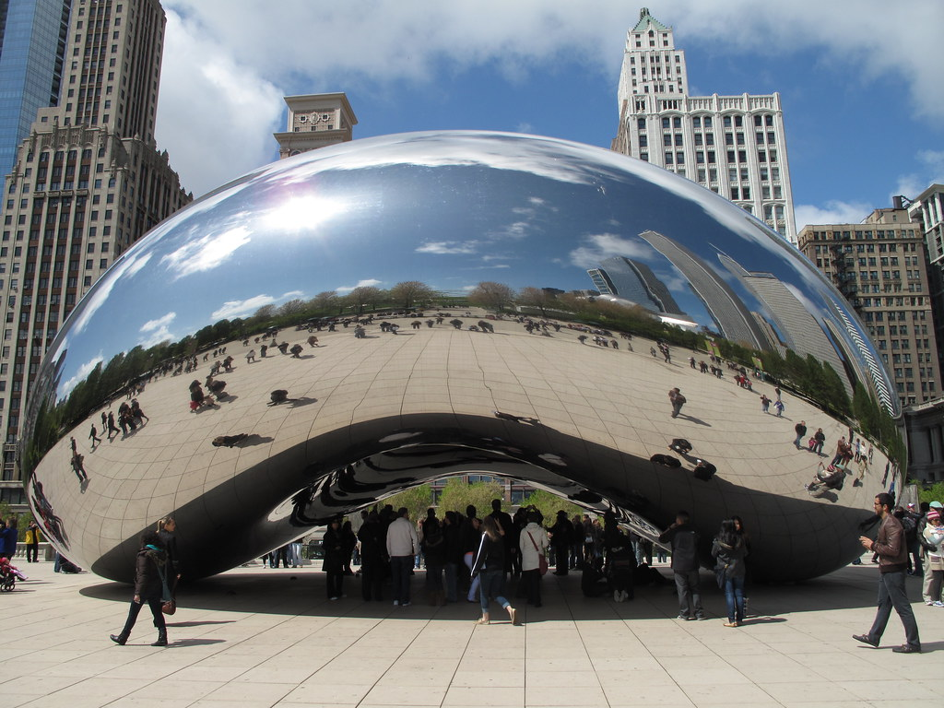
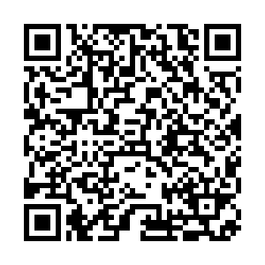
HIAS Curriculum Conference - 9th October 2023 Evaluation (office.com)

