Slide 1
Leesland C of E Federation
SEMH provision How our PALS and SEALS team support dysregulated children
Claire Hope - Executive Headteacher
Ros Wigley - Infant Head of School & SENCo
Becks Livings - Junior Head of School & SENCo
Headteacher@leeslandschools-fed.co.uk
Notes:
Welcome – thanks for choosing to join us this morning.
Going to talk about how our Pastoral & Learning Support works across both our school to support children to be in class and learning as much as possible.
Children as able to access this provision as and when they need it, as well as having planned sessions for interventions within the provision.
We are fortunate enough to have a room for each of these provisions, but the intervention is about the staffing and the training, not about the rooms.

Slide 2
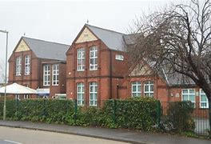
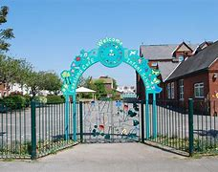
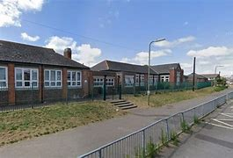
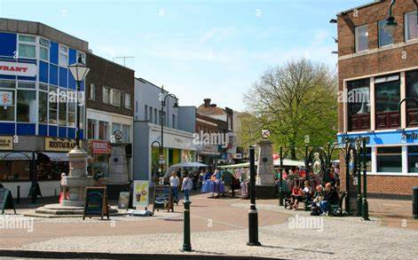
Our context:
Gosport
3FE reducing to 2FE
Infant and Junior Schools - next door
Church of England (voluntary controlled)
 | LIS | LJS
SEND | 32% | 34%
Pupil premium | 30% | 44%
FSM | 28% | 40%
White British | 78% | 88%
EAL | 5% | 7%
Attendance | 94% | 93%
Persistent Absence | 25% | 20%
Notes:
We are in the town area of Gosport - area of relative deprivation, but it is a mixed catchment: poor quality housing for some, and high risk of no-fault evictions currently; substance misuse and mental health concerns for a high proportion of parents and carers; relatively high levels of domestic abuse; many families have multiple generations coming through our school.
Our schools are currently reducing PAN from 3 form entry to 2 form entry - low pupils numbers across Gosport and no very little new housing being built.
Not a very multicultural area, although this is increasing.
Persistent and severe absence is a real concern for a core group of families - mainly those identified as disadvantages, and a high cross over between disadvantage and SEN.
Very loyal community – families will usually engage with us, even when they are angry about something! We pride ourselves on being available for all families and getting back to them for honest conversations as soon as possible – we try not to make them wait for an appointment if we can.
Having Heads of School in each school, who are also SENCos, helps this communication and families feeling they are being listened to and involved.

Slide 3
Why we went with this model
CPOMS and ABCC analysis
Staff feedback
Behaviour policy
Notes:
Revamped behaviour policy about 5 years ago, using the 'Pivotal' model and the book 'When the Adults Change'. This meant getting rid of behaviour charts in classes; developing scripts to use with children; reducing the infamy of poor behaviour; being really firm about 'praise in public, sanction in private'; training staff about being calm, consistent, clear.
We have a small minority of high profile' children who struggle to regulate in school. For many of these, writing is a trigger, as well as when they perceive work to be difficult. Some are not able to accept perceived failure or mistakes. They suffer from catastrophic thinking, and don't have coping mechanisms when things are tricky.
A number of children with poor attendance, or frequently late to school, due to adult mental health, domestic abuse, substance misuse, or chaotic households, struggle to consistently arrive at school ready to learn. This comes through from ABCC and CPOMS tracking.
We worked with staff to listen to what was preventing learning for some children, and why the learning of others was being disrupted. We also focused on staff workload and what would help teachers to actually be able to teach.
30 day challenge from When the Adults Change book – all staff changed one thing for 30 days (took a 'nugget' from the book)- then discussed impact. Such as scripts; meet and greet at the door; 'drive by' interventions....
This doesn't mean there aren't still interruptions to learning and days when certain children are heightened in class, but it has helped.

Slide 4
How PALS and Seals Sanctuary work:
Love, Grace and Respect at the core of all we do.
Aim is always to get children back into whole class learning as soon as possible
Scripts - consistent messages and phrases
Not a sanction
- Seals (Infants)
Meet and great
Snack, story, start again
Sessions for groups (based on SDQ)
1:1 time
PALs (Juniors)
Sensory circuits
Keys to PALs
Key pupils
1:1 time & interventions (based on SDQ)
Notes:
Professional Love shown to everyone. Our values are really important in all we do.
Dignity and respect for everyone - especially when a child is dysregulated. This doesn't mean we don't have high expectations for behaviour and learning.
We always mean what we say. Scripts are important, for example:
'when you do x, x will happen.'
'At Leesland, we always x'
'At Leesland, shouting/swearing/hitting will never get you what you want.'
' I remember when you did x (positive), that the [name] I need to see now.'
Change of face can be really useful (give example)
Take up time is time limited. Work has to be completed, but this can look different for different children.
PALs and SEALS are not a sanction. They are a means to providing interventions.

Slide 5
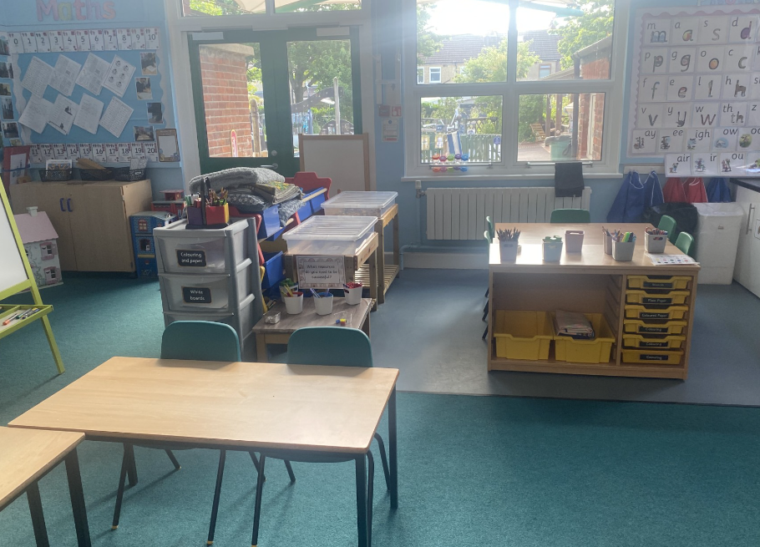
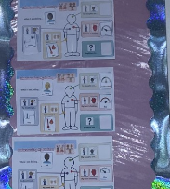
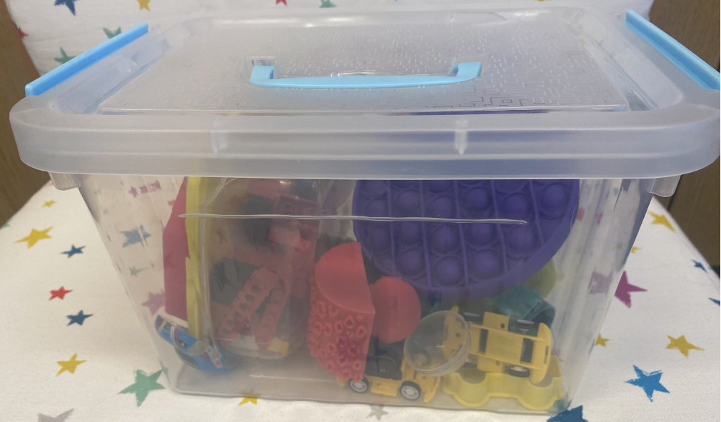
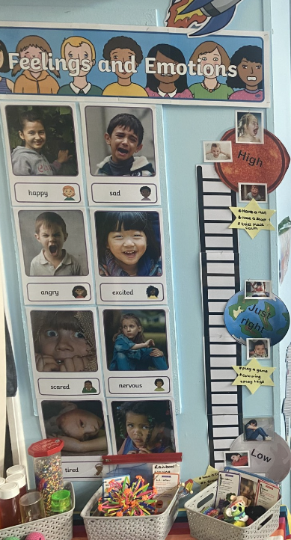
Seal Sanctuary
De-escalation tools around the room – ear defenders, sensory items and play, cuddly items, blankets
Wow wall - all key children have a special board with their targets and things they are proud of
Photos to support the 'I can't do it'
Seal books - to share when they have had a wobble - full of all the successes they've had.
Emotional toolkit boxes for in class and to bring to Seals these include a range of things from photos of family to sensory toys tailored to children's likes and interests.
Targeted intervention - small groups based on SDQ

Slide 6
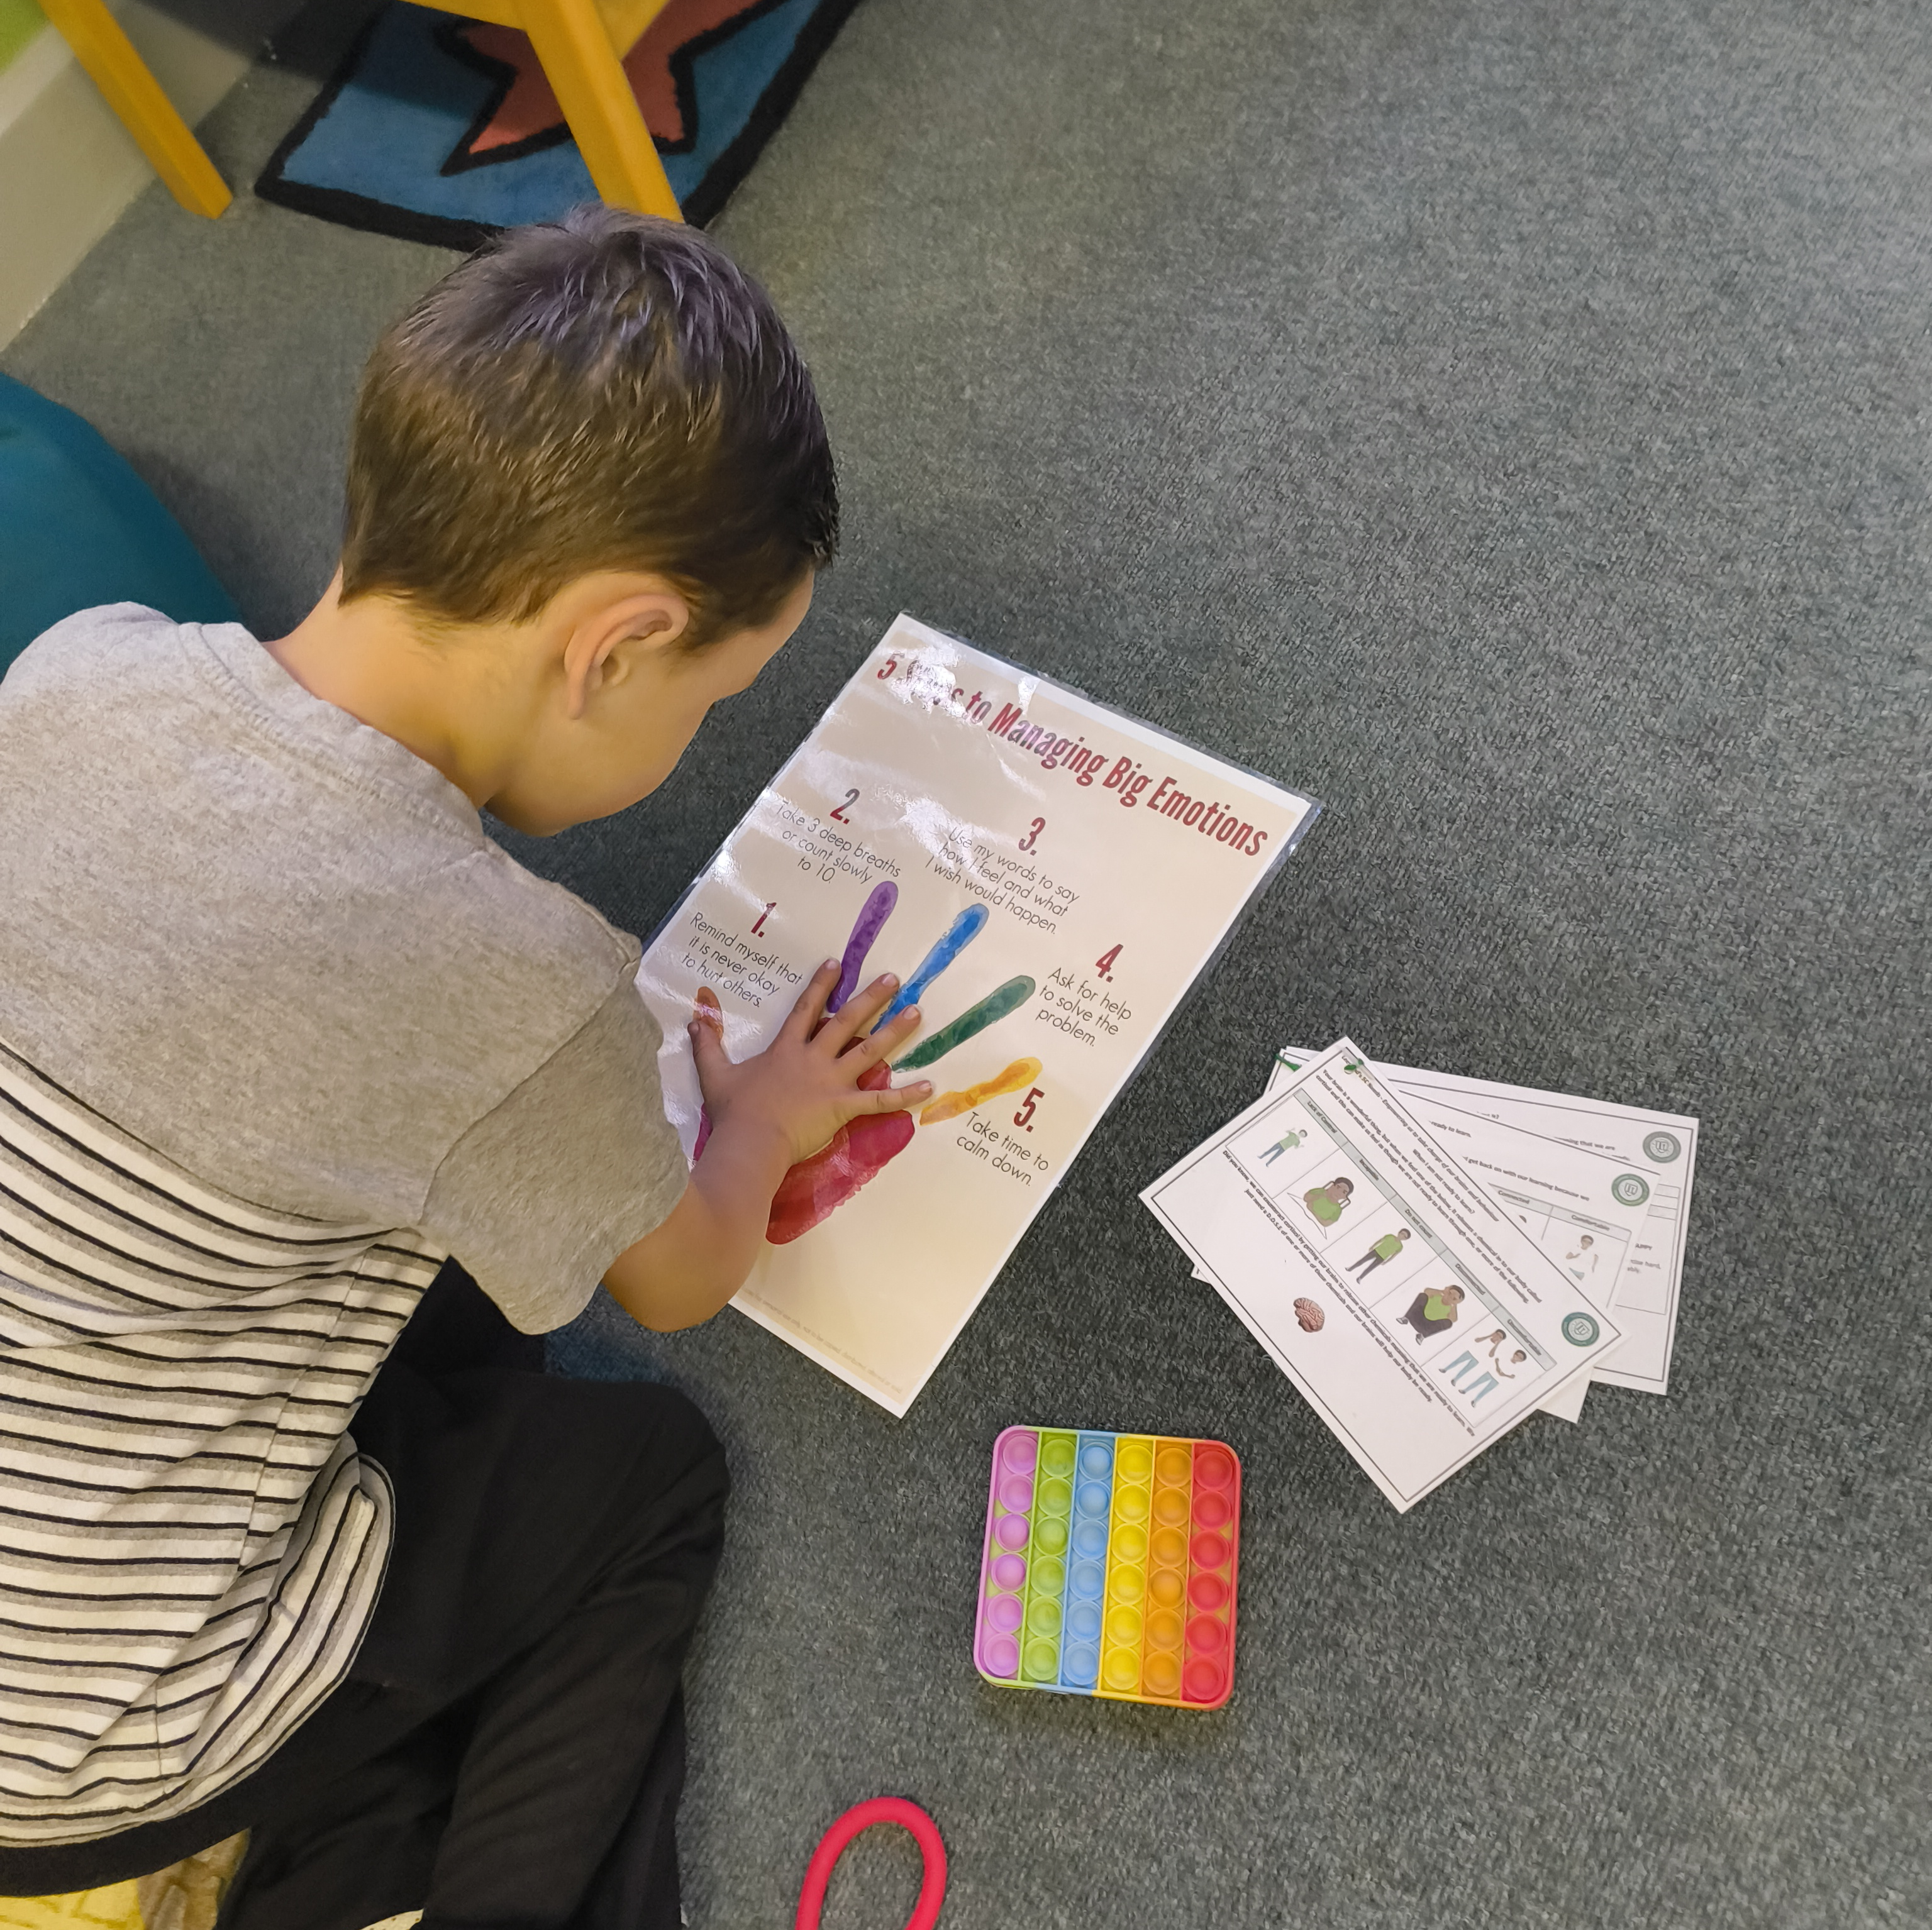
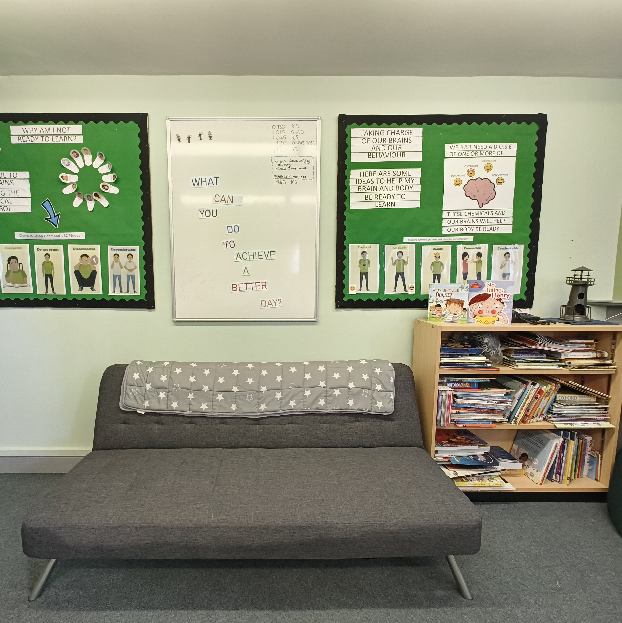
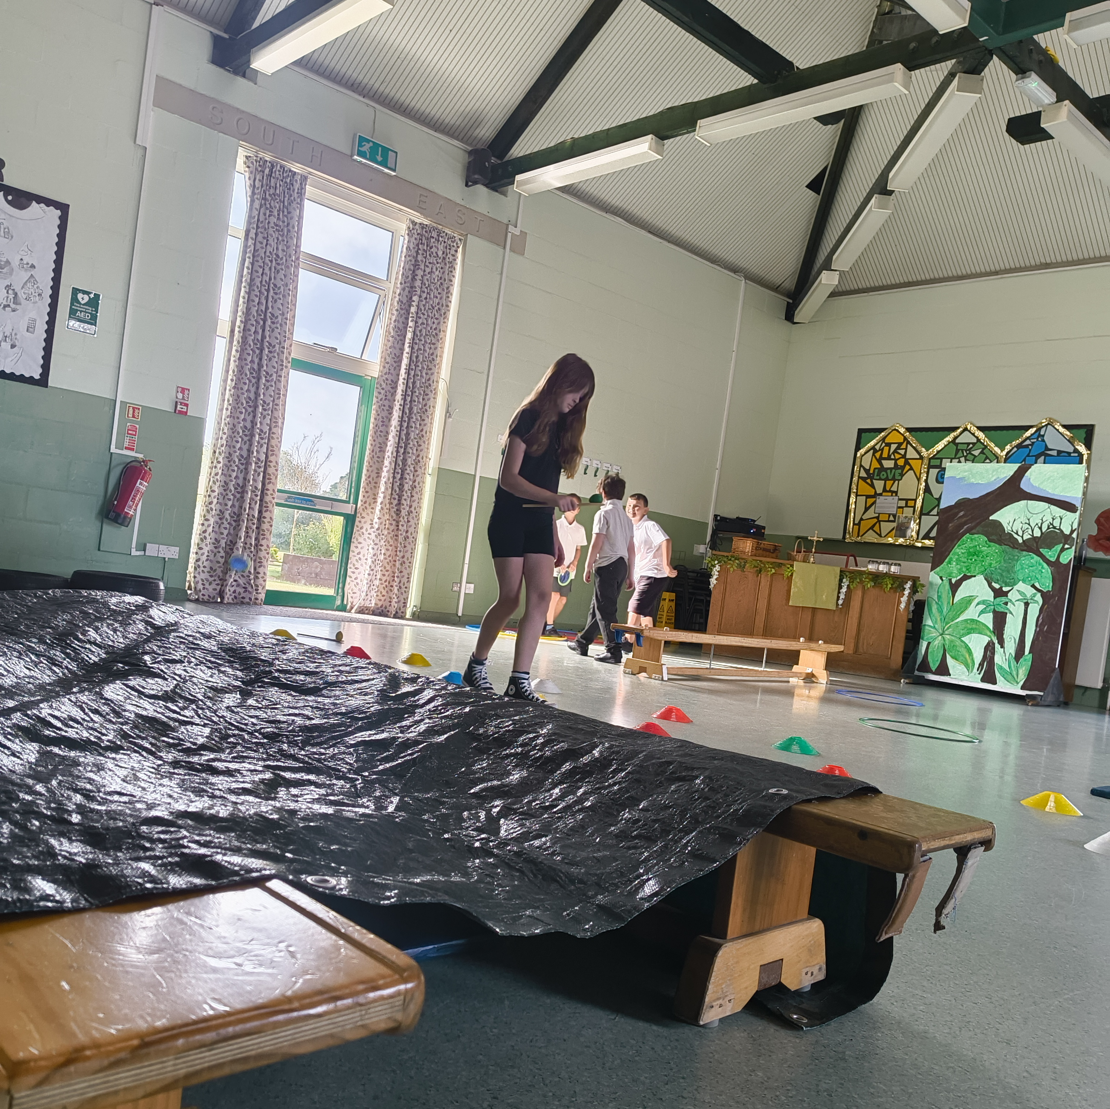
PALS: Pastoral and Learning Support Team
Targeted intervention
Sensory circuit with alerting, calming and organising stations.
De-escalation tools around the room – ear defenders, sensory items and play, cuddly items, blankets.
Kit Messenger 5c's used to identify the reason children are not ready to learn.
Strategies and toolkits, individualised to children, used to address the reason, or reasons, the child has shared why they are not ready to learn.
Keys to PALS and criteria as to why they may need to attend PALS in class. This works alongside tools children use to support their own regulation.

Slide 7
Practicalities: Our Heads of School are also SENCos. This is incredibly impactful for staff, pupils and families.
Seals:
One specialist behaviour LSA oversees the provision, working closely with the SENCO / Head of School. They have key intervention groups, but also time to 'scoop' children at key times and 'check in' with them throughout the day. They also undertake CPOMs and SDQ analysis and are both proactive and reactive to any issues arising or anticipated.
PALs
One pastoral support LSA oversees the provision, with three other part time LSAs who are allocated (loosely) to year groups. They all have key intervention and focus children, but also time to 'scoop' chidlren at key times and 'check in' with them throughout the day. They also undertake CPOMs analysis and are both proactive and reactive to any issues arising or anticipated.
Seals and PALs staff have strong relationships with families (as do class teachers and SLT) and make phonecalls, have face to face meetings as needed – planned and un-planned. Emphasis is on working together in a child-centred model.

Slide 8
Impact:
Suspension data - now nil return for 2023-2024 (we do still use internal suspension as a last resort, across the Federation)
Feedback from staff - all staff still 'pick up their tab', but feel better supported. SLT still have a high level on involvement and this is how staff feel best supported.
Feedback from pupils - using language of regulation and naming/taking ownership of their emotions
Feedback from families - praise in public, sanction in private is still a key element. Helping to maintain dignity for all children when they are dysregulated, in line with our values.
Academic data for key pupils

Slide 9
If we started again….. (trouble shooting)
Initially, staff sending pupils as a sanction…..
Practicality - room with only 1 exit if possible!
Some resources in cupboards that can be locked (reduces tipping)
(Infant) Zones in room - plenty of smaller areas for children to 'snuggle' into if they are unsettled

Slide 10
Questions.....
Useful links:
www.leeslandschools-fed.co.uk
Creating successful sensory circuits • SEN Magazine
HOME | Paul Dix

