Slide 1
Academic year 2023-2024 Teaching & Learning Themes
Notes:
This year we continue to prioritise teaching and learning across the whole school, with a series of research based projects that link to our SIP. Each half term there will be two project options to choose from. The idea is that you will choose one of the project titles and focus on new strategies to use with your chosen group of students. During the process each half term, you will have the opportunity to collaborate with colleagues, using allocated Monday time. This dedicated time will allow you to work on your project, without adding to your workload in terms of taking your time.

Slide 2
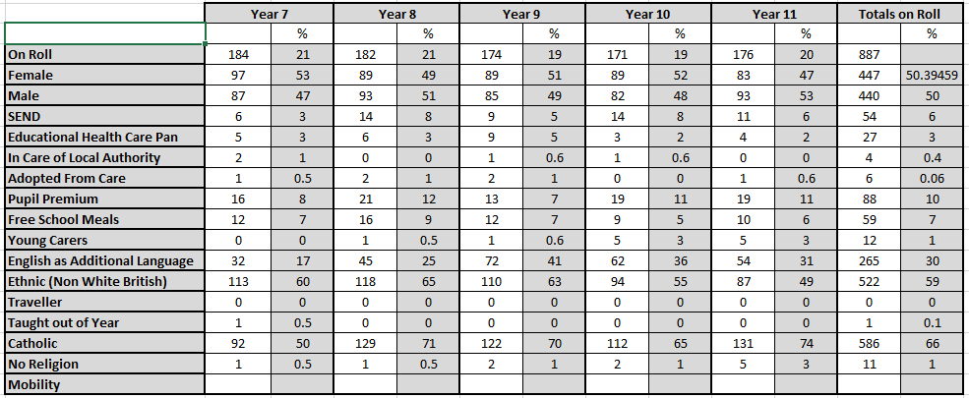
What does our school look like?
Notes:
It is important to understand the contextual make up of your school in order to plan improvement strategies. We will use a blank document rather than our own…

Slide 3
Structure of the Project
Start of Term – Launch projects 1a and 1b. Whole school T&L workshop. Record ‘Intent’ in Tracking Excel document.
Creating and implementing project ideas.
Buddy for the term, learning walk, student voice survey.
Recording of ‘Implementation’ and ‘Impact’ in the tracking document.
Uploading examples of resources made, used, student feedback from the project into the folder in the T&L folder on Teams.
End of Term – celebrate and share good projects.
Notes:
Each half term will follow the same format, beginning with the launch of two projects options in the way I have done in the past. During this first workshop session, typically on week 2 of the half term, you will decide on your project choice and collaborate with each other in sharing ideas to get your research project started. Monday of week 4 gives us opportunity to continue work on our projects, whether that be sharing ideas with each other, designing data collection methods or student voice feedback in the form of short surveys with the groups you have worked with. By the end of week 6, the impact of your project should be recorded on the tracking document that I will show you shortly.

Slide 4
Academic year 23-24 T&L Themes
Autumn Term | Spring Term | Summer Term
Literacy across the curriculum – Subject specific vocab Modelling answers – Think like an examiner | Closing the gap B. Oracy and talk opportunities across the curriculum | Retrieval practice – interleaving and spacing B. Reading in your subject – Cultural Capital
Notes:
Here is an outline for the year so you are able to see which project titles might interest you throughout the year. You will choose one of the two project choices available for each half term. These also link with the professional themes sessions for ECTs and trainee teachers.

Slide 5
Academic year 22-23 T&L Themes
Autumn Term | Spring Term | Summer Term
Half Term 1 TEEP learning cycle (for depts. that need to implement on a large scale) Explicit teaching/ QF | Half Term 3 Stretch and challenge Scaffolding | Half Term 5 TEEP – underpinning elements x5 Metacognition – learning to learn
Half Term 2 Independent writing Marking policy review | Half Term 4 Data and intervention Revision techniques | Half Term 6 Retrieval practice – interleaving and spacing Making links – activating prior knowledge, pre-empting future learning, vocab lists
Notes:
Here are last year’s themes

Slide 6
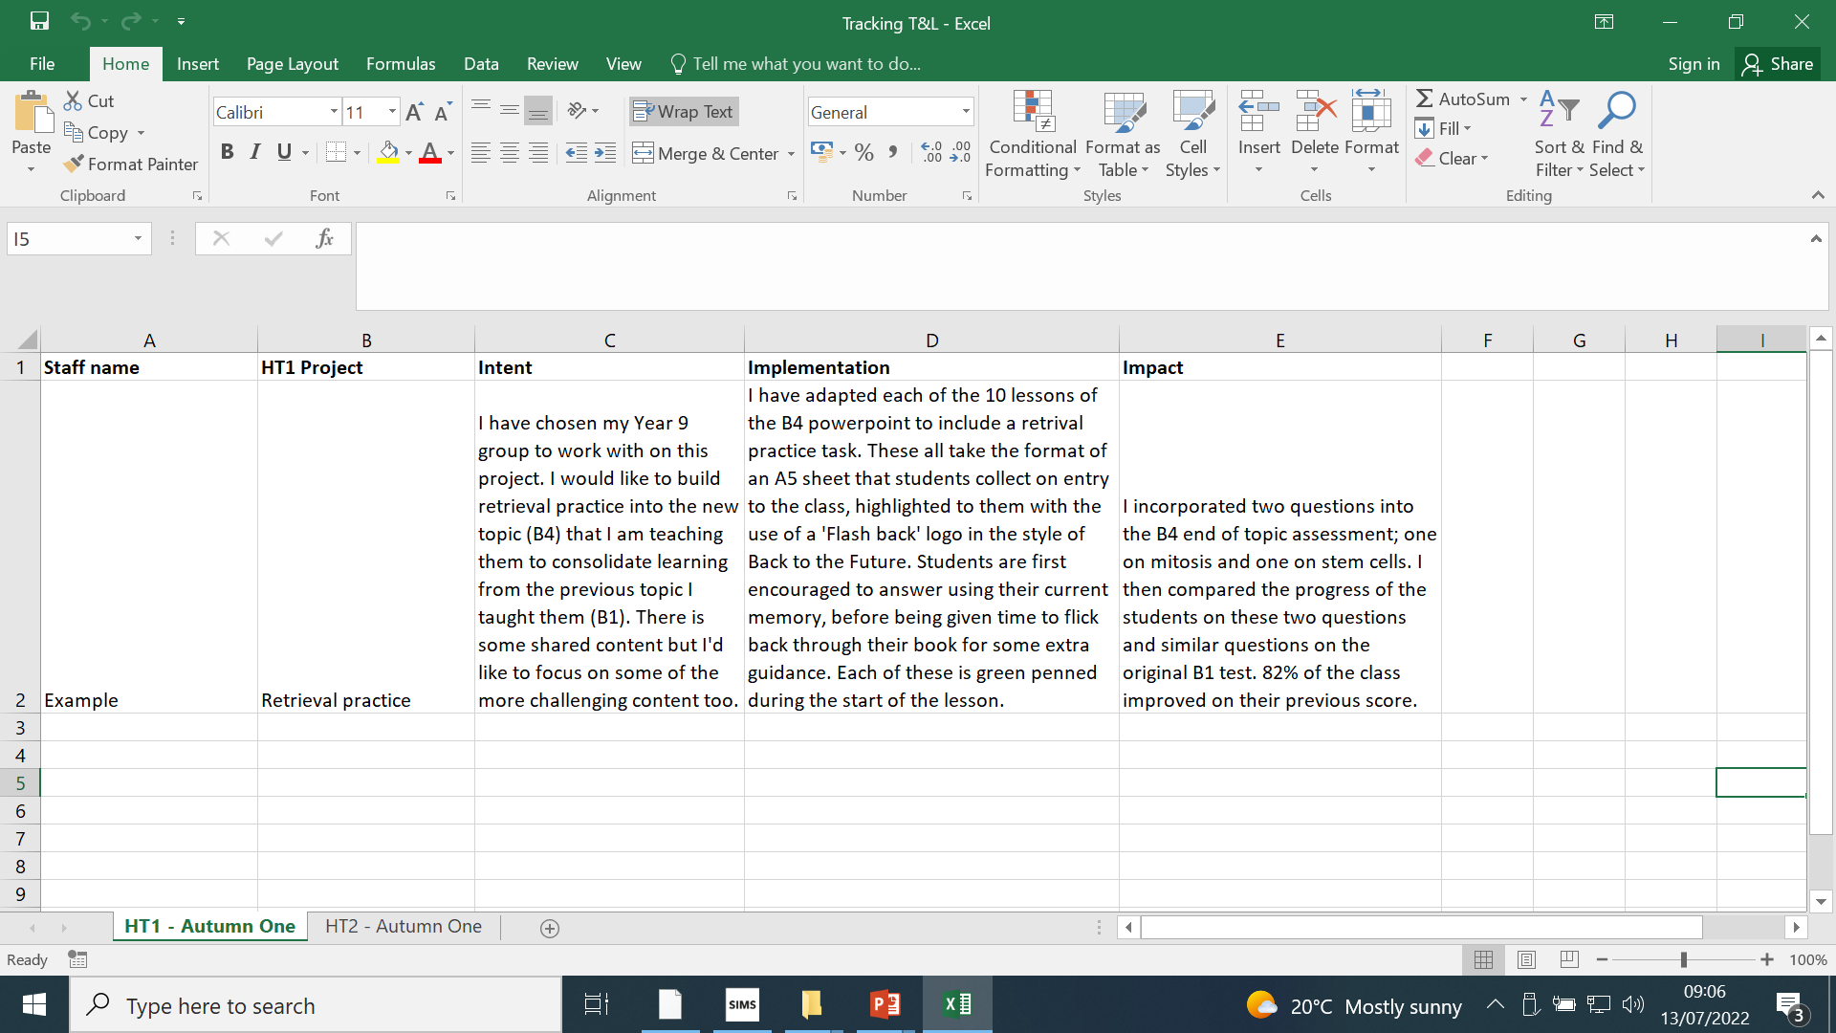
Tracking document
Notes:
Here is an example of the tracking document where you will log the stages of your research project. These are under the headings of intent where you will identify which group or sub-group of students you will be working with and an outline of what you plan to do. Implementation where you provide greater detail of what you implemented within your teaching and what you were hoping to achieve. The final section is impact where you will record information either in the form of data or student feedback about the improvement to teaching and learning you have made. Not only will the tracking document be used to log what you have achieved in improving student progress, which will later be used in performance management. It will also allow staff to share the amazing work with their colleagues.

Slide 7
Person A | Person B | Summary of ideas
Person D | Person C
Autumn Term
Project A – Literacy across the curriculum – Subject specific terminology
Project B – Modelling answers – Think like an examiner
Intent: Which class or sub-group will you work with?
Implementation: What are you going to do? What will this look like in your planning and teaching?
Impact: How will you measure your impact? Data driven? Student voice?

