Slide 1
The EHCP Process for Parents
Presented on behalf of the Havant Headteacher SEND Solution-Focused Action Group

Slide 2
Introduction to the Havant Headteacher SEND Solution Focused Action Group
We have identified three priority key areas:
Empowering Our Parents
Working Effectively with the Systems and Processes in SEND
Meeting the Complex Needs of our Pupils
We represent a highly passionate team of school leaders who are collectively invested in partnership working to meet the changing needs of our school communities.
Over the past 12 months, together with Caroline Wilkins, our SIM, our steering group has shared experiences and strategies, identified support networks and signposted best practice for the wider benefit of school leaders.

Slide 3
Working Effectively with the Systems and Processes in SEND
Exploring the systems and processes in SEND we have been carefully considering the challenges for parents.
Whether a parent has raised a concern themselves about the progress their child is making and the support they are receiving or whether staff in school initiate conversations about a child potentially benefiting from additional support, the process for requesting an Educational Health Care Assessment can seem complicated, confusing and daunting for many.
Today we would like to share with you a short case study which has supported our work to create a step by step guide for parents in understanding the process and strengthening a partnership approach to achieving the best outcome for their child.

Slide 4
Jack – A failed EHCP process
Year 5 boy
Diagnosis of Autism
Incontinence issues – this was mum’s focus
In school, Jack is high functioning and needs very little or no support
Teacher adapts feedback to help Jack understand it is not a criticism
He does not report ‘accidents’ in school and no obvious signs for adults
Over a 3 month period, despite several meetings, Mum chased/harassed SENCo for an EHCP – school had a lack of evidence which was explained to mum
Mum disregarded this and pursued her own EHCP, which has failed twice

Slide 6
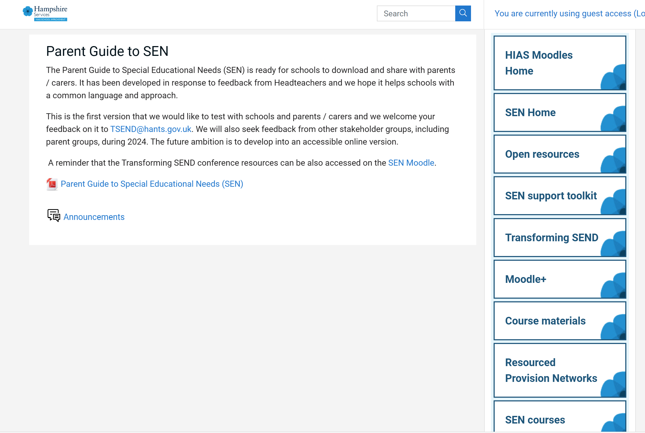
Additional Support for Parents
Click on the link to the LA Moodle:
Course: Parent Guide to SEN (hants.gov.uk)

Slide 7
Click on the link to the Parent Guide…

Slide 8
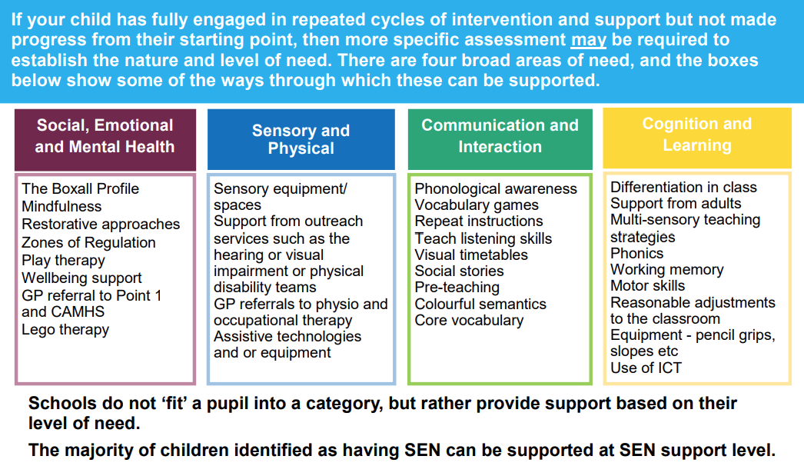

Slide 10
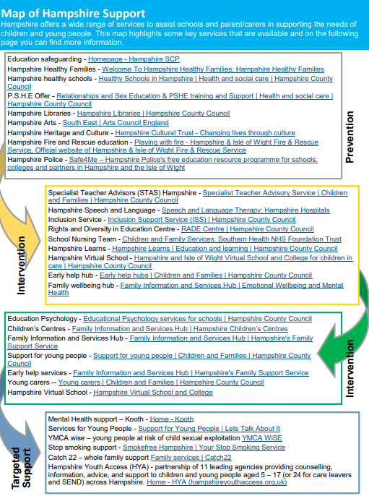

Slide 12
When more detail is required…

Slide 13
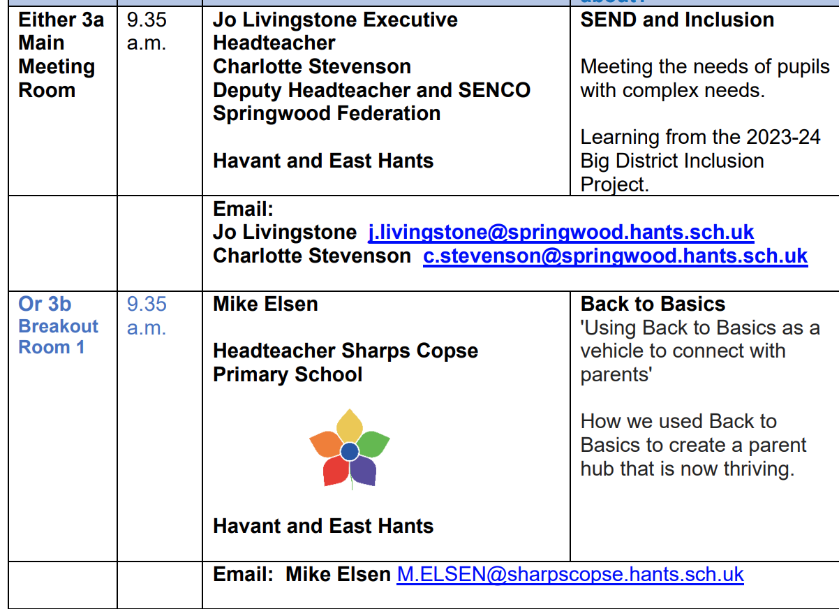
Next steps…

Slide 14
Do you have any questions for us?

