Slide 1
Tackling educational disadvantage through promoting parental engagement
Beth Waters – Pupil Premium Lead
Notes:
Questions in the chat bar for any questions at the end.

Slide 2
North Baddesley Infant School and Nursery Context
309 children
10 classes including nursery
14% pupil premium
9% EAL
13% SEN
Diverse catchment – large village - leafy green, affluent areas and pockets of extreme deprivation with high crime rate
According to the IDACI (Income Deprivation Affecting Children Index), the school serves a neighbourhood ranked 9,522 out of 32,844 neighbourhoods. It is important to note that within the community that we serve there is a central area that demonstrates significant deprivation comparable with areas nationally which puts our school in the 30% of most deprived neighbourhoods in the country in relation to this impacting children. In addition, this neighbourhood is the 8th most deprived in Test Valley and the most significant area of deprivation within the Romsey area.
At the last opportunity that the school performance could be compared nationally NBIS sat in the top 20% of all schools for ARE outcomes in Reading, Writing and Maths at the end of KS1.

Slide 3
Promoting Parental Engagement
Annual survey
Family Links parenting course
Community hub
FoNBIS (PTA events)
Culture of support available

Slide 4
Why we send an annual survey to families
Understand the needs that our families have
Shape the pupil premium strategy and pastoral action plan
Help us decide what workshops to run for parents
Understand priorities for families and background for children
Notes:
Began in Covid just before the second lockdown when we were shaping remote learning.
Most of the questions were around use of technology, spaces available in the home, food needs etc.
Each year we have revised the questions based on the previous year and changes in the world eg rising cost of living.

Slide 5
What was the survey for 2024?
Are you eligible for pupil premium?
Do you have any of these resources to support with home learning?
Do you have internet access?
Are you able to access an outdoor space?
Do you have any of these resources in your home?
How confident do you feel supporting your child with learning at home?
If the school were to provide workshops for parents to support home learning, which would you be interested in?
When are you available to attend workshops?
Some families received food parcels from school during the pandemic. We understand families might be finding it difficult to provide food for everyone now with the rising cost of living. Please let us know how you are feeling about this.
Do you have a support network available when you need it?
Unfortunately, we are all feeling the impact of rising energy prices and the cost of living increases. Please let us know how this is making you feel and if we can support you in any way.
Would you like the opportunity to talk with one of our pastoral team who support the whole family (Mrs Calder and Mrs Cundy)?

Slide 6
Headlines
183/259 (70.6%) families responded to the survey
17 (9.2%) of families did not know if their child was eligible for PP. This is a reduction of 29.3% compared to last year
13 (7.1%) of families only have access to public spaces
All families had a range of technology and resources for learning in the home
All families had access to the internet
4.3% (8) of families do not feel confident supporting learning at home. A reduction of 6% compared to last year
48% of families would like parenting events in the evening (6.30pm)
11 (6%) families still and 16 (8.7%) families sometimes need food parcels
4 (2%) families need and 5 (2.7%) families sometimes need more support
9.8% of families are concerned and may need support with the rising cost of living and 5.4% are worried and feel they need support
11 (6.8%) families said they would welcome a chance to speak with a member of the pastoral team. This is an increase of 6.8% compared to last year

Slide 7
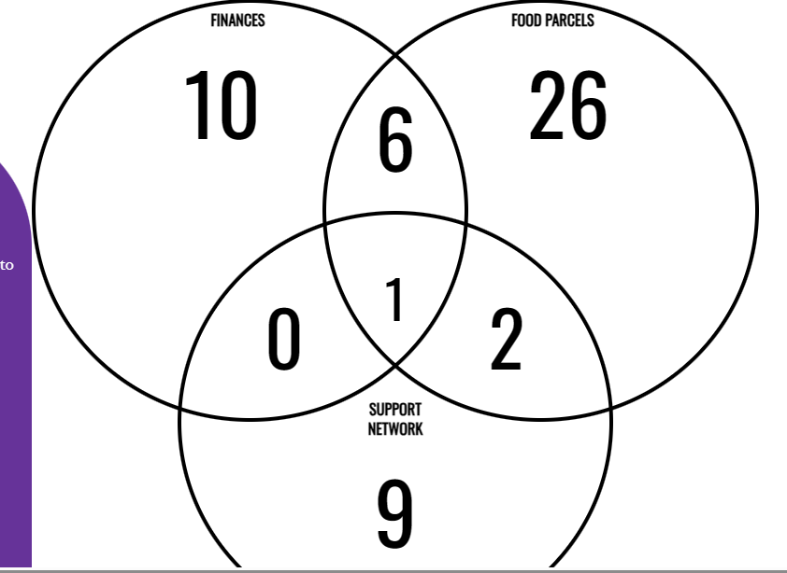
Magnitude of disadvantage
Notes:
This information allows us to understand the magnitude of disadvantage that some of our families are facing. We can therefore prioritise need for families and positively impact them.
We collate a list of all the information provided and meet with relevant school leaders eg pastoral team, SENCO, year leaders, lunch leaders, holiday club leaders. We then contact parents individually and offer them the support we have. For example gardening club, behaviour workshop, food parcels, support from debt management.

Slide 8
Headline | 183 responded to survey. Reduction of 68 compared to last year.
Implications for our school | We are not reaching as many families as before
What have we done so far? | We tried communicating this before the summer holidays to action responses earlier but its possible there were too many communications to parents at the end of term and this contributed to lower response rates.
Next steps | Plan when survey should be sent to maximise response rate but also efficiency of actions.
Notes:
Previous year had a return rate of 82.5%.

Slide 9
Headline | 9.2% of families did not know if their child was eligible for PP
Implications for our school | This is a reduction of 29.3% from last year! The communication to parents, data collection sheets and information on the website seems to have helped increase parental awareness of PP.

Slide 10
Headline | 7.1% of families only have access to public spaces (3% increase from last year)
Implications for our school | Children may have barriers relating to gross motor skills or limited experiences to relate to impacting attainment
What have we done so far? | Children to be offered clubs to support access to outside areas at lunch time and after school
Next Steps | Monitor the impact

Slide 11
Headline | 48% of parents think 6.30pm is the most convenient time for workshops
Implications for our school | To get the best attendance from parents we need to offer times that suit them
What have we done so far? | Offer a range of times for parents
Next Steps | Ensure we offer parenting workshops at these times more than previously

Slide 12
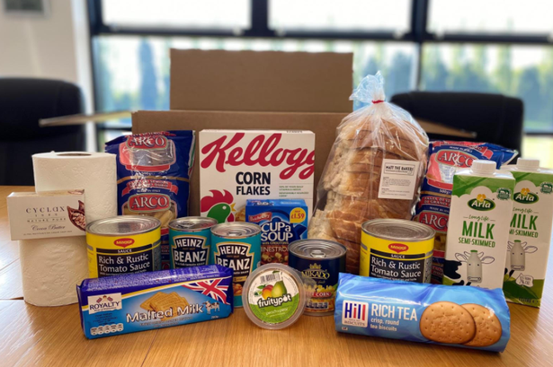
Headline | 14.7% of families sometimes or still need food parcels
Implications for our school | Children may not always be ready to learn if they have not had sufficient food at home
What have we done so far? | Been a food bank ‘hub’ over the summer holidays and communicated this to identified families
Next Steps | Incorporate food bank offer with community building when it launches

Slide 13
Headline | 4.7% of families need or sometimes need more support (this is a reduction of 11.8% compared to last year)
Implications for our school | Some parents may feel overwhelmed and struggle with mental health issues where they don’t feel they have sufficient support
What have we done so far? | We have supported many parents throughout the year through coaching, coffees and family links. We offered chats with family support workers (requested by 11 families)
Next Steps | Make contact with families who have requested support

Slide 14
Headline | 15.2% of families are concerned and may need support with the rising cost of living
Implications for our school | Parents may feel unable to pay for trips or enrichment for their children
What have we done so far? | Grant funding for enrichment for children and subsidised places for clubs Coffee mornings with utilities companies
Next Steps | Offer financial advice services at more convenient times for parents

Slide 15
Comments
Really struggling with bills like electricity/gas water and mortgage. Have debt collectors letters.
Thank you (for offering family support services) I know I can come in anytime and talk - you have all been great!
Thank you for putting this out to parents - I think this is a very good idea considering the current situation and makes me feel comforted.
I do struggle mentally as I'm the one being relied on and I think I sometimes find it difficult to admit I could do with a little extra help.
Notes:
We get honest feedback from parents via the survey that we wouldn’t always get from face to face conversations.
We make sure that we respond to families so they know they have been heard.
We believe this is one of the most significant reasons in why we get such a high response rate. On social media we put out short headlines like ‘X% of you said you wanted workshops at 6.30, our next one is at 7pm’ or ‘x% of you are worried about the rising cost of living. We have supported this many families, let us know if we can help you’. We also put together a flyer that went out during parents evening to provide more examples so families knew that we take their information seriously. The findings really shape our actions for the coming academic year.

Slide 16
Family Links Parenting Course
Run all year round in 3 x 10 week blocks
Led by our own pastoral team
Invitation and voluntary attendance
Notes:
One of the actions that has come from the survey but also incidents of children’s behaviour and safeguarding concerns is to offer a parenting course. We have offered NVR run externally in the past but wanted a course that could be run by our team so that parents felt comfortable. We trained our pastoral leaders and they now run this course all year round. We use the survey information along with other knowledge to invite families. The pastoral leaders take care to ensure that the groups are diverse and will not create friction as these groups become a support network in themselves.

Slide 17
Family Links Parenting Course
Positive comments from parents who go on to promote the course to other parents
Reduced number of CPOMS entries for behaviour from children of families who attended
Parents often create own WhatsApp chat after and meet regularly to support each other
We have recruited 4 parents to the school in a range of roles – admin officer, learning support assistant, midday supervisory assistants
The group were fantastic. They were extremely supportive, respectful, interactive and listened without being judgemental. Loved being around this group!
Notes:
We are incredibly proud that for some parents the impact of the course was so big that parents felt able to rejoin employment due to increased self esteem and sense of belonging. When we advertised roles, they applied independently. This has cascaded to the children who now have more stable lives and understanding of how to be supported at home. 50% of these families are eligible for pupil premium.
Constantly reflect. Will be offering a shorter course for more vulnerable families who find committing to 10 weeks to overwhelming.
Considering alternative venues for these families too, to remove the barrier of school.

Slide 18
Family Events
We work closely with our PTA and this year created an event that was affordable to all for Christmas – our own light up trail!
We offered discounted tickets for vulnerable families
Had hundreds attend
We love getting parents across the threshold into school in a variety of ways to reduce that anxiety and promote a positive attitude towards school
Notes:
All of our PTA events offer discounts or free tickets to vulnerable families – this knowledge comes from the survey or from parent discussions. We don’t offer things in blanket fashion.

Slide 19
Ad hoc support
Costumes available for dress up days in the library – no need to request
Milk and food available on the playground/in the office
Our pastoral leaders also works in the office to promote communication with families
Pastoral team always available at parents evenings, discos, have their own email, on the gate at drop off and pick up etc
Pastoral led holiday club and wraparound care – use the survey to allocate free spaces

Slide 20
Any questions?
Notes:
Please email any questions or you’re more than welcome to visit!
Link to the TED video on the HIAS moodle.

