Slide 1
How can you support innovative curriculum design in Geography?
Juliet Collinson – Swanmore College
juliet.collinson@swanmore-sec.hants.sch.uk
Notes:
Bit about me…I am

Slide 2
Discussion
What makes a curriculum good?
What makes a Geography curriculum good?

Slide 3
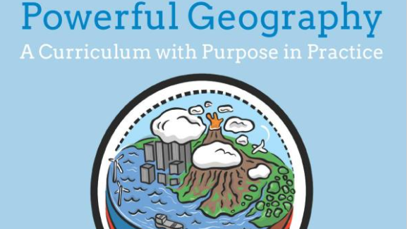
“Anything is Geography”
Notes:
Mark Enser rips apart the idea that ‘anything is Geography’. When I started teaching I remember plotting where premium league football teams played in order to play into the interests of students or teach about sweatshops in Bangladesh in order that pupils might change their purchasing habits or look at the geography of crime by building empathy for different stakeholders. The point wasn’t what you are teaching but what the outcome of your teaching was. This is no longer the case. We are being asked for breadth and depth of the curriculum and therefore we do in fact need to know what Geography actually is. To develop a clear and powerful curriculum we need a clear understanding of what Geography actually is.

Slide 4
What is Geography?
“Seeks to make sense of the world and its people, places and environments through explanatory relationships.” ‘Education inspection framework: overview of research’, Ofsted, January 2019 and ‘Principles behind Ofsted’s research reviews and subject reports’, Ofsted, March 2021.↩
Notes:
Research review series: geography - GOV.UK (www.gov.uk)

Slide 5
Principles
“In order to get back on track, we need to think about our attitude to the status quo, to be prepared to change. We have choices!”
- Mary Myatt
Notes:
Curriculum pace — Mary Myatt Learning

Slide 6
My experience…
KS3 3 Year Plan
 | Y7 (Sense of place) | Y8 (Sense of stewardship) | Y9 (Global challenges)
Autumn Term | My Patch | Weather and Climate | Tectonic Global Systems
Autumn Term | UK (3D model of UK) | Biomes | Volcanoes (Yellow Stone National Park)
Spring Term | Europe | Population | Earthquake (Haiti)
Spring Term | Europe | Amazon Rainforests | Predict, prepare and protect
Summer Term | Commonwealth – The British Empire | Antarctica (Antarctic treaty) | Human Threats
Summer Term | Global partnerships – (UN & NATO) | Sustainable Swanfest | Food Security
Fieldwork | My Patch Enquiry: ‘where’s my favourite place in Swanmore?’ | Swanfest’s sustainability Enquiry: ‘How could Swanfest be more sustainable?’ | Food banks Enquiry: ‘Are local foodbanks a long term solution for food insecurity?’
Notes:
Talk through what I identified about this SOW
Interleaving?
Depth?
Breadth?
Causal relationship ie: weather and biomes

Slide 7
What was my success criteria?
Do you know what they have learnt before coming to you?
Does your curriculum have Depth and Breadth?
Can you explain why that topic is where it is and what it connects to?
What am I looking for?
Do you provide opportunities for ‘beautiful work’
Are current case studies being used?
Does your curriculum include local Knowledge?
Is everything underpinned by disciplinary knowledge
What skills are being assessed in each unit?
Do you use enquiry based learning? Why?
Notes:
Based on the above, high-quality geography education may have the following features Research review series: geography - GOV.UK (www.gov.uk)
A few questions: do we provide enough opportunities for our pupils to produce beautiful work? Do they have the chance to polish and refine something? Are they clear about what good work looks like? Have they been inspired by the finished work of others? How often do pupils get the chance to produce work for a real audience? Are there opportunities for multiple drafts, punctuated with honest and specific feedback? Beautiful work — Mary Myatt Learning

Slide 8
Notes:
Substantive knowledge sets out the content that is to be learned. The national curriculum and other geography education literature presents this through 4 interrelated forms: locational knowledge, place knowledge, human and physical processes & geographical skills.
Disciplinary knowledge considers how geographical knowledge originates and is revised. It is through disciplinary knowledge that pupils learn the practices of geographers.

Slide 9
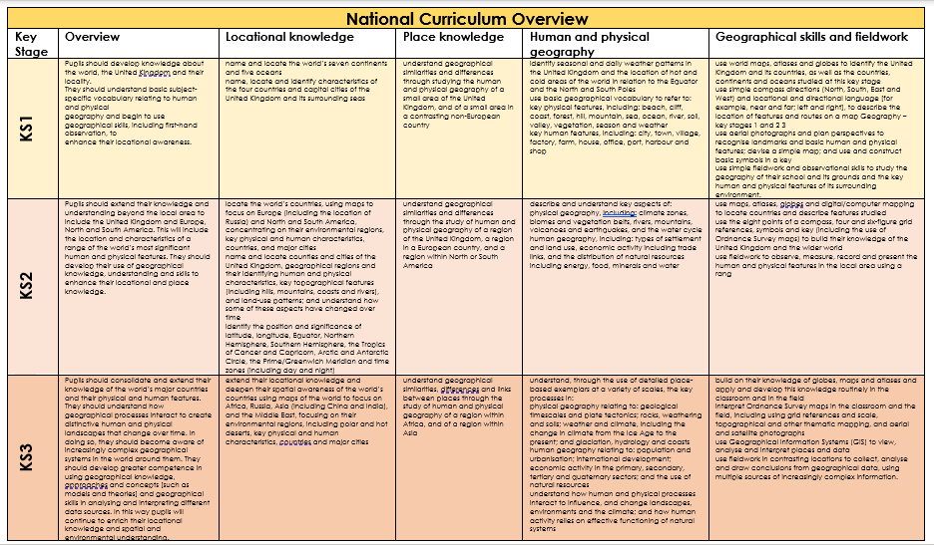

Slide 10
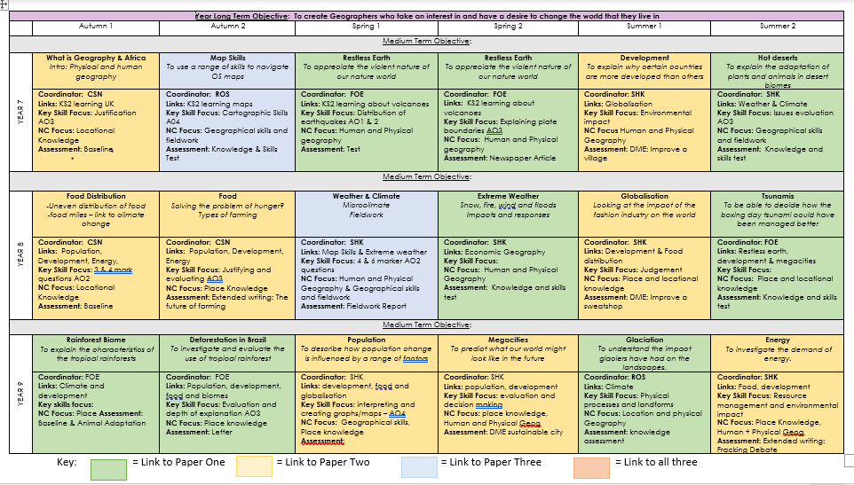
My experience…
Interleaving?
Depth?
Breadth?
Causal relationship ie: weather and biomes
Notes:
Talk through what I identified about this SOW

Slide 13
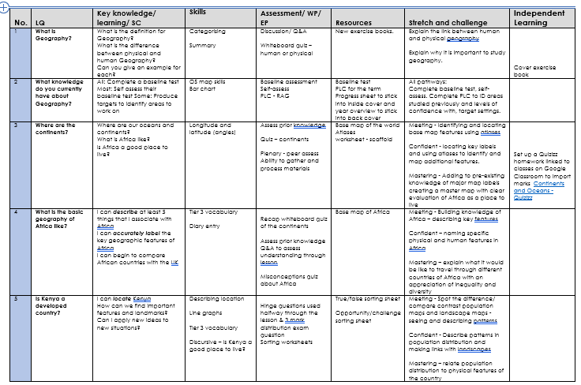

Slide 14
Discussion
Are there ways of monitoring impact of this new curriculum?
Are some methods more effective than others?

Slide 15
Audit your curriculum

Slide 16
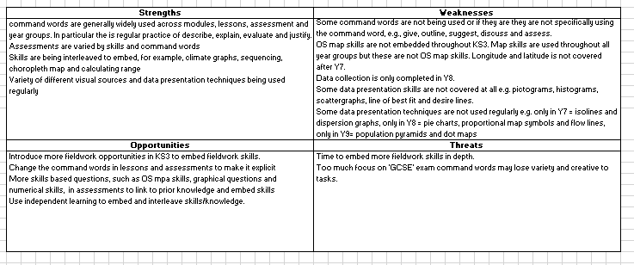
Audit your curriculum

Slide 17
How to review impact
Notes:
Pupil voice, progress and conversations and probing questions – add example questions, pupil voice and data to show how I know that my curriculum is good.
Conversations…- Curriculum conversations can be tough, for several reasons. One reason is that it’s a hefty job. This is why the conversations need to happen over time. And a second reason is that any conversation about our practice or provision can made us feel vulnerable. For the senior leader the vulnerability can come from not knowing very much about the subject they line manage. For the subject leader, the vulnerability can come from fear of being judged about their work. One way to ease this is to use ‘distancing’ language. What is ‘distancing’ language and how can it help? No-one wants to feel like a muppet — Mary Myatt Learning

Slide 18
EXTRA

Slide 19
Key Points
PrincipledcurriculumdesignSSAT2013.pdf

Slide 20
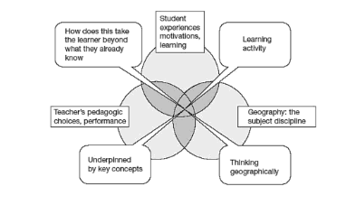
Notes:
https://www.amazon.co.uk/Effective-Innovation-Secondary-Geography-Curriculum/dp/0415519063?asin=0415519063&revisionId=&format=4&depth=1

Slide 21
What is Geography?
[the] integrated study of the complex reciprocal relationships between human societies and the components of the Earth. Geographers study place, space and time, recognising the great differences and dynamics in cultures, political systems, economies, landscapes and environments across the world, and the links between them.
‘Subject benchmark statement – geography’, Quality Assurance Agency for Higher Education, December 2019.↩
Notes:
In the United Kingdom, the Quality Assurance Agency for Higher Education has set out geography as:^{[footnote 7]}

Slide 22
Principles
‘The slow philosophy is not about doing everything in tortoise mode. It's less about the speed and more about investing the right amount of time and attention in the problem so you solve it.’
- Carl Honoré.
Notes:
Curriculum pace — Mary Myatt Learning

