Slide 1
Project 26 Improving attainment in 2026
20 May 2025
Tania Harding
Tania.Harding@hants.gov.uk

Slide 2
Wifi
Ald3rWGu3sT#

Slide 3
Mobilising all to thrive and to do well
Our desires are mimetic
We have never had it so good but we want it to be even better
Happiness = quality of life - envy
Diary of a CEO podcast, featuring Jimmy Carr

Slide 5
Agenda
Welcome, introductions and aims
Unpicking some success
Let’s explore and share our cohort details
So what…and what’s next – the gap task
Assessment stamina and the will to succeed.
Meeting closes by 4.30pm

Slide 6
It takes a village to raise a child…
To raise attainment it will take a unified, vision-aligned and consistent approach from a number of staff in a relentless fashion for this to be secured.
Every person knowing their role – how it is done here….

Slide 7
Introductions and aims
In a group of three: Share your context and school motto/strapline/mantra and one thing to celebrate..
What does your PP strategy, teaching and learning strategy/policy and behaviour strategy/policy lead to?
Revision ….. Or is it working practice….in science…etc

Slide 8
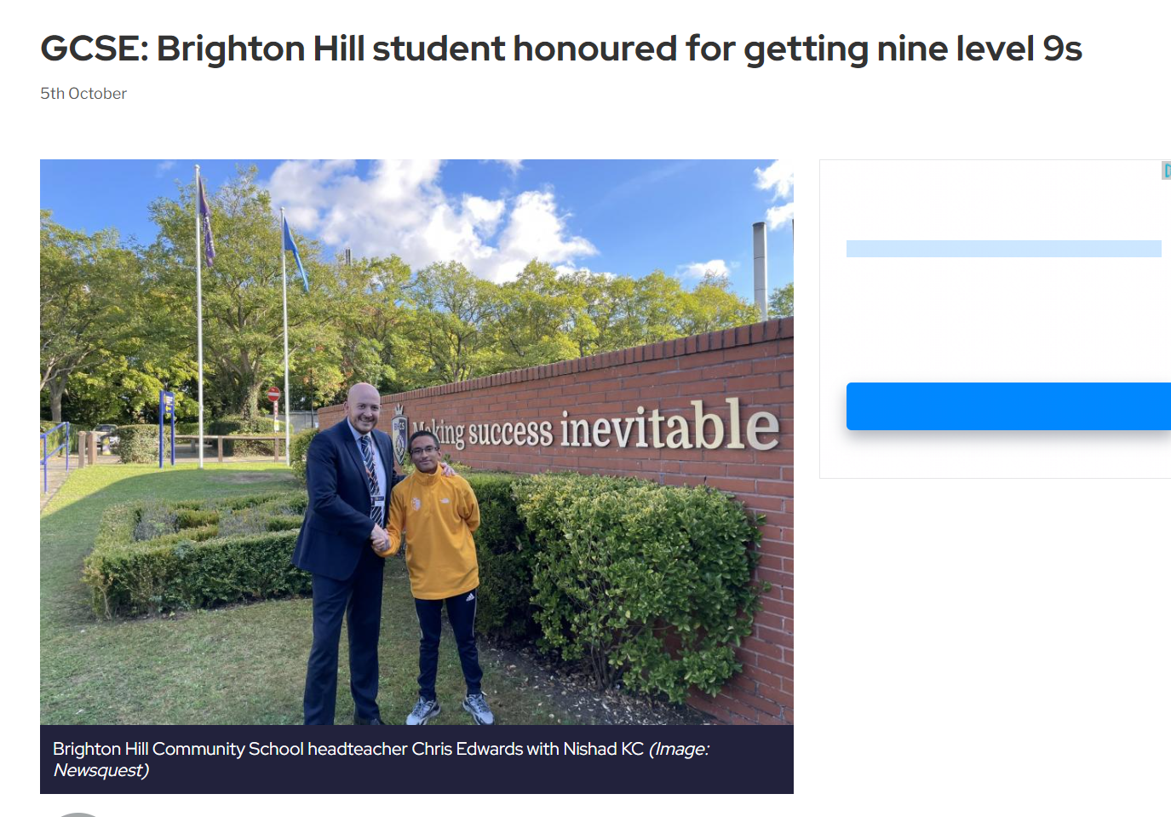
Unpicking some success…
Within every cohort, there are success stories.
From 2023-24 cohort, share one pupil who had success and why.
Examples from schools here: +0.99, +1.56, +1.63, +1.67, +0.86
From 2024-25 success stories will be…
For your 2026 cohort who will be the successes….?

Slide 9
Messages
County Education Manager – Jean Thorpe
Secondary School Improvement Manager – Tania Harding
Inspector/Adviser – Victoria (Tor) Flynn
We understand that you rapidly assimilate, evaluate and move forwards to concentrate on all pupils in following cohorts…and that this year’s cohort are currently deep in the assessment window. Plus, curriculum and assessment review to come…!

Slide 10
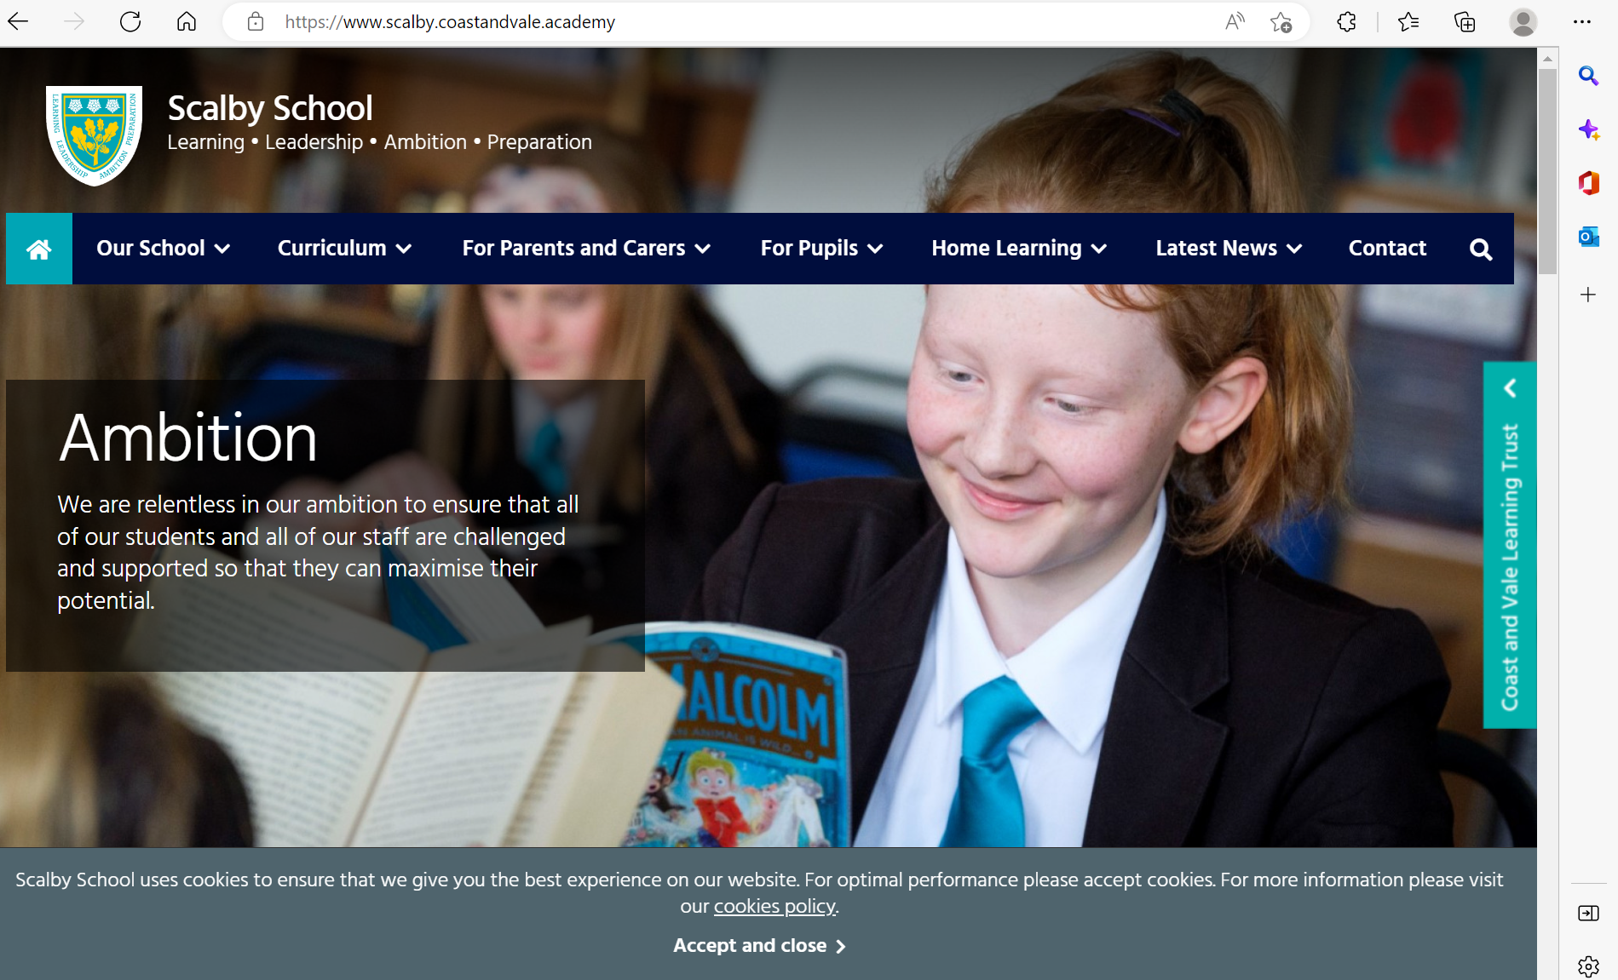

Slide 11
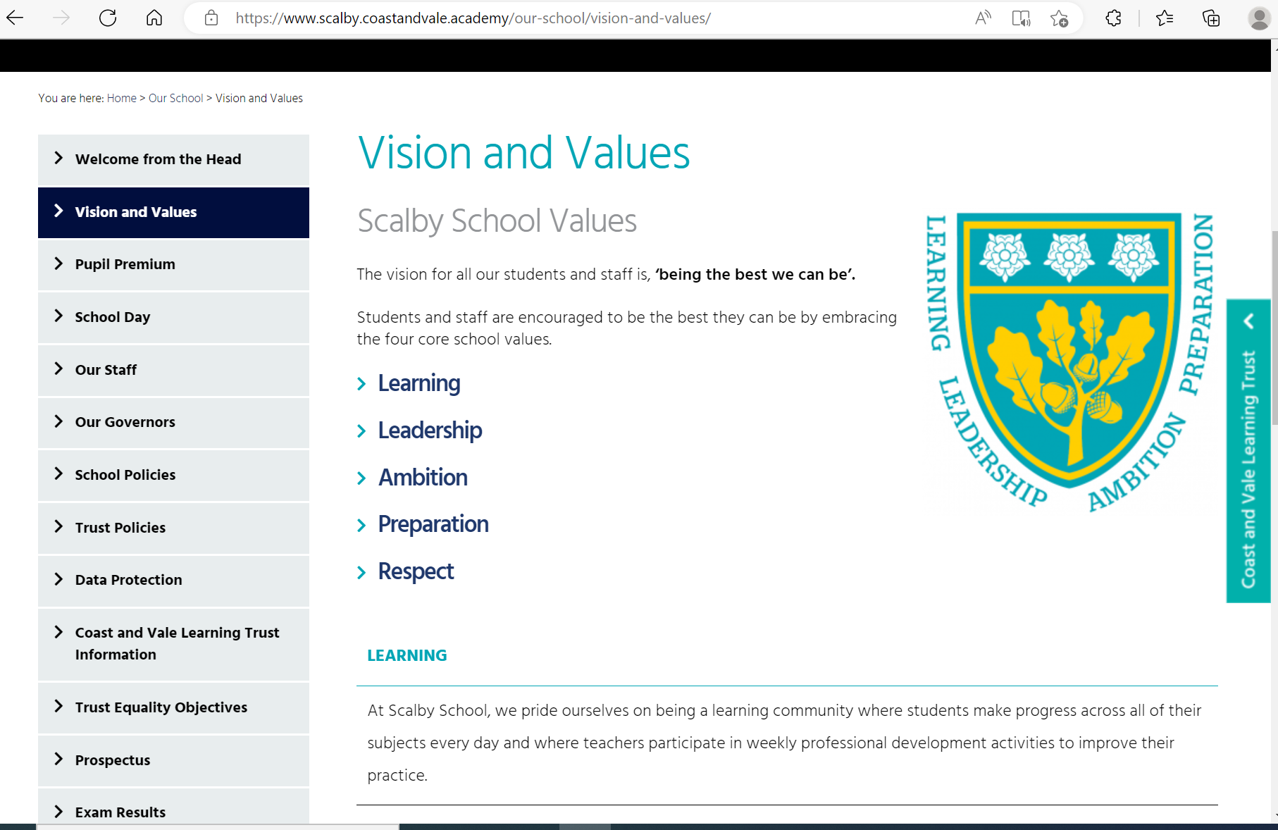

Slide 12
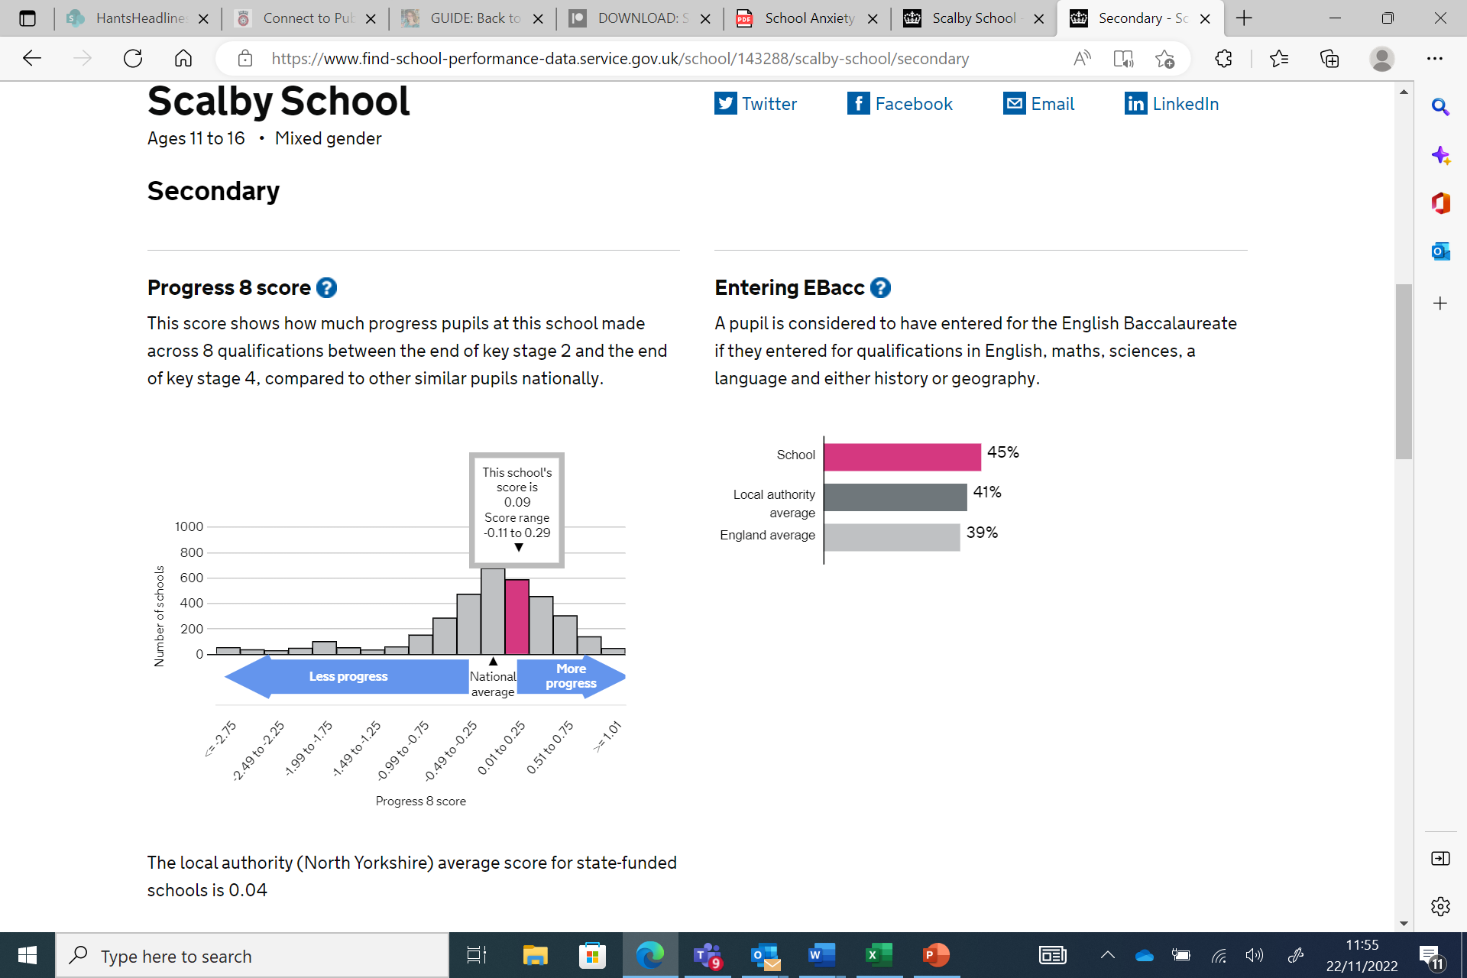

Slide 13
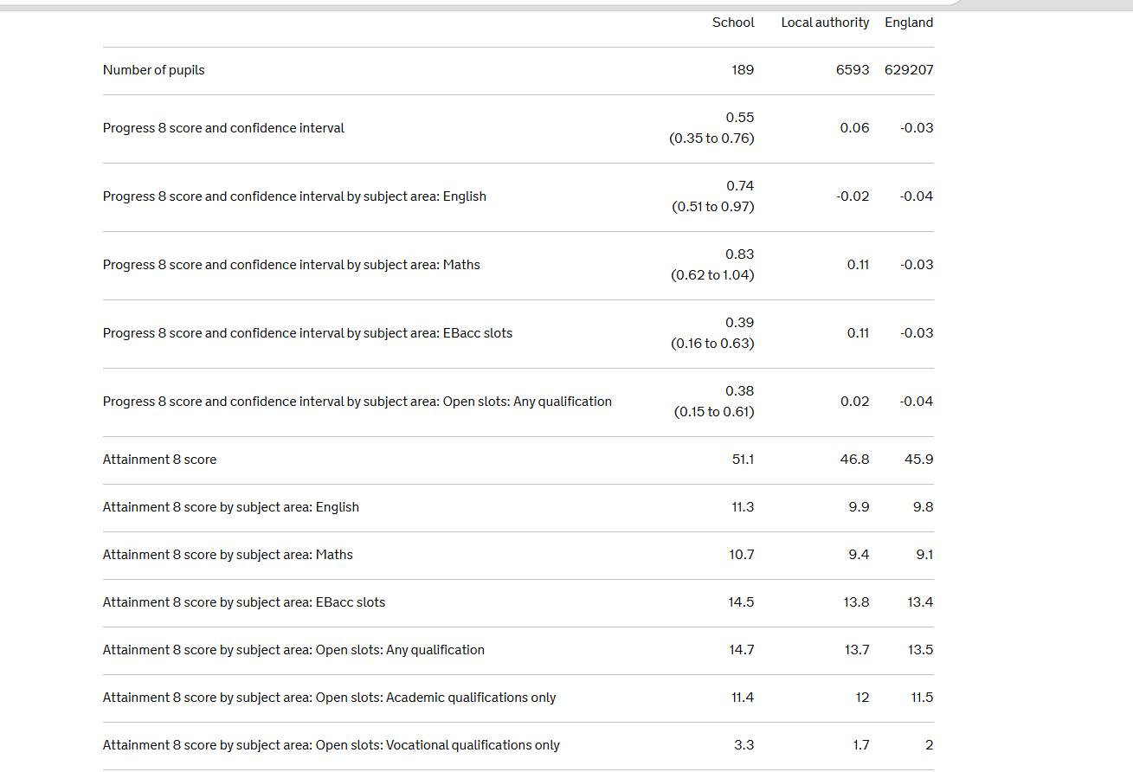

Slide 14
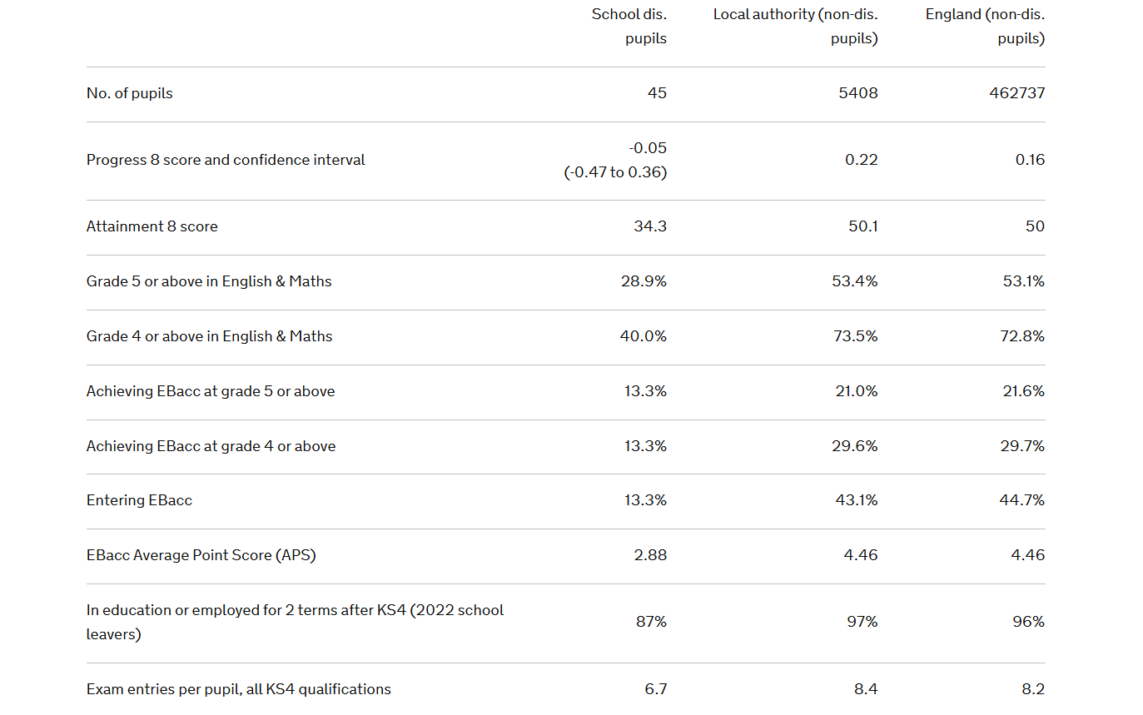

Slide 15
Getting ‘the basics’ right
Relational approach is strong
Culture and ethos, upholding school values is high
Plan, teach and assess – all done very well
Underperformance is tackled positively and early
Success culture created, self belief developed
Reflective and able to talk to students to further improve their own practice
Track the timetable of one of your spotlight pupils

Slide 16
In a group of three
Share year 11 numbers, two strengths and one thing that is worthy to note in terms of improvement needed/perplexes you/professional frustration

Slide 17
For our pupils to do well….
There is always a solution, no matter what the barrier*.

Slide 18
Four strategies to raise attainment of disadvantaged students at KS4 - SSAT (ssatuk.co.uk)
For our pupils to do well….
Start with the outcome you want
Make sure the curriculum you have in place will deliver for all students
Look at and act on your cohort’s data carefully and often
The data tells the story – act swiftly to close gaps as they occur

Slide 19
How does this work in your school?
Data input – review – HODs – teachers – students
How do teachers convey the passion for their subject and belief in students to do well in their subject? Do they connect, use relatedness and engage?
How do teachers hold themselves and students to account for improving achievement versus their starting points?
Is this true irrespective of any barriers?

Slide 20
The Big Ideas
Pupil motivated to do well
Strong aspiration
Willingness to learn…and fail and learn…resilient
Work ethic
Family highly value education, highly supportive, reading and learning is valued
Guaranteed a job in a trade, no grades needed
Struggles to trust adults, tracking the timetable shows little interaction from teachers, low praise/reward

Slide 21
Our spotlight pupils
Every child an individual with a satchel of strengths
Hidden talents and transformative engagement sits within – we have to find the lever to unleash it
Belief is key
Valuing education? If they don’t, is our relationship strong enough that they want to do well for us instead.
‘We push them until they can push themselves.’

Slide 22
Working with your spotlight students

Slide 23
Good…and to improve
Belonging, Purpose, Success
What are the three best things about school
‘If only we knew’ …what would you tell us to help you be even better
Attitude to learning – 1 to 10 and/or Effort – 1 to 10
Outcomes – 1 to 10
Target set using SMART

Slide 24
Semi-structured conversation with the conversation (and not the recording) at the heart of it
Belonging
Who does the student feel they can talk to/has a good relationship with?
Who would be their choice of mentor? Can they explain why.
What are their friendship groups like?
Have they got any ideas of how they could help in school? What do they think are the best 3 things about school?
Purpose: What do they do that they enjoy?
Do they have any responsibilities (eg caring).
What are their main interests? What is their aim post-16? Have they had enough time to explore their interests/aspirations in order to secure a pathway?

Slide 25
Success: Tell me one thing you were last successful in. When you do well, how do you best like to know eg verbal praise, postcard home…
In all of your subjects, which do you believe you can be most successful in. Why? Least successful in? Why?
What would you finish this sentence with:
If only you knew….

Slide 26
Graphing or something similar…
Plot their view of their effort/attitude to learning in a subject, their view of ‘how they are doing’ (outcomes). Retrack if higher than they think. Plot cross.
Complete for all subjects.
Set 3 SMART targets.

Slide 27
Modelling the to-do list
Organisation is an example of taking control so that what needs doing is not overwhelming – talk to pupils about how they manage this
Model how to do this effectively using two/three approaches and get them to co-construct what they would like to try for themselves

Slide 28
How good are our teachers at the robust and not so robust conversations?
Do we catch a pupil doing really well?
How is warmth and ‘we are doing this’ fostered?
How is encouragement built?
If a pupil’s effort is not where it needs to be, what is said/done? Do we build the incremental steps to success? Chunk the overwhelming into the manageable?

Slide 30
Reflect
Welcome, introductions and aims
Unpicking some success
Let’s explore and share our cohort details
So what…and what’s next – the gap task
Assessment stamina and the will to succeed.
Meeting closes by 4.30pm

Slide 31
Using data to feedforward
After enjoying successes with your students…
We understand that you rapidly assimilate, evaluate and start to move forward to concentrate on all pupils in following cohorts…as well as what is needed specifically for this year’s year 11.

Slide 32
Exam performance
Every school prepares students for exams
Is there a difference between class performance and exam performance?
What subject specific aspects need considering?

Slide 33
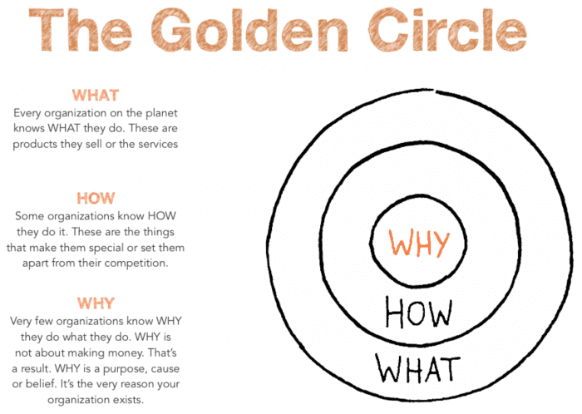

Slide 34
It takes a village to raise a child…
To raise attainment it will take a unified, vision-aligned and consistent approach from a number of staff in a relentless fashion for this to be secured.
Achieving this with the pupil at the centre with the aim they become self-driven….
‘pushing pupils until they can push themselves…’

