Slide 1
Diversity, Inclusion and Belonging - Our Approach
How we celebrate diversity and ensure all in our multi-faith, multi-cultural, high EAL school feel a sense of belonging.
Presented by: Catherine Whatley, Headteacher St John the Baptist Catholic Primary School, Test Valley
Notes:
Introduction –
Hello,
Thank you for your time this morning.
I have been asked to share with you our school’s approach to diversity, inclusion and belonging. We haven’t introduce a new initiative, or followed a particular resource or programme, it is much more about our shared sense of purpose and the school’s ethos.

Slide 2
Our Context
Finding the WHY - ethos
Pulling in the same direction
Getting the welcome right
Curriculum
Celebration

Slide 3
Our Context
FSM – 6%
EAL – 55%
SEND – 10%
Ethnicity – 60%
Comparisons taken from IDSR, 2nd May 2024 update
Notes:
So a little bit about who we are?
We are a 1-form entry primary school – 207 children across the 7 classes, YR – Y6.
We are a voluntary-aided Catholic School within the diocese of Portsmouth.
A town school, with a wide catchment due to our faith status. Our families are from Andover and surrounding villages, some travel in from Wiltshire.
We take children from 13 – 17 different pre-school settings and our children go on to 7 – 9 different secondary schools.
Our families are already very diverse geographically when joining our school and also when moving on to the next stage of education
Looking at our IDSR, our Free School Meals and SEND groups are well below national average
This has remained consistent over the last three academic years.
However, FSM numbers, although low, are treated with caution. School deprivation is below average. We have hidden deprivation amongst our families. Many of our families work multiple jobs to ensure they do not hit benefits thresholds. They value education and work, and both parents will work long hours to support their families. The impact of this is our children have less time with their parents, language and personal development can be impacted. But formal recognition and funding is not there to support these families.
We have a growing diversity through Faith – Although a Catholic school, we have a growing number of Hindu, Sikh, Muslim, Buddhist and non-faith families joining us as well as families from many other Christian denominations.
But the groups which have the greatest impact on diversity and our work to ensure we are inclusive and everyone feels they belong is Ethnicity – 60% of our families identify as not white British. Asian and Black ethnicities are significantly above the national average, as are non-British white backgrounds. This is comparable to city schools and make us unique in our local area.
Over the last few years, children speaking English as an additional language has ranged from between 49% and 55%. English as Additional Language – 49% (57% in the highest class), 20 identified different languages are spoken across the school. The most common language spoken beyond English is Polish, followed by Malayalam. Other languages include Fijian, Hungarian, Nepali, Sinhala, Slovak, Urdu, Romanian.
The diversity of ethnicity and language means we have a rich cultural diversity too. This brings with is many positive opportunities and plenty to celebrate but also challenges. Unfortunately, our families share stories of discrimination within the wider, local community and our children witness and experience direct discrimination themselves. We are all experiencing a decline in children’s speech and communication development as they start primary education. Alongside this, we are increasingly welcoming children into YR who have little to no spoken English.

Slide 4
Finding the why – ours is faith
Self-actualization
Esteem
Physiological
Safety
Love/Belonging
Co-construct Vision, Mission and Values
Weave this into all aspects of the community
Performance Management
Language used around the children
Language used between staff
Agree ‘what this looks like on the ground’
Notes:
Celebrating the rich diversity of our school and ensuring an inclusive environment where everyone feels a sense of belonging is key to the success of our school.
Using Maslow’s hierarchy of needs, we know that a child needs to feel that they belong before any learning can take place – their basic and psychological needs must be met (security, safety, friendships, prestige and a sense of accomplishment)
We are also a Thrive school. Using the Thrive strands, the Power and Identity stage of development is a key time in primary school, impacting our children between 3 years and 7 years old. Establishing a sense of identify, and celebrating what makes each child different and unique, has to be the bread and butter of the role of adults at KS1.
All this professional knowledge is great, but every member of staff has to be on board for it to have the impact we want and need. I once heard someone say, “It takes a village to raise a child. But if that child thinks the village hates them, they will burn it down”. This really resonated with me and it has become the mantra for SLT.
So, to get every adult in our school on board, we needed to find our why.
For us, it is our faith. But the ‘why’ could be anything. It is intrinsically linked to who or what your school is. Because we are a faith school, our why sits with our patron saint (SJB) and our parish mission. But digging into the history of any school, its name, its community and you will find the moral purpose to underpin your why.
We started by co-constructing our Vision, Mission and Values – staff, governors, children, parish, parents altogether. I wanted to ensure that our ‘why’ was clear, simple, shared by everybody and became the golden thread that ran through our school from policies to practice, the language we use, the curriculum we offer.
Once we had our Vision, Mission and Values in place, I explored this with staff and governors so we had a shared understanding of what this looks like ‘on the ground’ – in our day to day practice. This understanding feeds into performance management discussions and targets, the language we use around the children and to each other, even when the children are not within earshot. This work took place over several twilights, with all staff contributing, and resulted in a document which comprehensively explained our ‘why’. At the centre of our ‘why’ was the word TOGETHER. It became clear, very quickly, that the staff wanted to ensure that despite the diversity of our community, that we were one family and worked TOGETHER as staff, parents, governors and children.

Slide 5
Pulling in the same direction…
Notes:
What is our driver? What is our identify?

Slide 6
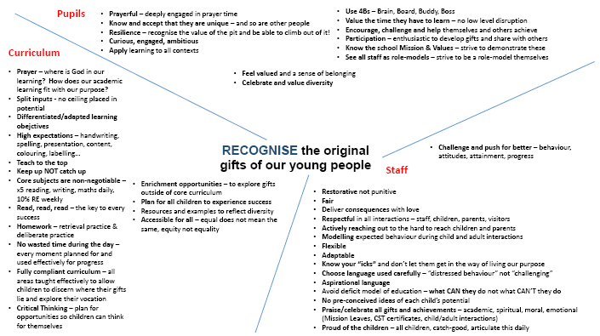
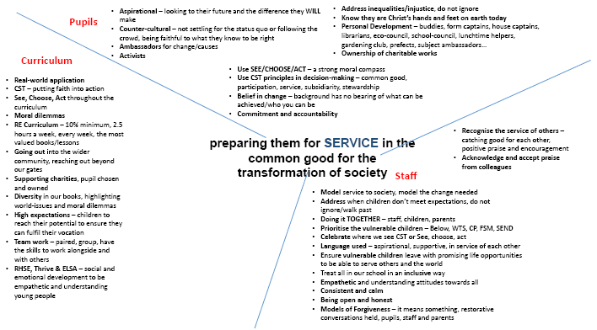
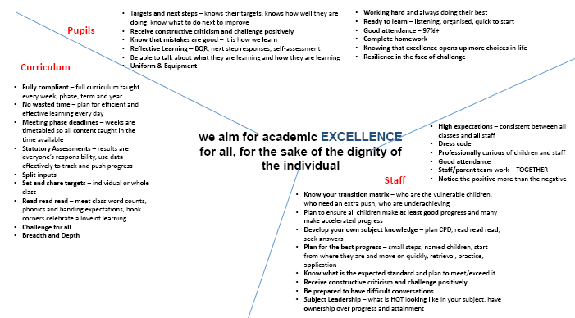
Understanding our role within the school’s vision
Notes:
The Vision statement is the adult’s ambitions for our school – our ultimate goal.
When exploring the vision of our school – we identified how it impacts the curriculum we offer, staff conduct and the expectations we have of our pupils/

Slide 7
Understanding our role within the school’s mission
Notes:
The Mission statement is the child’s version of our ‘why’
When exploring the vision of our school – we identified how it impacts the curriculum we offer, personal development, behaviour & routines, prayer & liturgy, school values and the purpose of Catholic Education

Slide 8
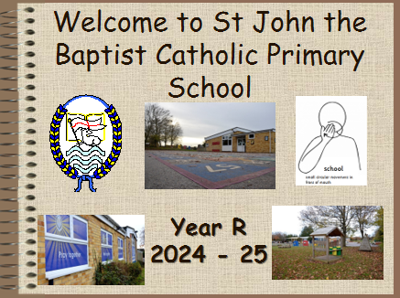
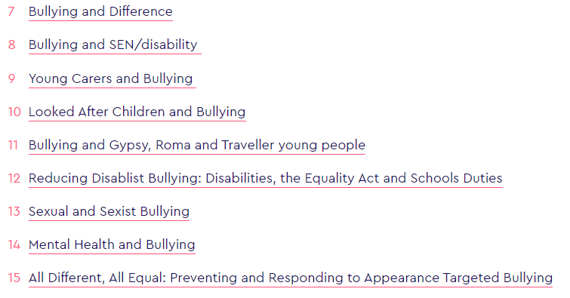
Getting the welcome right
Welcome, Generous, Service, Faithfulness
Transition
Capture home languages early
Welcome booklets available in other languages
EMTAS Coffee Mornings
Early Reading Workshops
Learn the children’s names
Parent Support Group
Training & Learning
Awareness days
Discrimination
Anti-bullying Alliance CPD
Anna Freud, Educate Against Hate, Mentally Healthy Schools, Child Net, LBHF
Notes:
We then focused on our school values and reflected on whether or not our processes reflected our ‘why’ – focusing especially on inclusion and belonging.
It was really important to staff that the sense of belonging and celebration of diversity was planned for from day one.
When we capture data to welcome new children and families, SLT look particularly for diversity of language and culture. This helps us to ensure our families are included in welcome meetings and supported to integrate into school life.
Once home languages and cultures are captured, we can tailor welcome packs and conversations to each families needs.
Makaton is used alongside the written word in all our school-made welcome packs and transition books
Ready for School flyers from SfYC are provided in all the languages represented in each new cohort
EMTAS Coffee mornings are booked for early in the Autumn term with as many translators as we can get. The SENCO organises this as she also leads on EAL. This ensures that SEN is identified early and not confused with EAL need.
Through conversations with our families, we regularly discover that many have anglicised their child’s name under the misapprehension that we won’t be able to or might be unwilling to use their given name. It means a lot to our families when we use the child’s given name and support their peers to use it too.
Inclusive language – we anticipate families who have very different views of SEND and difference. Then language used around SEND and behaviour has to be modelled very carefully by staff to ensure it is aspirational and strengths-focused rather than a deficit model.
As soon as we think we know the barriers to belonging, another one surprises us. So we are always learning as staff.
- Over the last three years, we have completed the Anti-bullying Alliance audit of provision. As part of this journey, we complete annual ABA training. It is free of charge and offers a variety of online learning topics which have helped us raise awareness and promote inclusivity and belonging across the school. The barriers for all vulnerable groups can be explored and effective, easy-to-implement strategies are provided.
- Discrimination is tracked through CPOMS, broken down into each category (racist, sexist, homophobic, disablist etc.) This is analysed by SLT for patterns and learning opportunities, which is then built into staff briefings and CPD throughout the year.
- Regular Staff training: Mentally Healthy Schools (challenging stereotypes), Child Net (banter), Anna Freud (stereotypes), LBHF (prevent, hate crime)
- Awareness days: Lots of Socks Day/Andover Twenty1 for Down syndrome, Neurodiversity, plus many more built into the curriculum, more of this later

Slide 9
Curriculum
Empowered to make change
Led by the children
MPs
Environmentalists and Ecologists
Local and national businesses
Local and national charities
Text Drivers
Reflects our school community
Every child can see themselves
Representation
Curriculum Weeks
Displays
Images in exercise books
PowerPoints & Resources
Book Corners
Balance
Charity events
World Events – viewpoints
Notes:
We have built our curriculum around our community. It has been really important to us that to build a sense of belonging, our children not only had to feel they belonged but also see they belonged.
Our writing curriculum is led by text drivers – we choose texts that will challenge and inspire the children to write. Over the last three years, we have revisited the texts we have chosen to ensure our children are represented. From picture and story books in Year R where the main character is culturally or ethnically diverse to short stories and novels in KS2 where the main character is Muslim or Sikh or has a disability or a difference. We plan carefully to ensure there is also a balance of genders and the contexts explored open our children’s imaginations to the experiences of their classmates.
Amazon, Scholastic Shop, Booklove,
Book Corners were also a particular focus – giving them a refresh so not only were they inviting but any child could find a books which represented them
Seeing themselves as learners and as belonging to our school extends further into our curriculum offer.
We dedicate a week, three times a year, to an individual subject. This provides us with an opportunity to fully celebrate that subject, build in CPD for staff as we plan and deliver an aspect of that subject from YR to Y6, involve parents’ expertise and invite them to celebrate their children’s work and make links with local companies. But we plan to ensure these weeks represent our community too.
STEAM Week – alongside Stannah Stairlifts, based in our town, with a particular focus on female engineers and women in STEM.
Science Week – scientists from different backgrounds and who are not the stereotypical examples.
Maths Weeks – female mathematicians and those from different backgrounds.
Our displays and the resources and images we use to support learning are also monitored. Rather than find the first google image that appears, teachers ensure there is a balance of faces, people, abilities in what they provide to the children.
Empowered to make change
Throughout the curriculum, where ever we can, belonging, inclusivity and the celebration of diversity is planned for. Some of this is led by the children – for example, writing to our local MP to complain about the environmental impact of single use plastics (through a writing journey) or learning about a local homeless charity and raising money to support local young people in need (RE). These examples, although not clear at first glance what they have to do with diversity and inclusion, empower our children to have a voice and to not be afraid to raise that voice to tackle inequality of injustice. This is so important when some of our children feel disempowered to speak because of their own experience of inequality or discrimination.
Balance
One particular challenge we have faced in the past is that of balance. Engaging in charitable work is a core part of our mission and the children engage in a wide range of local and national charities, some long standing support others based on a particular event or emerging need. With some charities, we often found that the representation of a particular nationality or culture could be skewed if not carefully balanced. We had one particular Y6 cohort who were passionate about challenging the white-hero narrative and wanted to ensure balance was provided in the charities we support. So now, our Year 6 cohorts research the charities they wish to engage with, present their choices to the rest of the school, who then vote for their chosen charity and decide how to fundraise – PJ days are very popular this year!
The same can be said for the news outlets – as our children progress through the school, they notice bias on the TV, online and in newspapers. So we have built into our curriculum opportunities to discuss bias, stereotypes and address national and international events to highlight where more tolerance and acceptance is needed.

Slide 10
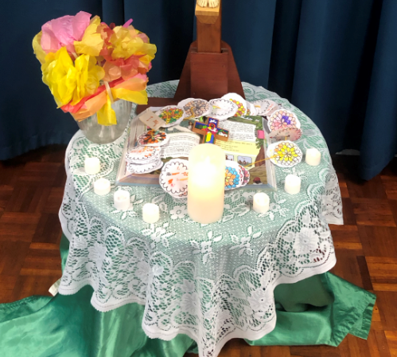
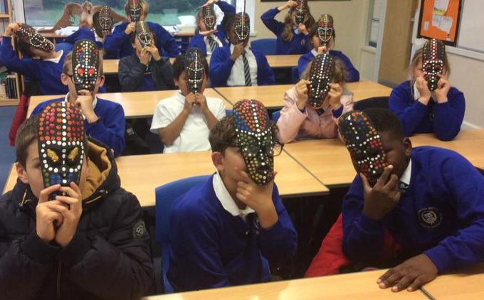
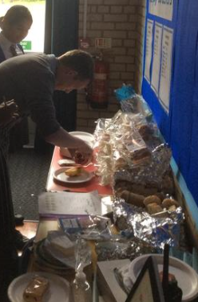
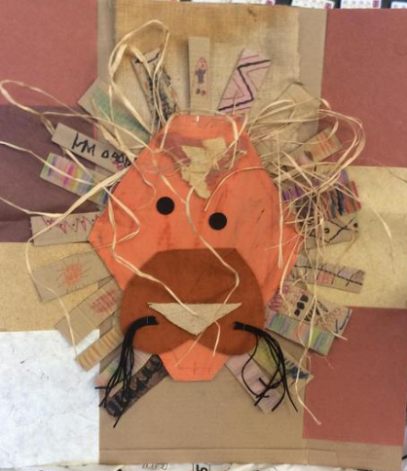
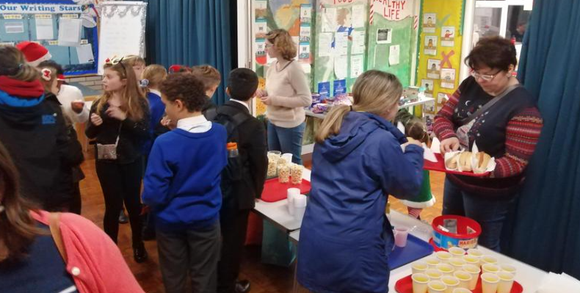
Day of the Dead
Art
Music
Religious Education
Prayer
Food
Community engagement
Passport to the World
Dance
Music
Language & storytelling
Prayer
Food
Community engagement
https://st-john-the-baptist-catholic-primary-school.primarysite.media/playlist/celebrating-diversity
Celebration
Friends of St John the Baptist
PTA
Community engagement
Food stalls
Small businesses
Music
Dance
Tailored to our children
Lots of Socks
Neurodiversity
House Charity Events
Notes:
Beyond routines and the curriculum – our bread and butter, we plan an annual calendar of celebration. Opportunities for the children to celebrate our diversity, to recognise the strengths it brings and to welcome our parents in their learning and our school family.
Passport to the world:
This week takes place once a year
We focus on different languages each year: Malayalam, Italian, Polish, Yoruba, Pidgin English, Igbo, French
It started with a celebration of European days of languages but we changed this as the diversity within our community changed and grew.
This week long celebration includes Traditional dance and music and art, story telling traditional tales and learning vocabulary, Prayers – in home languages
The wider Community is involved – many activities supported and led by parents
Although a Catholic school, Catholics from other countries will often celebrate our feasts and holy days differently to how we celebrate in the UK – Harvest, Christmas, Lent, Easter, Saints days are all exmaples of this.
Recently, we celebrated our South American and Asian communities with the Day of the Dead/All Souls Day (November)
November – Feast of All Souls
South American and Asian communities celebrate the Day of the Dead
Lessons
Created marigold flowers, calaveras, ofrendas
Prayer for our dead
Special School lunch
Community – many activities supported and led by parents
FOSJB –
food stalls – Indian, Pilipino, Italian,
Small businesses – Nigerian clothing and accessories, Ghana
Music groups – Pilipino,
Dance – Indian, country dancing,
Multicultural celebrations
Our Feast day (24th June) we hold an annual families picnic on the field – all are invited to share lunch with us before we hold sports day in the afternoon.
This year, many of our communities came out in force, setting up picnics, sharing their food, and welcoming all to their groups
Tailored to our children – sense of belonging, empowered to change
Locks of Socks – Down Syndrome
Neurodiversity – Autism, ADHD
House Charity Events – Help for Heroes, Naomi House, Jack’s Place, Sibs, Blue Cross, Heart Foundation

Slide 11
Our Context
Finding the why – ours is faith
Values
Mission
Values
Welcome
Curriculum
Celebration
Notes:
In summary,
Our approach to diversity, inclusion and belonging has been built like this…
We started by looking closely at our context
Then understanding what our ‘why’ is, our purpose, who are school was at its core
Then co-constructed our road map – the vision, mission and values. All stake-holders and at staff/governor level, a shared understanding of what this looks like on the ground
From here, we can plan for the experiences our children and families will have, so all feel they are represented and belong, all have a voice and can make a difference – procedures, curriculum and celebration
Any questions…

