Slide 1
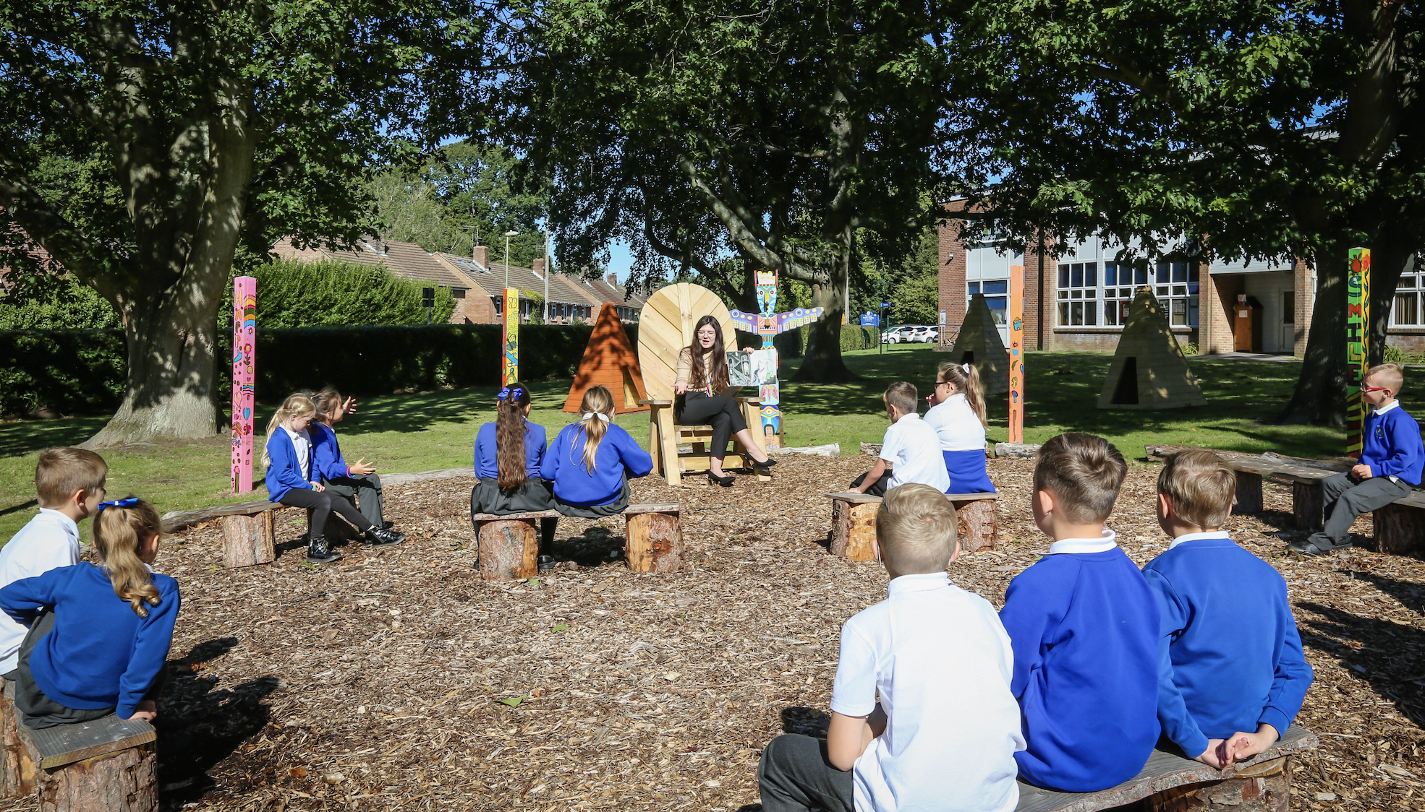
Hampshire Research School
Notes:
Hants research school - front lawn primary - based in Leigh Park. 2 form entry primary school with a nursery - 430 pupils, 30% SEND and 70% PP.
Today here to talk to you about how we’ve used EEF research in reading comp to underpin how this is taught consistently across the primary and share with you the impact it has had.

Slide 2
Notes:
Over 30 RS now work closely with EEF. We are the only primary one in hants.

Slide 3
As a Research School, our core purpose is to:
- share and disseminate the very best of evidence-informed practice to schools and teachers across the South of England
- help teachers and leaders to mobilise the research evidence that is out there, into their classrooms
- provide evidence-informed training around a range of themes
- support schools in the region.
Notes:
Take evidence and show how to use in classroom - demystify the jargon. Useable for school leaders.

Slide 4
Notes:
EEF provide guidance reports which show you the best bets to make improvements in a particular area. Uses efficacy trials and numerous studies and then assimilates the results into key recommendations.

Slide 5
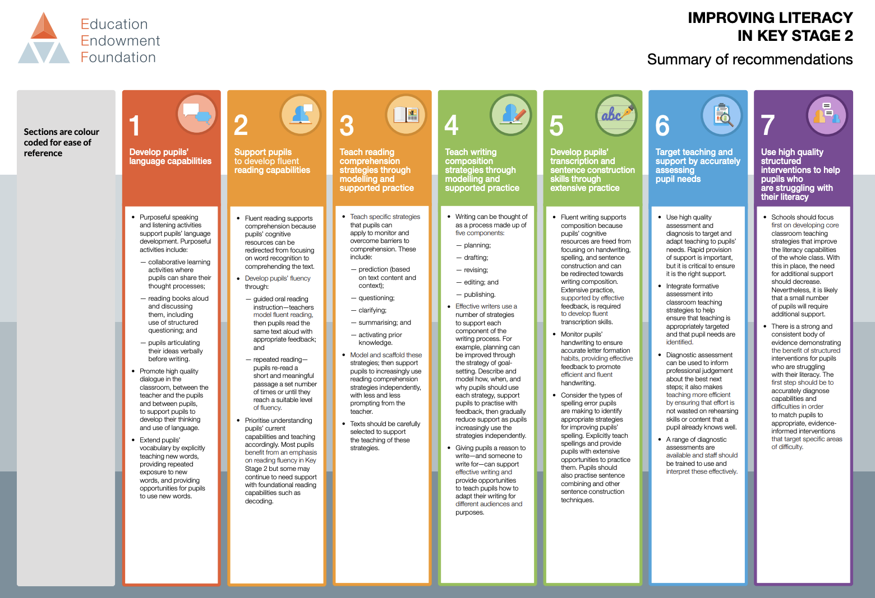
Notes:
Focusing on Imp lite in Ks1 and 2.

Slide 6
EEF - Key Findings
Reading comprehension strategies are high impact on average (+6 months). Alongside phonics it is a crucial component of early reading instruction
Effective diagnosis of reading difficulties is important in identifying possible solutions
A wide range of strategies and approaches can be successful, but they need to be taught explicitly and consistently

Slide 7
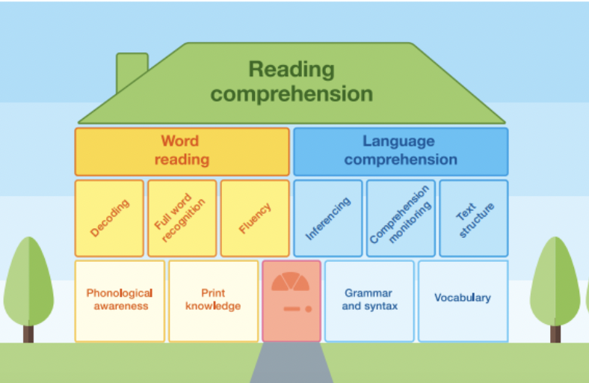
Comprehension focus
‘Reading without reflecting is like eating without digesting.’
Attributed to Edmund Burke- 1729-1797
Notes:
Without explicit teaching of reading comprehension, we leave this vital skill to chance. The right to read with understanding is the foundation of learning and well-being.
It is the basis of a ‘read for pleasure’ culture. But before we delve into the teaching of reading comprehension strategies - have a look at the house what do you think is missing?

Slide 8
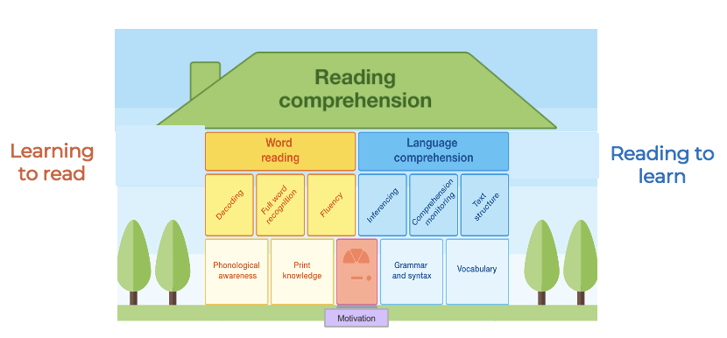
The Components of Reading

Slide 10
How do we increase motivation?
Elicit curiosity
Provide opportunity for safe exploration
Increase social interactions
Provide right level of challenge
Praise the process rather than the outcome
Harvard University
Notes:
These flick up one at a time…

Slide 11
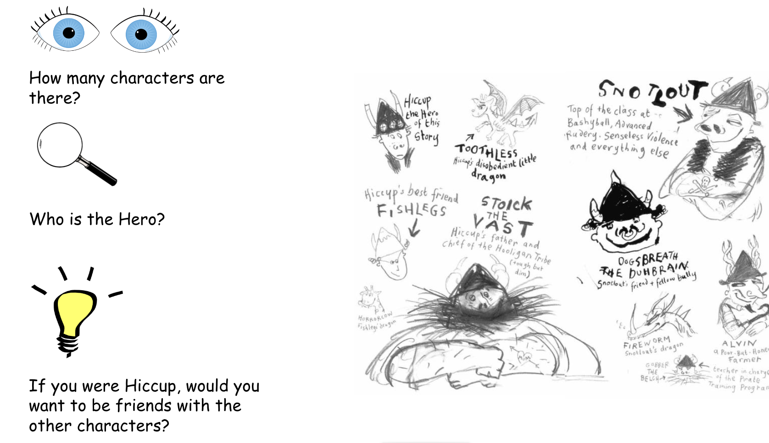
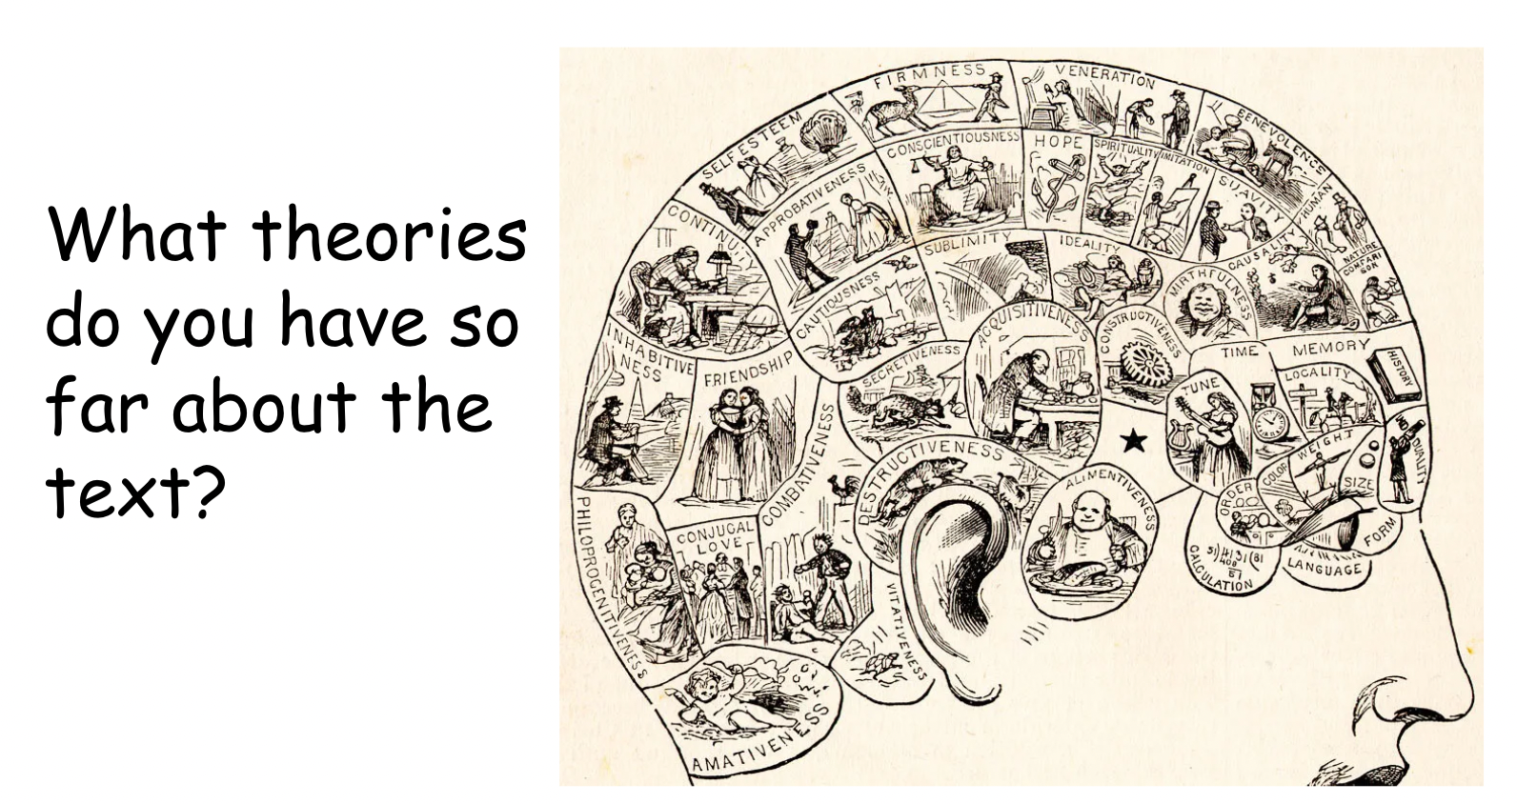
How do we increase motivation?
Elicit curiosity
Notes:
Elicit curiosity - are we making time in the timetable to allow children to be curious about the texts? To give their opinions openly and question what they are reading? Do they have the chance to not only make predictions but to discuss their initial theories about what they are reading and what might happen and how these may develop?

Slide 12
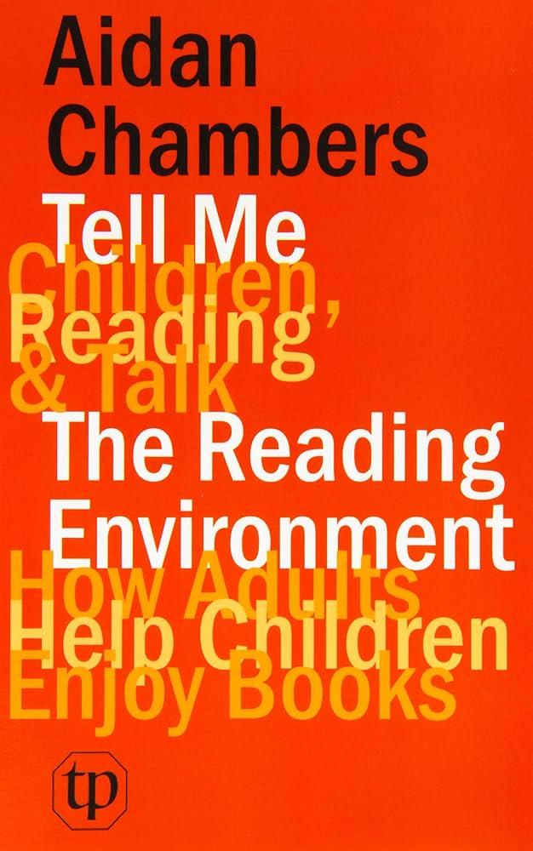
How do we increase motivation?
Provide opportunity for safe exploration
Increase social interactions
Notes:
These flick up one at a time…
Safe exploration and increased social interactions - know how important it is for children to be able to discuss their learning in order to make sense of it. It is the same with reading - do whole class reading lessons have book talk style lessons planned into where children can build or challenge each other’s ideas, do they incorporate the work by Aiden Chambers ‘Tell me grids- - safe space to get things right or wrong and do we use sentence stems to help scaffold children so that they can safely interact with each other?

Slide 13
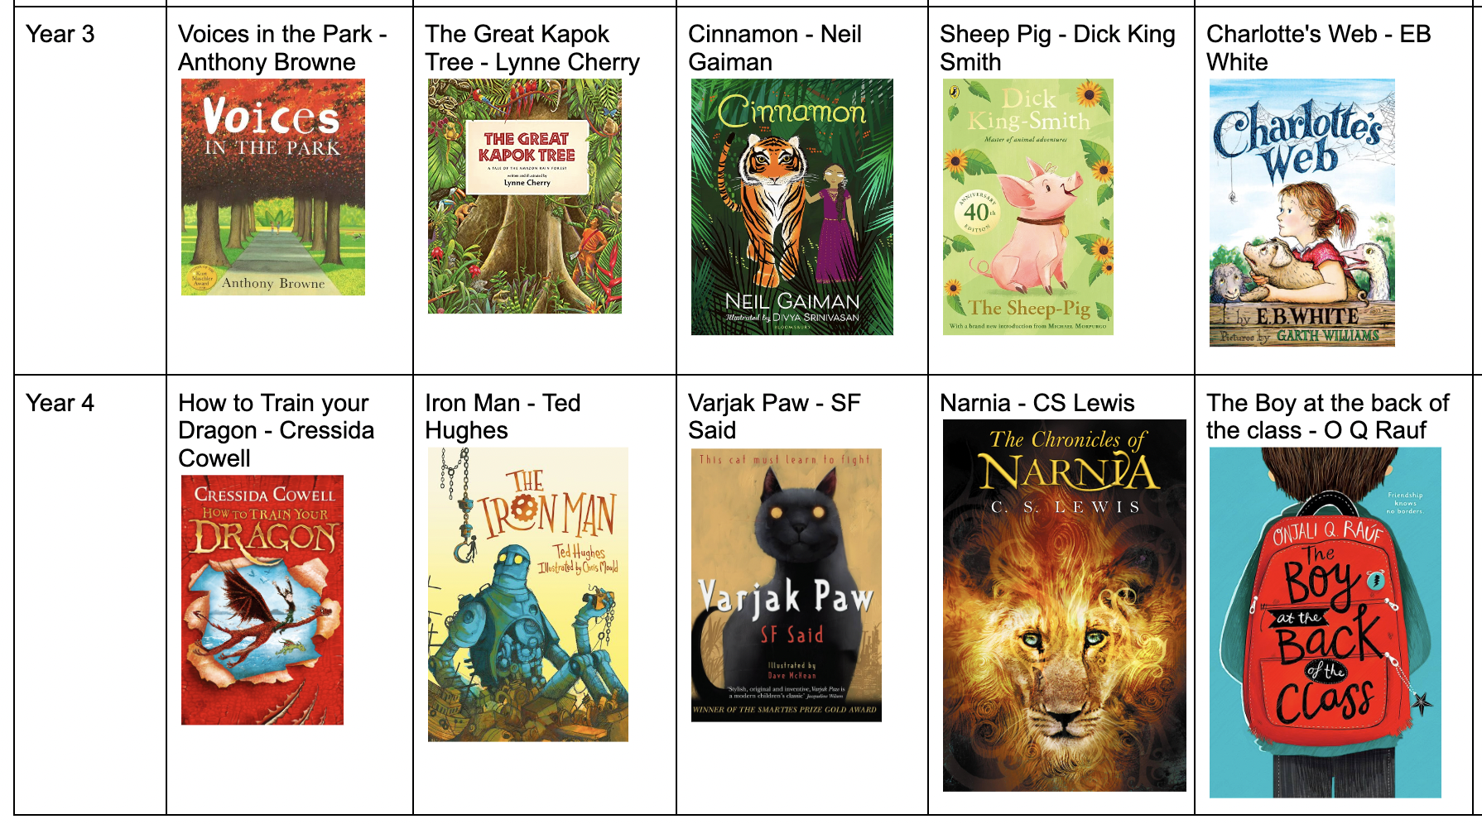
How do we increase motivation?
Provide right level of challenge
“Reading teaching which is based on rich and challenging texts being read aloud by the teacher is especially valuable for pupils that struggle. They have access to texts at the level that some can read independently, so they encounter the same ideas and language that he already meets.”
Reading Framework 2023
Notes:
Challenge - if we are going to beat the matthew effect - are the books that we expose our children to challenging enough for their age - do they stretch them and make them want to read more - either on their own or with an adult. If we are reading to them they can access any book - often children who are poor word readers can comprehend at age related so they need that exposure.

Slide 14
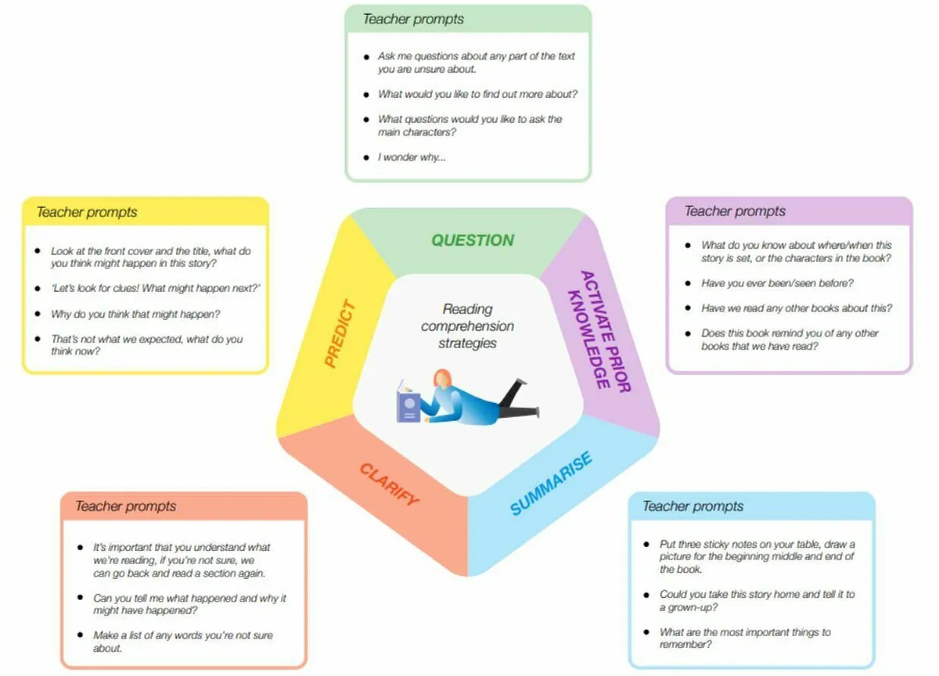
What are reading comprehension strategies and how do they work?
Notes:
So once we are confident we are motivating children we do then need to think about the explicit teaching of the comprehension strategies and the EEF list these strategies as being the important ones to teach…..questioning, prior knowledge, summaising, clarifyign and prediction. Without explicit teaching of reading comprehension, we leave this vital skill to chance. The right to read with understanding is the foundation of learning and well-being.
It is the basis of a ‘read for pleasure’ culture.
Reading comprehension strategies are a series of techniques which support children to comprehend the meaning of what they are reading.
For example, where weaker readers may be less successful in asking questions of a text, modelling and scaffolding can supports them to do so.
We may also support children to summarise what they have read so that they are able to consolidate the meaning of the text effectively
When consid
The explicit teaching of reading comprehension strategies works by giving ​‘novice’ readers the tools to think like ​‘experts’ when reading

Slide 15
Portrait of a strategic reader
Before reading…
Asks questions about the text
Activates prior knowledge
Makes predictions
During reading…
Monitors understanding
Makes connections within and beyond the text
Makes mental models of the text
Updates and makes new predictions
After reading…
Clarifies understanding of the text
Revisits and revises predictions
Asks further questions
Reflects on their own reading
Notes:
Ultimately, we want all children to become strategic readers. Discuss the behaviours of a strategic reader and how this can be seen to develop with ease for some children. Reiterate the point that weaker readers have not developed these strategies and therefore need to be taught them.

Slide 16
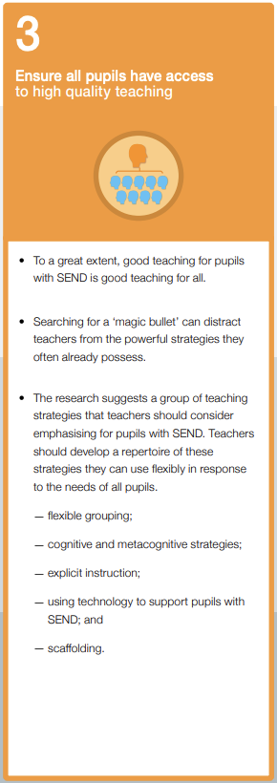
The gradual release of responsibility model describes how greater responsibility for using these strategies can be transferred to the pupil:
Explicit description of the strategy
Modelling of the strategy in action
Collaborative use of the strategy in action
Guided practice using the strategy with gradual release of responsibility
Independent use of strategy
Notes:
Developing comprehension strategies requires explicit instruction and extensive practice. Evidence based collaborative activities and approaches, which structure intervention with peers, are likely to be beneficial.
Links a lot to the Inference training from Leicester – look at folder in my cupboard!

Slide 17
Prediction
"I have called you here today," boomed Stoick, "because we have a problem on our hands.A rather large Dragon is sitting on the Long Beach." "This is no ordinary Dragon," said Stoick. "This Dragon is HUGE. Enormous. Gobsmackingly vast. I've never seen anything like it. This is more of a mountain than a Dragon. And, as our fleet is out of action, we have no means of escape from the island. We stand in awful peril and nobody in this room, apart from Hiccup, can speak Dragonese. Hiccup, will you go to this monster and ask him whether he comes in PEACE or in WAR?" Hiccup had no choice but to nod.
It is one thing to approach a nightmare when you are part of a crowd of four hundred people. It is quite another to do so on your own. Hiccup had to force himself to put one foot in front of the other. The Dragon saw Hiccup watching him in fascinated horror and he brought his ridiculously enormous head down closer to the boy. Hiccup nearly passed out as his offensive Dragon breath poured out in a disgusting, yellow-green vapor. It was the stench of DEATH itself. This dragon meant them harm.

Slide 18
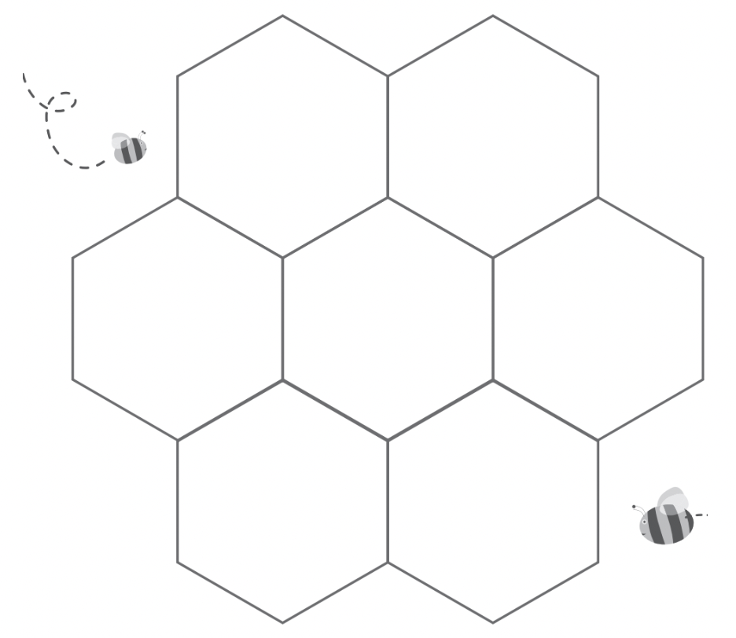
What do we know about Winter?
Summarise what you know.
What do you know about Winter?
Notes:
How does the text help us to imagine?
Model, then children draw and label.

Slide 19
Questioning
His hair was damp with sweat, his fingers clasped tightly round Aya’s thumb. She remembered the first time she had held him, the wave of love she felt. She would never let anything happen to him - ever. “Don’t worry Moosie!” she whispered into his damp cheeks. “Aya’s here, Aya is going to sort it all out.”
Mumma was sitting next to her. She looked tired and far away. She stared at the dusty windows as if she could see something through them that Aya could not. “You okay mumma?” Aya asked. “You hungry? I could get you some food, there’s soup today.” But mumma said nothing. ‘I will make sure she eats properly today,’ Aya said to herself, ‘and rub her temples the way dad used to.’ Aya thought back to her home and sitting at the kitchen table with dad. She could still see dad’s smiling face, the dark almond eyes, the hint of grey in the stubble on his chin. She pushed the thought away, she couldn’t think about dad. Not if she was going to keep it together.
She barely remember how the war in Syria had begun. She must have been small. She had a memory of dad watching the television one evening with some of his friends from the hospital. They were arguing about recent events. “Why are they so angry dada?” she asked. “They want to make Syria a better country,” he said holding her tight. Dad smiled. Even after a long shift at the hospital, he always had a smile for his Aya.

Slide 20
Clarifying
Similarities and differences……
Narnia
Demon Headmaster

Slide 21
Encouraging the children to make connections to their own experiences (TS), to other books they have read/films they have watched (TT) and to experiences they know about in the wider world (TW) will deepen their understanding of what they are reading.

Slide 23
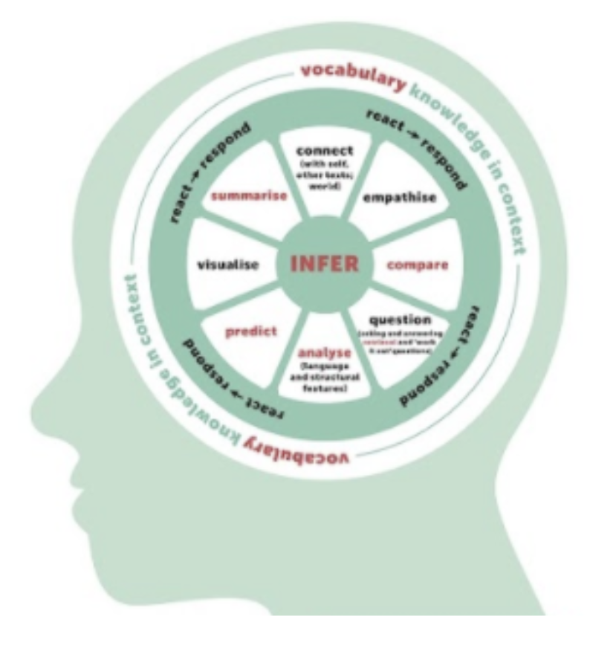
Tools | What the reading tool involves
Predicting | Making a logical plausible guess as to what will happen next
Questioning | Asking questions about the text to show different layers of meaning
Clarifying | Checking how specific words and phrases have been understood
Summarising | Stating the main events or ideas in the text
Visualising | Developing a visual image of what has been read
Prior knowledge | What do you already know that will help you understand?
INFERENCE
Notes:
Need to teach the tools that allow the outcome of inference - spread this out over time so that the children can join the dots and make the connections when they are reading independently - that’s why progression of knowledge for comprehension goes into detail for each tool and why it is plotted out that these are taught explicitly so that the children have a model to follow and then the opportunity to apply independently in order to make inferences.
Pupils should also be taught how to integrate combinations of strategies to develop effective comprehension of different texts. Ultimately, the aim is for pupils themselves to take responsibility for automatically using these strategies to monitor and improve their reading comprehension.

Slide 24
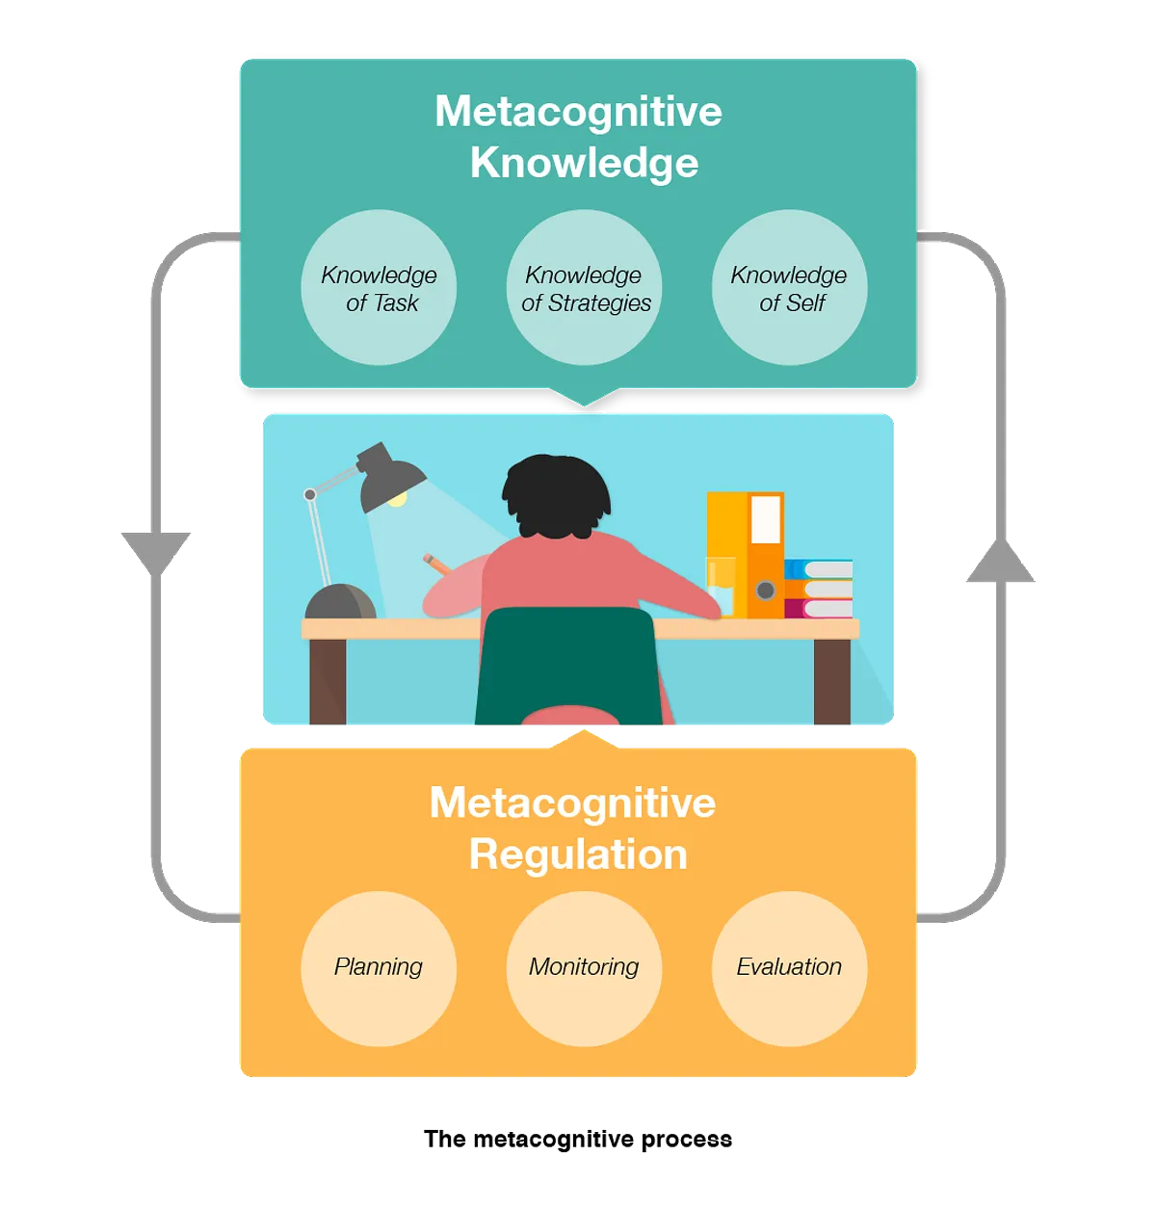
Read aloud-think aloud
I’m going to read a short text and show you what I’m thinking
The focus today is using our background knowledge as we read
Notes:
Get all the strategie working together Link to metacognition report too - in order to teach children how to infer, and use strategies, we need to show them what and expert does, therefore we need to explicitly show what happens in our heads as we read.
This will allow all children to access teh class text - high quality

Slide 25
13..?..unlucky..
maybe a frightening story?
Room 13 by Robert Swindells
reprinted by permission of The Random House Group Ltd
Fliss is on a school trip.
Fliss pressed the buttons in the armrest and tipped her seat back. But then the boy in the seat behind her yelled out that she was crushing his knees and demanded that she return it to its upright position.
Ok I’ve been on school trips …. Will it be like one of those?
Yeah …. So comfy!
Last year on a flight to Spain... that lady in front complained about me!
Notes:
The teacher now shows the slide and reads the text…but “thinks aloud” to show what’s happening in the mind of a comprehender. This thinking as we read should not be a secret..but often it is a mystery to weaker comprehenders

Slide 26
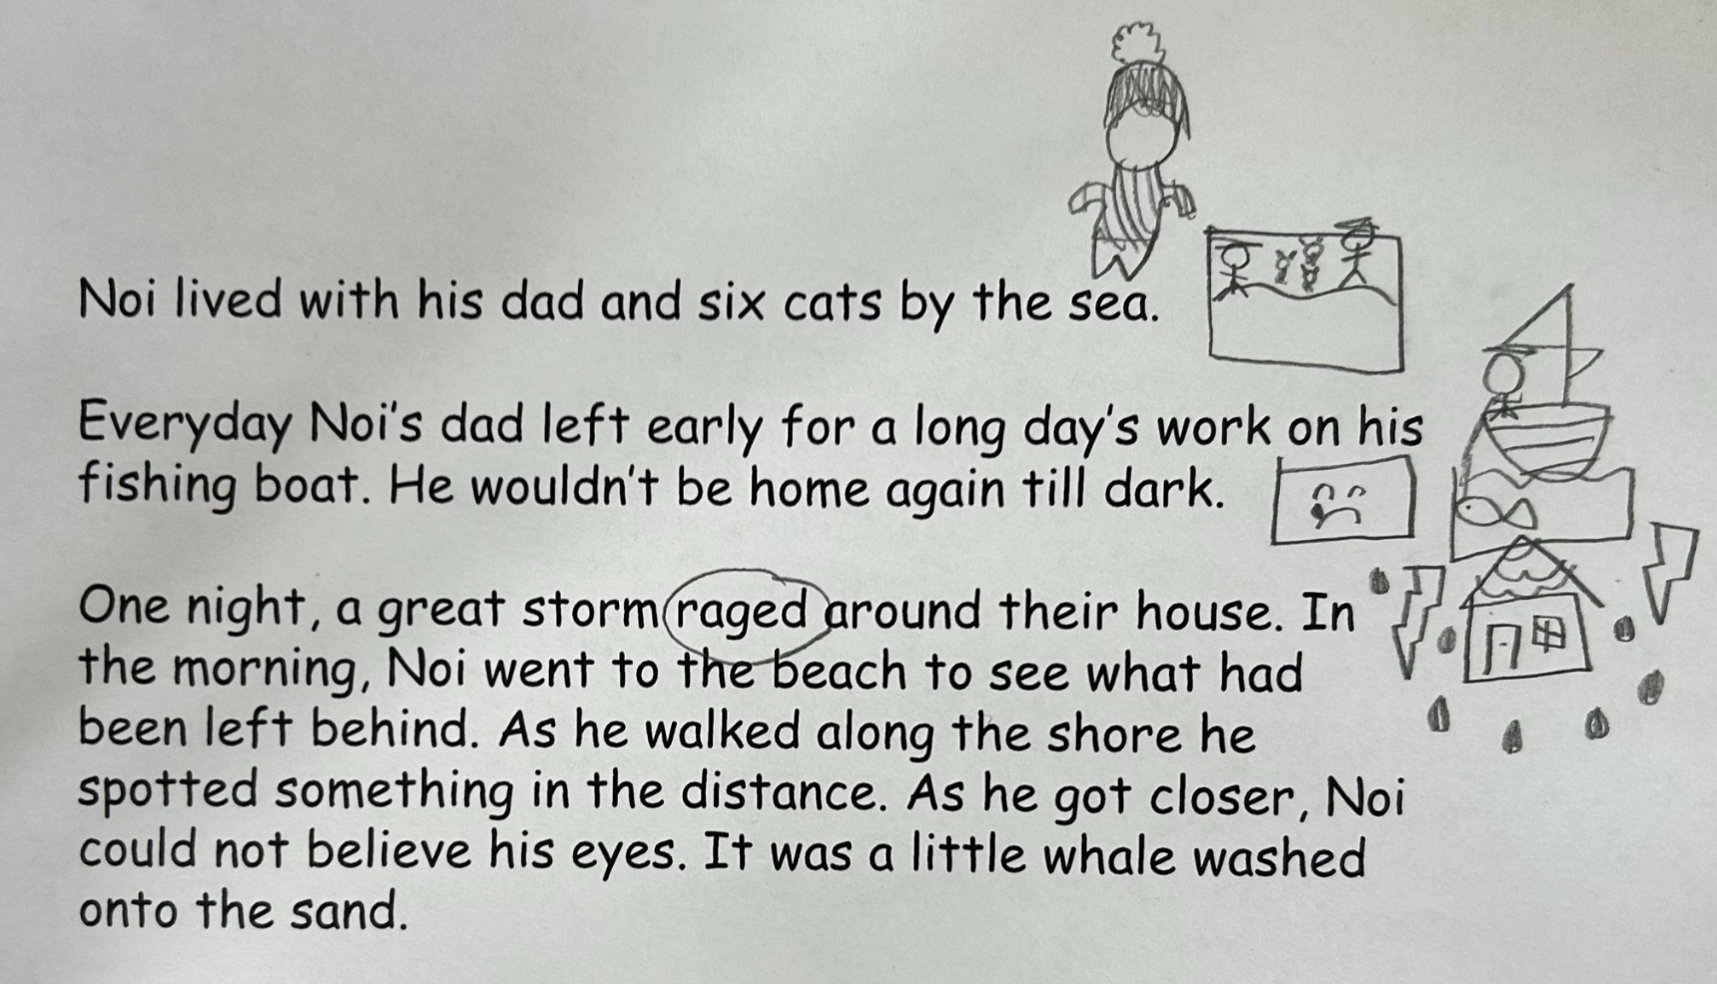

Slide 27
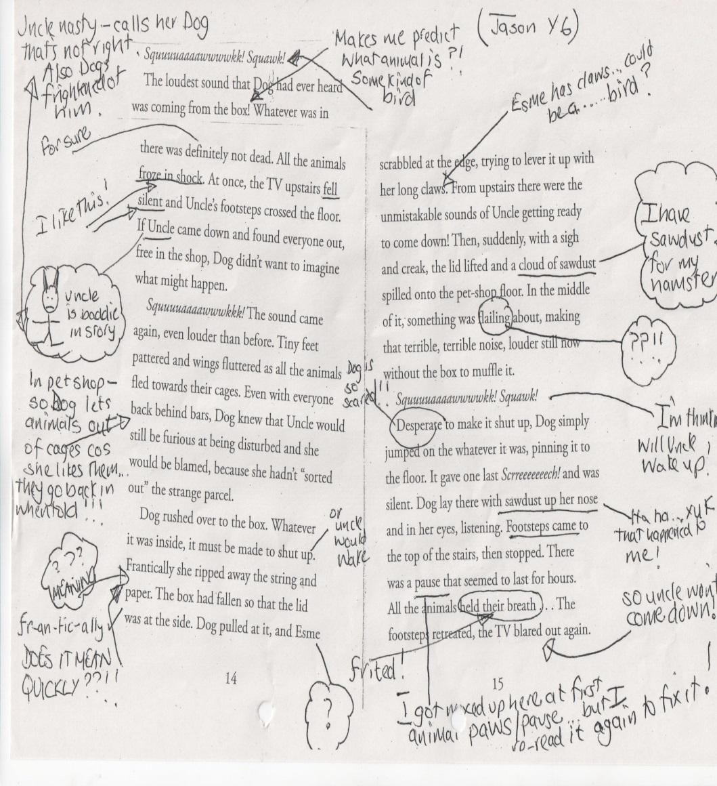
Notes:
An example of how they could annotate a section of text - connections to self, clarifying, predictions, opinion, questions, imagining/visualising….

Slide 28
How effective is the teaching of reading comprehension strategies?
On average, reading comprehension approaches deliver an additional six months’ progress.
Teaching and Learning Toolkit
Notes:
Four padlocks highlights the strength of the evidence base for this.

Slide 29
Impact
2019 | 2022 | 2023
KS1 Reading Results
81% | 80% | 80%
KS2 Reading Results
89% | 76% | 84%
Reading Progress
+2.3 | +0.2 | +2.5

Slide 30
What is your school’s approach?
Does your school have a clear rationale for teaching reading?
Are a range of teaching approaches used?
Are you meeting the needs of all your pupils in the way reading is taught?

