Slide 1
Tutor Reading Programme:
Jonathan Mann - Assistant Headteacher and Director of Literacy
Kallista Kilby - English Teacher/ Literacy Programme Lead

Slide 2
Literacy enables people to have a greater degree of control over their own lives.
Yusuf Kassam
Notes:
JRM

Slide 3
The Impact on an Individual - The National Literacy Trust
Profile of a person with poor literacy
More likely to be permanently excluded from school.
More likely to live in a non-working household or work in low paying jobs.
More likely to live in overcrowded housing.
Less likely to live in a house with access to technology.
Less likely to vote.
Adults with low literacy levels are more likely to suffer from poor health.
Adults with low literacy levels are more likely to suffer with depression, this increases five-fold if you are female.
Profile of a person with improved literacy
Becomes less likely to be on state benefits.
Becomes more likely to own their own home.
Becomes more likely to use a PC at work.
Becomes more involved in democratic processes.
Notes:
JRM

Slide 4
Book Choices
Implementation:
Research
Video and staff
Budget
Deciding texts
When?
How often?
Leading it
Constant vigilance
Notes:
JRM

Slide 5
Stages 1 - 3 - Predict, question and clarify
The Devil Walks
Word of the Day 17
Transport
Root word = port
Definition = to move/carry something from one place to another
Notes:
KLK

Slide 6
Stage 4 - Summarise
Transport
Trans = across
port = carry
Notes:
KLK

Slide 7
Stage 4 - Summarise
Transport
Root word = port
Definition = to move/carry something from one place to another
Example: An aeroplane transports passengers from one country to another.
Notes:
KLK

Slide 8
Retrieval 1
List as many words as you can which end in this morpheme?
Like (to show an approval or support)
What were the most common words within your tutor group?
How often do you use the words you have discussed?
Notes:
KLK

Slide 9
Retrieval 2
Businesslike
What synonyms could you associate with this term?
Synonyms = differents words that share the same or similar meanings
Notes:
Referring back to this slide may be useful: https://docs.google.com/presentation/d/1MhPEpRknYbxex2w__yQ-ztKDcCDYwg67RlpXgQGrjsI/edit#slide=id.gcf3380084b_0_17
Example Words: Formal, smart, practical, appropriate, professional

Slide 10
The Impact on Harrow Way Community School
Reading gritty and ‘real life’ stories have had a positive impact on student attitudes.
Literacy prefects collated student voice at the end of Year 1. Students asked for modern and more engaging texts.
Reading Data - students in Year 8 have been re-tested this year. 74% have maintained previous reading ages and continued to make gains beyond their age related reading levels.
Data set has been used to identify bottom 20%. Deep dive analysis into results has enabled targeted and precise interventions to be put in place.
Ongoing reading ages will now be shared with teaching staff.
Notes:
JRM

Slide 11
Reading Interventions and Bottom 20% -
Sharon Burningham LRC Manager and HLTA

Slide 12
HOW ASSESSED
All year 7’s took an Autumn term online test during English lessons - 30 minutes to answer 60 multiple choice questions.
Reading Skills - literal comprehension, vocabulary, comprehension requiring inference or prediction and opinions, comprehension requiring analysis.
Results - standardised scores, reading ages, percentiles, average scores

Slide 13
BEFORE INTERVENTIONS BEGAN
Sourced appropriate texts and purchased ( Barrington Stoke, Badger Learning)
Read and annotated a facilitator copy to ‘ lead ‘ the sessions.
Collated ‘extra ’ data on each student - not just reading ages. E.g. SEN, PP, CATS, EHC
Produce an activity pack/ graphic organiser for each book - brings a literacy element to the sessions
Letter home to parents/carers ( SENCO, English Lead)

Slide 14
IMPLEMENTATION - Session Format
Consistent routines and expectations
Do Now
All read twice ( random order and not over-corrected)
Peer feedback ( PV0 - positive vibes only)
Linking back to reading skills ( the Golden Nuggets ) and strategies e.g decoding through soundtalking, blending
Facilitator stop at annotations in text and generate discussion ( robust vocabulary, prediction, inference, some grammar and punctuation)
Self-esteem, confidence, encouragement, praise, tips and hints

Slide 15
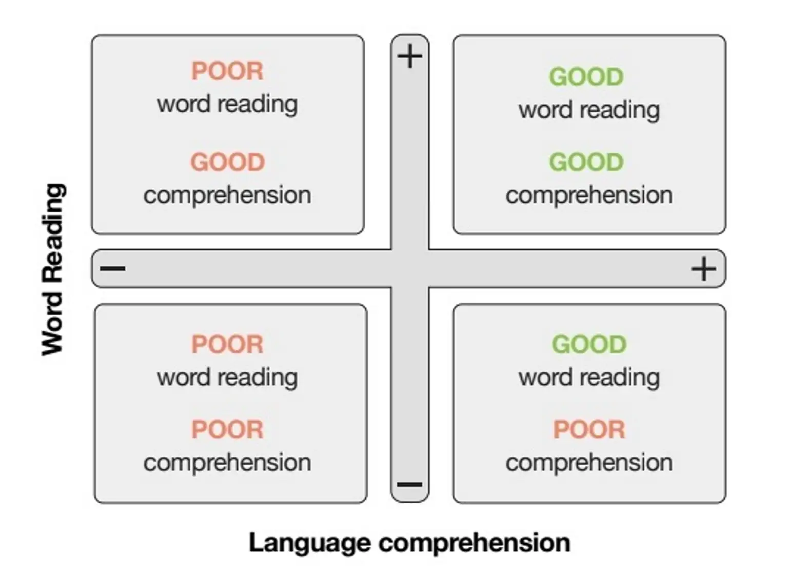
EEF - Simple view of reading

Slide 16
Reading: Research and Support
Greenshaw Learning Trust / Research School
Education Endowment Foundation
National Literacy Trust, Book Trust and Scottish Book Trust
Jess Ricketts, Royal Holloway University, LARA Lab Director. ( Reading and oral language development )
Alex Quigley, Author of Closing the Reading Gap
Alice Visser-Furay, Reading Specialist
Kenny Pieper, Author of How to Teach Reading for Pleasure
Pixl Reading
Professor Teresa Cremin, Professor of Education at The Open University

