Slide 1
Learning together – Empowered for life
Student Leadership
Follow us on twitter @yateleyschool

Slide 2
Headteacher: Paul German

Slide 4
Deputy Headteacher – Culture: Rupert Keeble

Slide 5
Past issues
Over complicated behaviour system and policy
Lack of consistency with rewarding achievement
A legacy ‘House Council’ student leadership model which lacked vision, impact and leadership
Poor visibility of student leadership and its members
Unclear structure, roles and responsibilities for student leaders
Minimal safeguarding education to students with relevance to local community and area

Slide 6
Change was needed
We visited numerous schools within and beyond Hampshire
We researched into proven success models via published material
We surveyed all our stakeholders to gain their views on our current models and ideas to take things forward
We worked alongside a team of Sixth Form and Year 11 students to start to make the required changes

Slide 7
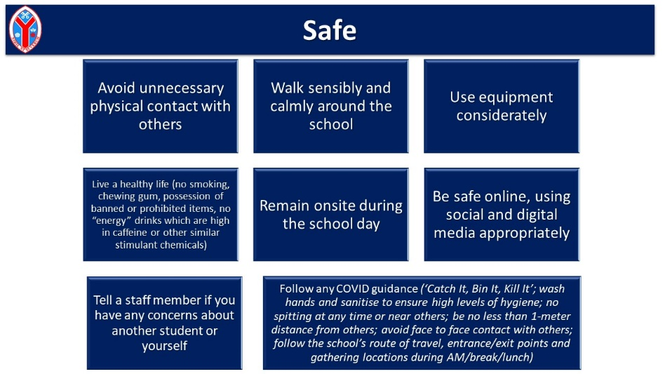
Impact of actions
Simplified behaviour policy and principles (Ready Respectful Safe) created by the students (focus on positive behaviour, restoration and relationships)

Slide 8
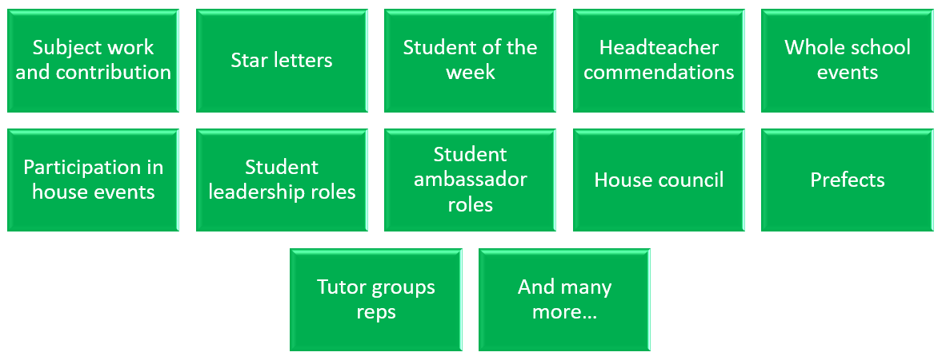
Impact of actions
Clearly defined house point system and thresholds for rewards

Slide 9
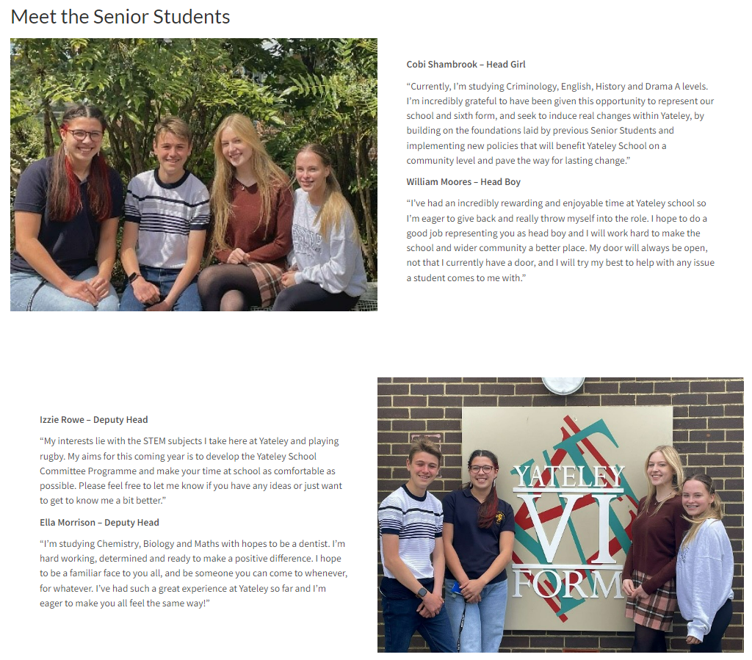
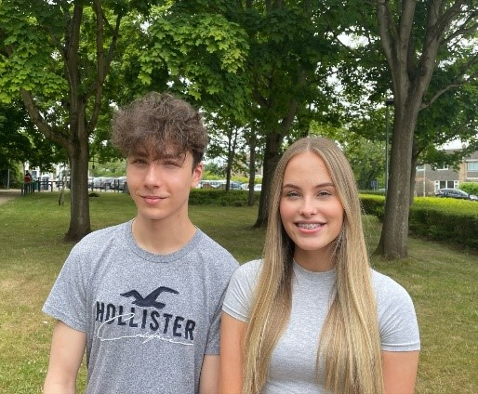
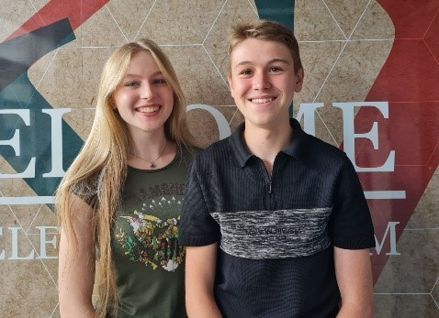
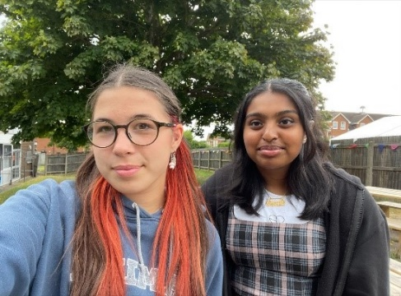
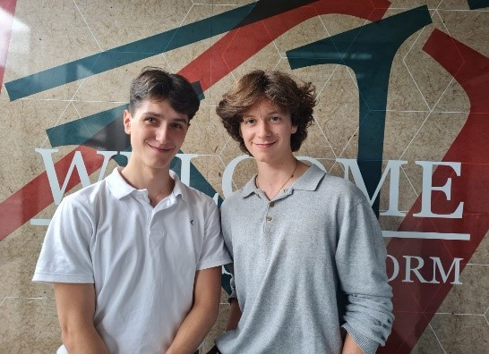
Impact of actions
A new student leadership hierarchy which was created and now led by the Senior Students which in turn created four dedicated student committee groups with timetabled meetings and detailed improvement plans.
Student leaders and representatives are badged, each student committee has its own display board, dedicated pages on our main school website.

Slide 10
Impact of actions
Clear roles of responsibility for all students that are within the leadership roles and also student representatives:
4 x senior students (main and deputies) who oversee the whole structure and report to SLT and governors
Student committee senior student leaders (2 in each of the 4 committees)
Student committee student representatives from all year groups
Staff members assigned to each committee
Each of the four houses have their own KS4 house captains, sports captains, dance captains, music captains, drama captains, charity captains, peer mentors
Safeguarding education via PSHE/RSE lessons and also via the weekly tutor time lessons to all year groups; have been tailored following guidance from KCSiE and also the views of the student leadership group on what is a priority in our area.

Slide 11
Senior Students: Cobi Shambrook William Moores

Slide 12
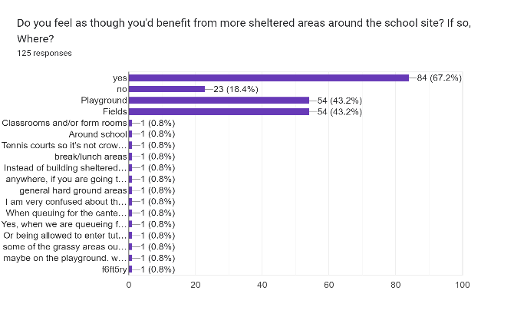
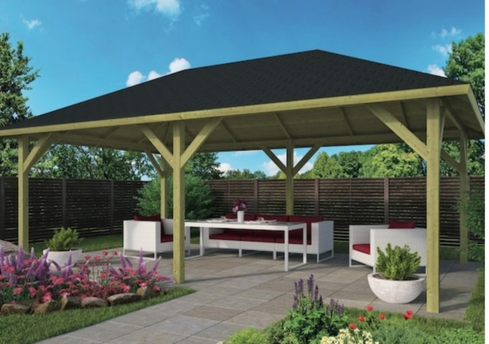
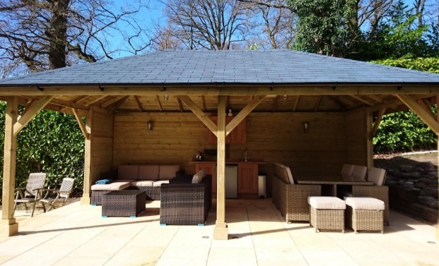
GOALS
SUCCESS
ISSUES
Construction project for sheltered areas around the school site
Committee lead fundraisers – raising money for charities that the students themselves choose.
Sheltered areas will be erected around the campus.
They will be in frequent use by both students and staff for teaching purposes and recreational use.
There is a large financial element to this project.
STEPS
Identify interest from students
Meet with appropriate SLT to develop a plan
Meet with the site manager regarding parameters of cost and size
Meet with the business manager to discuss fund raising options and begin an official project plan.
Carry out said plan

Slide 13
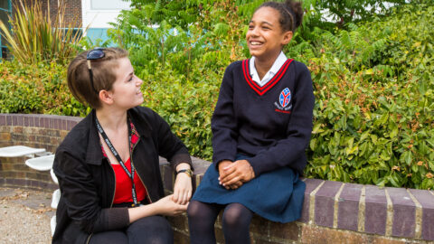
GOAL 1
SUCCESS
ISSUES
The continuation of the ‘Mentoring programme’
Student feedback on mentoring
Improvement in student behaviour
Students make use of safe space
Lack of initial uptake
Aligning students needs with suitable sixth form students
I always look forward to my mentoring sessions with Brodie - Marcus
STEPS
Conversations with staff and students regarding those they feel would most benefit from receiving mentoring.
Generate interest amongst sixth form students to take up the role of mentors.
Advertise across year groups, assemblies, encouraging form tutors to circulate information.
Once we have our participants – pair them with the students.

Slide 14
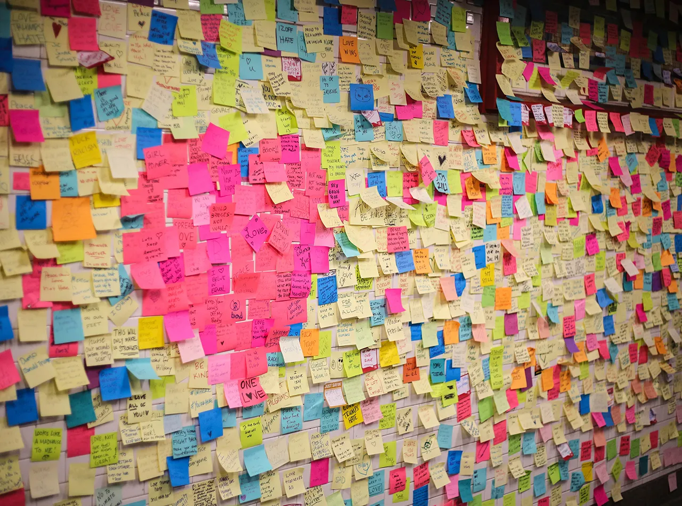
GOAL 2
SUCCESS
ISSUES
Practical and physical enhancements of “Safe space”.
The Safe Space will be consistently used for its desired purpose
It will be a space that the students have decorated themselves and thus feel comfortable in.
Improper use of safe space
Littering
STEPS
Speak to students who use it about why they are using it
Ensure that it is open and welcoming for all year groups
Introduce a register so that students who use safe space frequently are given a mentor or are able to move into different spaces.
Gain ideas from students of how it wants to be decorated

Slide 15
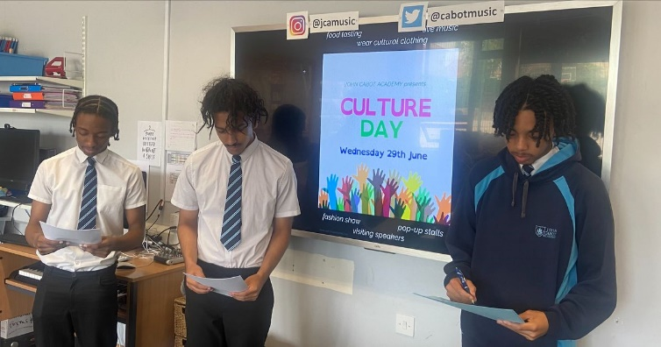
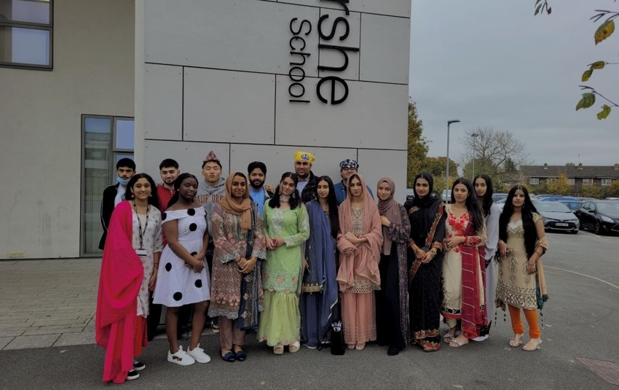
GOALS
SUCCESS
ISSUES
Develop a culture day
Create a more inclusive environment within Yateley school
Culture day is completed
See change in attitudes towards different cultures
Reaching students who want to take part and are passionate
STEPS
Speak to students about participation
Talk to teachers about ways their lessons link into the content
Send out information to parents about how they want to participate.
Arrange dates and Logistics

Slide 16
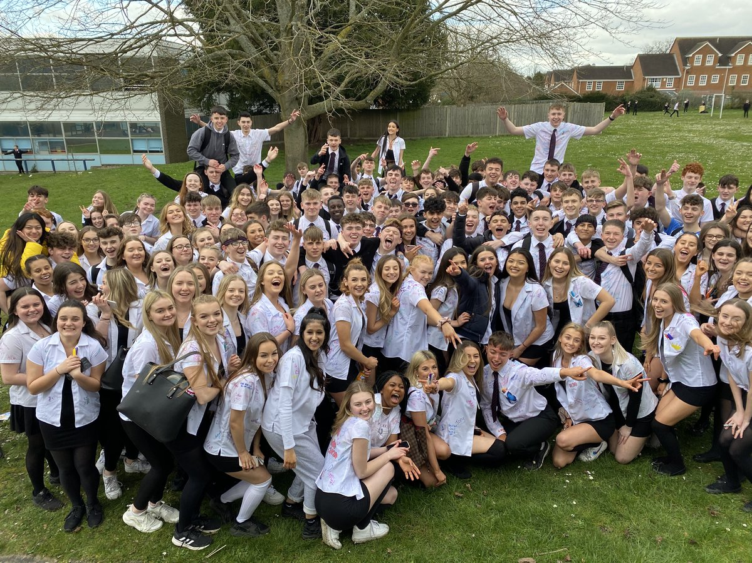
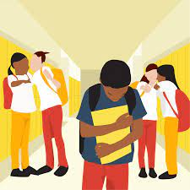
GOALS
SUCCESS
ISSUES
Complete Diana Award and generate an interest around it
Attain Diana Award badges
Raise awareness in general and make it a main focus during anti-bullying week
Diana Award Completed
More students coming to meetings with issues and feeling comfortable coming to us with them in general.
Bullying within the school decreases
Raising awareness around our committee
Choosing who could do the Diana Award
STEPS
Complete Diana Award
Complete and organize/plan campaigns for the badges
Speak to students and raise awareness about our committee and make the people to go to well known.

Slide 17
What next
Handover for future year groups:
New leadership team = integrate the new Senior Students into the committees, by attending meetings and engaging with the current committee members and inspiring current students to be future leaders.
Decision of goals for the year = once the handover is complete, the newly elected chairs will work with the committees to determine their goals for the year.
Attendance = assemblies, posters, display boards etc to promote the committees and encourage participation (even spread from all year groups and houses).
Visual impact = examples of impact from each committee within the school on a yearly basis
Communication = more regular updates via school publications (bulletins, etc)
The key is to maintain and support this new culture of open communication and student led change. The intention is for these committees to become as cemented and fundamental as the House System to support Yateley Schools continued positive development and improvement.

Slide 18
Learning together – Empowered for life
Thank You
Follow us on twitter @yateleyschool

