Slide 1
Quality Assurance of the Curriculum
Jon Eacott
Assistant Headteacher
Amery Hill School

Slide 2
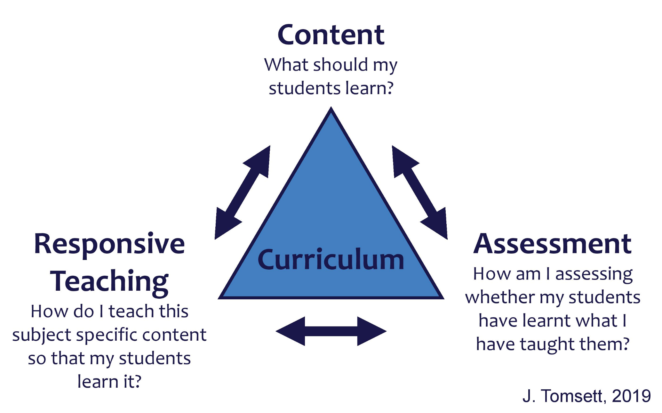
Teachers
Head of Department
Students
SLT Line Manager
HoD
Line Manager
SLT

Slide 3
Guiding Principles
Schools get better in the classroom
Do less, but do it better!
Do with, not to
This is not an Ofsted rehearsal

Slide 4
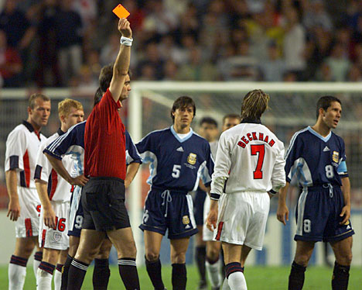
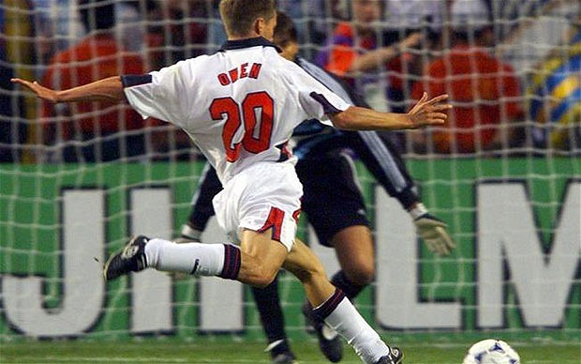
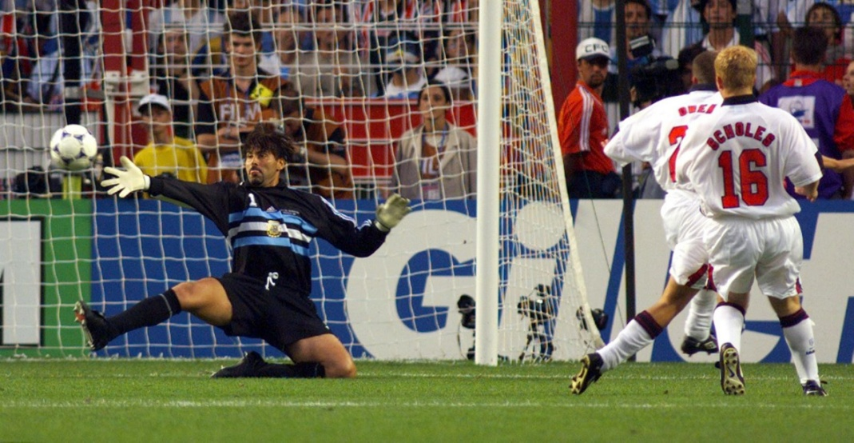
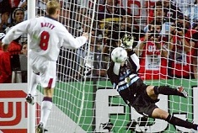

Slide 5
Guiding Principles
Schools get better in the classroom
Do less, but do it better!
Do with, not to
This is not an Ofsted rehearsal
How much more can we get out of this?

Slide 6
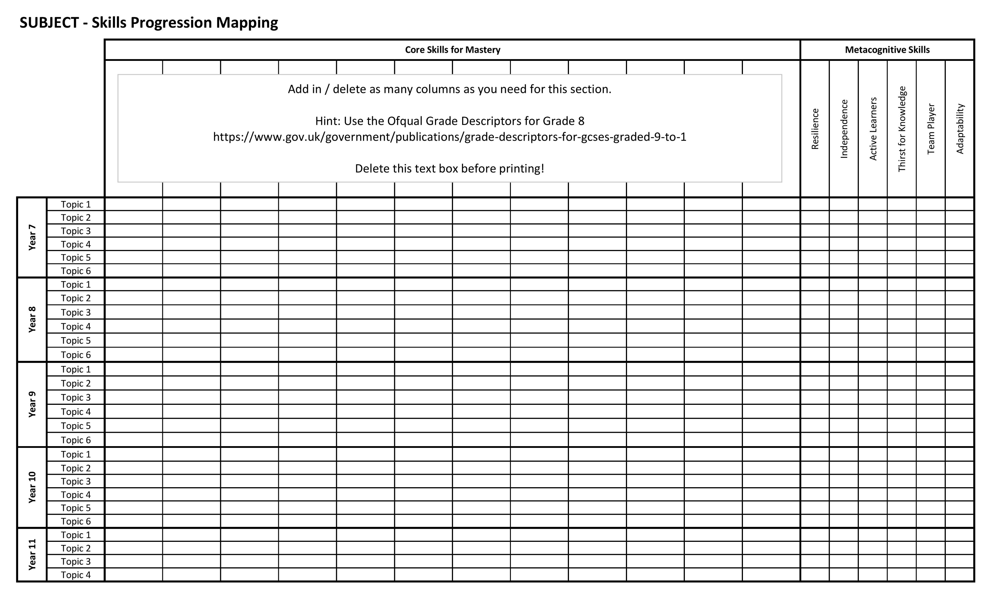
The Story
Spring 2019
Schemes of Work

Slide 7
The Story
Spring 2019
Schemes of Work
Spring 2020
Launch (with the intention of a trial in Summer 2020)
Autumn 2021
Trial
Spring 2022
Rollout

Slide 8
Date | Department
Autumn ‘21 | Maths
Spring ‘22 | MFL Technology – DT & Food
Summer ‘22 | English & Media
Autumn ‘22 | History Music
Spring ‘23 | Drama ICT
Summer ‘23 | Geography
Autumn ‘23 | Science
Spring ‘24 | RS PE & Dance
Summer ‘24 | Art

Slide 9
Quality of Education Overview
Data Analysis
internal and external

Slide 10
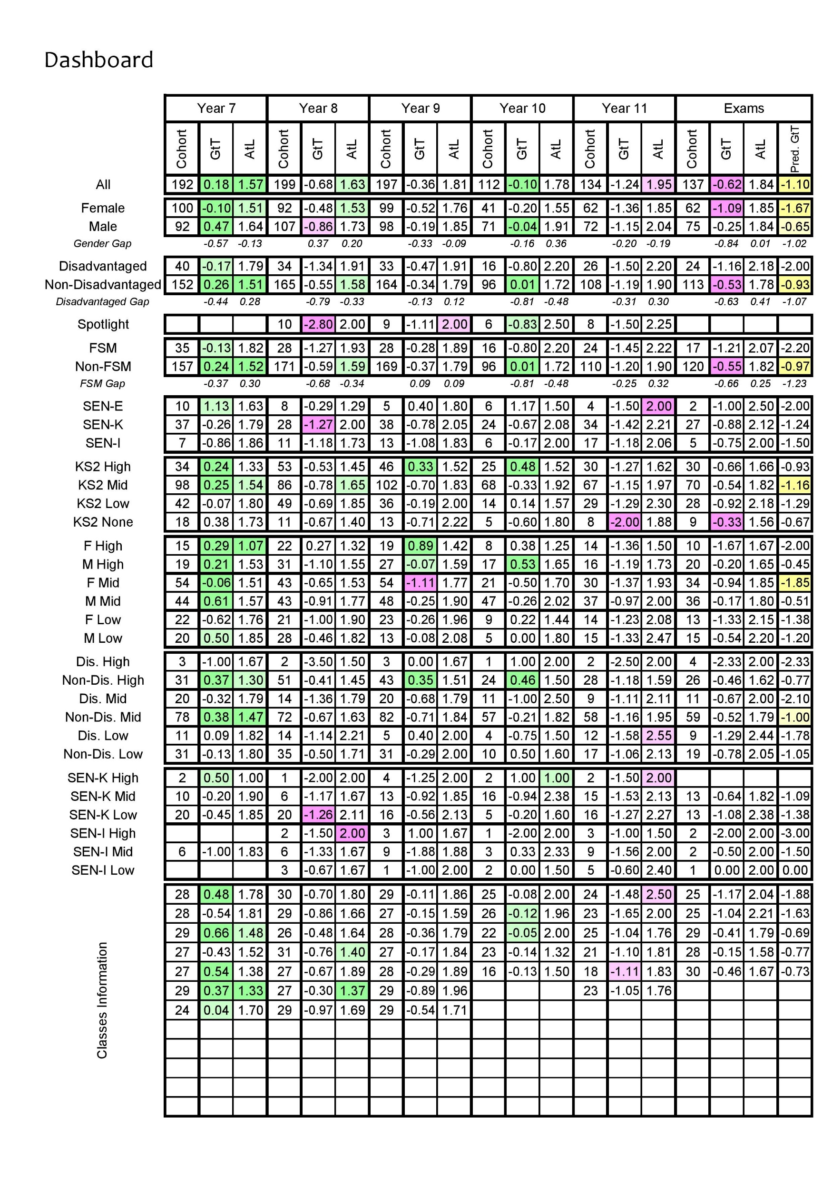

Slide 12
Lines of Enquiry – examples
Low prior attainment students do not achieve as close to their targets as their peers with higher prior attainment
High Prior-Attaining boys in Years 7 to 9, perform worse in <subject> than in their other subjects. Does the curriculum support the progress of HPA boys, or what further intervention is needed to increase their progress?
High prior attainment boys perform better in <subject> than they do in other subjects
Attitude to Learning in <subject> is generally worse for low prior-attaining students, than for mid and high prior-attaining students. This does not appear to be reflected in their Grades to Target measure.

Slide 13
Lines of Enquiry – examples
In <subject> in Year 10, boys display an average AtL worse than 2, yet for this cohort this average is not significantly worse than in their other subjects. Does the nature of these classes, and the way that they are managed, allow these students to succeed?
Mid-prior attaining students with SEN display a lower Attitude to Learning than they do in other subjects
There is variability in the Grades to Target measure between different teachers in Year 8:
 | A: | 0.20 | and | 0.52 |  | B: | -0.68 | and | -0.45
 | C: | -0.03 | and | -0.45 |  | D: | -1.10

Slide 14
Quality of Education Overview
Data Analysis
internal and external
Visiting HoDs
Lesson Observation
2 Year Groups
Scheme of Work
Student Panels
Work Scrutiny
Teachers
Head of Dept.

Slide 15
Date | Department | Visiting HoD
Autumn ‘21 | Maths | BPL, JEN
Spring ‘22 | MFL Technology – DT & Food | EWS, SBL SPR, NGS
Summer ‘22 | English & Media | NWS, SWD RST
Autumn ‘22 | History Music | VBE, NJN SOT, SRE
Spring ‘23 | Drama ICT | RST NET
Summer ‘23 | Geography | DHH
Autumn ‘23 | Science
Spring ‘24 | RS PE & Dance
Summer ‘24 | Art

Slide 16
Timetable – example

Slide 17
Head of Department Meeting
Attendees
Tone
Line Manager?
SLT
Interviewers
HoD
Line Manager?

Slide 18
Head of Department Meeting
Articulate in two minutes your vision for your department
Tell us about your curriculum and your rationale for it
Referring to the specific example from the current SoW - How does this part of the Scheme of Work fit in with the overall vision / rationale for the Scheme of Work? - Why is this particular topic being taught right now? - Can you talk me through the sequencing of lessons in the Scheme of Work? - What skills are developed within this unit? - How do they fit in with the overall 5-year curriculum?
How do you know your curriculum meets the needs of all individual students? - What do you put in place to ensure this happens?

Slide 19
Head of Department Meeting
Tell us who your stronger teachers are. - Why?
Tell us who your teachers are that need further developments? - What have you done to support them?
What’s the workload like for your team? - How do you monitor this and how do you support?
Specific data questions – related to progress of specific groups of students identified in the dashboard
Specific questions about the Department Handbook / Department Improvement Plan

Slide 20
Teacher Meeting – Departmental
How are you involved in the development of your curriculum?
How is feedback provided in your subject? - What does this look like in your lessons?
How do you check and track students’ progress over time?
If a student is underachieving, what types of support do you put in place?
What are the current challenges for the department? - How do you contribute to supporting the department with these?
What’s your workload like? - Do you have any suggestions we can take back to SLT / HoD on how to improve it?
Specific questions regarding progress of groups

Slide 21
Teacher Meeting – Lesson Feedback
What was the purpose of this lesson / task?
What did you expect students to be able to do before attempting this task? What would you want students to be able to do after attempting this task? - Could they? - How do you know?
How did you adapt this task to stretch the most able / support the less able?
How does this lesson / task fit in with the current Scheme of Work?
Why were the lessons planned in this particular order?
What skills does this unit help students to develop?

Slide 22
Student Panel
What do you enjoy about <subject>?
What things don’t you enjoy about <subject>?
Referring to a specific piece of work: - What was this piece of work helping you to learn? - How has the teacher feedback helped you? - What can you do / understand after this piece of work that you couldn’t do / understand before it?
How do you get given feedback? - How does this feedback help you to improve? - What’s the best piece of advice you’ve been given? - Why was it so helpful?
Are you given time to reflect on the feedback, with opportunities to improve?

Slide 23
Student Panel
What kinds of tasks are you set for homework in <subject>? - Do you find the homework useful?
How challenging do you find lessons / learning?
What does your teacher do if you don’t understand?
Specific questions relating to work scrutiny

Slide 24
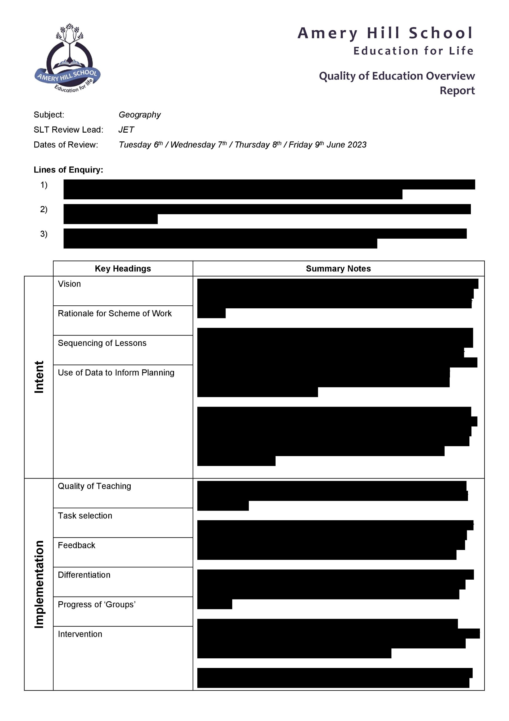
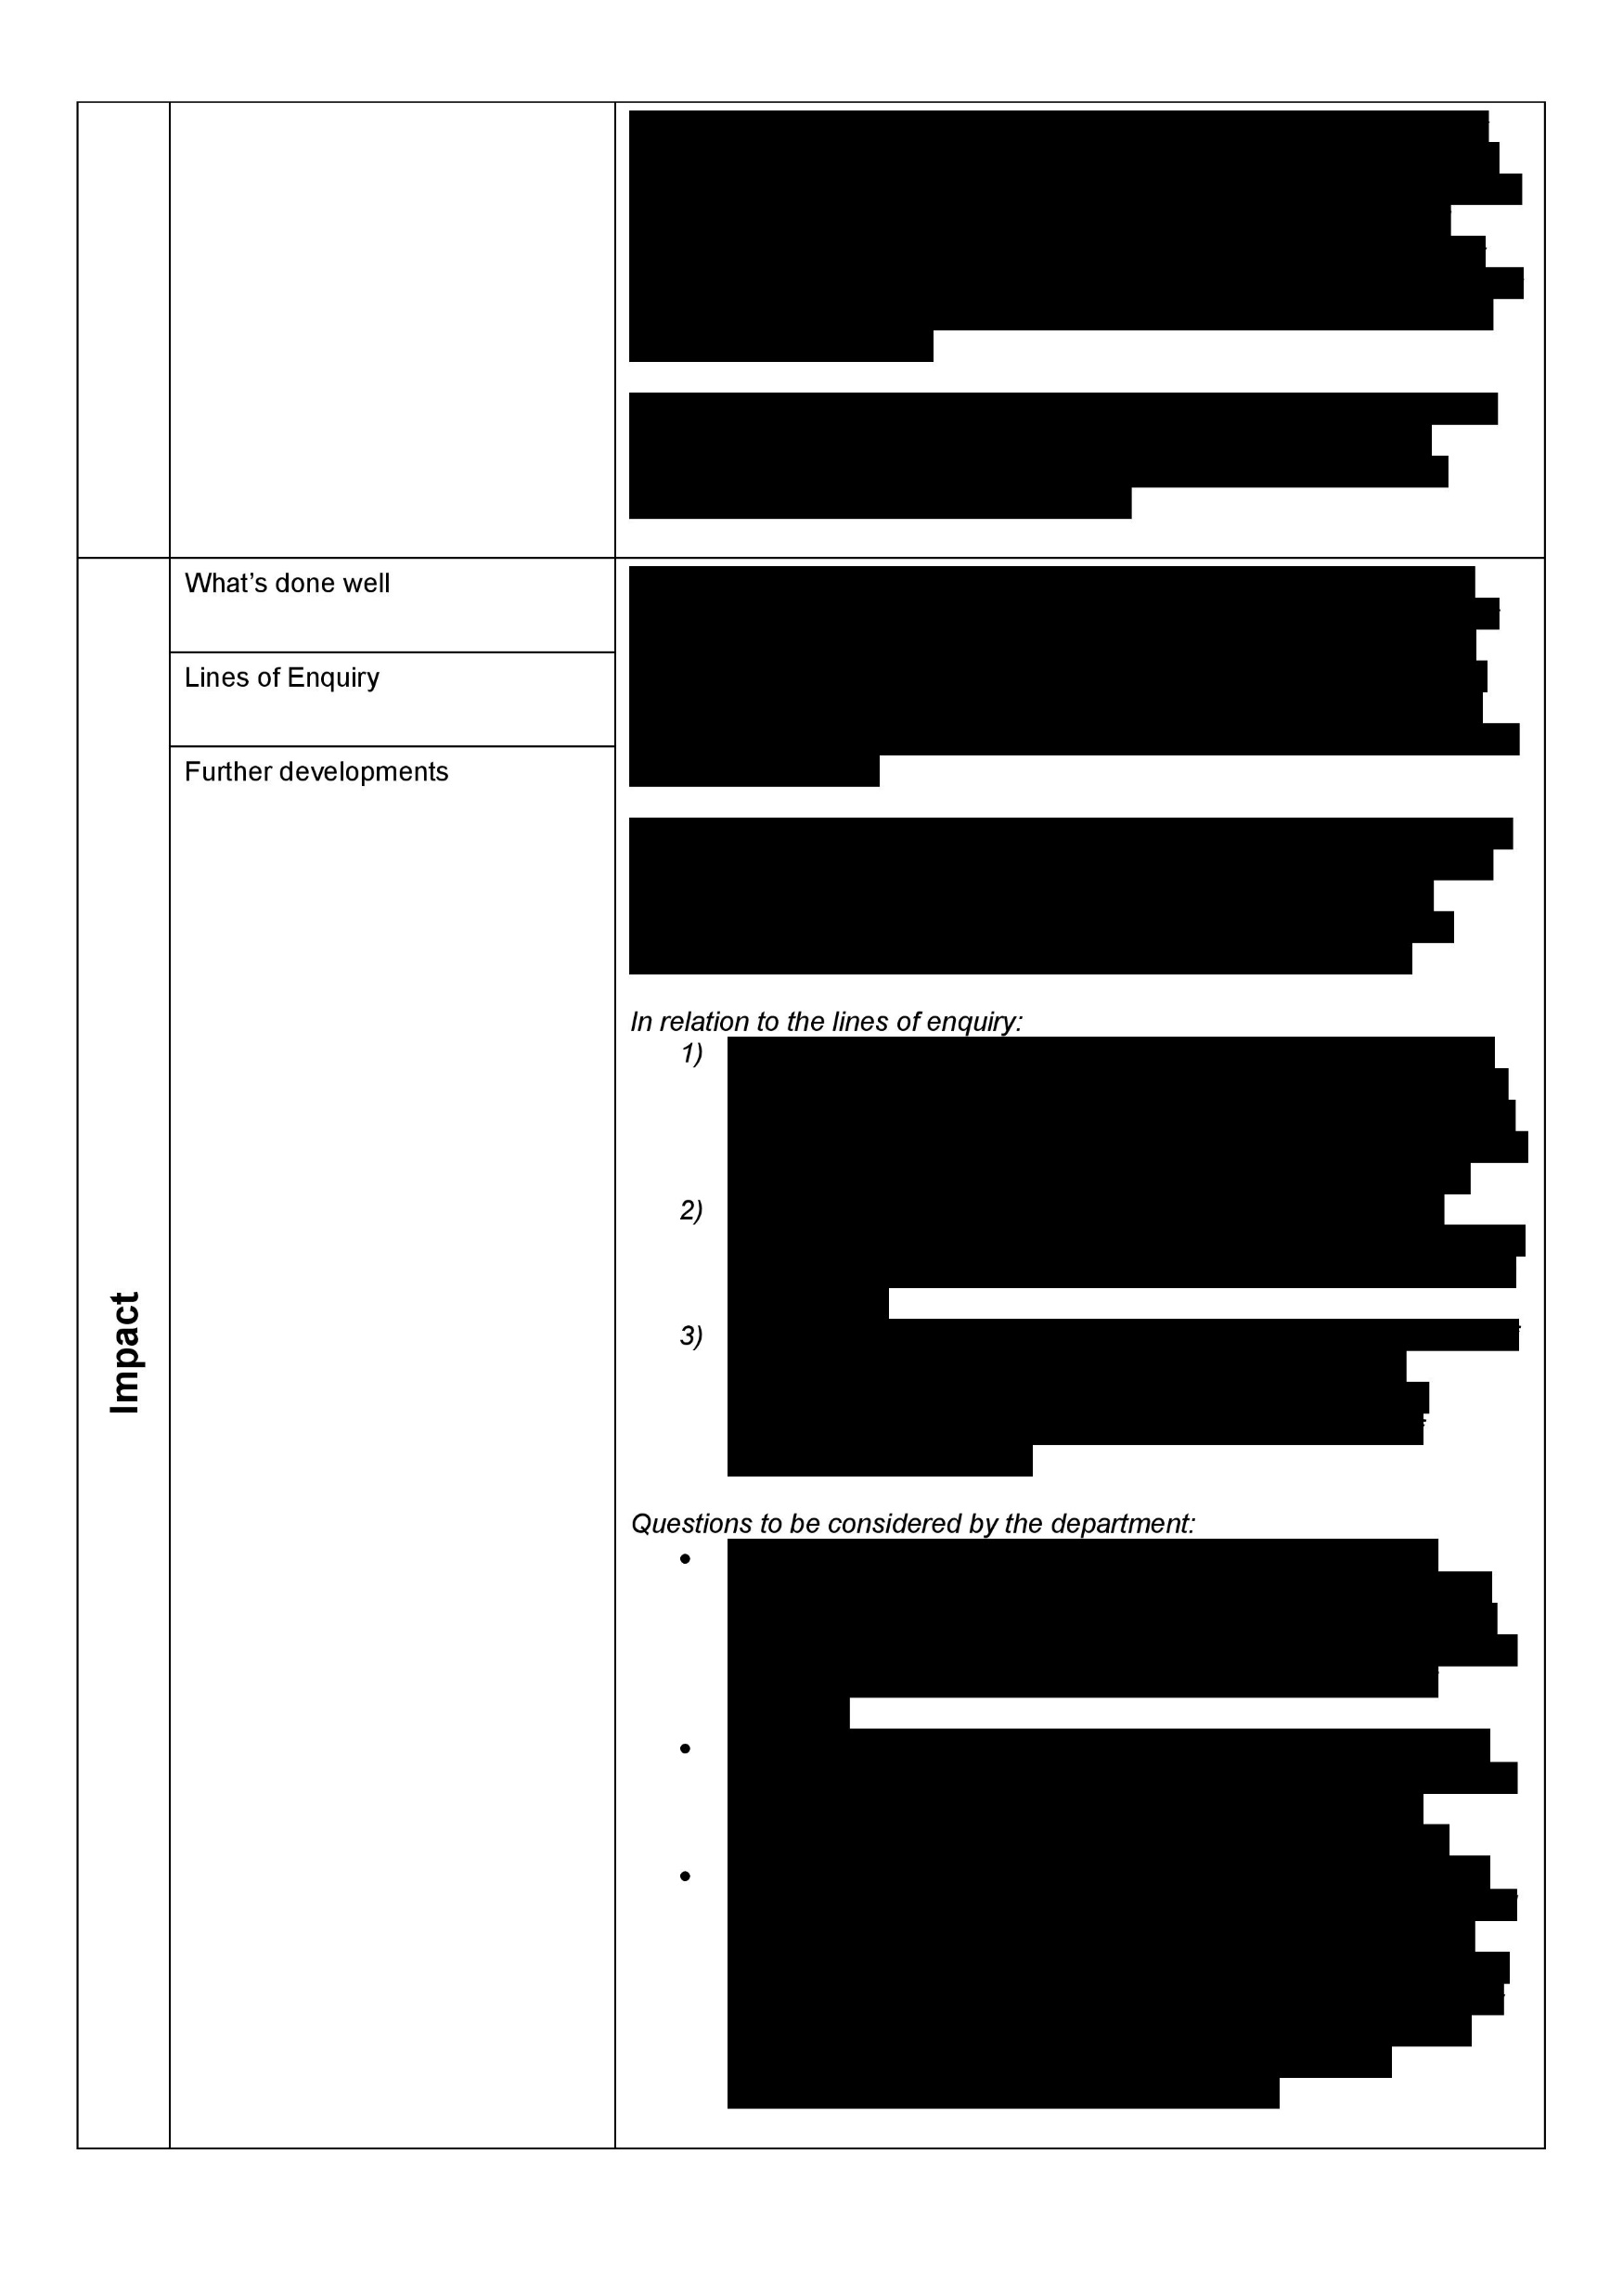
Concluding the Review
SLT Meeting – with Visiting HoDs
Report - Intent - Implementation - Impact

Slide 25
Concluding the Review
SLT Meeting – with Visiting HoDs
Report - Intent - Implementation - Impact
Feedback to the Head of Department
Feedback to the Department
Time to ‘make a difference’
Feedback to Trustees (Governors)

Slide 26
Selected Findings
Use of Exercise Books (Maths)
Feedback and Response for LPA Students (History)
Think It, Talk It, Tackle It Talking partners? (Geography)
Attitude to Learning for LPA students

Slide 27
Where next?

Slide 28
Where next?
‘Externality’
HoDs to quality assure their own curriculum
“With the examination boards’ online post-results service, combined with our understanding of the flesh and blood that produced those results, and copious amounts of our own wisdom and judgement, we have all that we need to make a decent diagnosis of what needs to be improved in our teaching.”

Slide 29
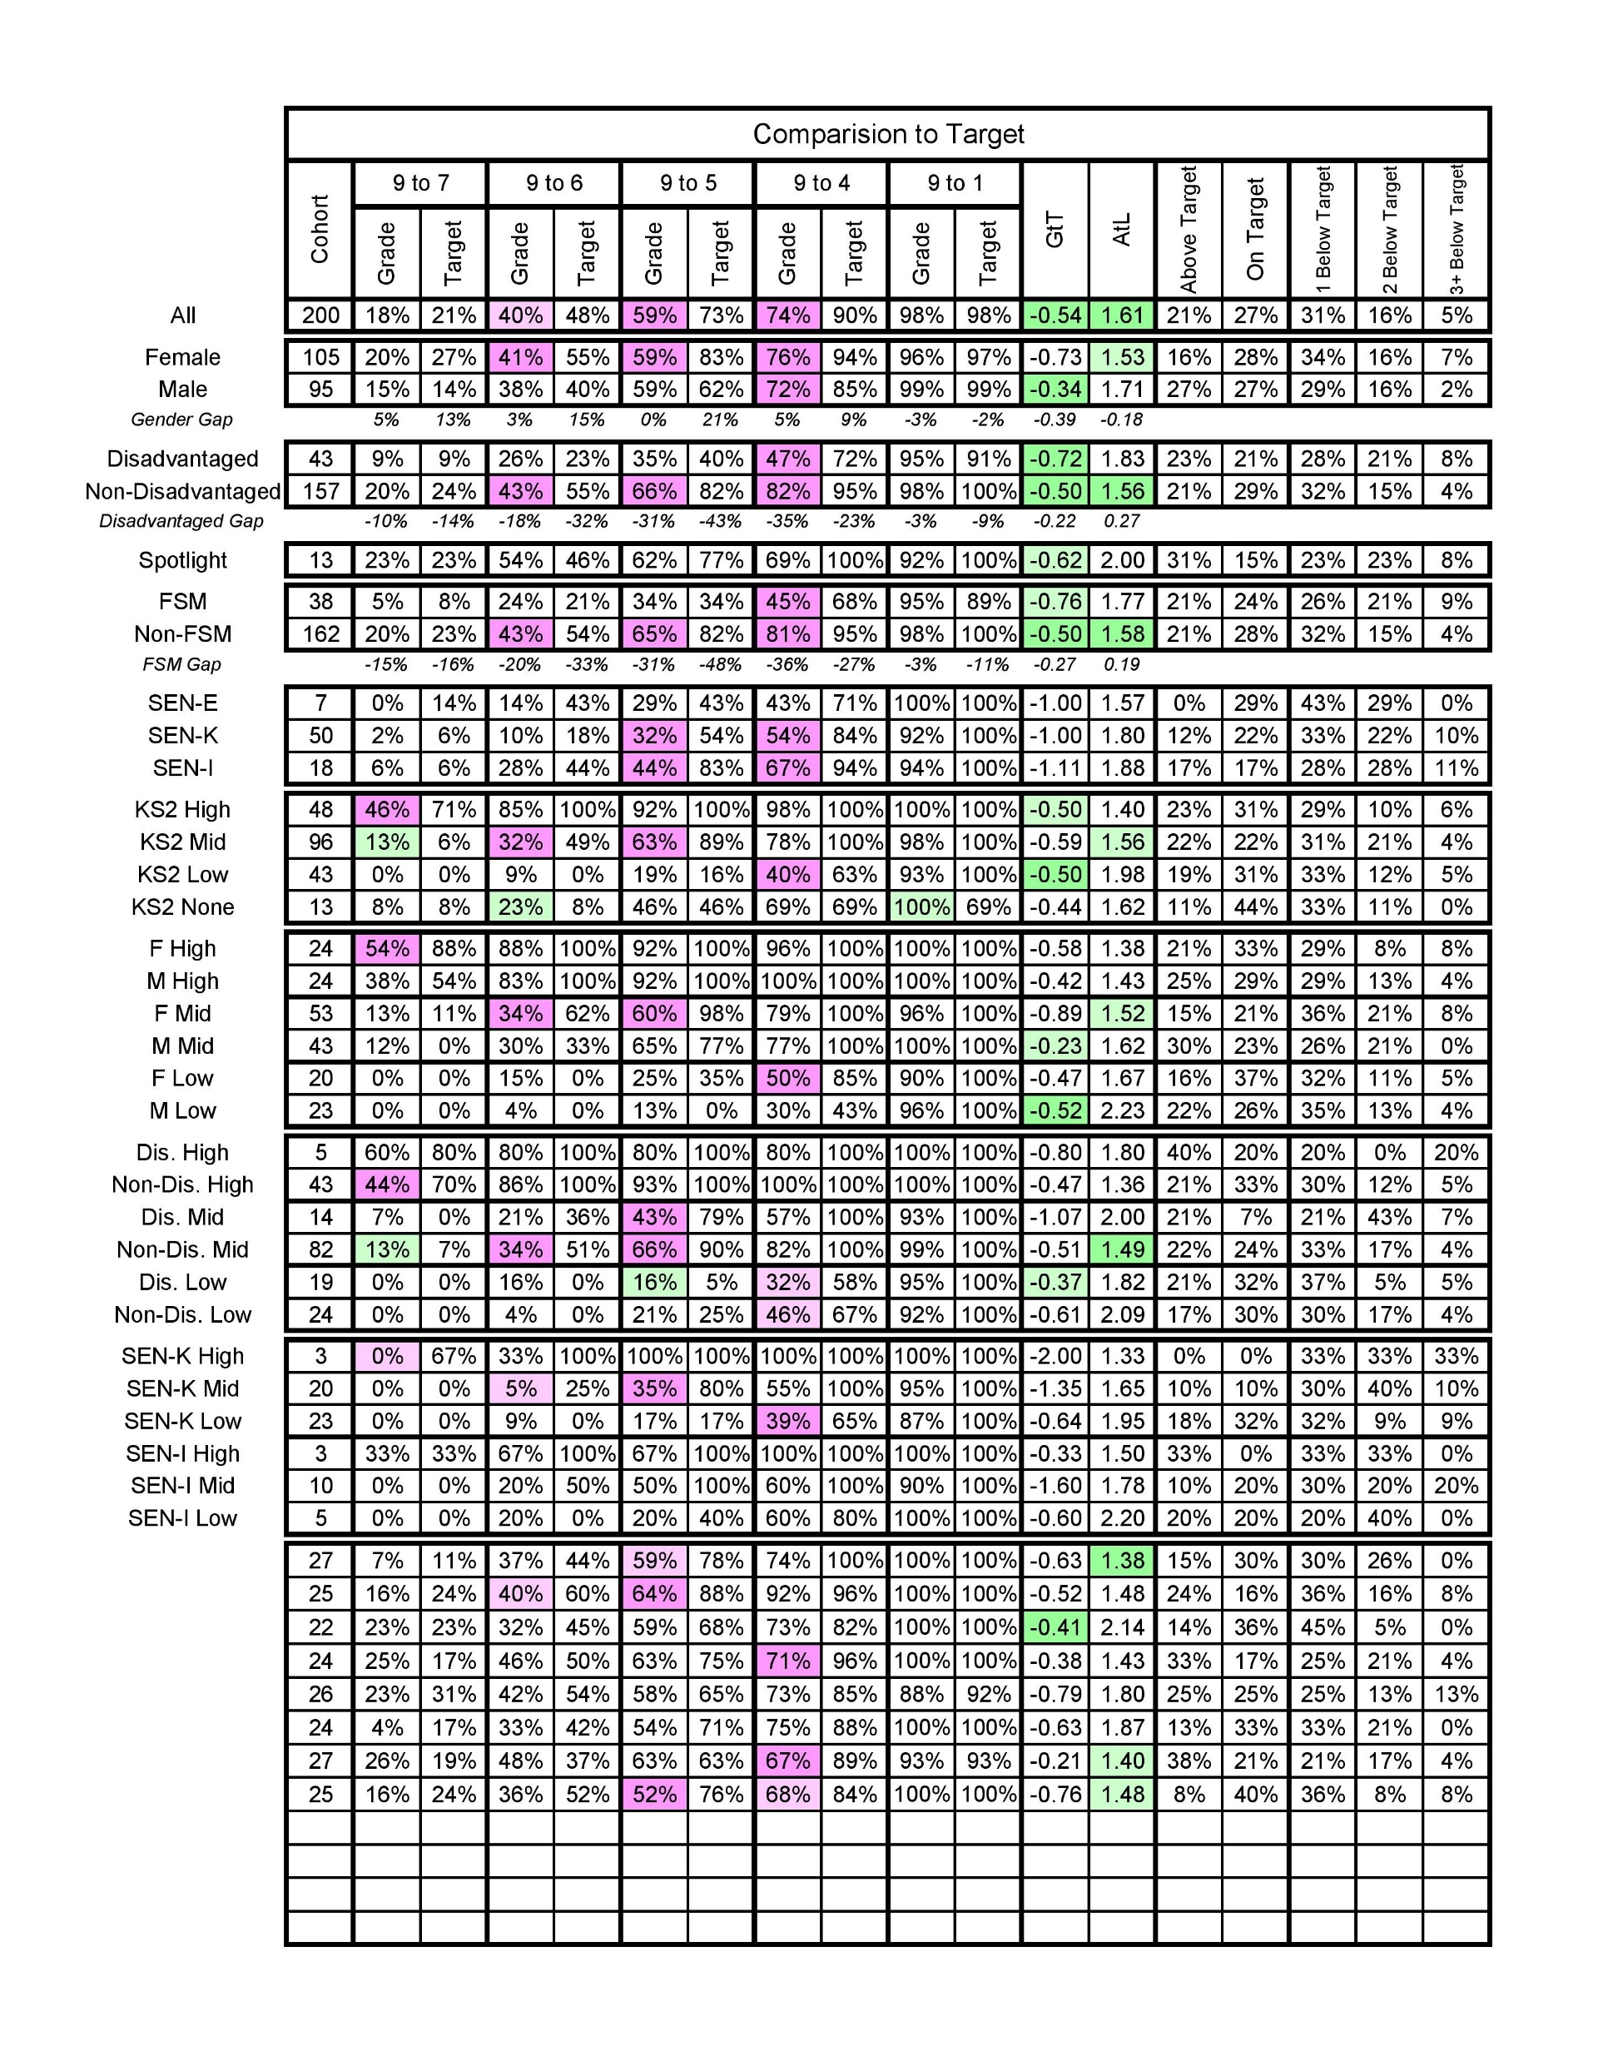
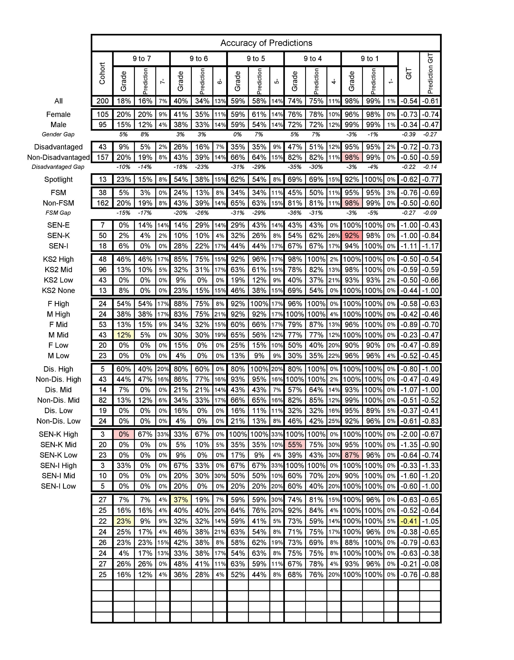
Exams Analysis

Slide 30
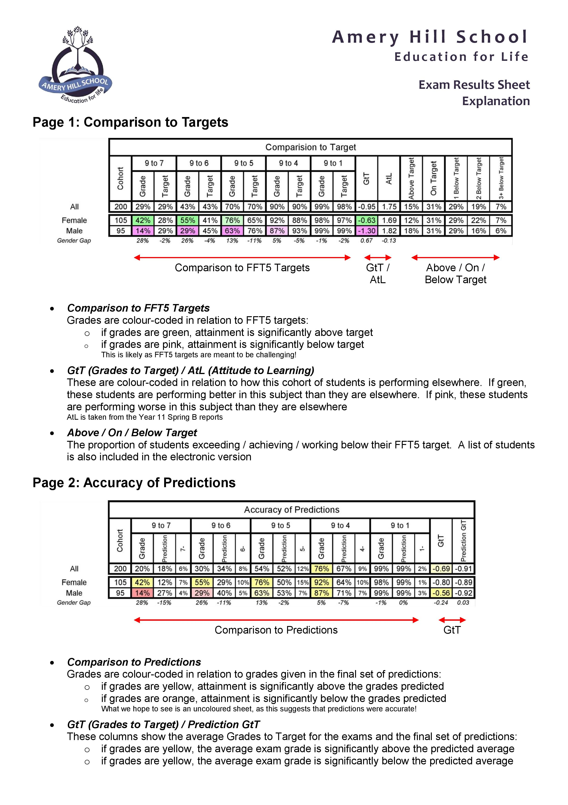
Exams Analysis

Slide 31
Data Capture Analysis
Autumn Term
 |  | Data Capture Timetable |  |  |  |  |  | Exams Analysis
 |  |  | Year 11 _{DC1}
 |  | Year 7 _{DC1} |  | Year 9 _{DC1}
 |  | Year 8 _{DC1} |  | Year 10 _{DC1} |  |  |  | Analyse Year 8
Spring Term
 |  |  | Year 11 _{DC2} |  |  |  |  | Analyse Year 11 – post mocks
 |  | Year 7 _{DC2} |  | Year 9 _{DC2}
 |  | Year 8 _{DC2} |  | Year 10 _{DC2} |  |  |  | Analyse Year 10 – post exams
 |  |  | Year 11 _{DC3}
Summer Term
 |  | Year 7 _{DC3} |  | Year 9 _{DC3} |  |  |  | Analyse Year 7
 |  | Year 8 _{DC3} |  | Year 10 _{DC3}

Slide 32
QofE Overview
Guiding Principles
Data Analysis
Schemes of Work
Lesson Observation
Work Scrutiny
Head of Department
Teachers
Students
Visiting HoD
Schools get better in the classroom
Do less, but do it better!
Do with, not to
This is not an Ofsted rehearsal
Jon Eacott
j.eacott@ameryhill.school

