Slide 1
Leadership in Times of Change & Uncertainty…Simple Thinking

Slide 2
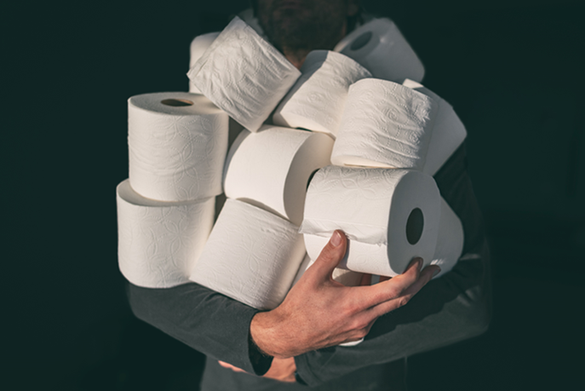
Simple Thinking

Slide 3
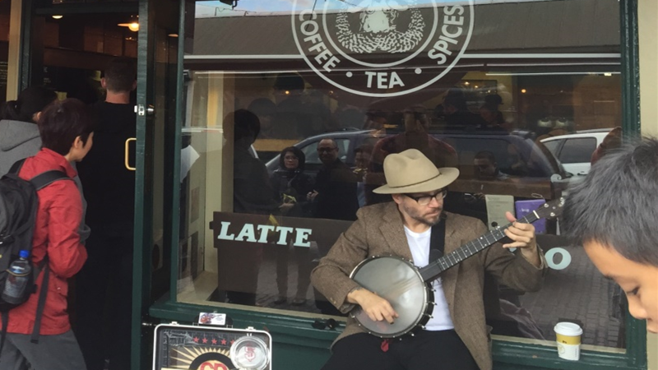
Simple Thinking

Slide 4
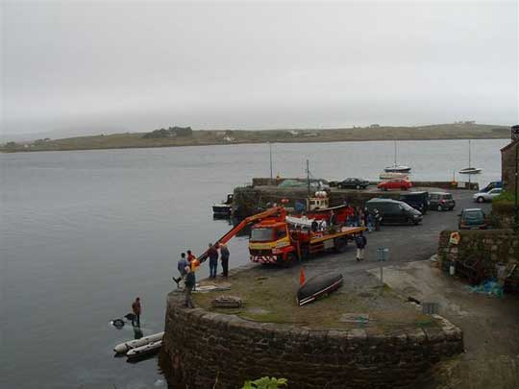
Whatever happens learn!

Slide 5
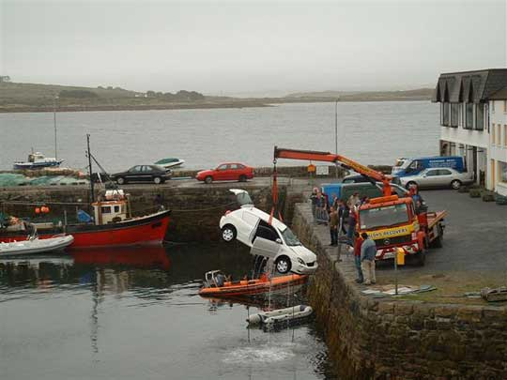

Slide 6
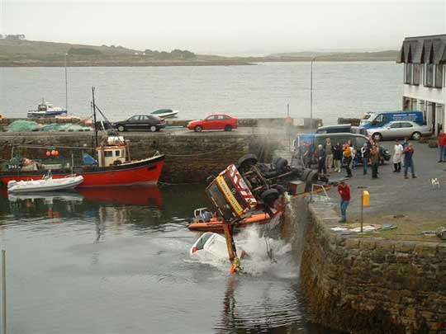

Slide 7
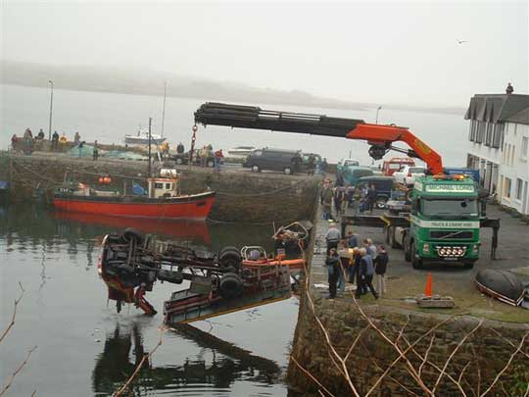

Slide 8
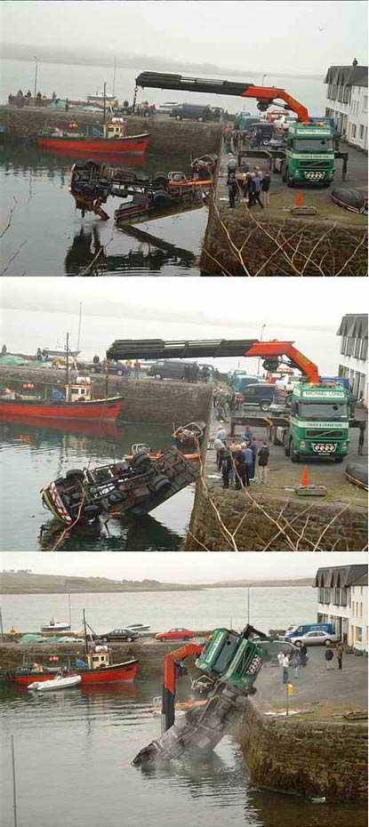

Slide 9
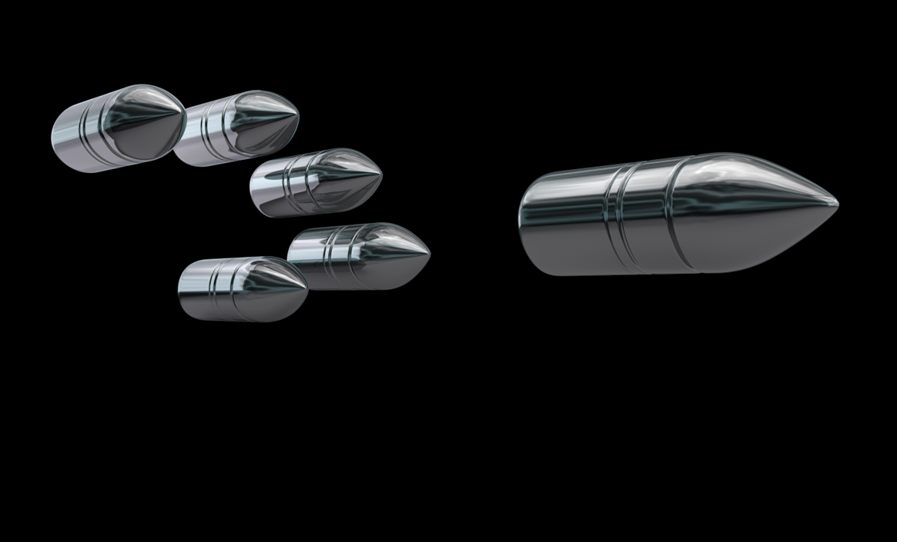
Simple Thinking

Slide 10
Vision
Simple Thinking

Slide 11
Clarity
What do you stand for?
Coherence
Internal/External…
Leadership
Symbolise the best values…
Simple Thinking

Slide 12
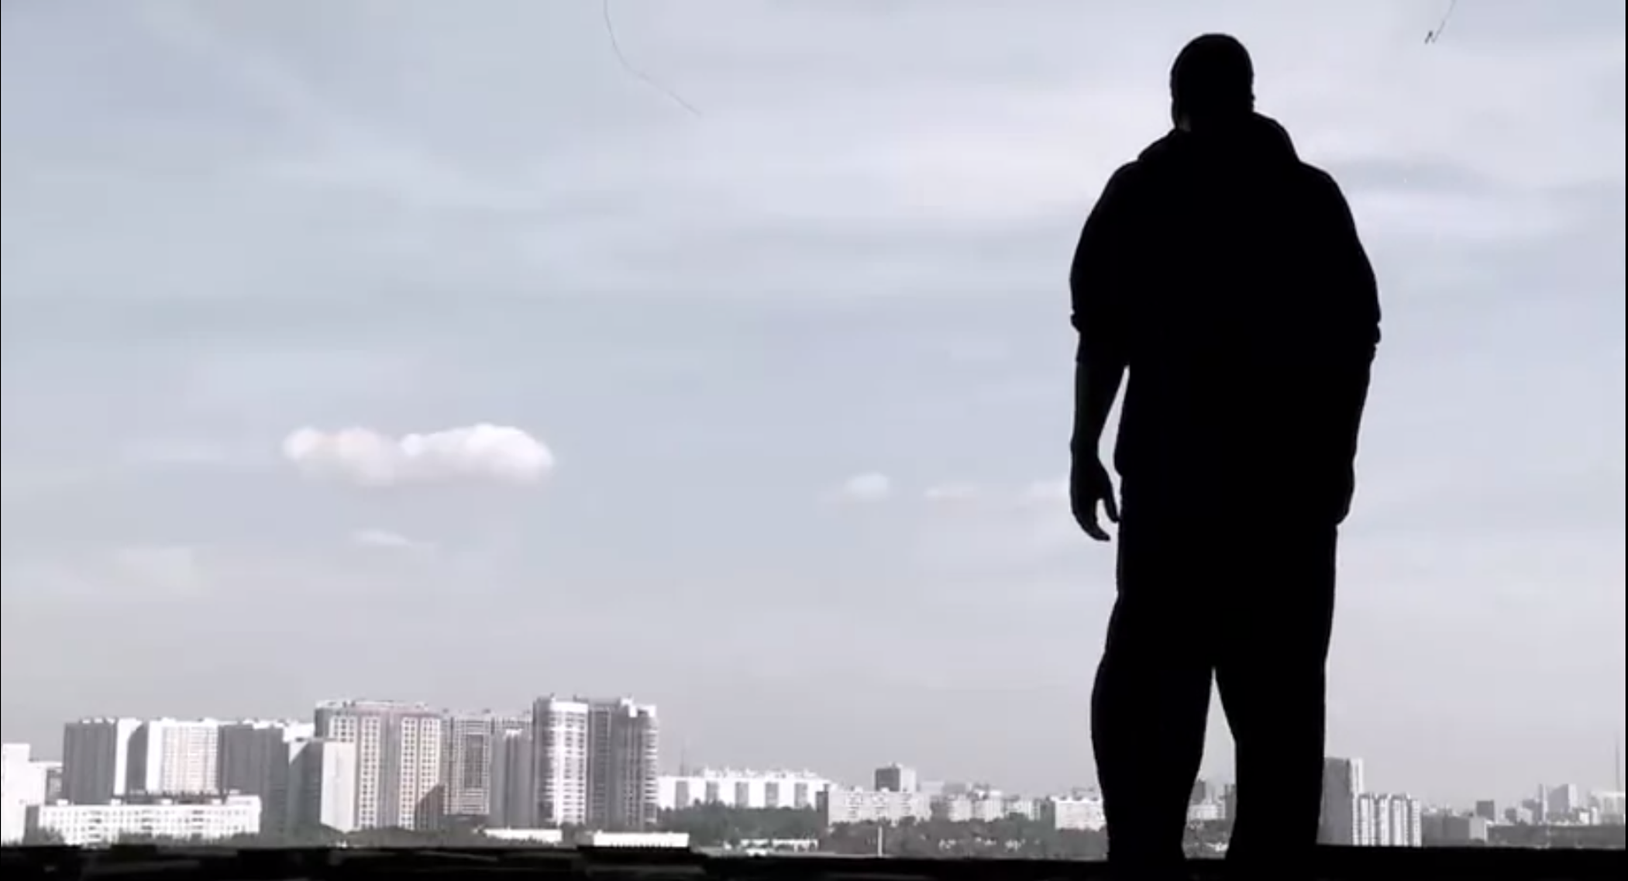
Simple Thinking

Slide 13
What is the worst thing
that can happen?
Simple Thinking

Slide 14
What is the one
thing I can do
to help stop the
worst from happening? Simple Thinking

Slide 15
What is the best thing
that can happen? Simple Thinking

Slide 16
What can I do to help
the best thing
to happen?
Simple Thinking

Slide 17
What is the most
likely thing to happen?

Slide 18
What can I do to
handle the most
likely thing, if it happens?

Slide 19
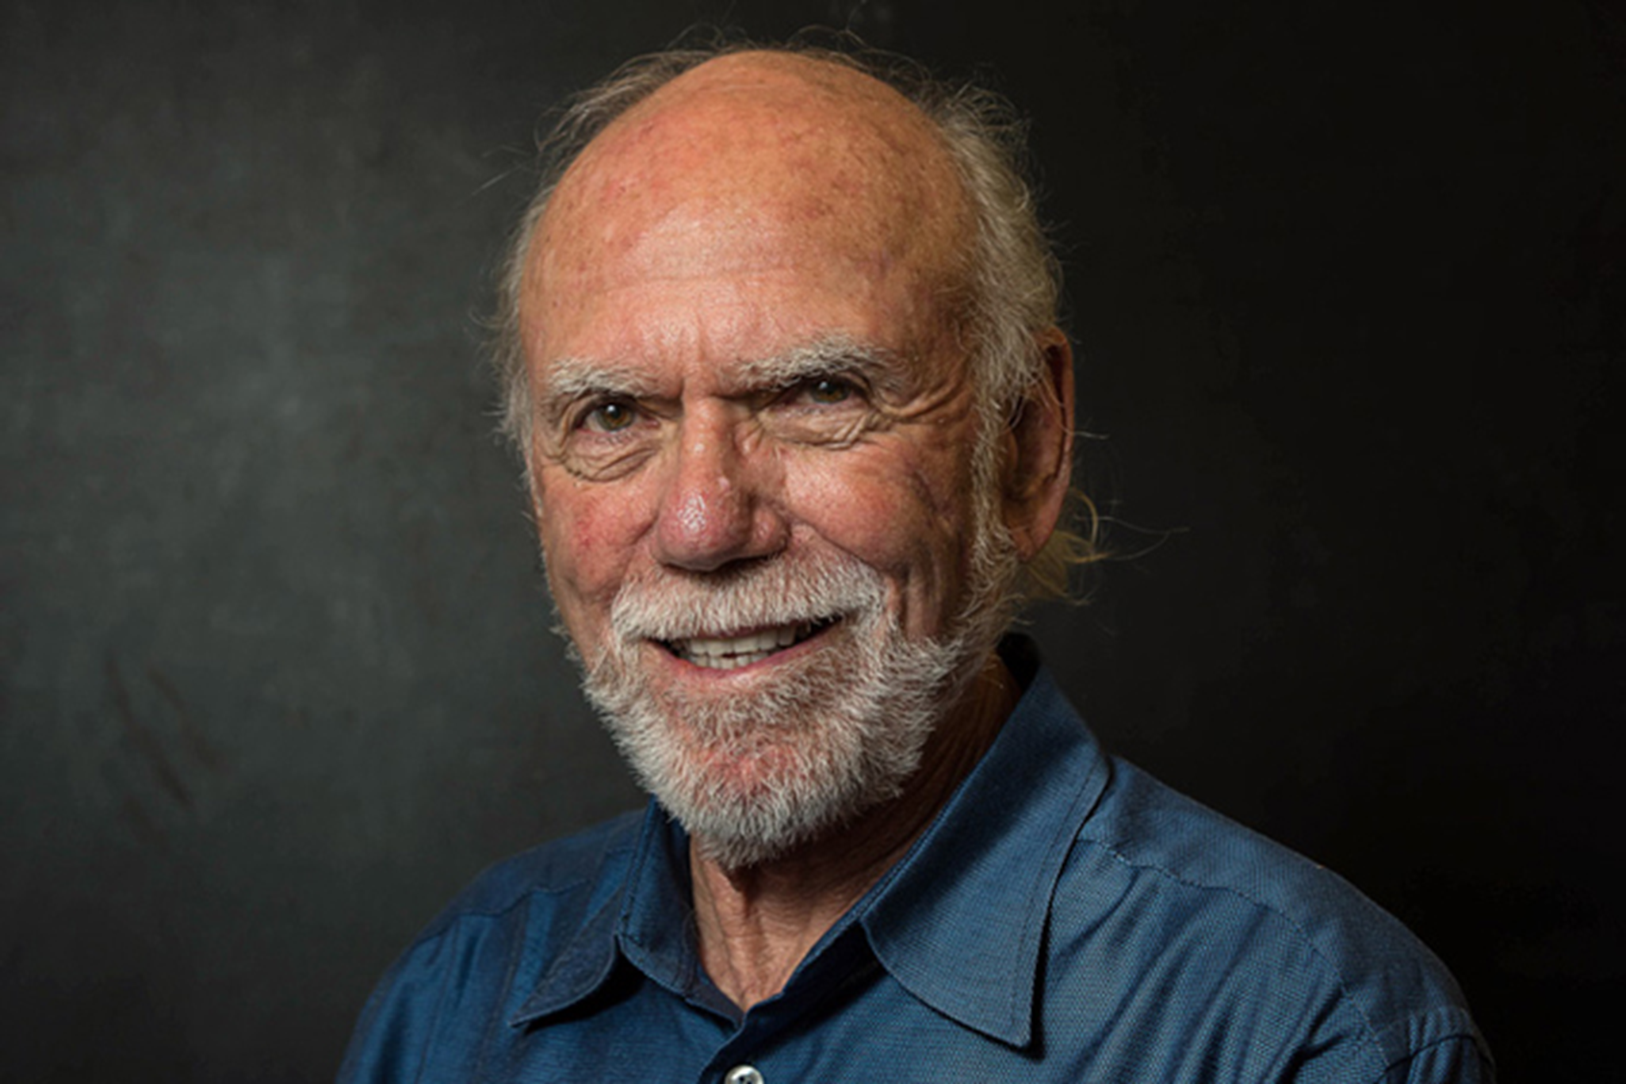
Simple Thinking

Slide 20
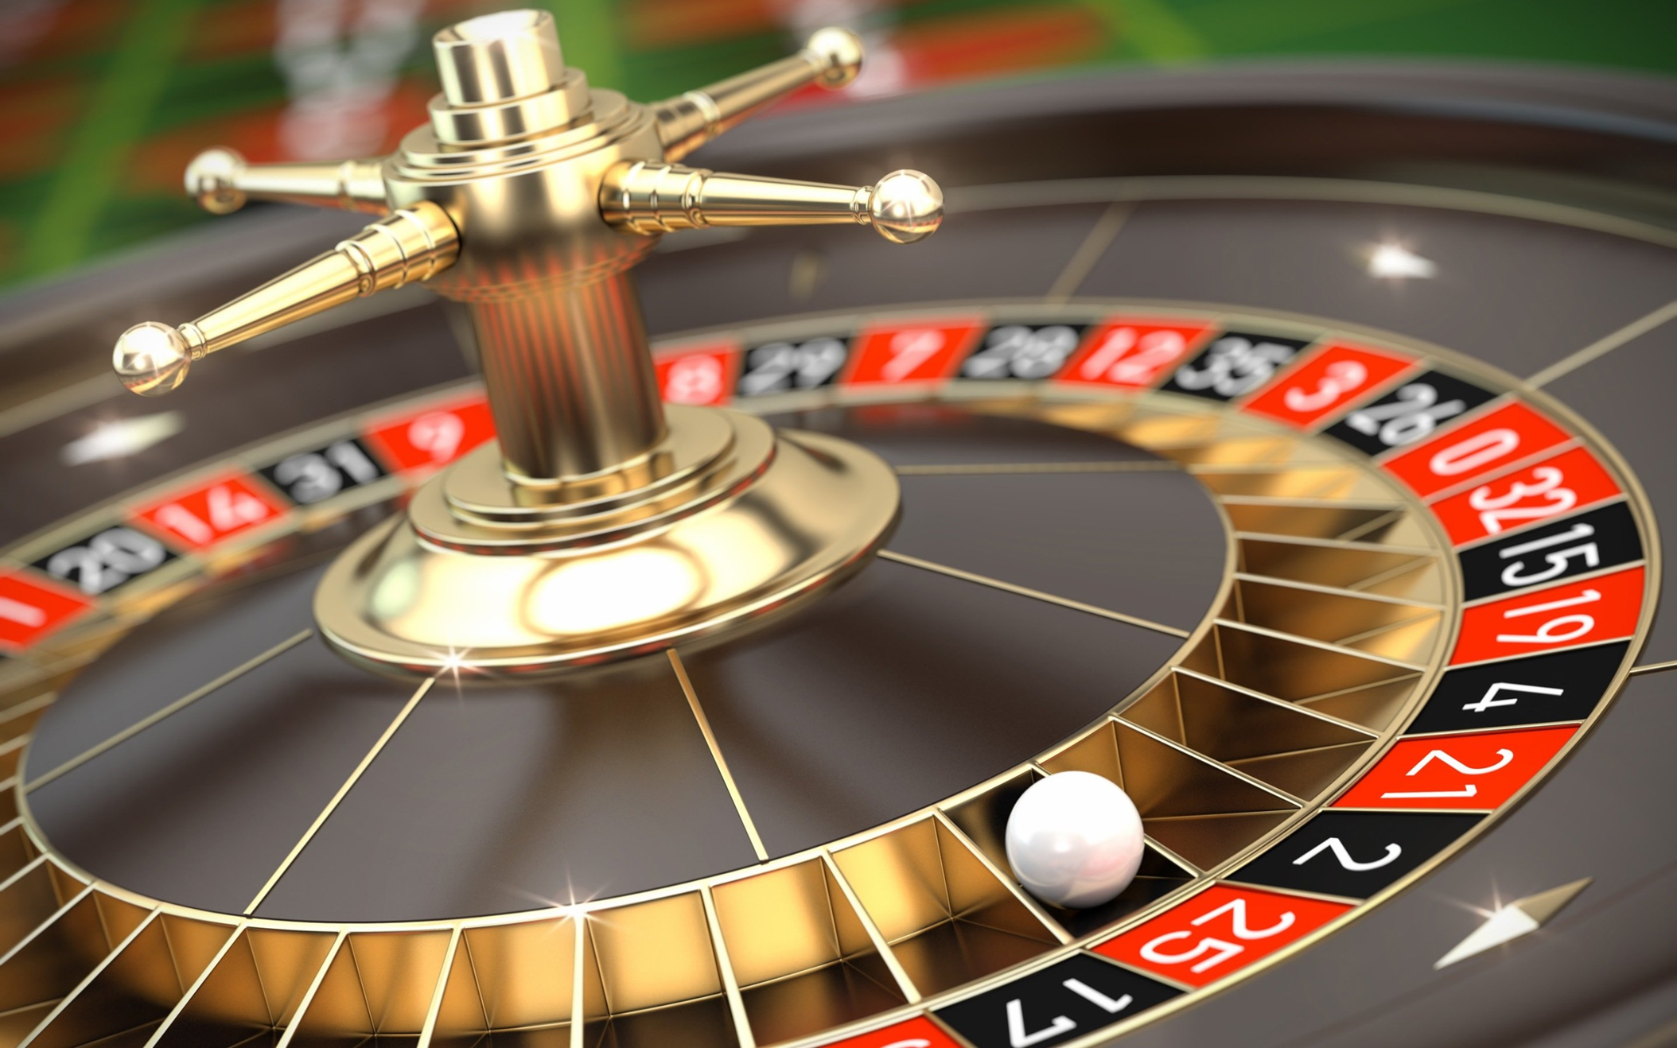
Simple Thinking

Slide 21
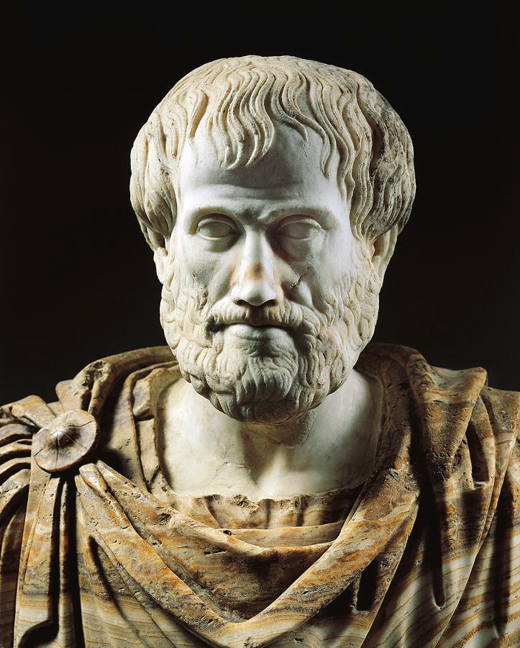

Slide 22
Psychological safety
Dependability
Structure and clarity
Meaning
Impact

Slide 23
Broadening Horizons…
Simple Thinking

Slide 24
“Alienus Non-Diutius”
Alone no longer
Simple Thinking

Slide 25
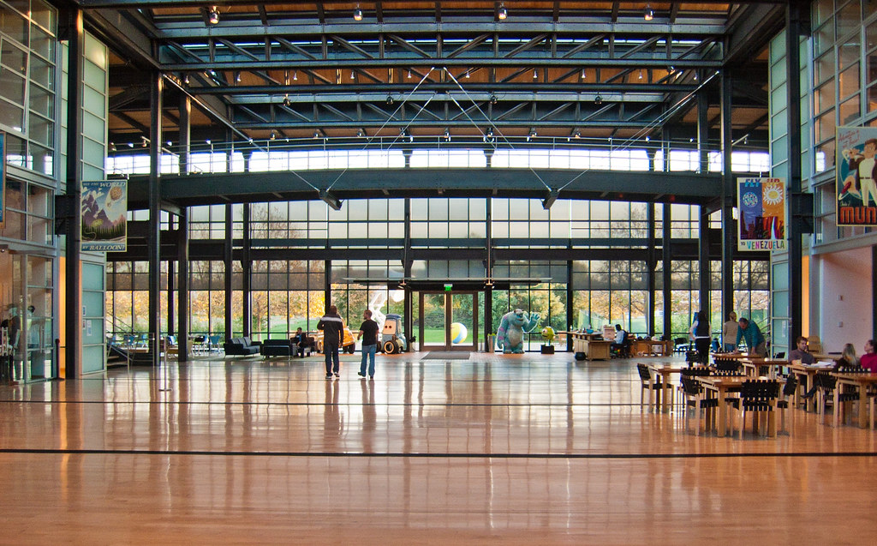
#ConstructEd

Slide 26
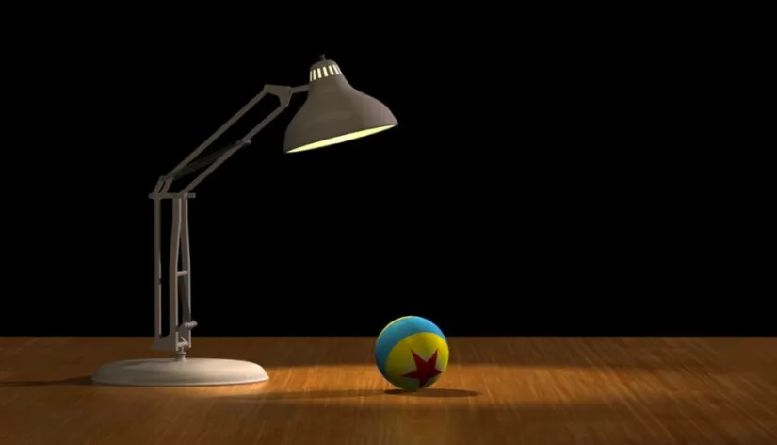
Simple Thinking

Slide 27
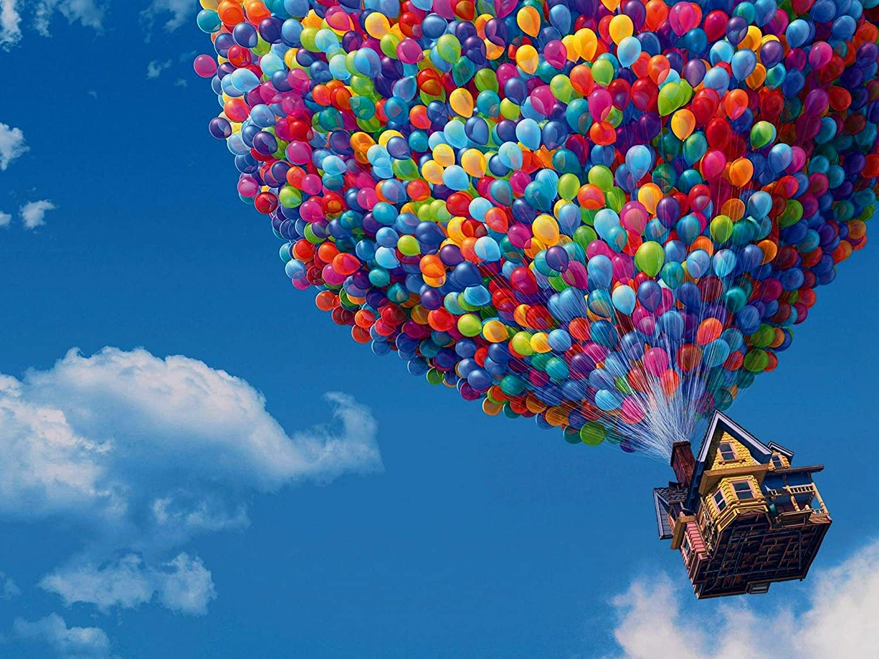
Simple Thinking

Slide 29
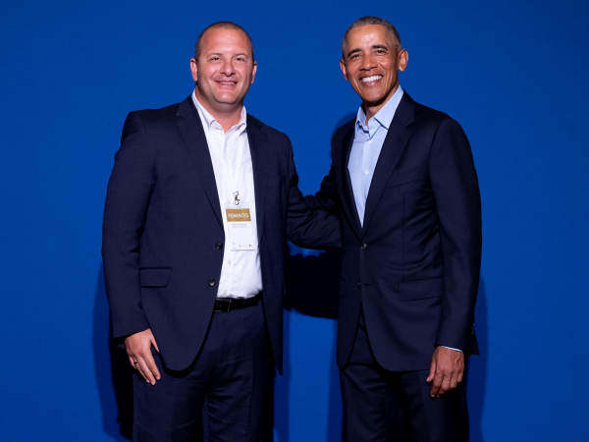

Slide 30
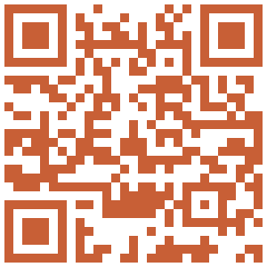
Twitter: @richardgerver
Web: www.richardgerver.com

