Slide 1
Creative Learning and Resourcing for Children with SEND
SAXON WOOD SPECIAL SCHOOL

Slide 2
ABOUT SAXON WOOD
We are a very small special school located in Basingstoke.
44 children on roll aged 3 – 11 years old.
Children with complex medical needs, learning difficulties and disabilities including ASD & ADHD.
Notes:
Tara

Slide 3
ABOUT SAXON WOOD
70% of our children are non-verbal and use a range of ways to communicate.
Our children may have some of the following needs:
PMLD, Complex Medical Needs, Cognition & Learning needs, Vision Impairments, Hearing Impairments, ASD, ADHD, SEMH
Notes:
Katie

Slide 4
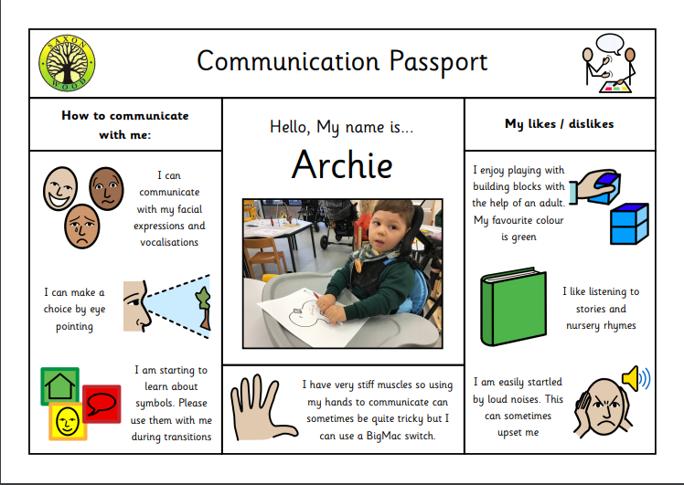
KNOWING THE CHILD
Communication Passports
What makes them happy
Triggers
Reactive Strategies (Positive Behaviour)
Picking your battles
Building positive relationships
Notes:
Katie

Slide 5
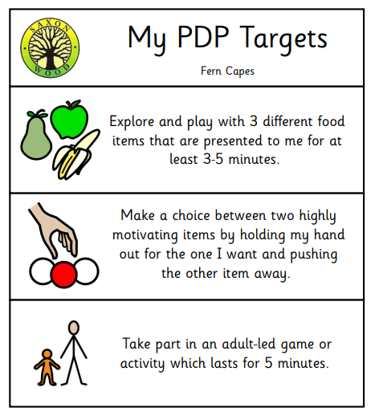
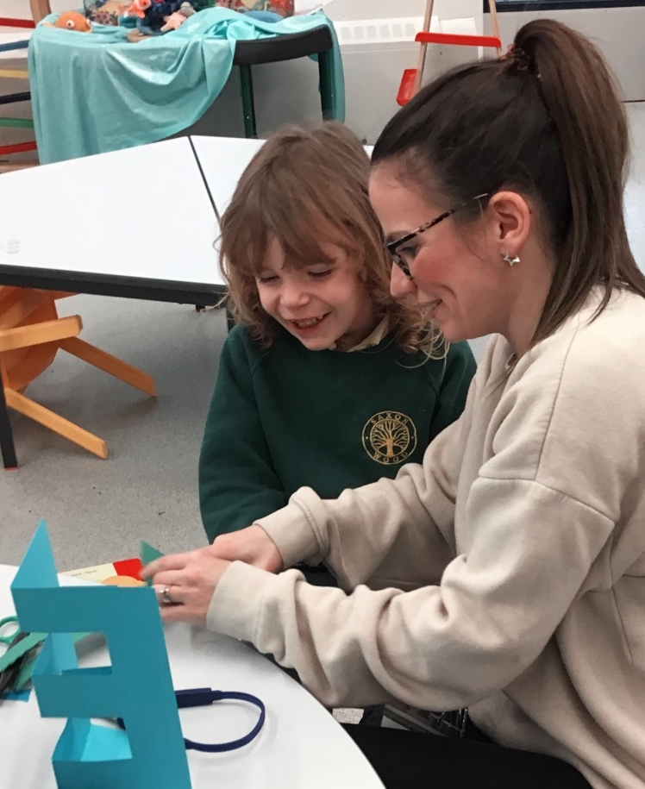
PERSONAL DEVELOPMENT PLANS
Small achievable targets
Discussed and agreed with parents
Reviewed termly
Dedicated daily PDP time
All staff aware of targets
Targets amended where necessary
Notes:
Katie

Slide 6
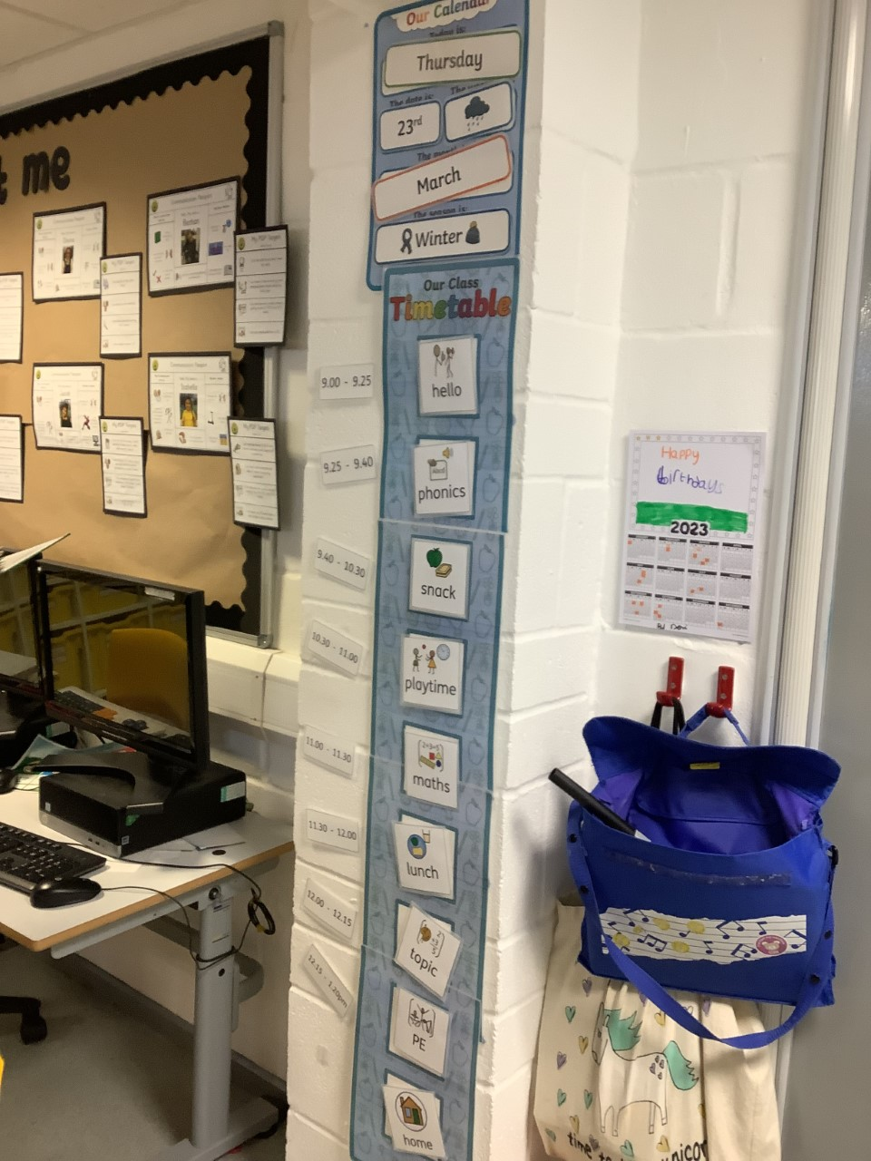
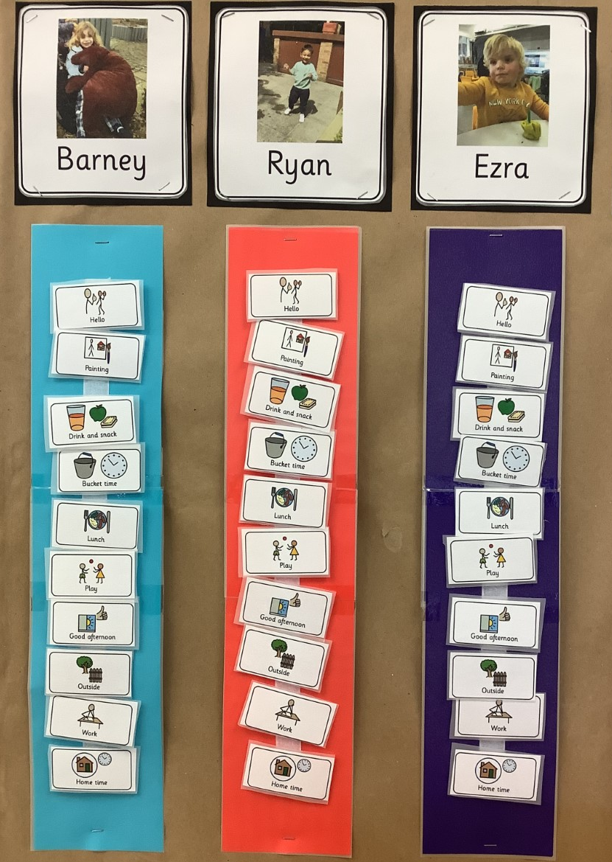
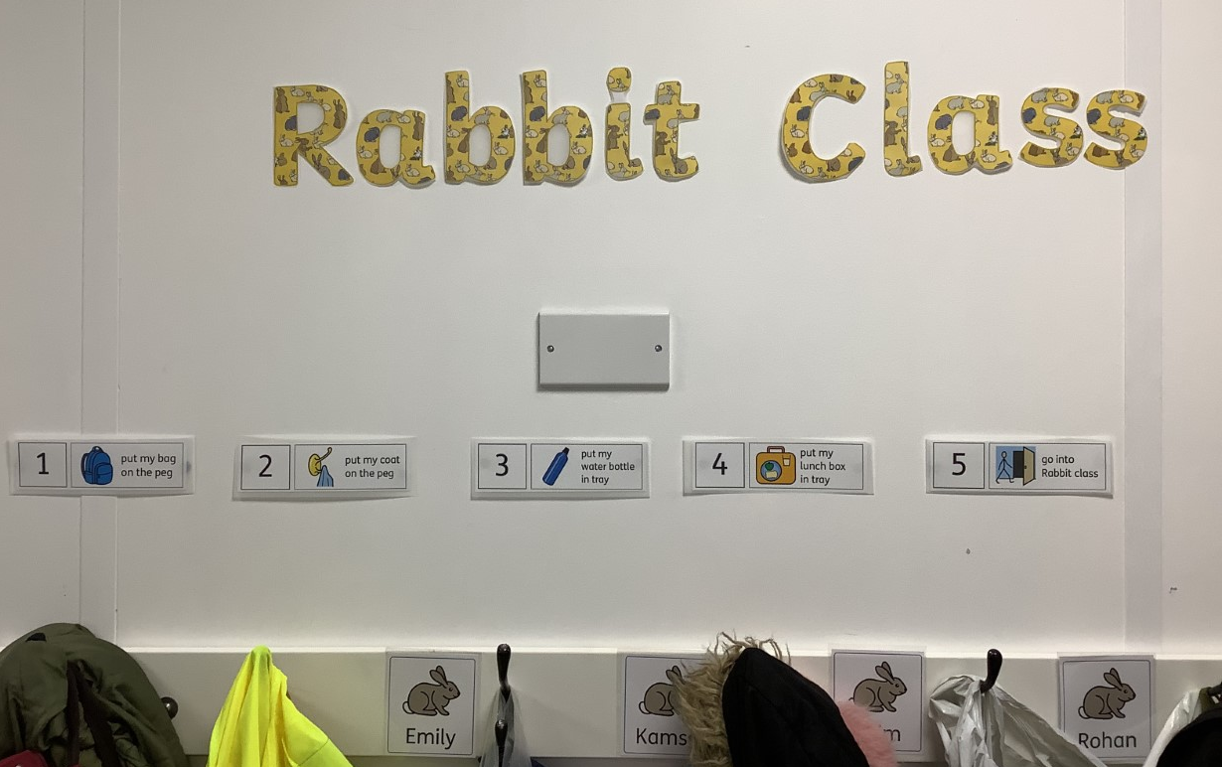
DAILY ROUTINE
Visual Timetables
Musical Cues
Notes:
Tara

Slide 7
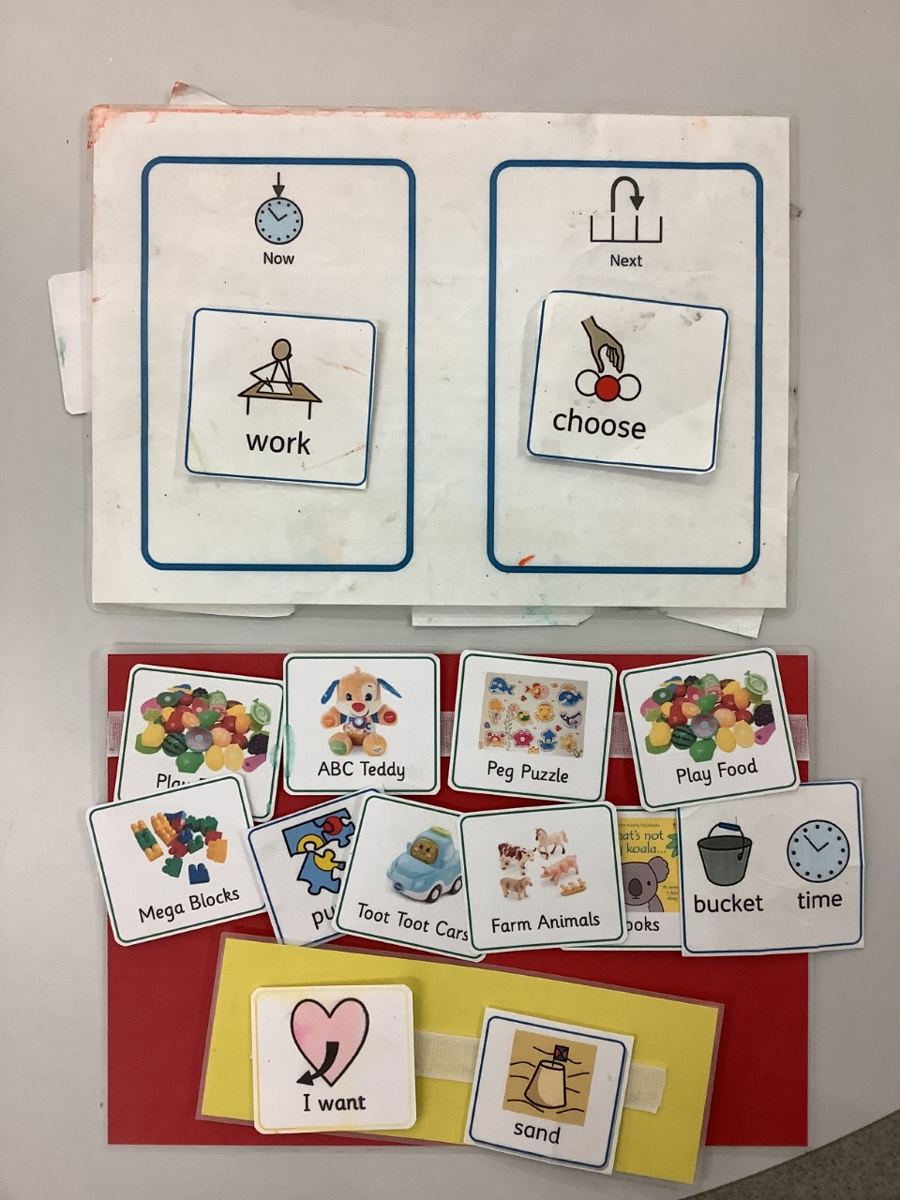
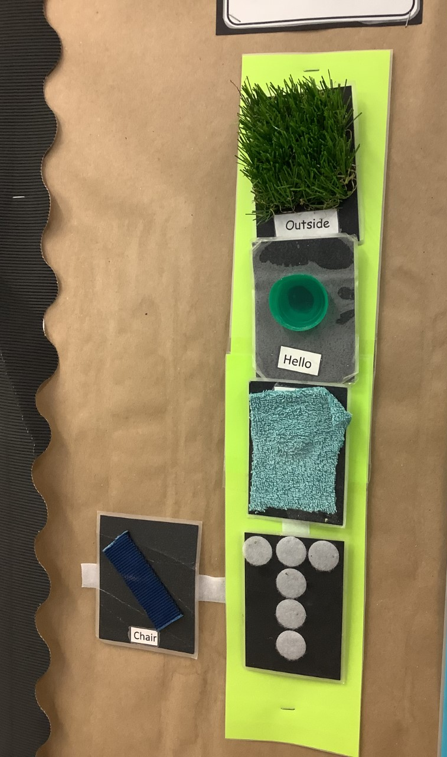
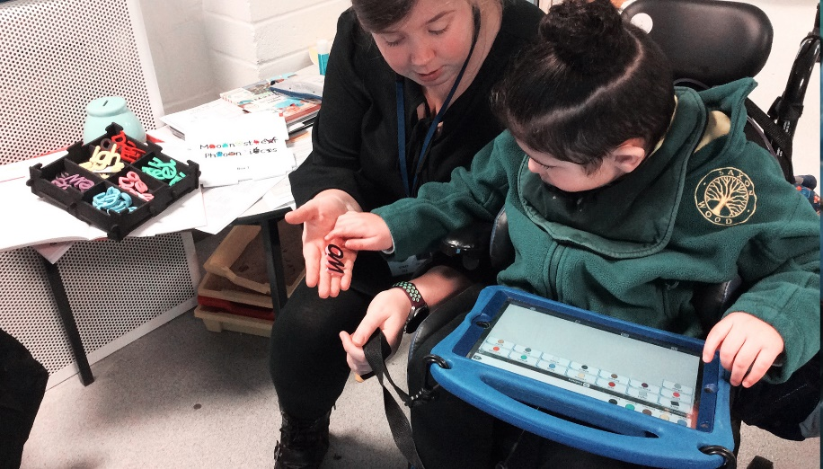
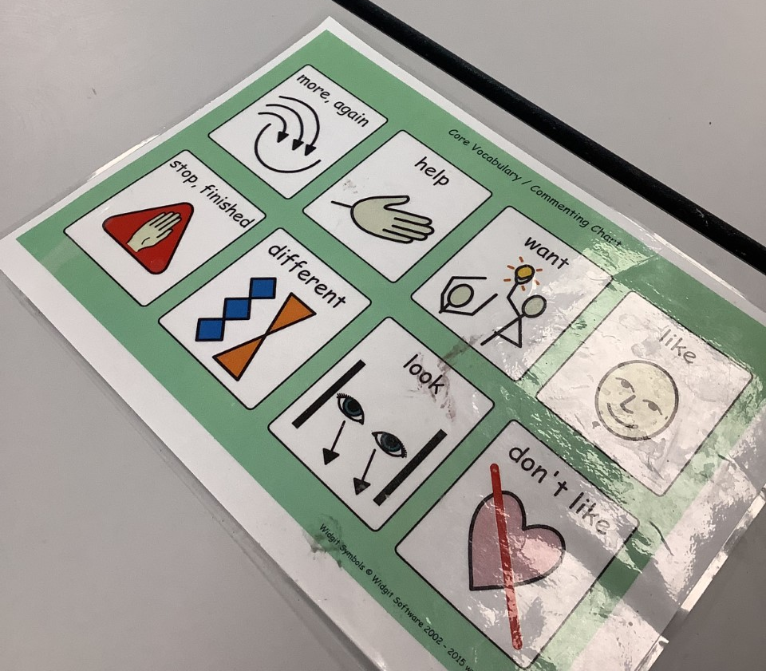
COMMUNICATION
Now & Next Boards
AAC Devices
Choice Boards
Objects of Reference
Communication Mats
Notes:
Katie

Slide 8
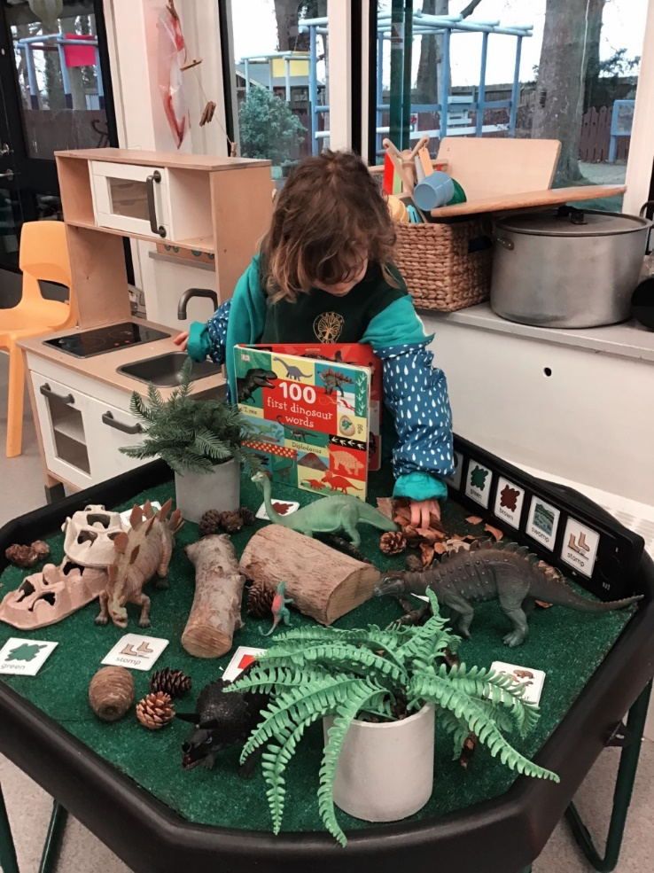
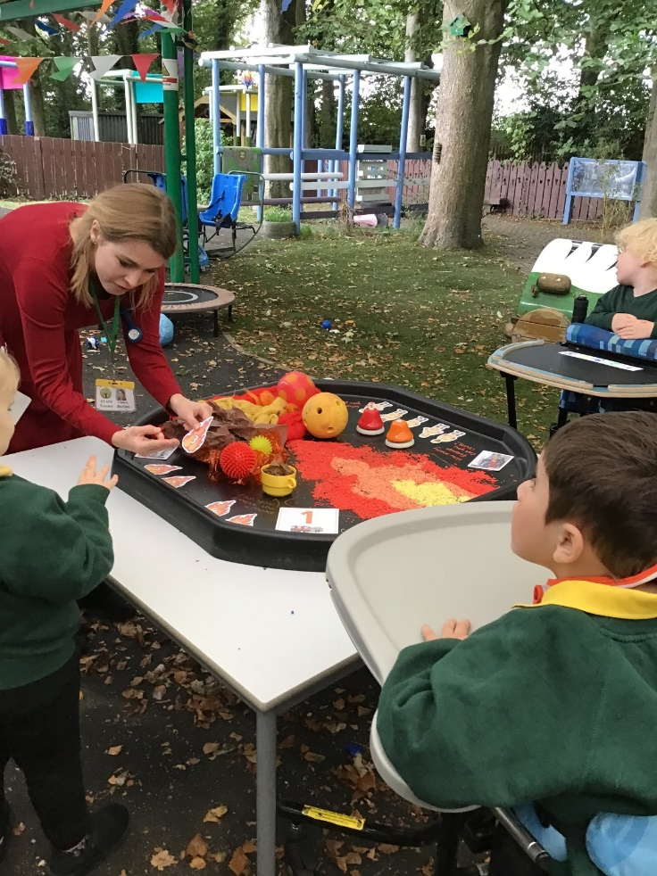
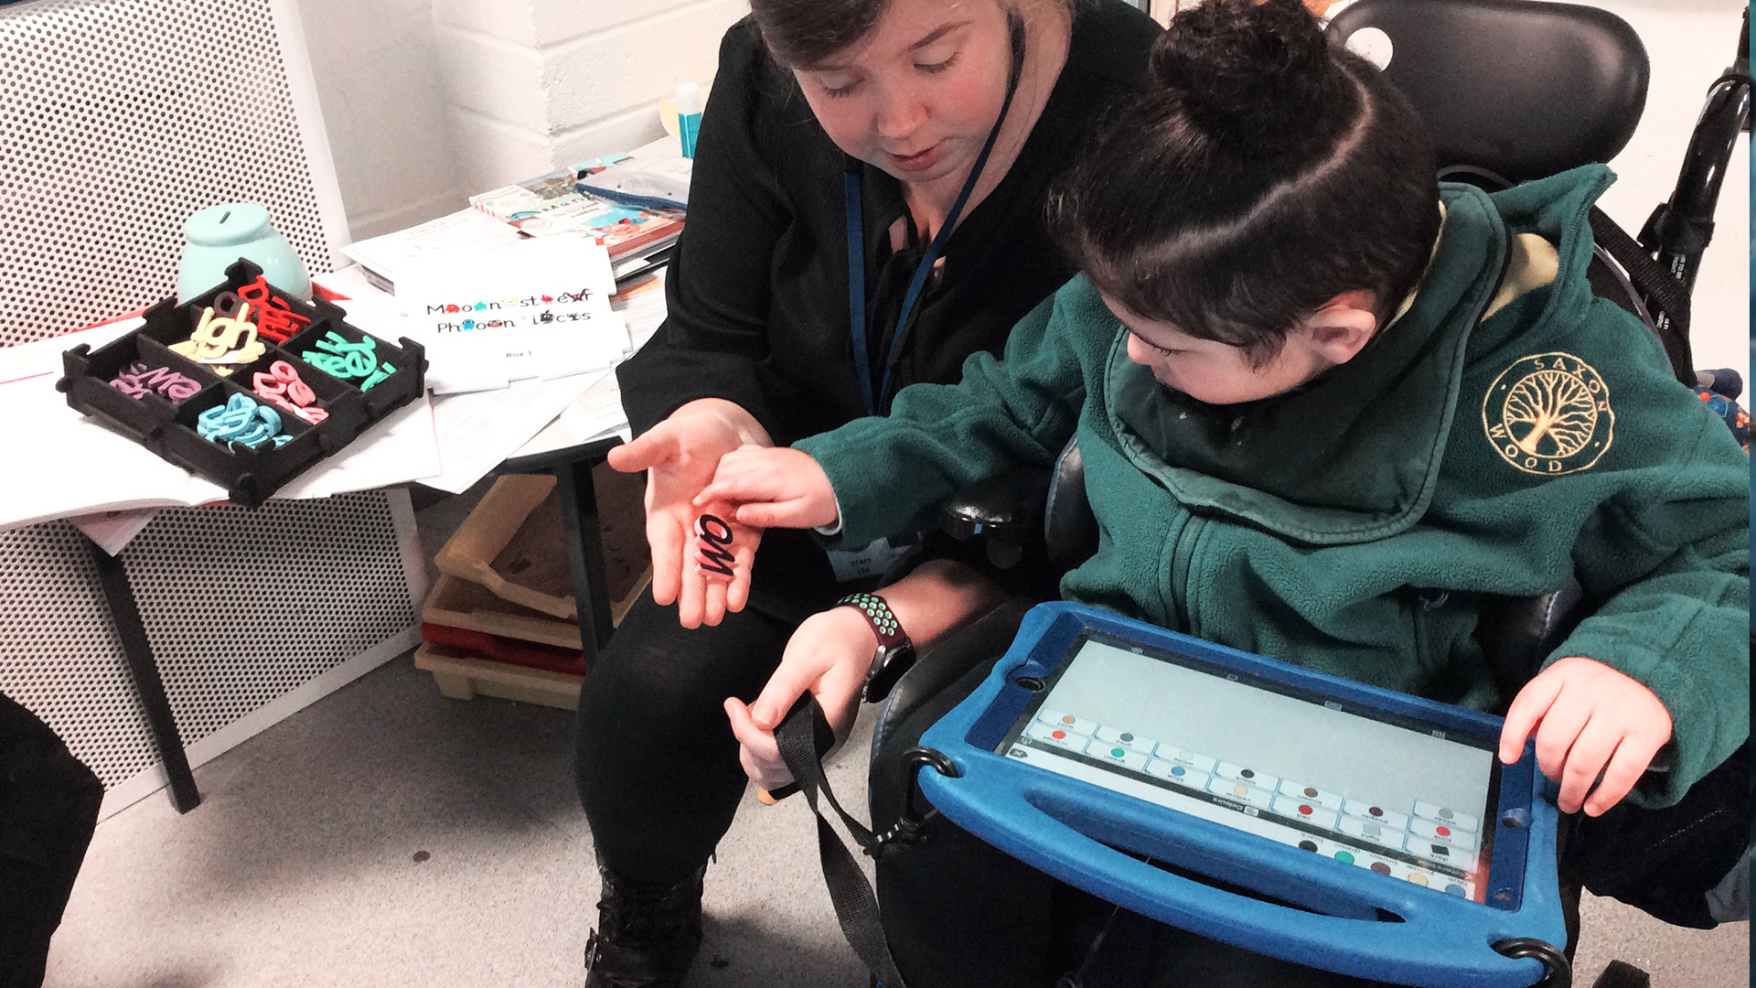
ENABLING ENVIRONMENTS
Language rich environments promote and encourage the enhancement of children’s communication and language development.
Notes:
Katie

Slide 9
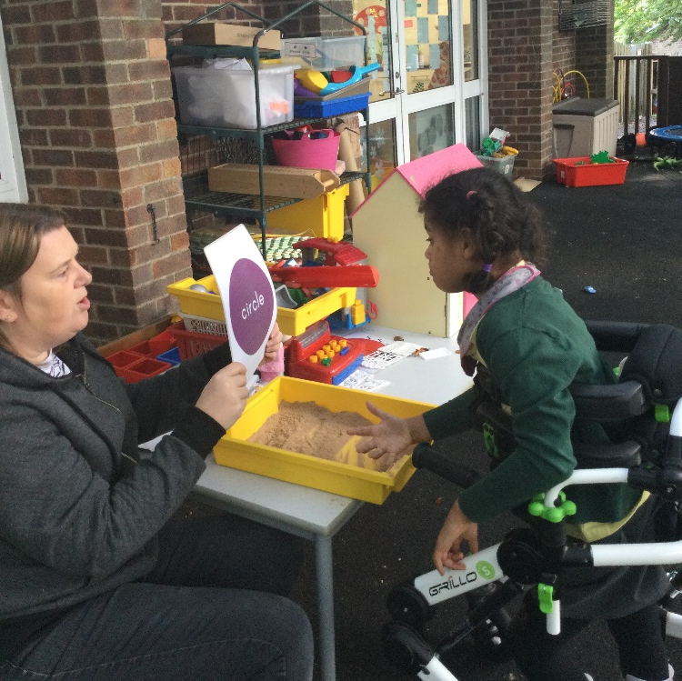
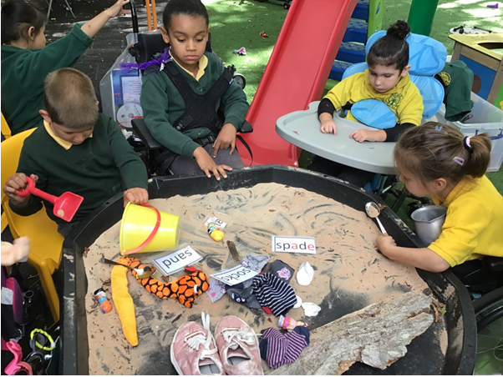
OUTDOOR LEARNING
Outdoor learning boosts confidence, social skills, communication, motivation, physical skills,
self-esteem, self-confidence and positive attitude to learning
Notes:
Katie

Slide 10
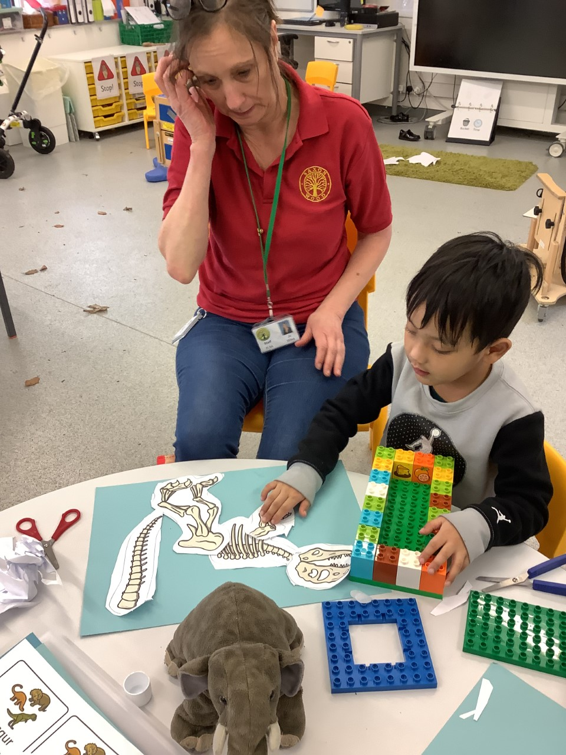
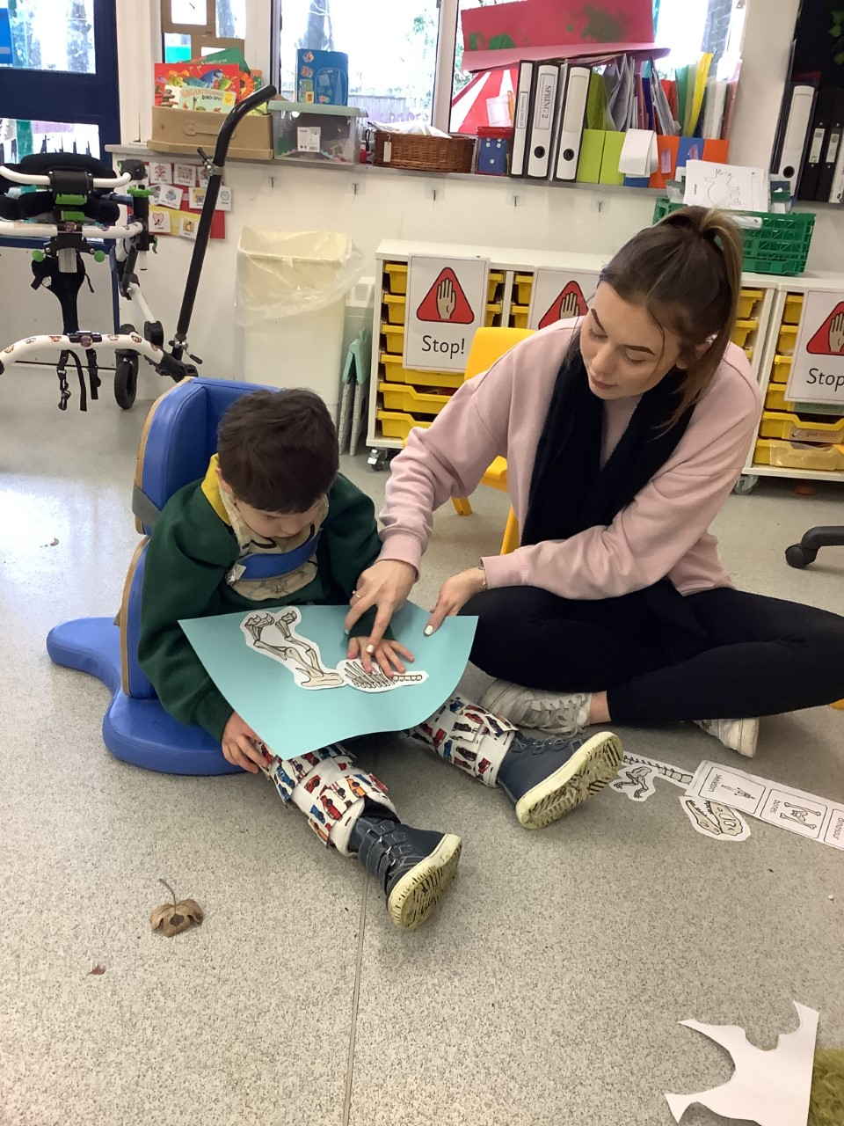
CREATIVE LEARNING
Children will access the same activity in different ways that are suitable for their own individual needs with support levels that are suitable.
The outcome is the same but the route taken to achieve it is different.
Children also wok on skills that are relevant to their abilities.
Notes:
Katie

Slide 11
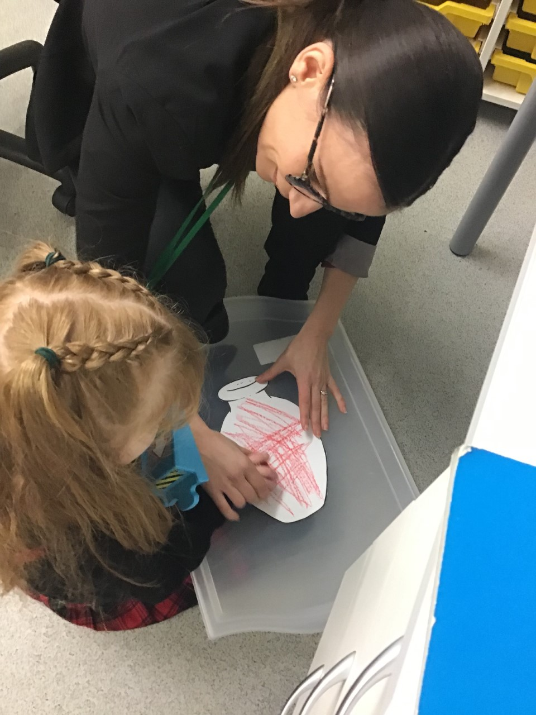
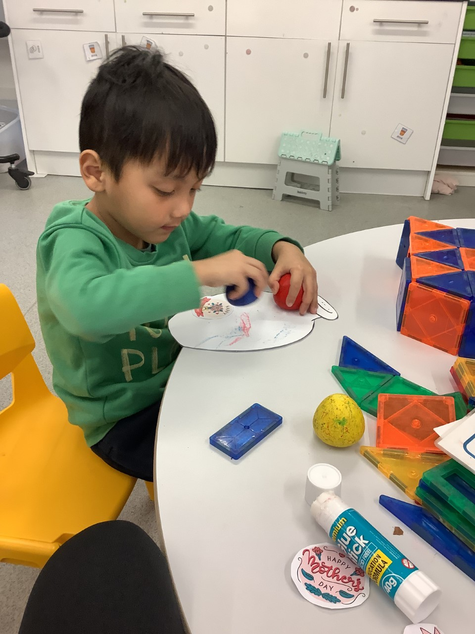
CREATIVE LEARNING
Child with Severe Visual Impairment
Taking part in mark making activities.
Developing fine motor skills.
Activity brought down to child’s preferred level and area to work.
Music playing in the background which helped with focus and attention.
Able to feel the texture of the crayon on the paper.
Able to feel the outline of the vase.
Activity: Making Mothers Day Cards
Learning: Crayon control / mark making
Child with ASD
Can work independently.
Needs help to stay on task.
Needs to keep motivating items nearby.
Notes:
Katie

Slide 12
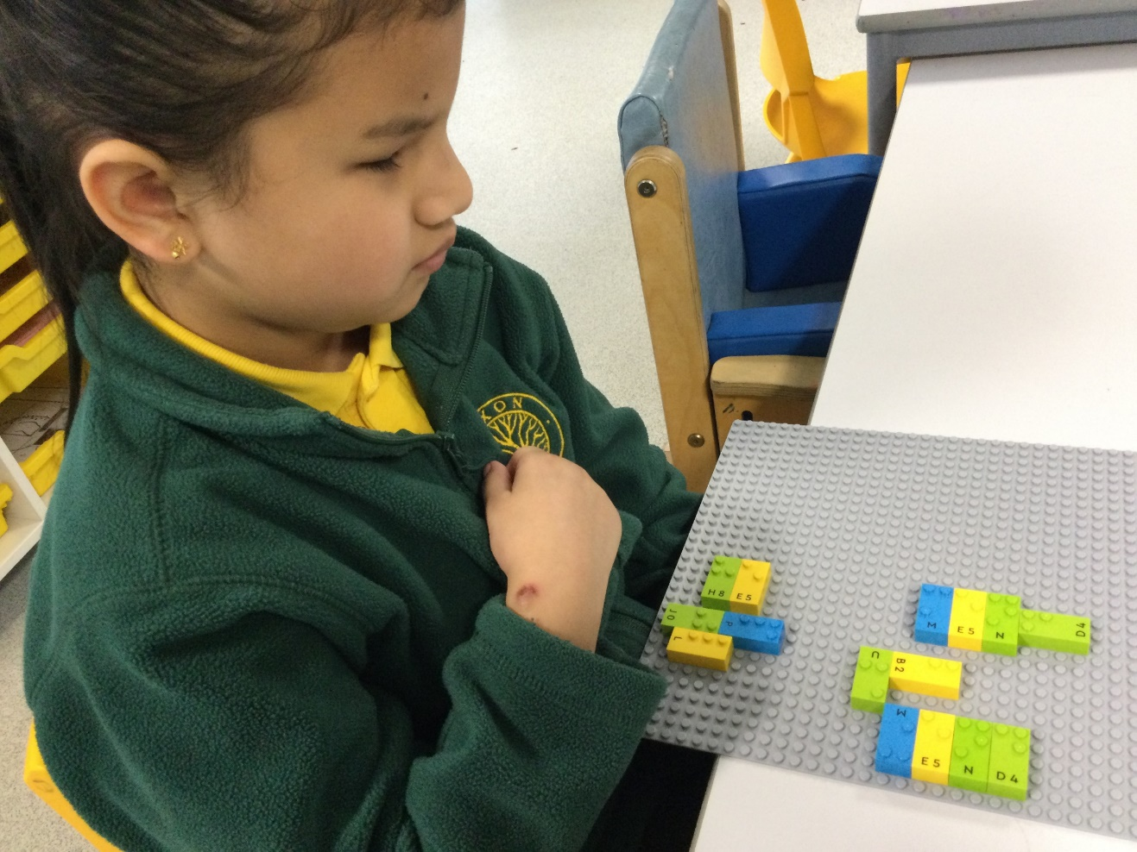
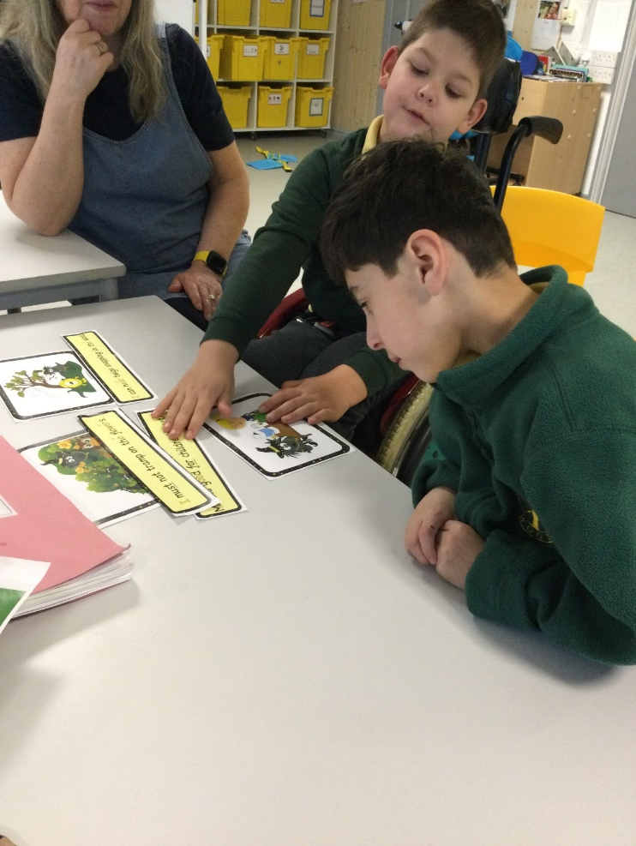
CREATIVE LEARNING
Learning: Phonics – Making Sentences
Activity: Lego Braille & Picture Cards and Sentence strips
Child with VI
Using Braille to access the same phonics lesson as the children who have sight.
Notes:
Katie

Slide 13
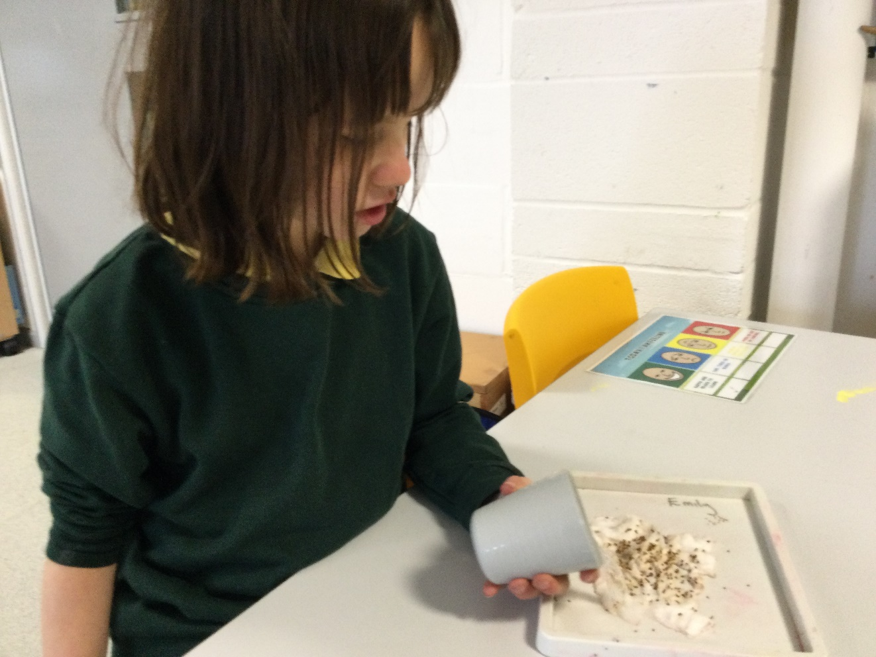
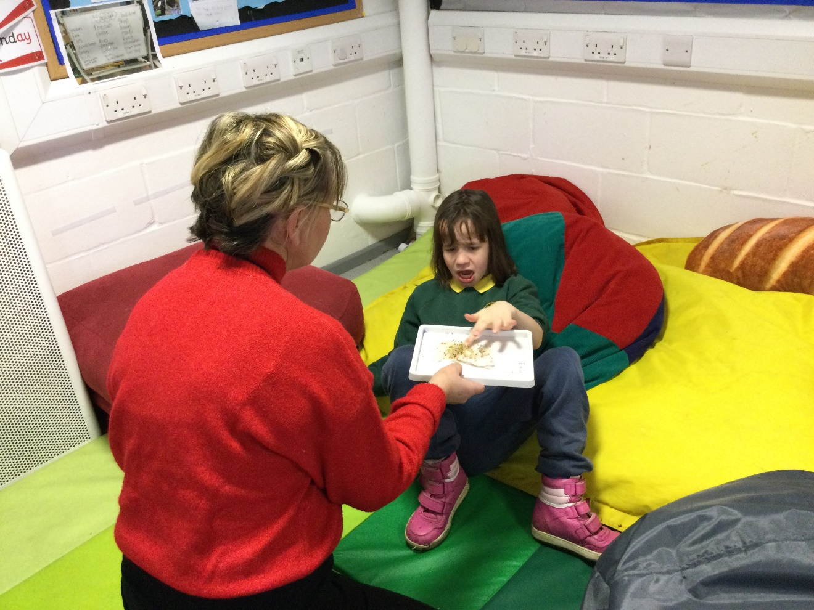
CREATIVE LEARNING
Activity brought over to the child
To access the learning
The child is accessing the activity at the table with every minimal support.
Notes:
Katie

Slide 14
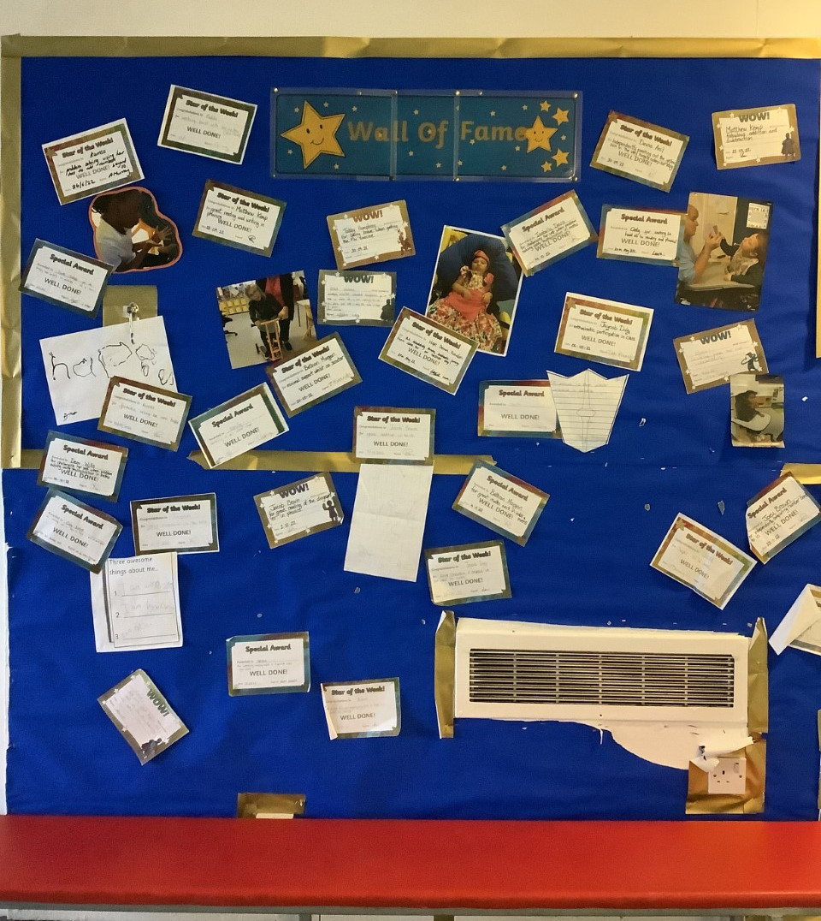
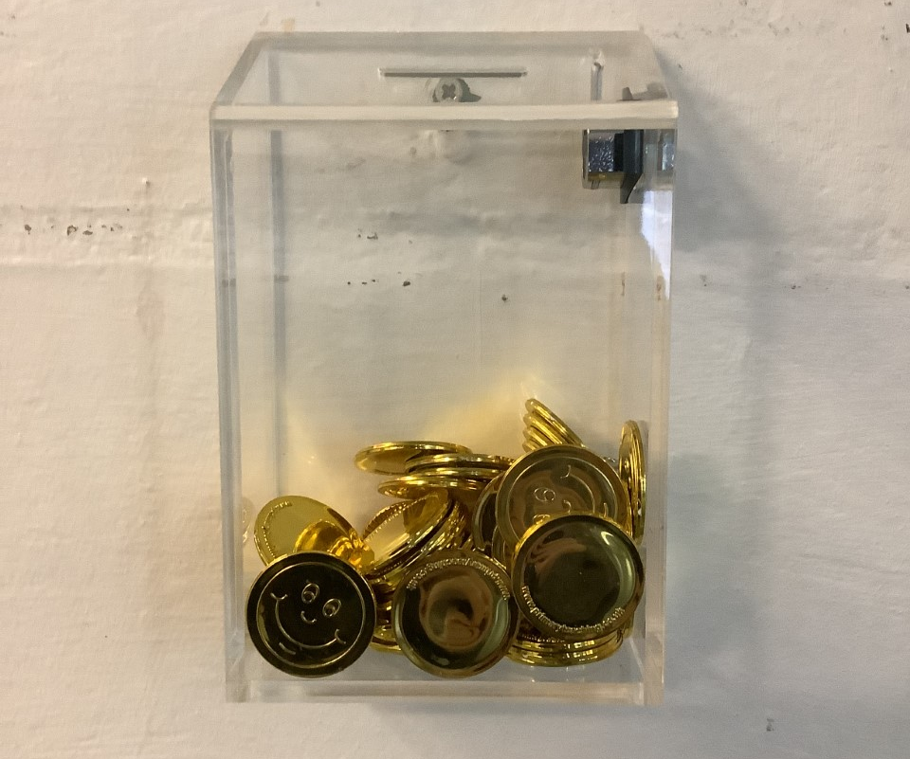
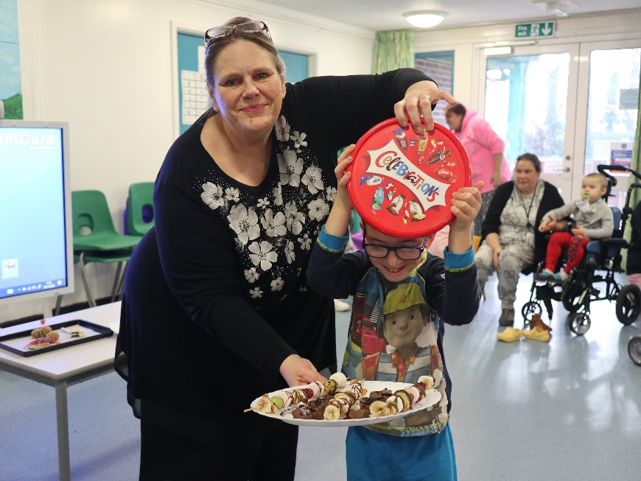
REWARDS
Celebrating small wins
Weekly Celebration Assemblies
Certificates
Gold Coins
Headteacher Prizes
Whole School Rewards
Notes:
Tara

Slide 15
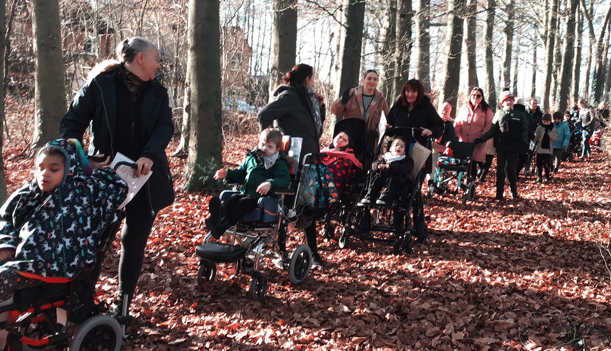
WELLBEING
Student questionnaires
Involvement of parents
Knowing where to go for help
Social time
Relax Kids
Lego Therapy
Activity Passports
Teddy bears picnic
Movie time
Pancake party
Enrichment Opportunities
Notes:
Tara

Slide 16
ANY QUESTIONS?
Notes:
Tara

