Slide 1


A strategic approach to inclusion to meet the needs of our community

Slide 2

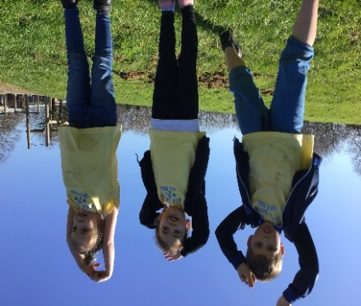
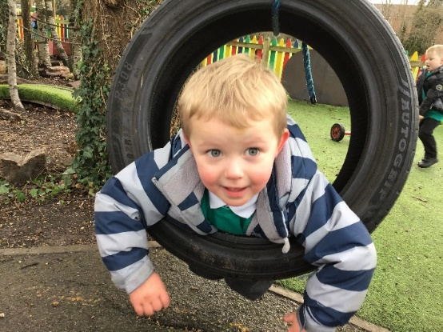



Slide 3
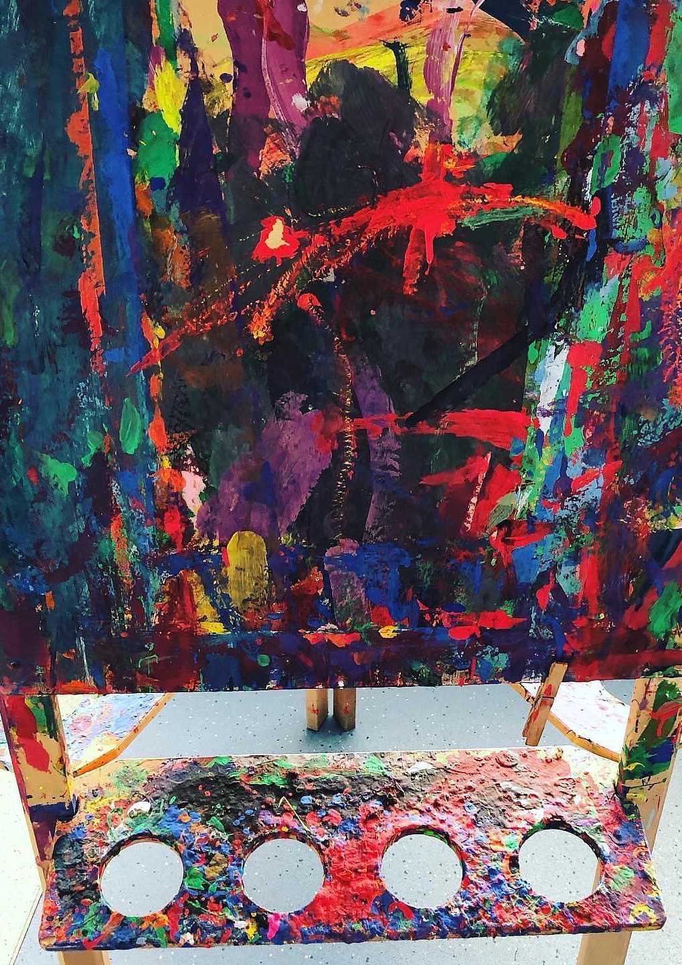
Context: so what is our reality?
70% not at age related expectations for speech and language in Year N
Lowest number of any non-SEND pupils in Hampshire (this includes resource provision schools) 62.3%
38 IARFs since January
Social Services or Police involvement: 43%
Pupil Premium: 53.81%
SEND: 37%
EAL: 9%
DA: A factor in all our CP cases
Neglect: Deprivation Index 6/422
81% Phonics Year 1 2023
KS2 SATS 2022 10% above national combined 69%
MTC 2023 Alver Valley mean score 21.5
(national 2022 19.8)
Notes:
We are a Nursery from 3 yrs, Infant and Junior Federation
Year 4 PP: 65.38% National 23%
National SEND 12.6% Of our SEND population 21% have diagnosed autism
EHCPs 8% (national 2.3% in mainstream)
Expectation we are still expected to get to National: The only way is to address the Inclusion aspect

Slide 4



What do we understand by Inclusion?
It is about our culture
“For Inclusion to work,
children and staff need
to have a sense of identity
and belonging”
I can stop what I am doing and listen to an adult
I understand I may need to wait
Notes:
“Where relationships are built on warmth and mutual respect” Ofsted March 2023
Strength in our practice comes from the tightness of practices which support each other, are streamlined and are bespoke for our school:
Six Strands which covers our Learning Approach curriculum,
Thrive which addresses our Emotional Curriculum and Forest Schools which supports all areas
P4C which gives our children a voice. Speech and language Therapist
Research included and gives us a tool to reflect on our evidence base
The impact of this, is there is a common language understood by all
Strong BP- shared and known by all pupils and parents (Induction) monitored and mapped with regular reviews to enable pro-active meetings 95% of children access this
Six Strands learning curriculum: focused on values which allow children to be included: Boundaries, Self-regulation, Focus, Respect, Independence, Resilience-→ IBMPS Target cards

Slide 5
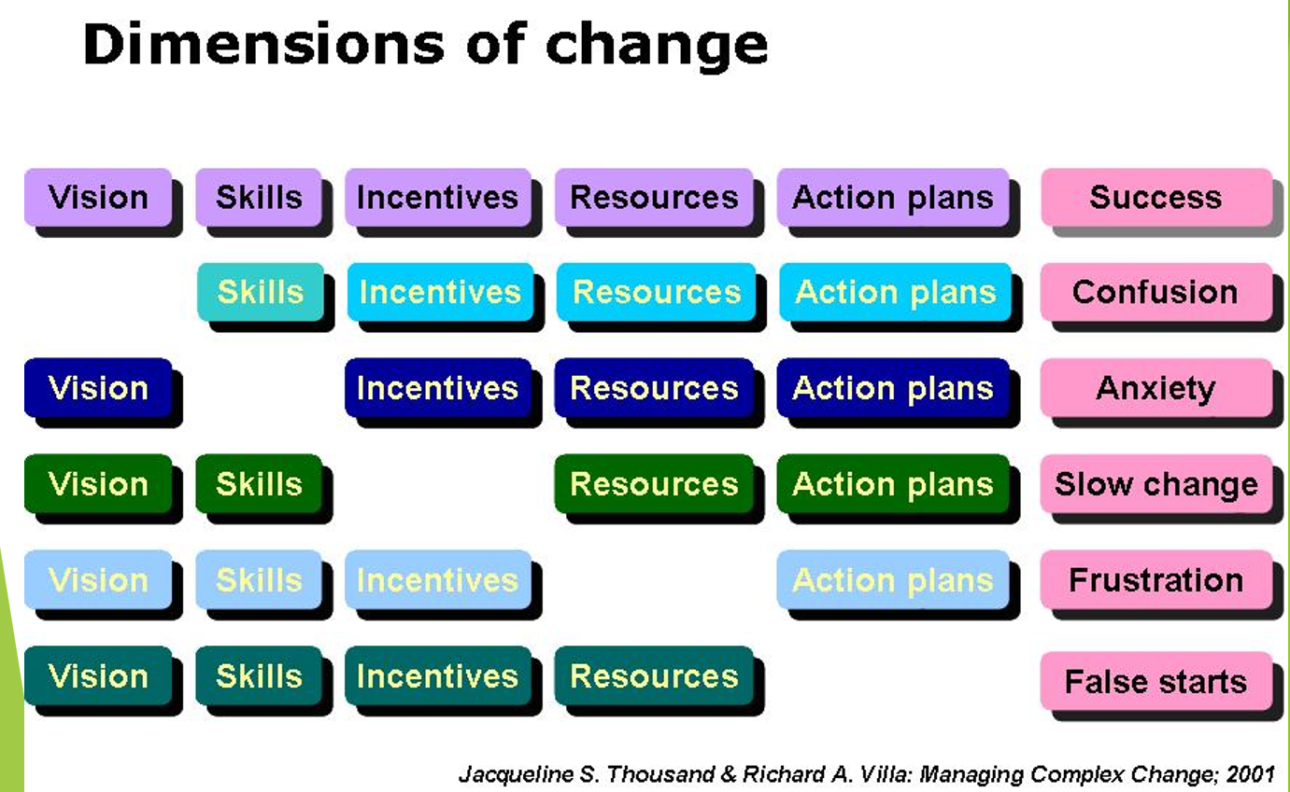

Slide 6
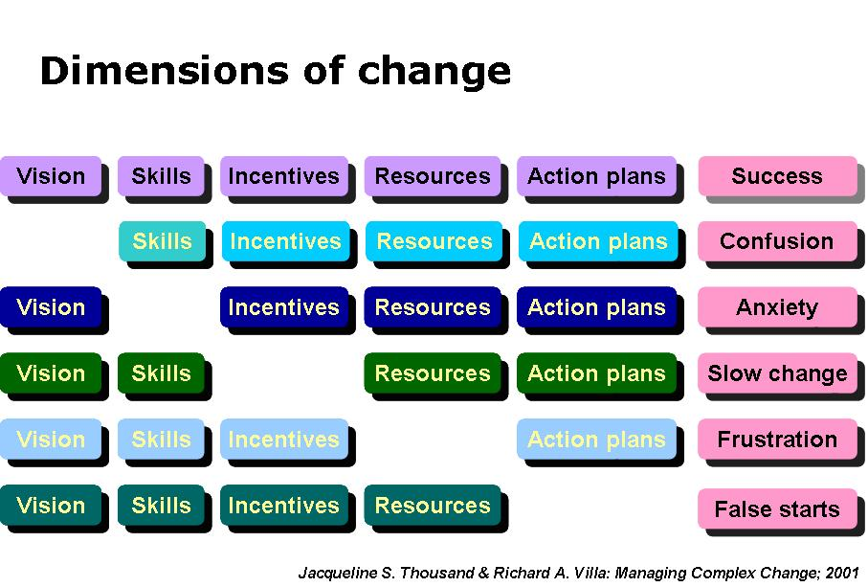
Notes:
MT – Make the link about the many leadership & management skills involved in middle leadership. Need to be skilled in all areas.
LINK BACK TO LEADERSHIP dimensions IN NPQML. Any key components missing and results can be disastrous.

Slide 7
It pervades all our work and is evidenced in our day to day
A clear deep understanding of needs of children in school e.g. leaders know what Inclusion looks like for their subject. Opportunities for Culture/SEND/
GDS/PP leaders to work with core subject leaders
Adults know where they need to get their children to at the end of the week/month/year:
Progress Reviews support inclusive practice
Expectations of adults and children are clear- they know what is next
Parents understand this too
What do we understand by Vision?
Notes:
“Where relationships are built on warmth and mutual respect” Ofsted March 2023
We actively monitor culture and this also forms part of our Governor Monitoring Plan. Vision is our rationale for doing things.
We talk about Inclusion: e.g. Diversity and Inclusion – Strategy Group and work in assemblies and Diversity Advocates

Slide 8
Systems to support consistency are mapped out over the year (calendar SEND/MITA)
Invest in what works and has cohesion: (Thrive, Forest Schools, part-time S&L therapist, Deputy SENCo)
What do we understand by Action Plan?
Notes:
“Where relationships are built on warmth and mutual respect” Ofsted March 2023

Slide 9
Adults have a good understanding of children and their needs
Adults and children are able to reflect and take responsibility
Supportive and relevant CPD of to build capacity: S&L/ Social stories/ MITA/ comprehensive Induction
What do we understand by Skills?
Notes:
Open access/Reflections to SENCo and Deputy SENCo
Reflection Questions: Thrive common approach and expectation that children will and can unpick their thinking
Masters Levels: Autism and self-regulation in Early Years

Slide 10
Champion Interventions that will work for our reality: (Strong Girls/ Autism Champions)
What do we understand by Incentives?
Notes:
LSAs: Developed a programme from the National Programme “Strong Girls”
Autism Group run by SENCo who has completed a Masters in Autism

Slide 11
Invest in your leaders
There is a consistency in practice built over time
Supportive and relevant CPD to build capacity
What do we understand by Resources?
Notes:
All classes have a same house style and have resources in class to support: visual timetables to 6 strands models BP visuals- so children do not feel Inclusion is a separate idea

Slide 12
Leaders
Managing the expectation of parents
Address the concept of “learned helplessness”
So current challenges?
Be realistic
& creative!
Notes:
Interventions: If it hasn’t been invented, create it! Strong Girls

Slide 13
So what next for Inclusion at Alver Valley?

Slide 14
www.alvervalleyschools.co.uk
Maximising the Impact of Teaching Assistants Rob Webster, Anthony Russell, Peter Blatchford
Leading change: Kotter’s eight steps MITA chapter 3
EEF Making Best Use of Teaching Assistants Guidance Report 2021
Spotlight articles https://www.alvervalleyschools.co.uk/blog/
6 Strands: Curriculum
Early Years Network https://www.alvervalleyschools.co.uk//early-years-network/
Signposting and Resourcing

