Slide 1
Inclusion and Relationships
Notes:
Mixed demographic, as with many other schools at present – anxious community

Slide 2
Inspiration from the Waterloo School
Emphasis on relational practices between pupils and staff
Emotion coaching approach to help children understand emotions, why we have them and how to manage them
Highly personalised Behaviour Support Plans
Notes:
*Talk from Kirsty Robinson (headteacher at Waterloo school) at the BDIP.
*I took 3 main points and we shared these at school as part of our PLC: 1 – our strong existing practice 2 – good to revisit as 5 years since we first introduced it & also have new staff & SMHLT 3 – needed to reflect on our current IBMPs

Slide 3
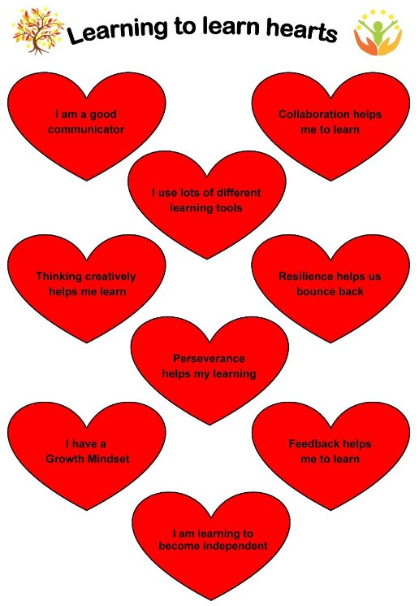
Existing practice at Liphook
This strongly affirmed our relationship based approaches at Liphook:
Strong relationships with children and families
Trauma informed practice in place
Emotion coaching approach in place
Positive behaviour culture based on our federation values and learning hearts – individual and collective reward systems
Notes:
*Already have very strong relationships with children and families – always looking at what is the child’s behaviour communicating?
*We became a trauma aware school in 2018 as introduced emotion coaching as part of this
*Values and learning hearts are the core of our school and embedded for all children, they have shaped our positive behavioural approaches with the children both individually and as part of a class (learning heart stickers or merits & collective rewards using the gingerbread child – children celebrating each other) Used this approach to ‘gel’ classes together, alongside other strategies such as a token system for a child who struggled to communicate positively with his peers that he wanted to play with him / using 3 or 5 point scales to check-in with children and de-escalate or co-regulate as needed.
*Learning hearts are also part of our learning plans – children need to have good learning behaviours first in order to learn

Slide 4
Practice we have revisited
Supporting children in developing their emotional regulation and how to use the emotion coaching strategy to help children understand and label their emotions, why we have them and how to manage them
Notes:
*Emotional regulation and emotion coaching staff meetings and INSET in Spring1 – also used the PBS well-being ‘behind the behaviours’ workshop for parents to enhance this training further e.g. window of tolerance, shield of shame
*All staff responded very positively as they can see what was discussed in the children they support and they felt it helped them to understand the children’s behaviours as communication more effectively.

Slide 5
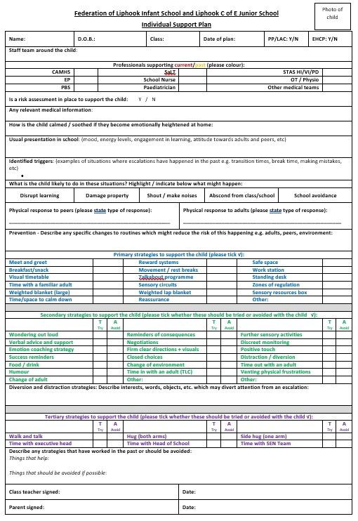
Adjusted practice at Liphook
Developed new behaviour plans which we have called
‘Individual Support Plans’
Notes:
*We needed new behaviour plans but wanted to come away from using the word ‘behaviour’ so used a similar format to The Waterloo School and adjusted it to meet the needs of our mainstream children with our particular resources.
*This has been extremely successful and has helped the staff to ‘unpick’ and understand each child’s behaviour as communication even further – also incorporating how parents support the child to de-escalate at home.
*No two plans are the same because they focus so specifically on each child’s individual needs. Also completed by class teacher with the SENCo as the level of discussion generated helps to unpick these behaviours further still to ensure we are giving the most appropriate support whilst developing more independence over time for each child at their own pace.
*Depending on each child we look at the ‘Usual presentation’ section differently e.g. a few children present the same in every situation, most children behave differently at different times e.g. during teacher input, with talk partners, in groups, independently, outside at break and lunch – depending on the child, we write about these different presentations in different locations and at different times e.g. transition times, particular lessons, when supply teachers are in, etc
*This helps us to complete the triggers as we can think about the triggers in each of these situations and then how we can ‘prevent’ or minimise it as much as possible and which strategies work best for the child e.g. certain children we would not negotiate with!

Slide 6
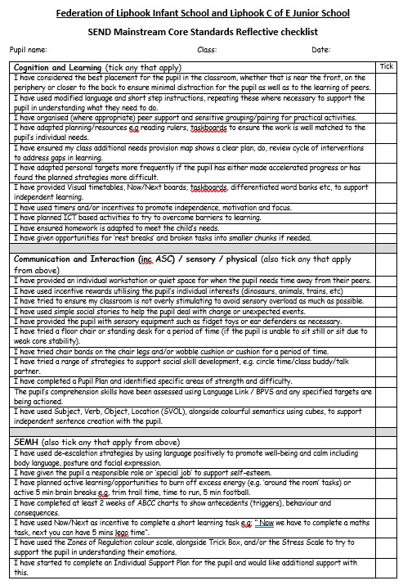
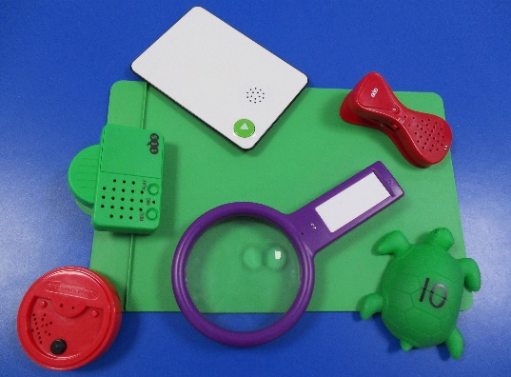
Interconnected practice
This is all used alongside:
Our speech and language approaches and pre-school language project
Reflective checklist to empower staff to try ideas first
Breadth of assessments to identify potential difficulties and a ‘whatever it takes’ approach to supporting children in minimising or removing barriers to their learning
Memory strategies and cognitive workload considerations built into every lesson
Notes:
*SaLT in school with learning plans and talking tins to relate targets back into class – teachers are clear re targets to be achieved and support this in the classroom through learning plans and talking tins
*SaLT in pre-schools – donation to support language earlier in our local pre-schools – very positive impact, children identified earlier and subsequently being discharged earlier
*Reflective checklist to empower staff to try ideas related to children’s needs in the moment rather than going straight to the SENCo and then if these ideas have not been as successful as we would like, it can be unpicked together
*Keeping the ‘whatever it takes approach’ at the heart of every member of staff to remove / minimise barriers for learning as frequently as we can
*Ensuring that memory and cognitive workload considerations are in every lesson e.g. spiral curriculum, strong knowledge of subject leaders and yearly subject champions, fast fours in lessons.

Slide 7
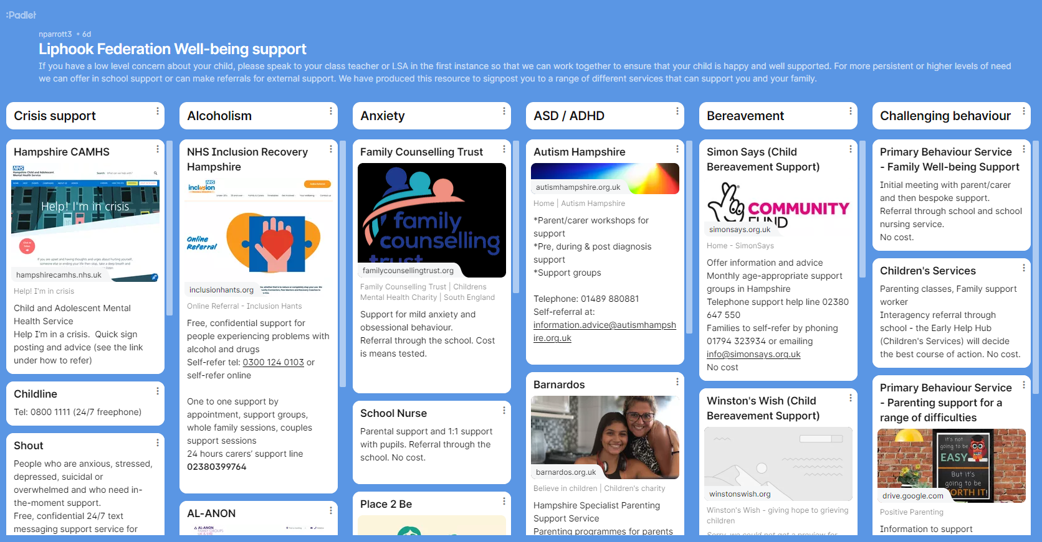
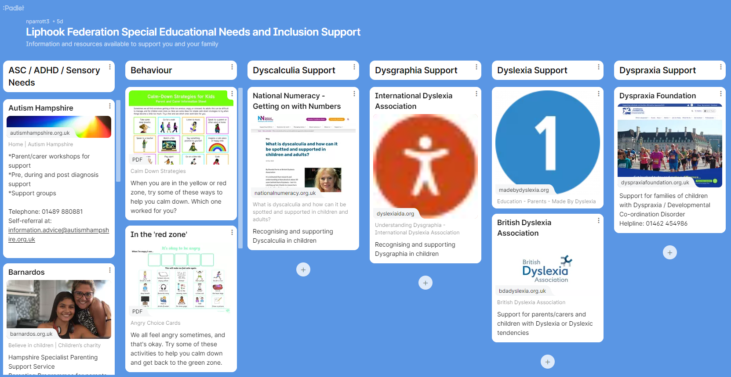
Additional support for our parents/families
We have created a well-being support padlet to share with parents:
We have also created a SEND support padlet to share with parents:
Notes:
Additional support for families in terms of mental health and well-being support, also support for families of children with SEND.

