Slide 1
Making the next steps successful.

Slide 2
Background:
Asst. Head SENDCo/DSL at The Coppice Spring Academy – Basingstoke
Asst. Head SENDCO/DSL at The Pride Academy – Uxbridge
SENDCo at Winton Community Academy – Andover
As a parent, I have two adopted children who both have EHCPs. They both attended mainstream primary schools.
My daughter transitioned to a Specialist Secondary school.
My son transitioned to a mainstream Secondary school and then to a Specialist Secondary school.

Slide 3
Why is this important?
When we get this right for any student – it's the pot of gold at the end of the rainbow.
When a successful transition has occurred, it can lead to:
Being academically and behaviourally involved in school.
Feeling a sense of belonging to school.
When it's not successful, the impact it can have on families and schools is huge.

Slide 4
If you were going to move to a new school in September, what would you need to do to prepare?

Slide 5
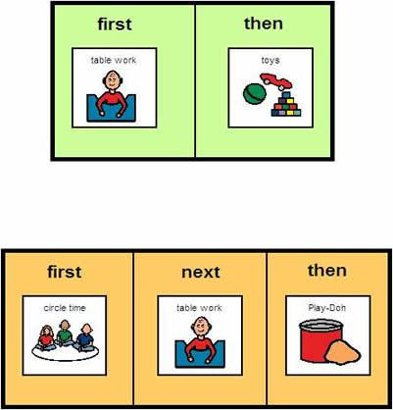
School Adjustment and Studies Research in Cardiff
Their findings produced these 10 suggestions:
Time
Visuals
Names to faces
Timetables
Homework
Friendships
Q&A
Parents
Journey
Previous pupils

Slide 6
Now add in the unique needs for each of our SEN learners and this could become a minefield of information overload!
How can we break this down into manageable steps for our SEN learners?
How can teachers and parents come together to ensure that this is as smooth as possible for all involved?

Slide 7
What does the research say?
One sentence summaries:
The Anna Freud Centre talks about empowering our young people through connections.
Teacher Toolkit discusses using a transition book and having plenty of visits to the new school.
Literature Review talks about the students' and parents' concerns are often based around the loss of relationships and the need for ones to be established swiftly.
SEN magazine discusses the need for links between primary and secondary curriculum.

Slide 8
What works?
Time – there must be time for secondary colleagues to come to you and you to them.
Clear roles and expectations – Head of Year/Head of Transition/SENDCo. Does the student understand these? Picture book/social stories e.g. In primary school you have Mrs. Jones and in secondary school you have Mrs. Willis.
Parental engagement – these are key, especially if the student has an EHCP. Parents may need their own support resources.
Share all the necessary information – Transition Partnership Agreement, TPAs/ Year 6 EHCP review
Collaboration – What will work? What won't work? What can be amended? What can't?
Shared strategies – what do they use at primary? How can this be replicated at secondary?

Slide 9
Transition books/maps – these can help students become familiar before they begin. This can in fact be any form of technology.
https://youtu.be/bC2_fmrjyE8
Question books – students put together questions for new staff.
Summer post cards – new school send post cards over the summer with a fact about the school or a greeting to them.
Summer schools and joint activities (sports, Escape room type activities) have been utilised to create a sense of community before the cognitive/sensory load is increased.
Ensure that new staff have the information needed to support learners' needs. We use Pictures of Need. These cover main points from EHCP as well triggers/strategies/what each stage of the crisis curve looks like for that child.
Local businesses have caught on to this in Basingstoke.
Special Offers and Special Events - Active Nation

Slide 10
Research and resources:
Anna Freud National Centre for Children and Families
Supporting-children-through-secondary-transition-v2 (annafreud.org)
The Teacher Toolkit Blog
Transition For Pupils With Additional Needs - TeacherToolkit
Mental Health Foundation
Mental Health Foundation | Good mental health for all
SEN magazine
Planning for transition • SEN Magazine
The SchoolRun.com
Secondary school transition for SEN kids | SEN transition to secondary (theschoolrun.com)

Slide 11
Research and resources cont.
BBC Bitesize
Starting secondary school - BBC Bitesize
Jessi's story: Starting secondary school with autism
Jessi's story: Starting secondary school with autism - BBC Bitesize
Relationships: The key to successful transition from primary to secondary school?
Relationships: The key to successful transition from primary to secondary school? - Anne Coffey, 2013 (sagepub.com)
Hampshire SENDIASS
Primary to Secondary Transition Preparation I HPCN Workshop - YouTube

Slide 12
Research and resources cont.
Facilitating a Successful Transition to Secondary School: (How) Does it Work? A Systematic Literature Review
(PDF) Facilitating a Successful Transition to Secondary School: (How) Does it Work? A Systematic Literature Review (researchgate.net)
School Transition and Adjustment Research Study (STARS)
School Transition and Adjustment Research Study (STARS) | UCL Psychology and Language Sciences - UCL – University College London
What Makes a Successful Transition from Primary to Secondary School?
DCSF-RR019.pdf (ioe.ac.uk)
Foundation for people with Learning Disabilities
Moving on to secondary school | Foundation for People with Learning Disabilities

