Slide 1
Purbrook Junior School
Big Inclusion Project
Caroline Gray and Freya Footner
Year 4 Teacher and HLTA

Slide 2
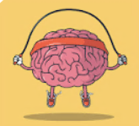
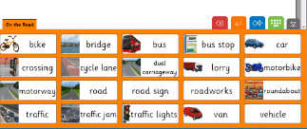
Strategies that have created a more inclusive classroom
Notes:
We are going to be going through the different strategies that we learnt from the Big Inclusion course and run through how this looks within our school. Some of these we found we were doing already – but noticed that making them an explicit part of our practice enabled all adults at school to feel better equipped within the classroom and means there is a greater consistency for everyone at school.

Slide 3
Bite sized chunks
More focused
LSA involvement
Independence
Notes:
Across the school, the ‘I do, we do, you do’ seems to be the best addition. We find this method breaks the learning into clear, bite sized chunks.
As a teacher, it makes you focus on what exactly the children needs to do to be successful. I have started using the same maths templates that I use for the whole class, for groups of children I am not working with. The LSA that is working with them has clear guidance of how the work is to be completed, but is then having similar conversations with them as I would be having.
HLTA: This also works from a HLTA point of view. As Caroline said, we are able to have more LSA consistency because now we are explicitly applying this structure of learning. From my point of view, it means that no matter the year group I am in, the children are already aware of their structure. I find this makes them more settled in their learning, where usually another adult in the room can cause confusion in techniques.
So, we are going to show a little bit of what this looks like in our school.

Slide 4
Notes:
This is an example of an I Do session from a Year 4 maths lesson. This is where the adult demonstrates and example of the learning with no child input. I would talk through the question and explain what they are doing as they go. If the children find it useful, they can make notes on whiteboards or jotter books as you go to help remind them and help their understanding.
At the ‘I do’ stage, children have become much more active listeners because they know this is where they are going to being to understand how to tackle their own questions.
HLTA: From a HLTA perspective, this is great because the children are already aware of this process. When I go into a classroom, they are aware of what learning works for them – some grab whiteboards, some grab jotters, some just listen. The consistency keeps the children more focused during the start of the learning.

Slide 5
Notes:
At Purbrook Junior School, we have added in our own ‘thinking time’ during our Maths lessons. We have questions on the board which are there to prompt the thinking behind what has been modelled in ‘I do’. We go through them step by step and then they can either be written in their books, the board or on the working wall. We have found that this enabled their meta cognition to understand in a deeper way because they’re able to understand WHY we have done each step – which gives them confidence when moving onto the we do and you do.

Slide 6
Notes:
From this, we then move onto the ‘we do’ part of the problem. They can have their notes from ‘I do’ and the questions are left so they can use that to help answer the question as a class.
A new question is provided but this time, it is solved as a class discussion. The ‘we do’ is a really useful tool for AFL which has then been a quick way to work out who gets it – off they go and can complete the following ‘you do’ question. The ones who need don’t feel confident or do not understand are able to be scooped up to work through an additional problem to make sure they are clear.
As mentioned previously, I am able to give any small groups who are not on same main learning similar sheets and the LSA that is working with them has clear guidance of how the work is to be completed, but is then having similar conversations with them as I would be having. The children have a worked method so know exactly how to present the work and the LSA is able to guide and support them until I get to check in with during the lesson. It does a bit of extra time when planning but the outcomes and understanding far outreach that extra 10 minutes.
HLTA: As I’m not always aware of the different levels of children in the class, so this is really great way of me getting a greater understanding of the children in the room. I am able to work more closely with the children who I know need extra help – but the other children can then get on independently, which means less interruptions.

Slide 7
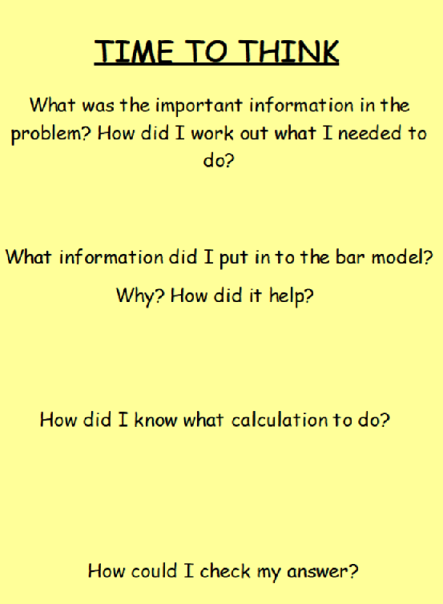
Notes:
The children then complete the ‘you do’ model independently. When they get stuck, we are able to refer them back to the ‘thinking time’ questions which enables them to revisit the steps and become successful from unpicking the work for themselves and providing them with that independence in their learning.
Any children who were unclear on the learning can remain in a group that you can complete one new calculation together.

Slide 8
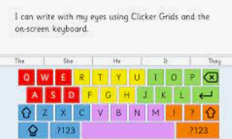
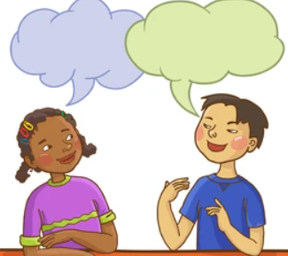
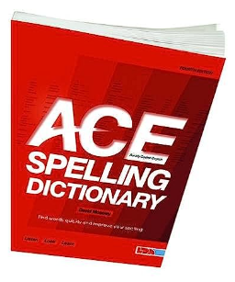
Dyslexia Strategies
Coloured paper and backgrounds
Fonts
Visuals/Widgets
Timetables
Seesaw and Clicker
Discussion time
Dyslexia friendly dictionaries
Notes:
HLTA: When we went through information about dyslexia during the big inclusion course, I was surprised how much I already knew. I kept turning to Caroline and said “WE DO THAT!” And it was true. But it wasn’t necessarily explicitly said to everyone – and why would you know if you don’t know? So now, we have loads of strategies that are shared with ALL members of staff which again creates that consistency for children across the school.
Making sure work is the correct colour for key children in the class. All technical equipment can have coloured backgrounds and all have the same dyslexic friendly font.
HLTA – even if I create a new flip chart in the classroom to quickly show something, most are now set up to automatically be a different colour – and if not, I know to do it myself. As do the LSAs. And these things can be a support for all of the class, not just the children who need them.
Visuals such as widgets and clear time expectations using timetables of what they have to do before they need to stop. Again, some of these things can be displayed anywhere in the classroom and can be for the benefit of all the children. It is also unified across the school so in each classroom, the same visuals are there to aid cognitive load and progress learning through reducing stress of seeing different things in each classroom and being overwhelmed.
SeeSaw is being used to help the children with SEND as the ‘I do, we do, you do’ can be recorded and they can replay it to refresh their memories if they need it. It builds the children’s confidence as they have a working model as a reference. We also use it in English, Reading, History, in fact any lesson where information can be recorded and the children can then respond to it – either by writing their answers or recording them. We make sure there is a balance of technology and work in books.
Clicker is great for children with dyslexia as they can use the word banks that you create and they can listen to the words before they select them. Through this process they are listening to the words to help them select the correct ones. It gives a little more independence and the analytics which is printed off with their work shows how much they use the resources we have provided for them and how much they have managed to use their own knowledge and words.
Discussion time or talk time – just by giving the children the opportunity to talk through their ideas before writing anything has again reduced the cognitive load. They already have their first sentence in their head and are ready to start. Once they have something in their books they have the confidence to continue.
ACE dyslexia friendly dictionaries were trialled a couple of years ago and to see a child who was unsuccessful at finding words in the collins dictionaries find a word in the ACE spelling dictionary was an incredible success. For the ones of you who don’t know about this dictionary it is ideal for people who understand sounds and syllables but have issues with spelling. Once they worked out the initial letter, they look up the word according to the sound– so very phonics based with long or short vowel sounds.

Slide 9
Speech and Language
Clicker – visual word banks
Seesaw
Colour semantics
Word mats
Clear, short instructions
Say and wait
Notes:
As mentioned in the last slide Clicker is great for children for the word banks and the analytics and having the ability to continually hear back what has been typed.
Again, SeeSaw can build a children’s confidence and independence as they can record verbally so they are able to access the same learning as everyone else but just respond in a different way.
In writing, some of the children have had small group work where we have been building the children's knowledge of sentence structures using the colourful semantics. It is all about repetition and using certain colours to represent certain word classes. The children are then able to continue this learning in the classroom relatively easily especially if a resource is structured in the same way as the semantics.
Word mats – whether these are on Clicker, or as a Widget with the images alongside, or just a mat with words – generally generated by the children at the beginning of the new project. Having these words readily to hand has helped the children to be successful.
I have found with the children with speech and language difficulties, sometimes less is more. Making the instructions really clear and implicit rather than wordy and long again helps them to access the learning.
Say and wait – a little bit like when you work with children with EAL. Asking they a question and saying Ill come back to you for an answer, or waiting for them to reply as you know they just need a little bit more thinking time.

Slide 10
Children with Trauma
Tone of voice
‘I wonder if…’ or ‘I think that…’
Give them time
ELSA
‘Uchat’
Nurture
Notes:
When children who have suffered trauma, I have found every day to be different with them as there are so many triggers that can set them off and unsettle them.
I have found tone of voice is the consistency that children need. Identifying that they are not in the place for learning and saying it explicitly to them also seems to let them know that I know they are not ready for learning so they might need time out for 5 minutes and giving that choice in a calm way often helps and having a safe place to go to, helps me as I know they are fine and helps them.
Using the phrases – I wonder if… or I think that… helps them to talk when they have become so overwhelmed and also lets them know I know they are struggling.
Giving them time – really hard to juggle in the class but having a ‘time out trolley’ which can be hand gym activities where they can choose an activity for 5 minutes to help them regulate helps.
We have a Uchat group once a week at lunchtimes run by the ELSA and Homelink worker so anyone in the whole school can go along and talk about any worries.
Nurture – some of these children have really benefitted from having a nurture group 3 times a week where they discuss anything they want, play games and talk without any judgement and it is just a save place to be.
Obviously there are days when none of things seem to work, and that is when is they struggle to regulate so the SENCO will come and support them.

Slide 11
Still developing and embedding
Notes:
Across the school, the I do, We do and You do is still being developed to work for us but the Maths leads have been really pleased with the childrens recall and work since we have used it.
Another thing we have been trialling – especially for a child with dyslexia who cannot use phonics is Seeing AI app – it reads any text to the child. This is wonderful when we are working with maths word problems and I am not able to support them all the time as I am working with other children. So instead of them waiting for me or another child to read the work to them, they can get an ipad and work independently.

Slide 12
Impact on Data
Notes:
Interestingly, as we have gone through the year, I have found children’s recall is becoming stronger using all of these methods. Progression is happening and it is slow and steady. More is seeming to move from the short term memory into the long term memory and is able to be retrieved back when the children need it.
The key thing for me is that children are growing in confidence and realising they can achieve.

Slide 13
Thank you for listening to us
Notes:
Thank you listening to us.
We will now try and answer your questions from the chat bar.

