Slide 1
Quick start, big finish: pupil success through inclusion and integration
Laura Harman-Box, Talavera Junior School
Notes:
Thank you for joining me here! If you have any questions as we go through, please pop them in the chat bar and I will endeavour to answer them at the end. My email address has also been included in the pack sent to delegates so feel free to send me an questions afterwards if you’d prefer.
I am going to discuss our attitude to inclusion and integration, understanding that we must all do what’s right for our own communities. We also understand that we are all of us only as “good” as our last set of results. We will always need to change, update and move on.

Slide 2
Context
Late arrivals
Garrison town with social needs
High turbulence – military families and refugees
High need – academically, socially/ emotionally
Notes:
We are in Aldershot, a garrison town with significant social needs. There is a high number of insecurely housed people, including families at our school. There are issues such as violent crimes, burglary, public disorder, and a high visibility of alcohol and drug abuse around the town. Suicide and self-harm are higher in Aldershot than nationally.
In addition, our school community is particularly turbulent – often around 30%. We serve a predominantly military group, keeping them in our junior school for an average of two years. This may include children leaving and returning or joining us only for year 5 or 6. Evidence shows military children can outperform non-military children at KS2, unless they have experienced significant deployments or separations. During Covid, this was the case for many families whose parents could not return from deployment, or were moved to help in the setting up of hospitals when they had expected to be at home.
We are also seeing a significant increase in the number of asylum seekers that we are serving, from a wide range of countries. This means we are a very lingually-diverse school, alongside the vast range of social and emotional needs that we manage.

Slide 3
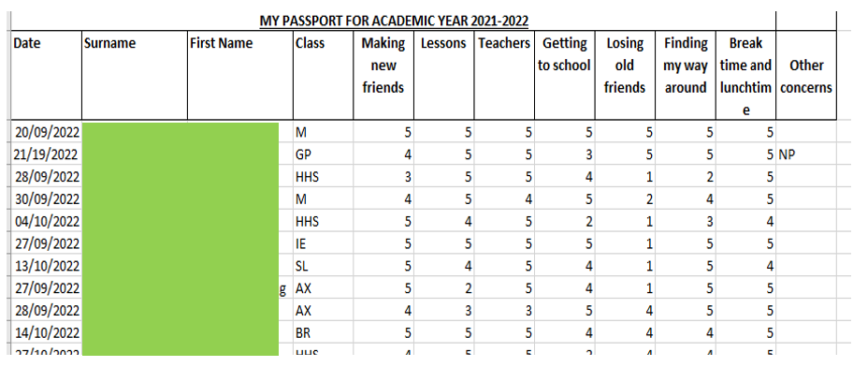
Mid-year entrants - what next?
My Passport
Data analysis and SLT feedback
PSHE curriculum
Talavera Ambassadors
Notes:
For these new entrants, we start with a smooth transition. We use an internal My Passport document to begin to get to know the child. We complete 3 of these – two when they enter. We track the scores that they give for different areas – we hope to see an improvement and can put things like buddies in place to support them – but we can also use them to see average scores, helping us to ensure our school environment gets ahead of these issues.
This analysis is fed back to SLT, giving them the opportunity to check in with their staff, to check their own environment is welcoming.
We also have Talavera Ambassadors who provide support for new students, buddying up with them to show them around and make sure they feel safe.
Our PSHE curriculum is embedded across the school and given high priority. We explore friendship and what healthy relationships look like in every year group, in addition to our Sex and Relationships unit which is taught yearly. Kindness, respect and openness are engrained in our culture.
Both our ambassadors and our PSHE curriculum help encourage psychological safety, a concept I’m sure you’re all familiar with from a recruitment perspective but which applies to pupils and their ability to learn too.

Slide 4
Mid-year entrants - what next?
ELSA and TALA – complete and analyse
Summative assessment - SEND pupils, Bell Foundation or particular concerns
Tracking: class-based and IEPs
Timetabled adult use
Notes:
We also have ELSA and TALA programmes available for pupils. These won’t be given straight away but provide an additional support if needed when the child has been at the school for a few weeks. The ELSA team analyse the outcomes of their sessions and feed these back to SLT.
Our TAs receive weekly CPD, on a wide range of topics, including how to complete summative assessments. Investing in our CPD has probably had the single biggest impact on our outcomes. It means that they can be trusted to deliver quality intervention and have the knowledge and skills to support both in class and out. Our TAs complete assessments for SEND pupils on entrance and this information is fed immediately to the SENDCo, year leader and class teacher.
We have implemented the Bell Foundation’s assessment for EAL pupils, conducting these with only pupils who the teachers believe are Code A or B. Of course, this is a developing skill and teachers are becoming more confident in noting where these boundaries sit. Assessment can then feed into adapted planning. Immersion is our focus but different languages function in different ways so children from different backgrounds will need different support.
The adaptations we’ve made to the curriculum are always with a view to exceptional acceleration of attainment. If we have a pupil in year 6 who cannot speak English, we are morally-bound to do all we can to ensure that they will be able to access GCSEs. It is about their life chances. This means every year leader must thing strategically about their use of adults to address all concerns. I’ll talk to you more about immediate intervention later.

Slide 5
Military entrants - what next?
Understanding your community
Listening to the experts
Can they articulate what you need them to?
Notes:
I undertook a study of military children in school and found that the children were able to clearly articulate their concerns, their strengths, their weaknesses and their opinions. Of course, you’re not going to be able to release your staff all of the time to conduct large-scale studies; however, it does highlight the importance of understanding your community. The children are the experts on their lives – listening to them can only enhance our practice.
It doesn’t hurt either that listening to your pupils gives them the opportunity to practise articulating what your provision is, allowing them to communicate effectively with any external visitors who may want to know what you offer!
For us, we found the main difficulties our military children faced were emotional and this allowed us to focus on and update our transition materials, alongside looking at our PSHE curriculum.

Slide 6
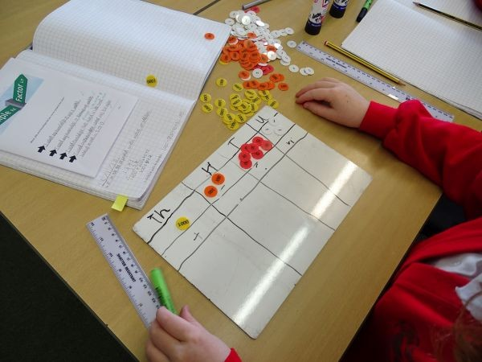
More important than assessment?
New students embracing our learning culture – every learning minute counts
Smooth transition support is used to integrate into the classroom
Phonics, for example – going backwards to come forwards
Target for all to be in the classroom
Supporting pupils to remain in the classroom wherever possible
Leadership culture
Notes:
Alongside this, though, is ensuring that children embrace our motto that every learning minute counts – this means that from the moment they are in school, they are using their learning time effectively. The transition support I mentioned previously is used primarily to help children integrate into the classroom. Our target is always for all children to be in the classroom. This includes when looking at adaptations and the need for pre-learning. We make use of tools like Google Translate, which has improved dramatically and has been shown to now be over 90% correct, to ensure all children have the technical language needed for learning.
We often talk about going backwards to come forwards. We address gaps that we identify by recapping the previous year’s curriculum or by linking learning to the previous Key Stage, for example, and then move rapidly through to our expectations for their current year group. Going backwards doesn’t mean we go slowly – the opposite! Going backwards means we secure the foundational knowledge that makes all other learning more accessible but is done efficiently.
Also incredibly important is the leadership culture of the school. This comes from our Strategic Team, of course, but is imbued into every member of staff. Staff are encouraged to ask for help and to ask for development opportunities. Wherever this is manageable, staff are given this – showing our confidence in them and giving them the chance to grow. This means that they are invested in Talavera and we are also lucky enough to benefit from their improved knowledge and skills.

Slide 7
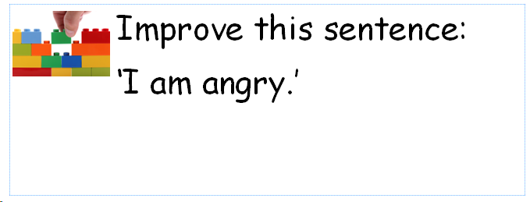
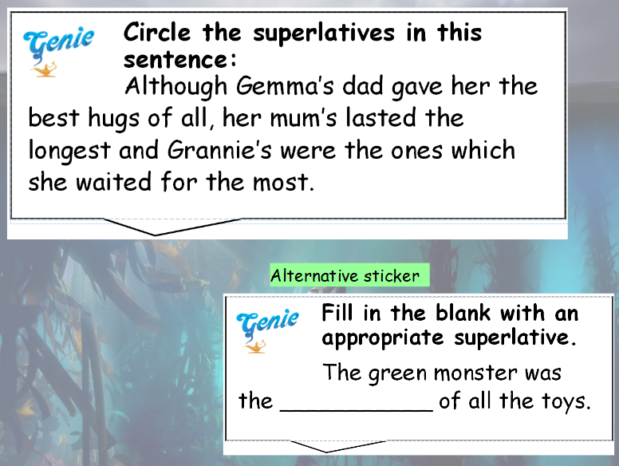
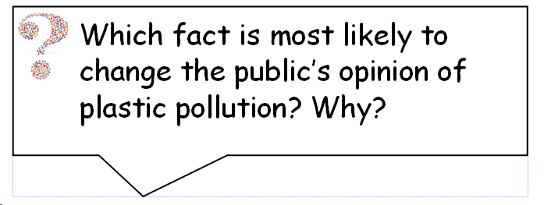
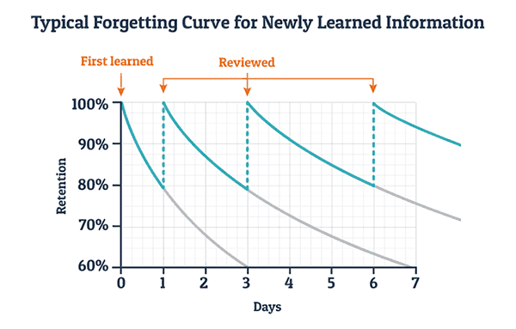
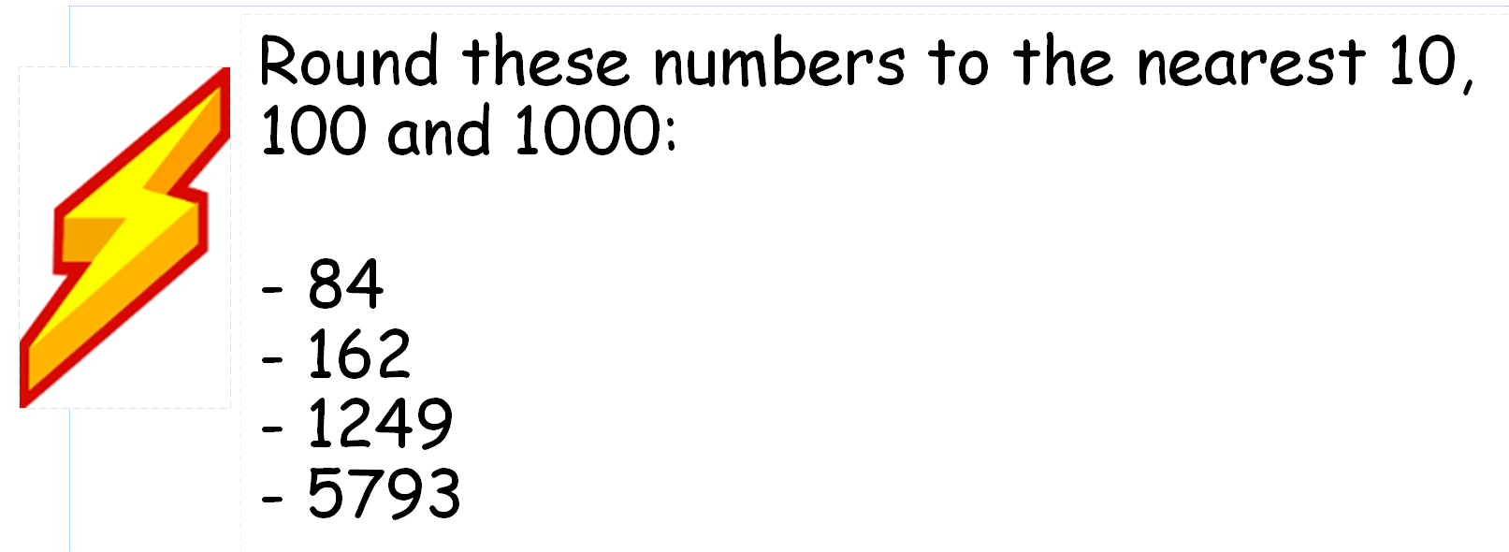
Formative, integrated assessment
Starting stickers – recap and review to respond to the Forgetting Curve
Marking stickers – depth of knowledge and skill practice
Regular learning review for all, assessment for some
Part of every lesson, for every year group – learning culture
Notes:
As you will all know, assessment for learning is a key tool is ensuring feedback is given effectively and in a timely manner. You have probably seen the Forgetting Curve, showing that retention is vastly improved through regular recap and revision. For these, we use starting stickers, such as the ones you see on the left. These address previous learning and allow for instant assessment.
Our marking stickers, such as the ones on the right, are used to ensure children have a depth of knowledge and have the chance to practise new skills. Crucially, the children often answer these incorrectly! By that I mean, they are given the chance to fail and this is then used to ascertain if a concept needs more teaching or if children can be supported through immediate intervention. You’ll notice there are four types on the right: close the gap for skills and knowledge the teachers feel should just need consolidating and shouldn’t pose a problem; explain for answers for which teachers want more information and an application of the learning; and challenge for children to stretch their understanding. The bottom sticker is our GDS extension and ensures that every child can use this time in a way that is effective for them.

Slide 8
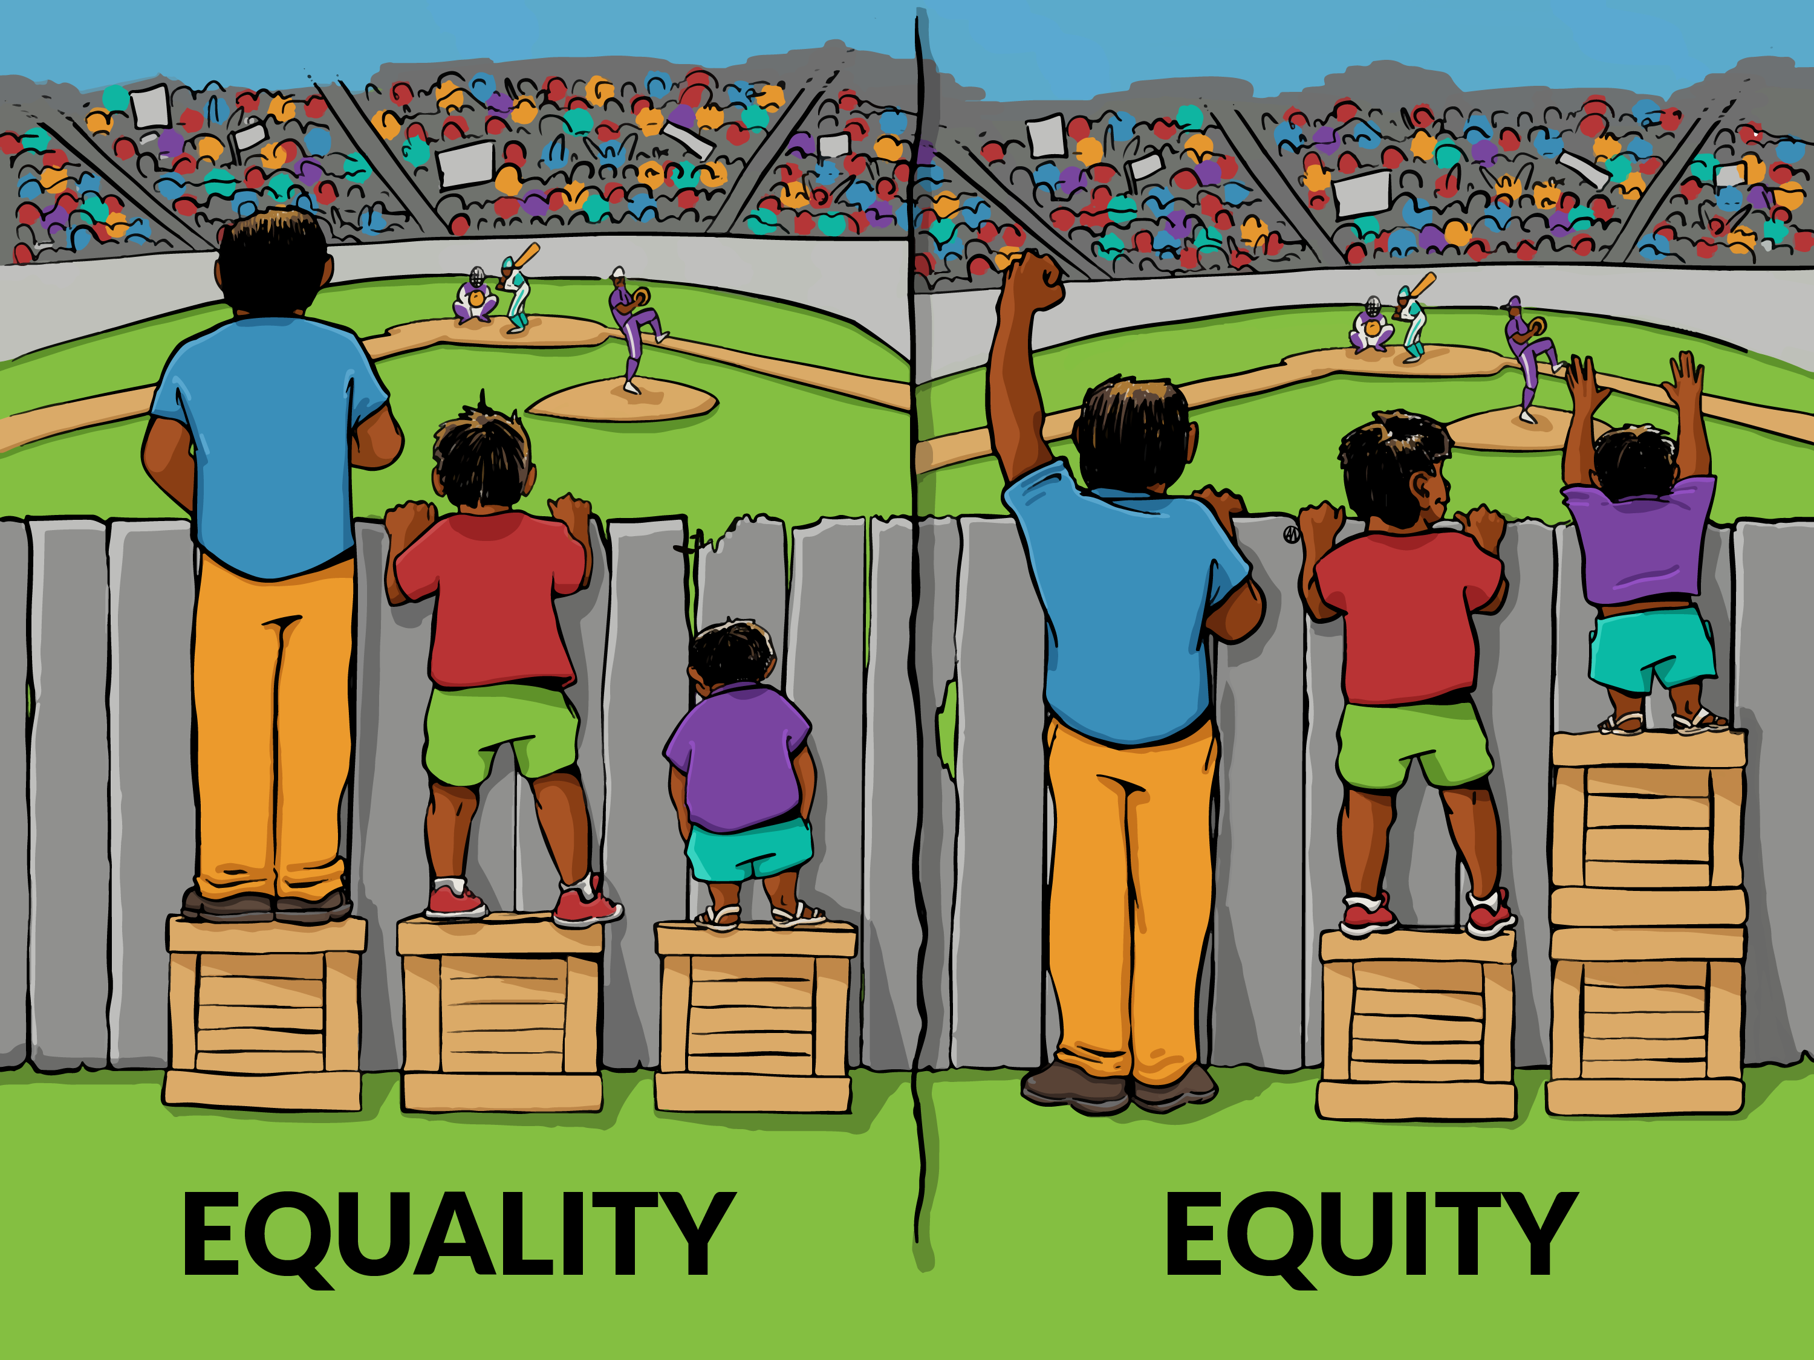
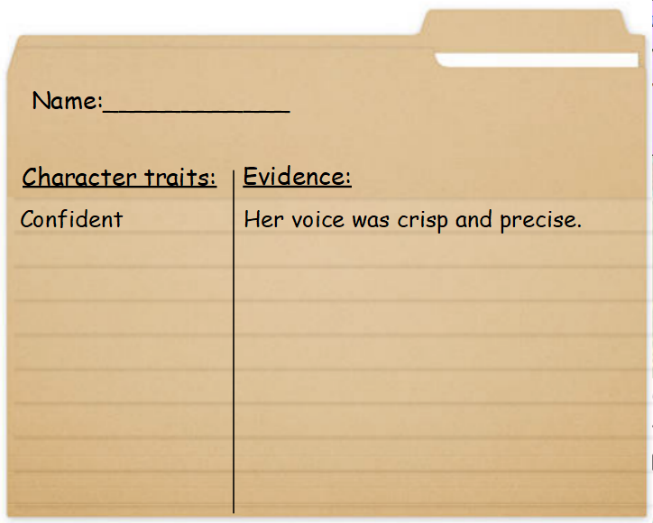
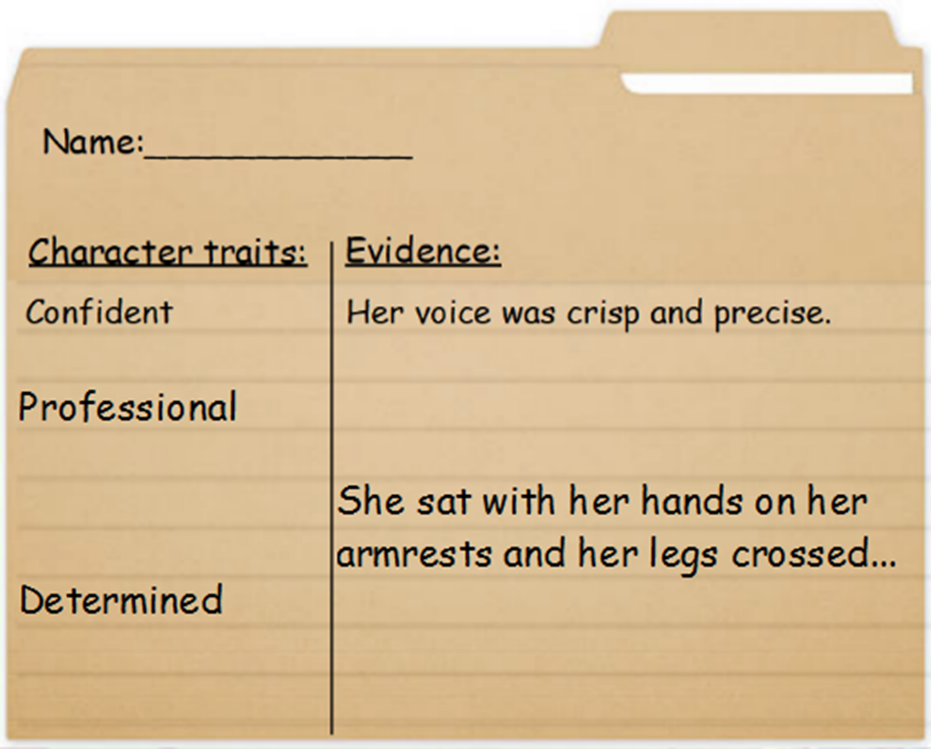
Responding to this in lessons
Split inputs – effective adult deployment, not getting stuck with one table, fluid grouping
Adaptation, not differentiation – scaffolding so everyone reaches the goal
Speed with depth – going backwards to come forwards
Notes:
With the stickers that I was just discussing, effective use of adults is crucial. We expect all of our teachers to make full use of their well-trained support by using split inputs. This is often after the initial sticker, during which teachers will make instant assessments of children and use their TA to respond to errors or misconceptions.
The learning culture of the school is so embedded in the children that there is never shame in working with an adult. They know that working with support does not mean failure and that even the peers they view as “clever” will be given help.
As I said before, this is about going backwards to come forwards. It’s about working at speed, whilst maintaining a depth of understanding. To ensure this happens, all children will be given the same task wherever possible. We use adaptations, not differentiation. What I mean by this is that tasks may be given additional scaffolding or feature additional tools such as word banks or number lines in order for all children to practise the same skills or apply the same knowledge. To do otherwise is to do a disservice to those children who have previously under-achieved.
This individualised instruction can be difficult when staff do not have the subject knowledge themselves to identify why children find learning hard or how to drill down into a concept. This is another reason why investment in CPD is vital. Often, people view secondary teachers as subject matter experts while primary teachers are jacks of all trades, masters of none. I’m sure you’ll all be aware that the sector we work in doesn’t allow for that anymore and our teachers must be masters of all.

Slide 9
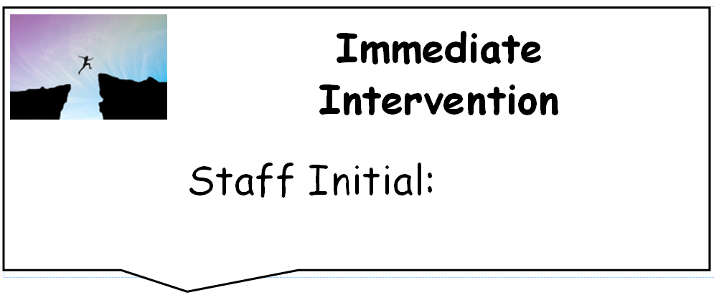
Responding after lessons
Immediate intervention instead of worksheet-based sessions – upskilling of all staff, given to all (no shame)
Responding within the same day – learning culture
Adult use – what if you don’t have them? Live marking, no mark days, clear marking policy, regular staff feedback sessions
Tailored homework – effective use of time, parental engagement
Notes:
When feedback cannot be completed in a lesson, we expect that it will still be delivered within a day – we all know that, after this, feedback becomes less and less effective. Immediate intervention is carried out by TAs primarily, though as SLT we will support in year groups who may need it. Teachers will quickly sort books into piles, much like the old red, orange, green technique, but by identifying specific areas of need.
A maths teacher may, after a lesson on rounding, put aside a group of 4 children who managed to round numbers up to a thousand but struggled to make the jump to 10,000. There will be another pile of children who made the specific error of not changing the remainder of the number to zeroes and perhaps one or two who seem to need a recap of place value in general. This information will be passed on to the TA who will undertake a short and fast-paced intervention.
It is fast-paced and short for two reasons. Firstly, we don’t want children out of afternoon lessons. This broad curriculum is important for their cultural capital, as well as their enjoyment of learning. Secondly, there is no point completing page after page of practice. It is far more effective to give them a short burst of additional learning and then check in on them in the next lesson to see if it has been retained.
We use these immediate intervention stickers to show where a child has needed that additional support. This gives us a tool to use when moderating books for assessment – did that child really have a GDS level of understanding? It supports us in identifying if adults are being used effectively in the afternoon – does one class in the year group have far more stickers? Why is that? It also gives teachers support during pupil progress meetings to show what is in place for children not making expected progress.
Some of you, though, will be no doubt thinking that this wouldn’t be possible as you do not have adults available in the afternoon. For each of you, I would ask if your teachers are all confident with live marking, making those snap AfL judgements in lessons. Can you make use of No Marking Days, so that teachers can use some time in the afternoons to pull children to the carpet for intervention? Does the marking policy ensure that feedback is prioritised and lessons given enough time for children to complete these next steps?
Finally, if children are still struggling with a concept, this will be sent home as tailored homework. There is no sense of shame in this happening – these children are expected to know and understand an incredible range of information and apply it in a huge number of situations. Instead, this is about celebrating their ability to close the gap.

Slide 10
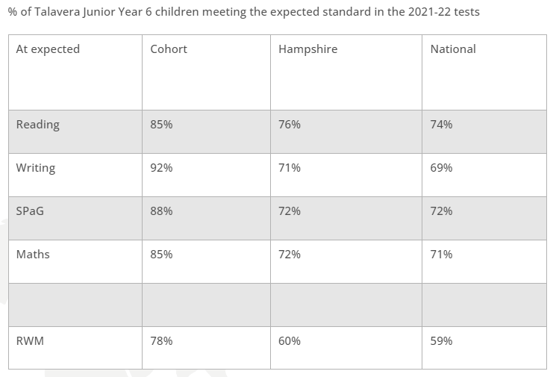
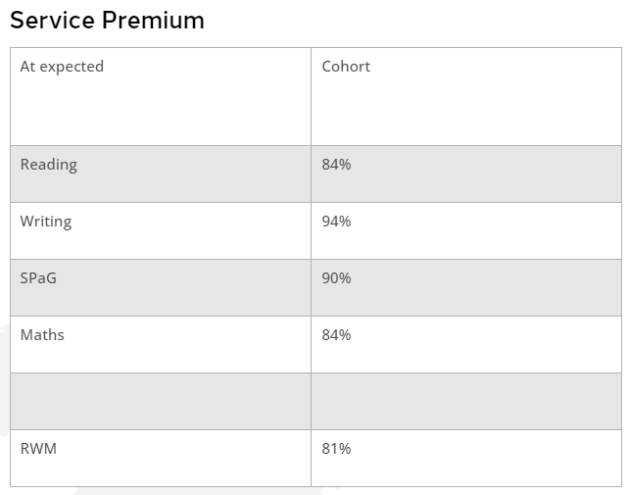
Outcomes
Notes:
We all know that we are only as strong as our last set of results and we don’t take for granted that we will always achieve these. Different cohorts, different staff make up – so much can affect outcomes. We are proud of what we have achieved over the past few years but know that we can’t rest on our laurels. For us, outcomes give children life chances and so, whether good or not so good, we want to do what we can to help children have a quick start to their learning, and end year 6 with that big finish!

Slide 11
Any questions? Additional resources:
Notes:
Thank you – does anyone have any questions?
IF NO QUESTIONS: You will see on the screen that I have included some additional resources which may be relevant to you. Firstly, there is a link to the Service Children’s Progression Alliance. SCiP works with practitioners to assist them in finding tools which are beneficial to military children. They have a Thriving Lives toolkit to help you audit your provision for this group and offer great advice.
The Bell Foundation offer advice for supporting EAL pupils and have been instrumental in supporting the raising of the profile of EAL learners in the classroom. Their assessments are ideal for new entrants and support the work that EMTAS do.
The Public Health Fingertips tool is great for feeling confident in identifying the needs of your local area. We use it to help inform our PSHE curriculum, as well as supporting our understanding of contextual safeguarding.
AFTER QUESTIONS: Coming up next are Tamsin Austoni and Natalie Hope from the Virtual School. They will be in the Main Meeting Room, talking about targeting the right provision for CLA and CIN pupils, focusing on Executive Functioning.

