Slide 1
Attendance
Anxiety
Teacher workload and retention
Chris Ayling | c.ayling@warrenpark.hants.sch.uk

Slide 2
https://www.youtube.com/watch?v=wQ5uDe9AiqY
https://www.youtube.com/watch?v=ehNqBp5dZoY
Chris Ayling | c.ayling@warrenpark.hants.sch.uk

Slide 3
Chris Ayling | c.ayling@warrenpark.hants.sch.uk

Slide 4
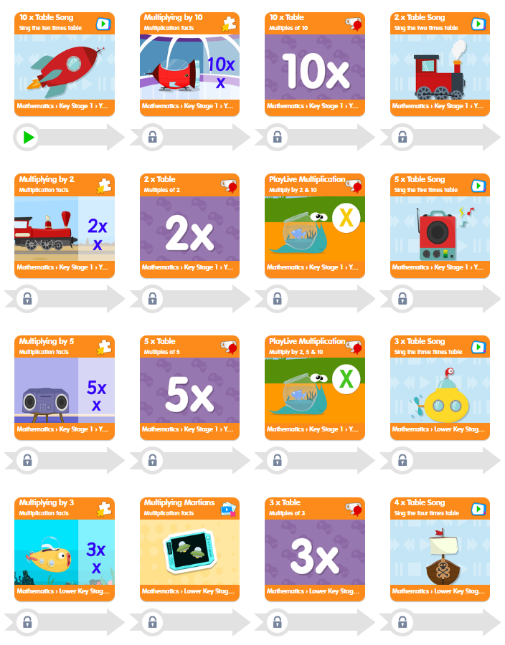
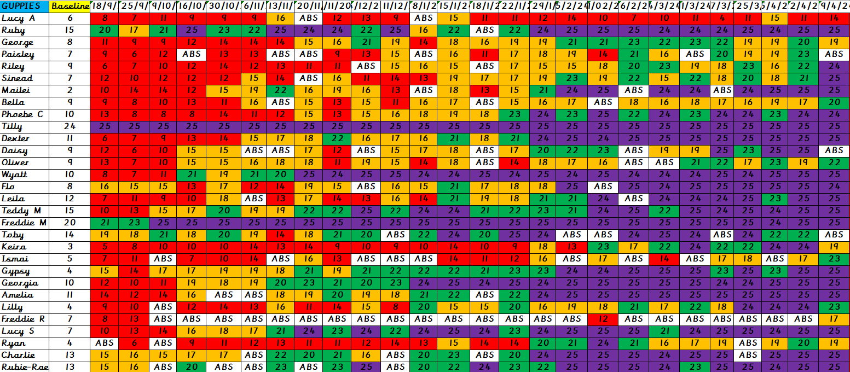
Multiplication Tables Check – Results 2023/2024
25 / 25 24
24 and above 42
23 and above 48
22 and above 50
20 and above 55
Average score of 23
Chris Ayling | c.ayling@warrenpark.hants.sch.uk

Slide 5
Multiplication Tables Check – Results 2023/2024
25 / 25 24
24 and above 42
23 and above 48
22 and above 50
20 and above 55
Average score of 23
Chris Ayling | c.ayling@warrenpark.hants.sch.uk

Slide 6
Biggest challenges
Maths Challenge
Breadth of curriculum content
Time to fit in all domains and objectives
Retention of skills and time to practise
Chris Ayling | c.ayling@warrenpark.hants.sch.uk

Slide 7
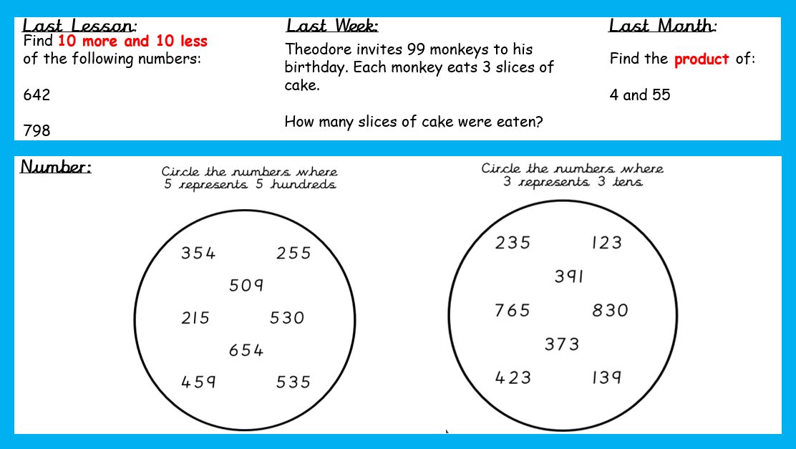
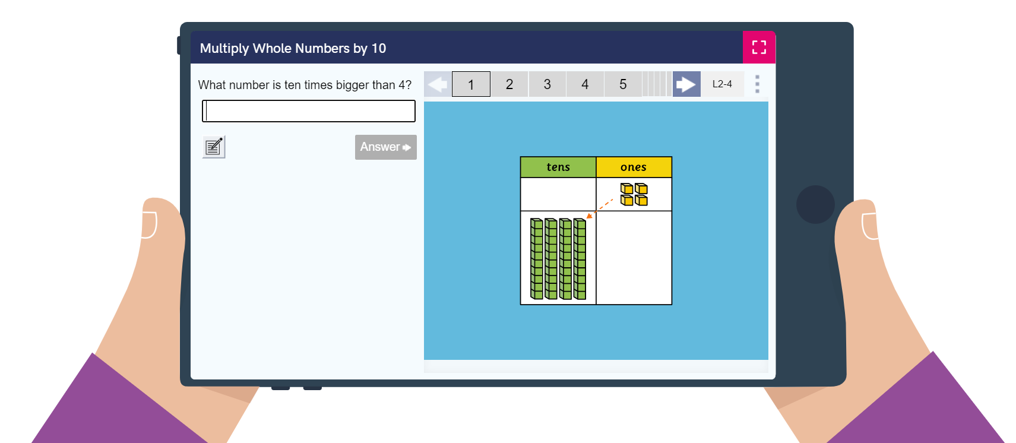
Is there another way?
Traditional retrieval practise task (20 mins)
800 tasks per year
Learning by Questions (20 mins)
4000 tasks per year
Chris Ayling | c.ayling@warrenpark.hants.sch.uk

Slide 8
What is Learning by Questions?
Amazing ready-made resources
A library of customisable KS2 resources aligned to the National Curriculum and other schemes of work.
Chris Ayling | c.ayling@warrenpark.hants.sch.uk

Slide 9
What is Learning by Questions?
The ultimate x-ray for your class
LbQ automatically marks pupils’ work and presents the teachers with an easy-to-read matrix for powerful interventions in the lesson.
Chris Ayling | c.ayling@warrenpark.hants.sch.uk

Slide 10
What is Learning by Questions?
Immediate personalised feedback for pupils
The teacher content creators have considered every misconception a child may have for a question and written bespoke feedback for each answer.
It's like having extra teachers in the classroom.
Chris Ayling | c.ayling@warrenpark.hants.sch.uk

Slide 11
Working towards mastery
Question Sets are scaffolded, building on prior skills and knowledge.
If LbQ recognises that a pupil is getting a lot of questions right, it automatically moves them onto the next level of challenge.
The classroom is fully inclusive, yet every child is working individually - at the right stretch and pace for them.
Chris Ayling | c.ayling@warrenpark.hants.sch.uk

Slide 12
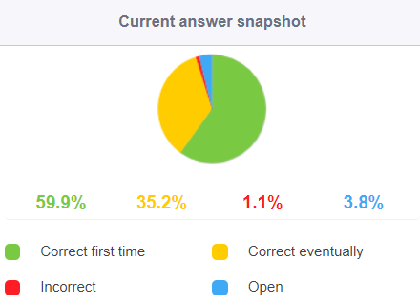
Benefits for Children
I can get on without having to wait for a teacher
If I get it wrong, the feedback helps me highlight my next step so I can try again
My teacher knows exactly when I need help
I can build my confidence
I can practise in my own time
If I’m absent,
I can catch up
= success!
Chris Ayling | c.ayling@warrenpark.hants.sch.uk

Slide 13
Benefits for Teachers
Give in the moment AfL to support when it matters most
Maximises impact of adult/s
Focus teaching on misconceptions
Efficient use of time to practise
No marking!
Ongoing assessment – don’t wait for assessment weeks!
Moves to mastery
Teaching / assessment / pre & post teaching / home learning / intervention
Reduces workload
Feedback to every student
Chris Ayling | c.ayling@warrenpark.hants.sch.uk

Slide 14
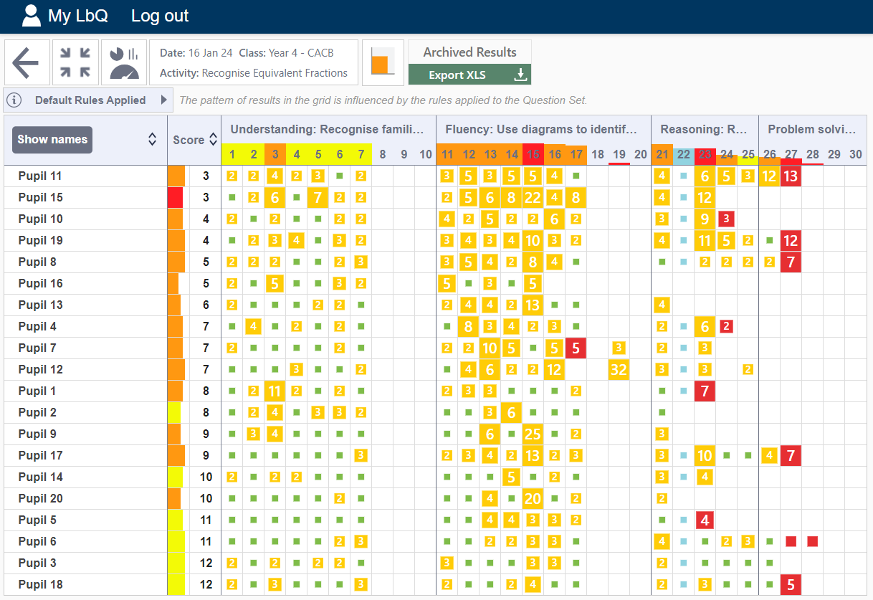

Slide 15
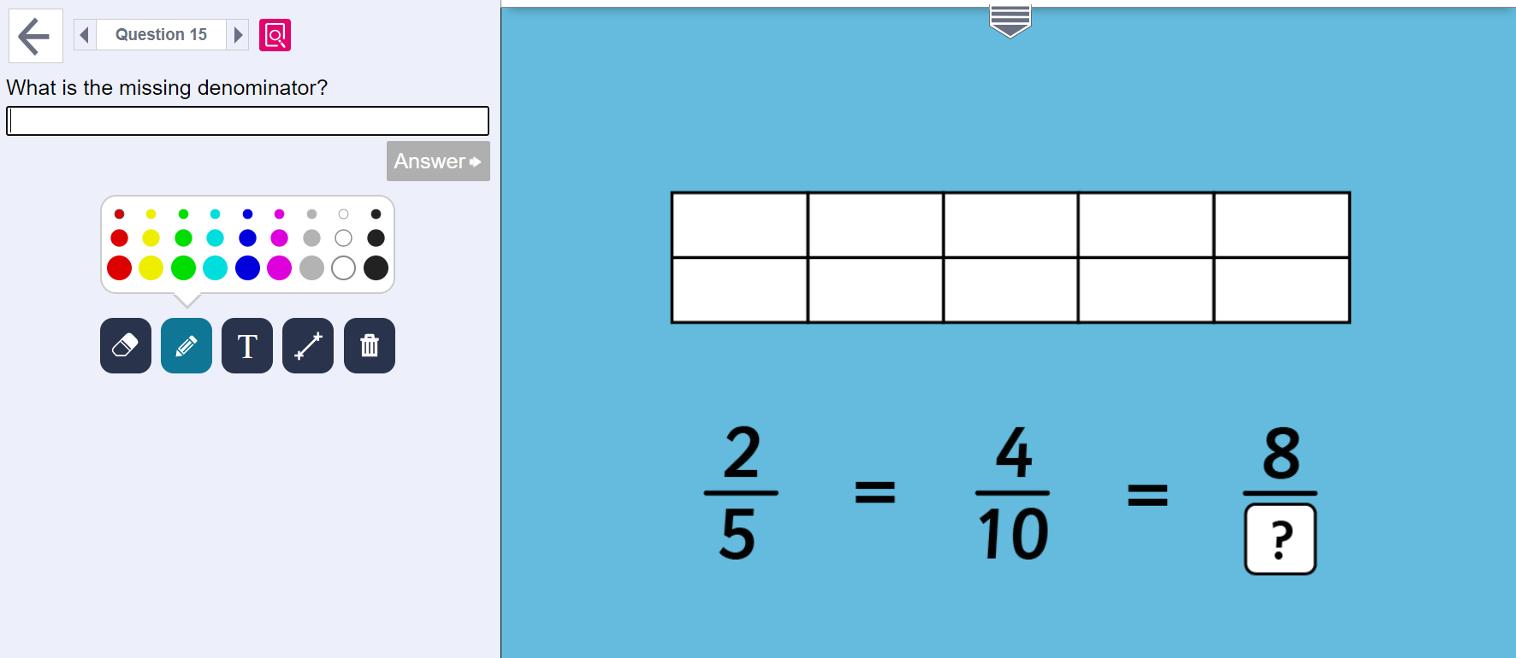

Slide 16
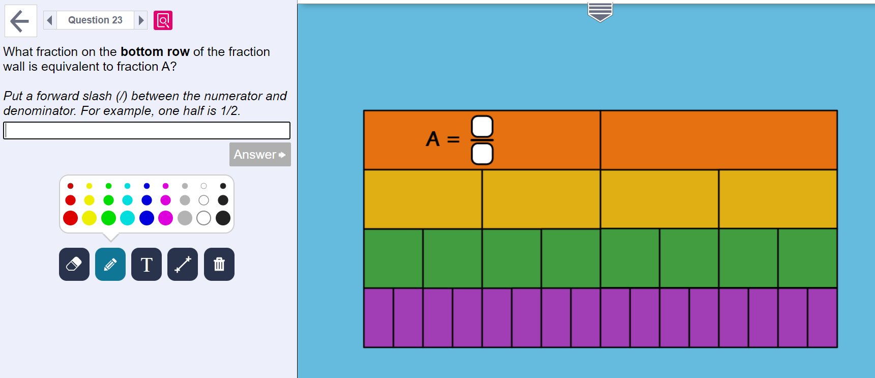

Slide 19
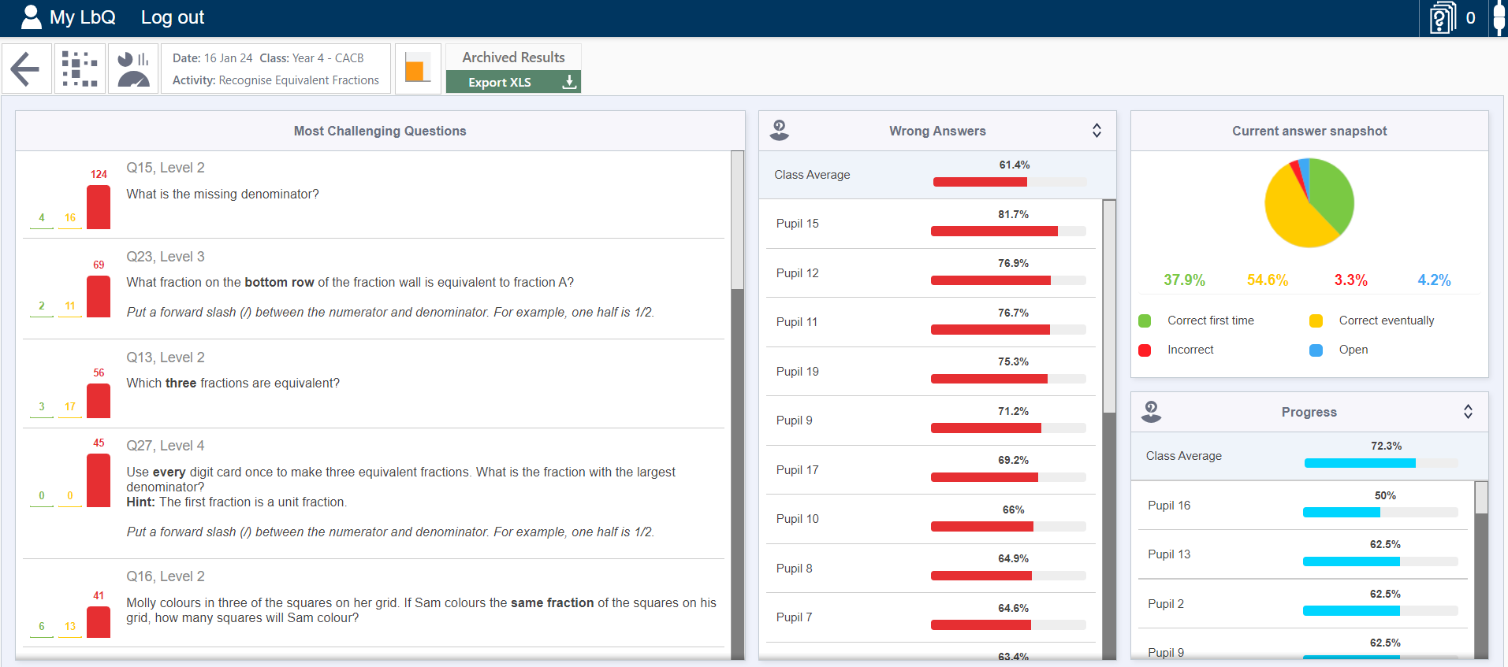
Chris Ayling | c.ayling@warrenpark.hants.sch.uk

Slide 20
Chris Ayling | c.ayling@warrenpark.hants.sch.uk

Slide 21
Chris Ayling | c.ayling@warrenpark.hants.sch.uk

Slide 22
Chris Ayling | c.ayling@warrenpark.hants.sch.uk

Slide 23
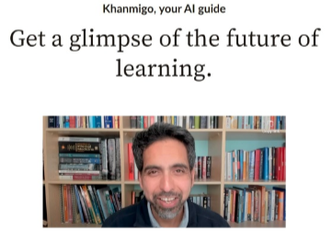
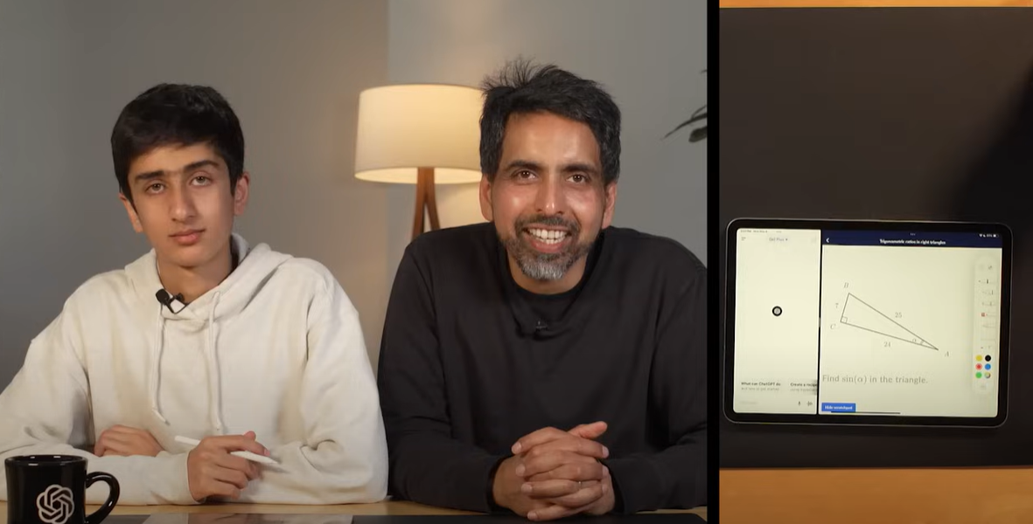
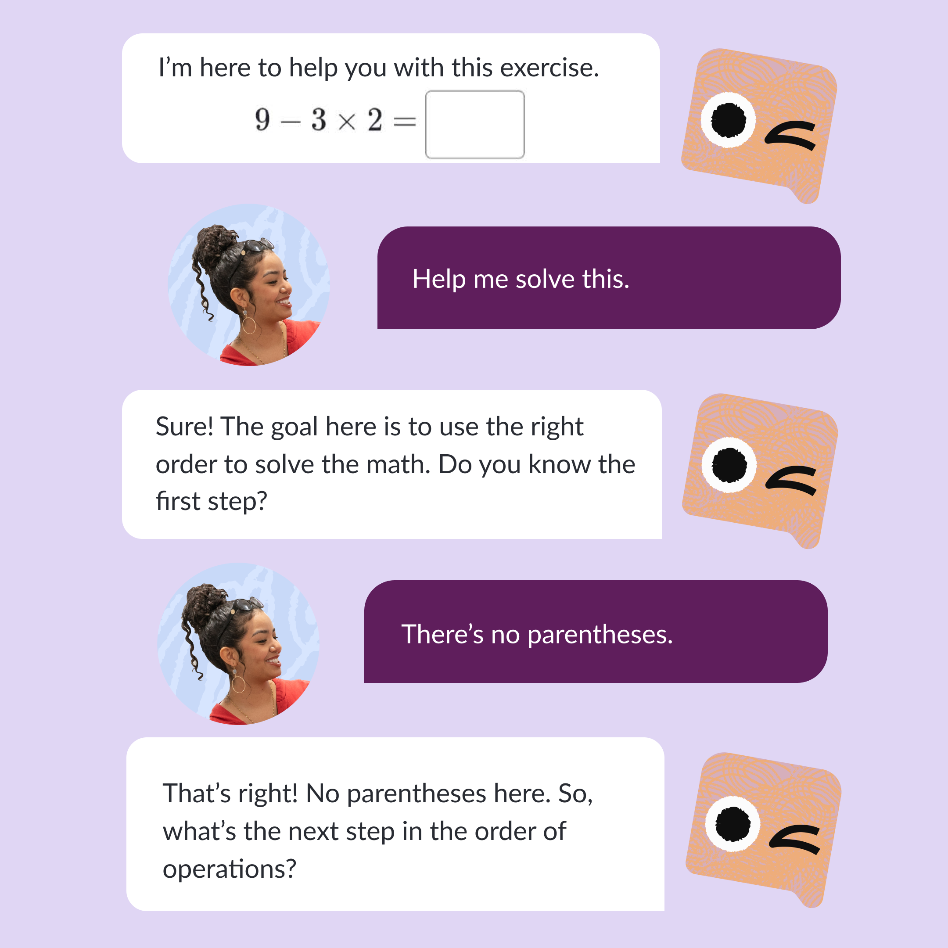
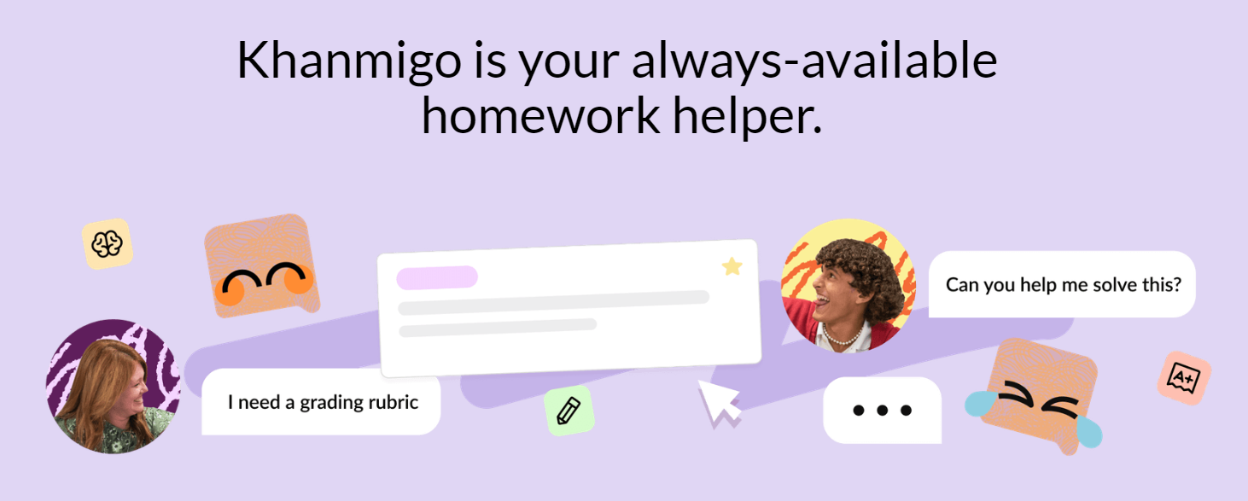
Chris Ayling | c.ayling@warrenpark.hants.sch.uk

